Slide 1
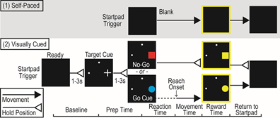
Max t = 5s
Go Cue:
Hit: As long as one finger inside the circle
Close: the nearest touch point is less than a threshold
Missed: touch with points are far from the target
No action: no touch detected
Nogo:
Succeeded: keep still on the touchpad, no touch
Fail1: touched
Fail2: lift without touch

Slide 2
NO
YES
WaitStart
Interface
Touched Startpad
YES
Ready
Interface
Not Enough Hold Time
NO
No
Error
Interface
Leave Startpad
YES
Wait t_interTrial
Correct
Interface
NO
Overdue Reach Time
YES

