Slide 1


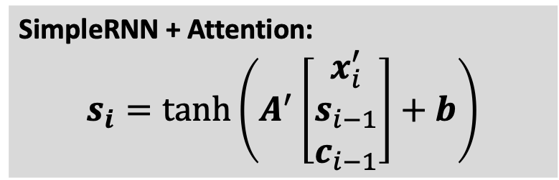


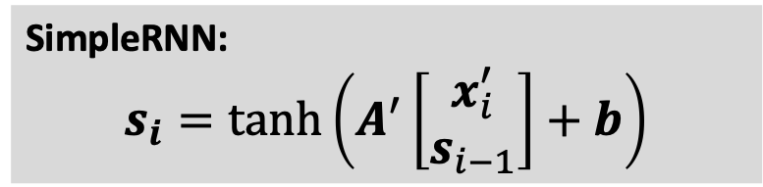





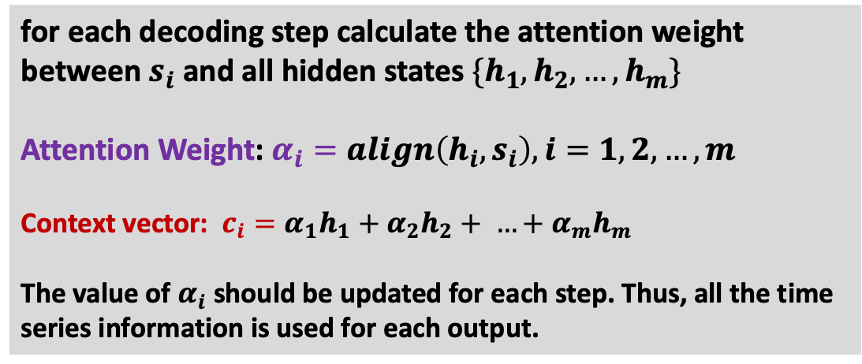
SimpleRNN + Attention
for each decoding step calculate the attention weight between $s_{i}$ and all hidden states $\{h_{1}, h_{2}, …, h_{m}\}$
Attention Weight: $α_{i}=align\left(h_{i}, s_{i}\right), i=1, 2, …, m$
Context vector: $c_{i}=α_{1}h_{1}+α_{2}h_{2}+ …+α_{m}h_{m}$
The value of $α_{i}$ should be updated for each step. Thus, all the time series information is used for each output.
SimpleRNN:
$$s_{i}=\tanh\left(A^{′}\left[\begin{aligned}x_{i}^{′} \\ s_{i−1}\end{aligned}\right]+b\right)$$
SimpleRNN + Attention:
$$s_{i}=\tanh\left(A^{′}\left[\begin{aligned}x_{i}^{′} \\ s_{i−1} \\ c_{i−1}\end{aligned}\right]+b\right)$$
$$c_{0}$$
$$c_{1}$$
$$c_{2}$$
$$c_{3}$$
$$c_{n}$$
$$α_{1}$$
$$α_{2}$$
$$α_{3}$$
$$α_{m}$$
s₀
s₁
s₂
s₃
s_{n}
h₁
h₂
h₃
h_{m}
A’
A’
A’
…
A’
A
A
A
…
A
x₁’
x₂’
x₃’
x_{n}’
x₁
x₂
x₃
x_{m}

Slide 2
