Slide 1
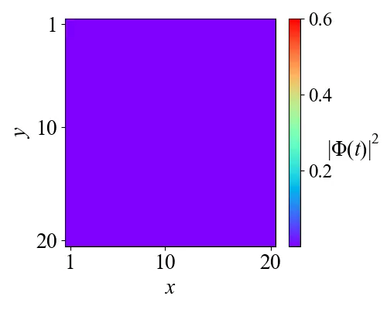
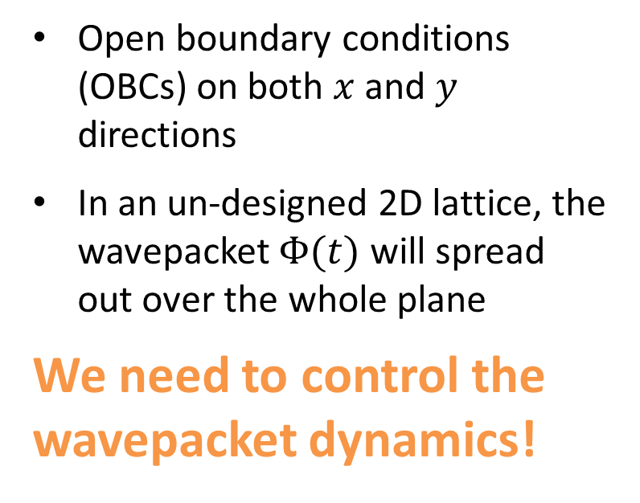
Wavepacket in free space (a tight-binding lattice with even hoppings)
Continuous $exp(−iω_{S}t)$ driving on $r_{s}=\vec{0}$
Open boundary conditions (OBCs) on both $x$ and $y$ directions
In an un-designed 2D lattice, the wavepacket $Φ(t)$ will spread out over the whole plane
We need to control the wavepacket dynamics!
https://arxiv.org/abs/2309.15008
mengjie.yang@u.nus.edu

Slide 2
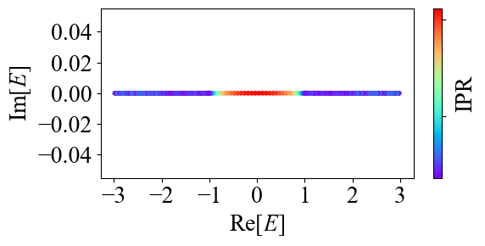


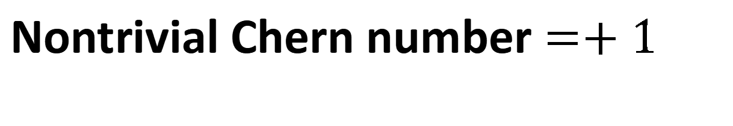
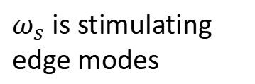
Nontrivial Chern number $=+1$
$(t=1, m=1, γ=0)$: Hermitian
$ω_{s}$ is stimulating
edge modes
Continuous $exp(−iω_{s}t)$ driving on $r_{s}=\vec{0}$
Dynamics controlled
https://arxiv.org/abs/2309.15008
mengjie.yang@u.nus.edu

Slide 3
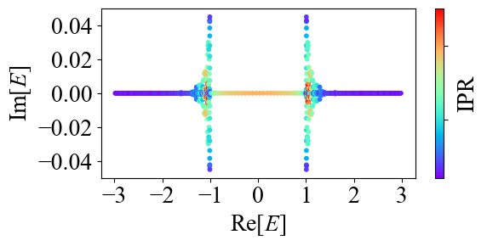
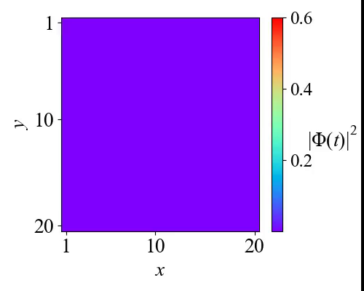
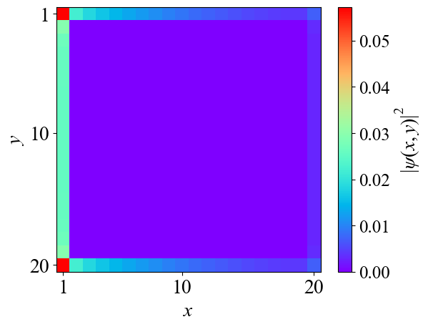


Skin effect amplified edge dynamics
$(t=1, m=1, γ=0.05)$: left NHSE
Continuous $exp(−iω_{s}t)$ driving on $r_{s}=\vec{0}$
Edge state with left skin effect
https://arxiv.org/abs/2309.15008
mengjie.yang@u.nus.edu

Slide 4
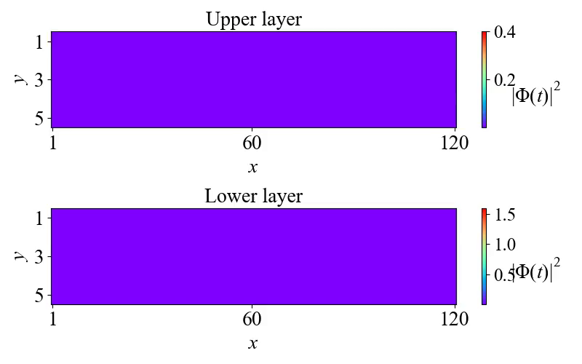
Net gain emerges!
Continuous $exp(−iω_{s}t)$ driving on $r_{s}=\vec{0}$ for upper layer
Left NHSE
Right NHSE
https://arxiv.org/abs/2309.15008
mengjie.yang@u.nus.edu

Slide 5
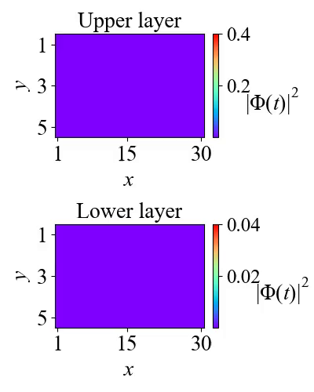
Short systems, no net gain
https://arxiv.org/abs/2309.15008
mengjie.yang@u.nus.edu

Slide 6
Three questions arise:
Is it a size-dependent phenomenon? If so, what is the transition width?
How to explain this in theory?
In general, what factors are necessary to induce such gain?
(These questions are answered in the paper)
https://arxiv.org/abs/2309.15008
mengjie.yang@u.nus.edu

