Slide 1

TRF_WB Matching Program
Anthony Yang & Andrew Louie
July 2024

Slide 2




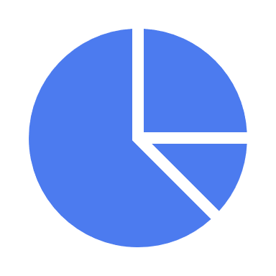





Problem Statement
The Problem

Slide 3
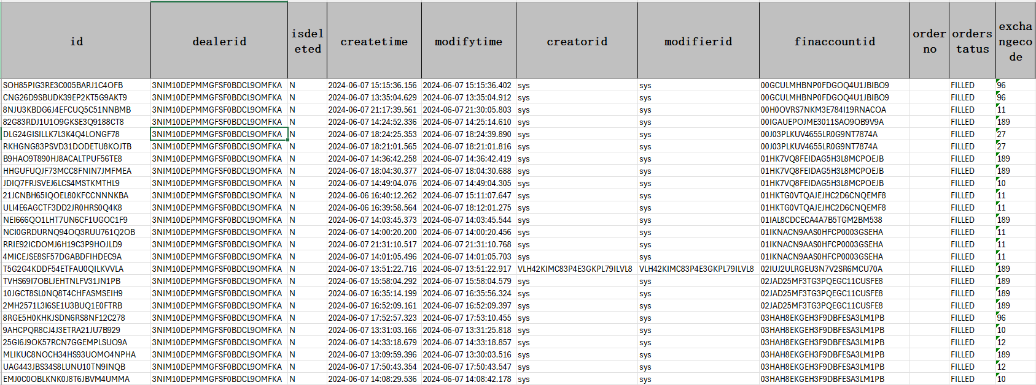
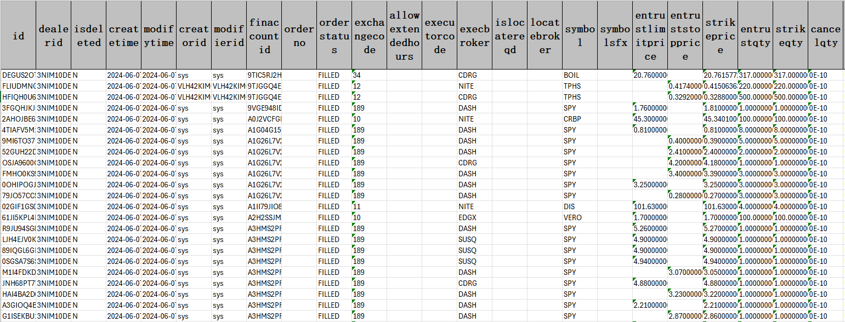
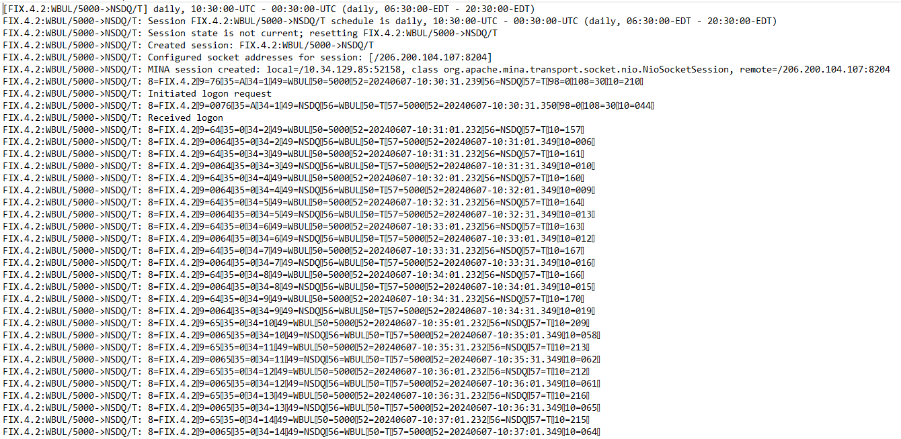
How to find ‘breaks’ between TRF and WB
Webull Buy Sheet
Webull Sell Sheet
TRF Order Sheet
Notes:
Anthony
To start, something that we noticed during the sign up process was the time associated with the sign up especially during the tax certification step. Filling in the same information across all three apps, Robinhood was the only app that let me do the sign up in a single session on the app, and I was actually able to get onto the plaid landing page to link my bank account. Moreover, webull took the longest time to get through the signup process taking 7 minutes and 30 seconds compared to robinhood’s 5 minutes and 30 seconds. Granted this is also a very complicated issue involving regulations and compliance etc but this was something we’d like to highlight

Slide 4

Our Solution
Our Solution

Slide 5
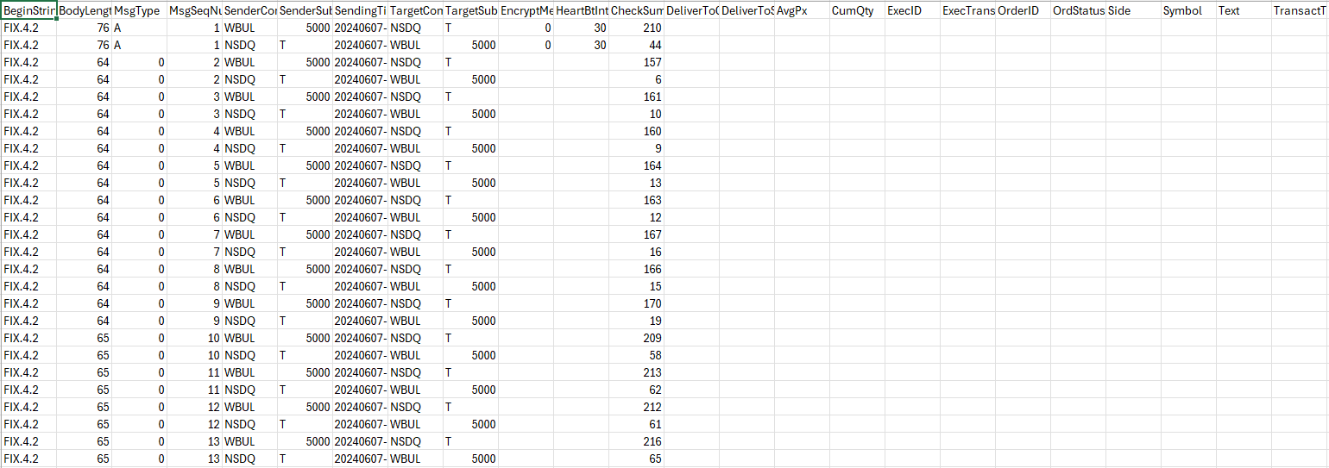
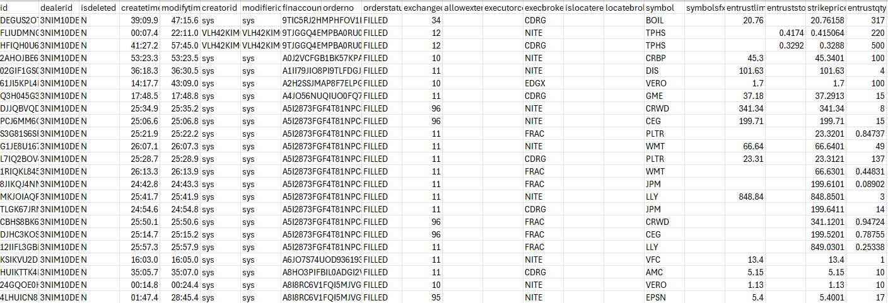
Prepare Data for Processing
trf.log
trf.json
Wb_sell.xlsx and Wb_buy .xlsx
Wb_sell.csv and Wb_buy .csv
Remove Options/Futures, Replace HDSN with HRTF
Notes:
Anthony
Moving on, our first observation is that the UI/UX of the app is intimidating for new users. Starting off on the left, this is a slide from webull’s investor presentation deck that we found on the SEC’s website. From the beginning webull has been catered towards more experienced traders. This means that a lot of the design in the app is very intimidating for new traders and their first experience on brockerage apps. We can see this in the examples when we compare the difference between webull’s watch list page and robinhood’s watch list page. While it might objectively be helpful for investors to have more information, most of this information is inaccessible to new traders, whose main objective is to get a simple and fast interface to buy stocks

Slide 6





First Round Match
Find exact match between (wb_buy, trf_sell) and vice versa based on broker, symbol, quantity, price
First round match percentage = 72%
TRF
WB

Slide 7

Second Round Match
Match on cumulative trade quantity between not_matching files for each broker, symbol and price
Second round match percentage = 20% for WB, 25% for TRF
TRF
WB

Slide 8
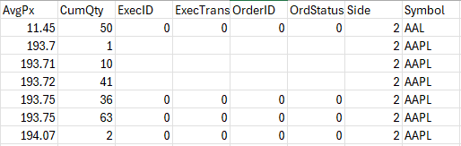

Third Round Match
Find subset of numbers that add up to cumulative trade total between not matching files based on broker, symbol, average price
Third round match percentage = 4% for WB, 9% for TRF
TRF
WB

Slide 9
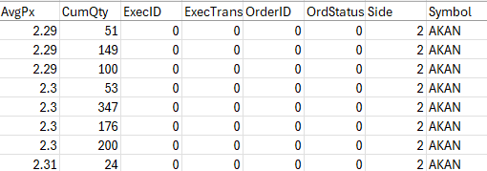

Fourth Round Match
Use DP to calculate if it’s possible to sum up to a value, then append random combination to matching list
Fourth round match percentage = 20% for WB, 25% for TRF
TRF
WB

Slide 10
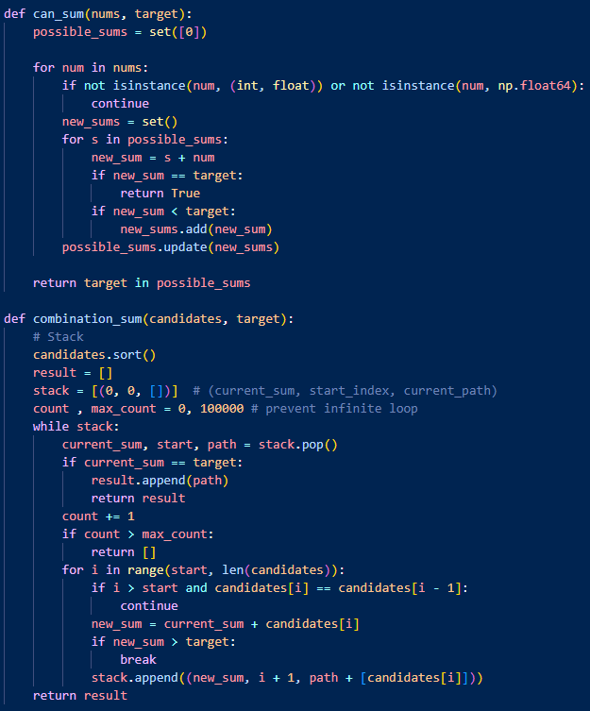
Fourth Round Match Algorithm
Based on similar problem:
Combination Sum II – LeetCode
“Given a collection of candidate numbers and a target number, find all unique combinations in candidates where the candidate numbers sum to target”
Two functions:
can_sum: use dynamic programming to calculate if a list of numbers can sum up to a target number
combination_sum: use stack-based depth first search to calculate a possible combination that sums up to the target – capped at 100,000 attempts

Slide 11
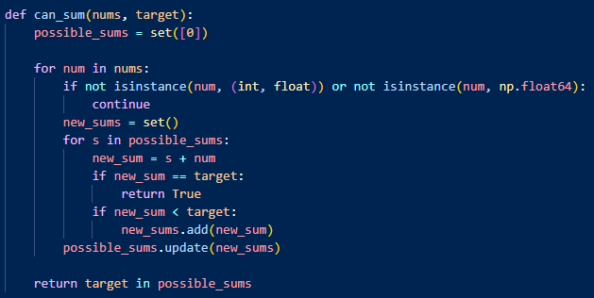
can_sum
Calculate if it is possible to reach a target number with a set of numbers, ensures we don’t do unnecessary calculations if the quantities in TRF can’t possibly add up the quantity in WB
Simple example:
nums = [2,3,7]
target = 10
First iteration:
possible_sums = {0}
num = 2
new_sum = {0,2}
Second iteration:
Possible_sums = {0,2}
num = 3
new_sum = {0+3, 2+3} = {3,5}
Third iteration:
Possible_sums = {0,2,3,5}
num = 7
new_sum = {0+7, 2+7, 3+7, 5+7}
= {7,9,10,12}
Since 3+7 == target, we return True

Slide 12
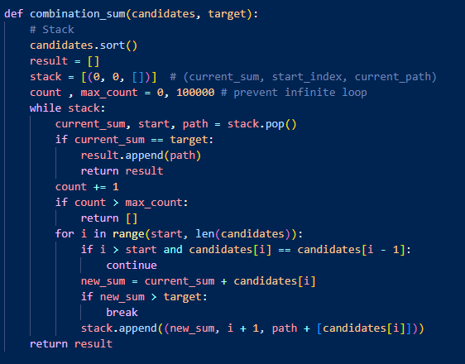
combination_sum
Calculate a possible combination that can sum to our target quantity. The number of attempts is capped at 100,000 to prevent getting stuck
Summary:
Sort candidates to make calculations easier
While there are still values to explore:
If the current sum = our target, return the combination that makes up our current sum
If the number of iterations exceeds our maximum – assume no combination will be found and return
If the current number equals the previous number, skip it to prevent duplicates
Add the next number in candidates to our current number
5) If the new total is greater than our target, exit from loop
6) Add the new sum, index, new path to the stack to continue exploring

Slide 13
Summary
Total Matching = ~ 90% for Webull files, ~90% for TRF files
Issues: runtime of round 5 is a bit long and randomly matches orders
TRF
WB
Quantity
Price

Slide 14

Potential Solutions
Fuzzy match price and quantity – could lead to false positives
Example: match the trade from TRF to 5 of the trades from WB and split WB’s trade
TRF
WB

Slide 15
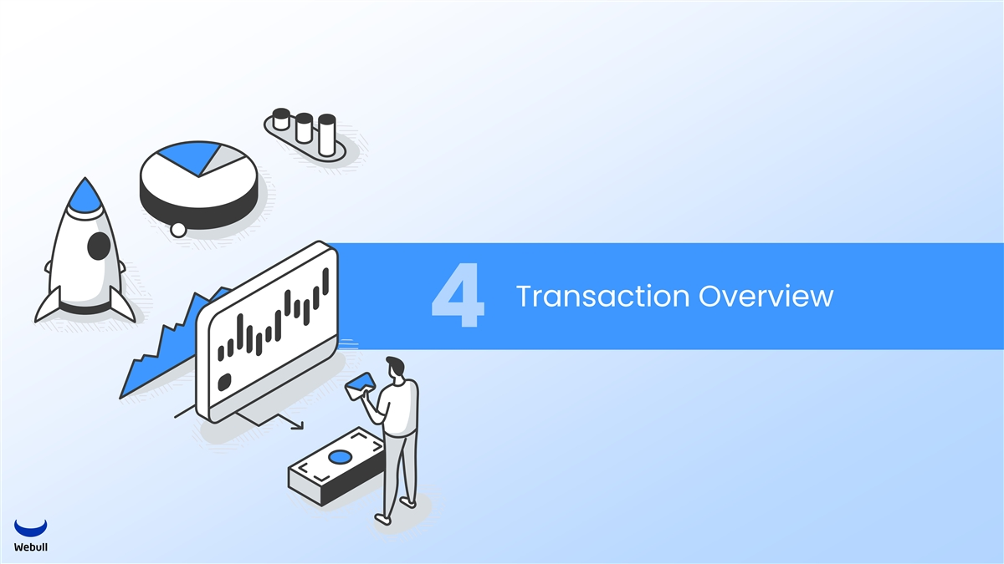
Conclusion
The End

