Slide 1
Blackjack Game Variant Simulation
Team: Nan Yang, Wei Zhong
Notes:
ln this Project, we are planning to model the popular casino game — blackjack. We will use its simplest version as our baseline model, which I’m being introducing in details shortly. And we will use Monte Carlo simulation to explore how different rules and strategies could affect the game outcome in the long run from the perspective of the House.

Slide 2
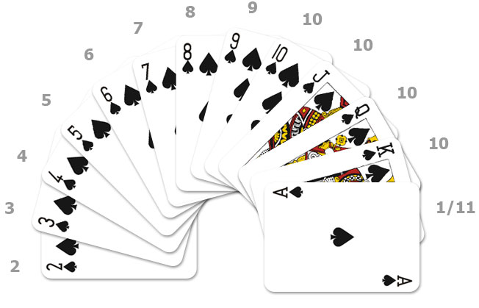
Basic rules of Original Blackjack
Simplest version: single deck, single player
Card values
Game process
betting → each party get 2 cards
→ player’s decisions → dealer draw card → end
To win:
Blackjack at the first two cards (3 to 2)
closer to 21 than dealer without going over
Notes:
Assuming that not everyone in the room are Blackjack experts like both of us, so first, let’s take a look at the basic rules of the game. As I just mentioned, for now we are using the simplest version of the game, that is, single deck game and single player.
- card values are displayed in this picture: 2 to 10 are counted by their face value, jack, queen and king are also counted as 10s; and ace can be either 1 or 11 depending on the situation (since we would want the total value of our cards to be as close to 21 without getting over 21, so as long as counting ace as 11 doesn’t get you busted, count it as 11, otherwise, otherwise it is 1.)
Generally speaking, the game starts with the player putting his bet on the betting area. Then initially player will receive two cards, both facing up; and dealer also gets two cards, only the second facing up. Then if Blackjack doesn’t happen then player can decide on his following moves based on some strategies, which is explained in details in the next slide. This continues until player decide not to take any more actions, dealer will first reveal his hold card, and if the card total is 16 points or lower, the dealer will always draw another card from the deck. When dealer stops, game ends.
- To win: 1) Blackjack at the first two cards (ace and one of the ten-point cards); 2) If Blackjack didn’t happen, then game continues and your goal is to get closer to 21 than the dealer without go bust. Note that, if you go bust, you automatically lose, and the dealer does not have to show their hand.

Slide 3
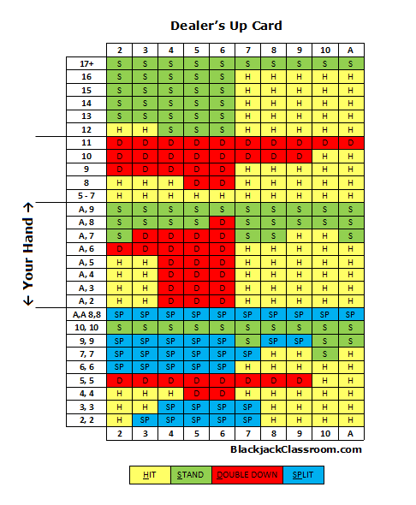
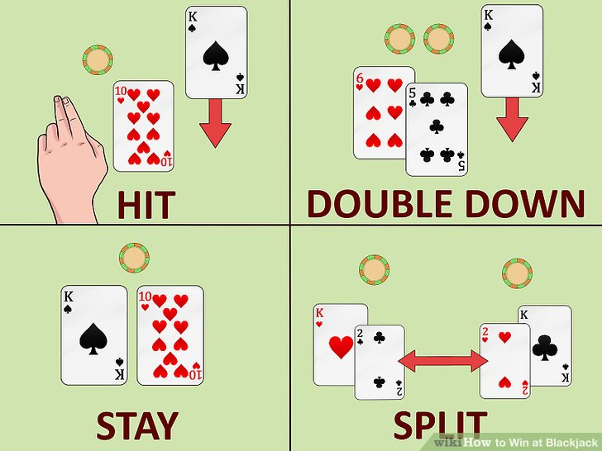
Player Strategy
Advanced Strategy:
Hit
Stay
Double down
Split
”Dumb” Strategy: hit until 16
Notes:
This strategy card is said to be available at all casinos. And this specific one is downloaded from blackjackclassroom.com. This one is for single deck game only, multiple deck games have different strategy chart. The suggested strategy will be at the interception of your hand and dealer’s up card.
- hit: to request another card
- stay: no additional card
- double down: you choose to add additional bet after the initial bet, but you only get one more card. The additional bet can be anything up to your initial bet
- Split: only allowed when the first two cards are the same, and you may split them into two separate hands by placing another bet equal to your initial bet. You can think of these two hands as acting independently like two players. Re-splitting are allowed in our model.

Slide 4
Game Variant
For Player:
General fee to start
Before adding this general fee, our simulation result shows that casino could even lose many in the long run even with a steady winning rate.
Our guess is that in reality, no matter win or lose, casinos always have other gains, such as hotel fees, etc. We want to take that into account when calculating it’s profit.
Player has the choice of paying additional fee for a higher pay rate under same color when he wins

Slide 5
Monte Carlo Simulation
Test variant game result (from Dealer perspective)
probability of net win: around 48.02%
probability of net lose: around 43.49%
probability of tie: 8.49%
probability of Blackjack: 9.32%
even with a general fee of as small as 1 dollar, casino is profiting
Compare different strategy result

Slide 6
Thank you !

