Slide 1
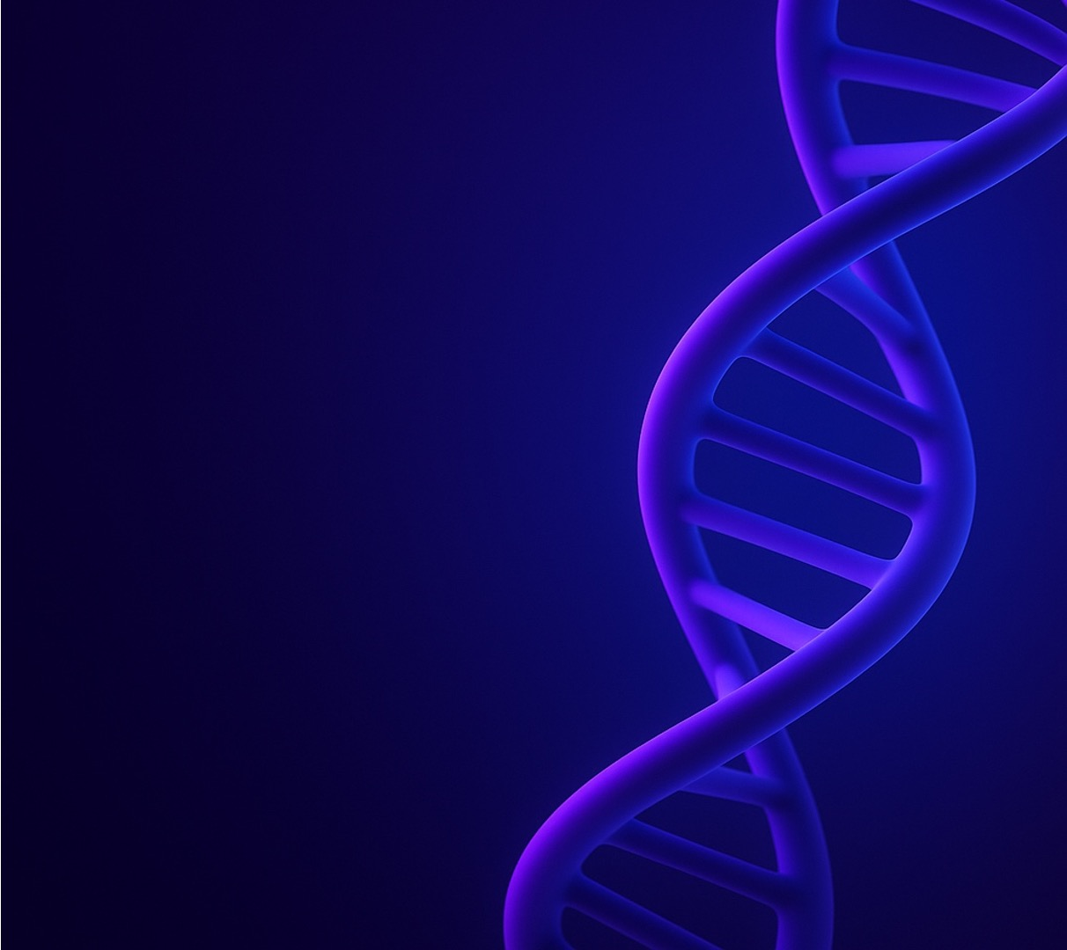
Decoding Life Structure and Function of DNA
An overview of molecular genetics and its applications

Slide 2
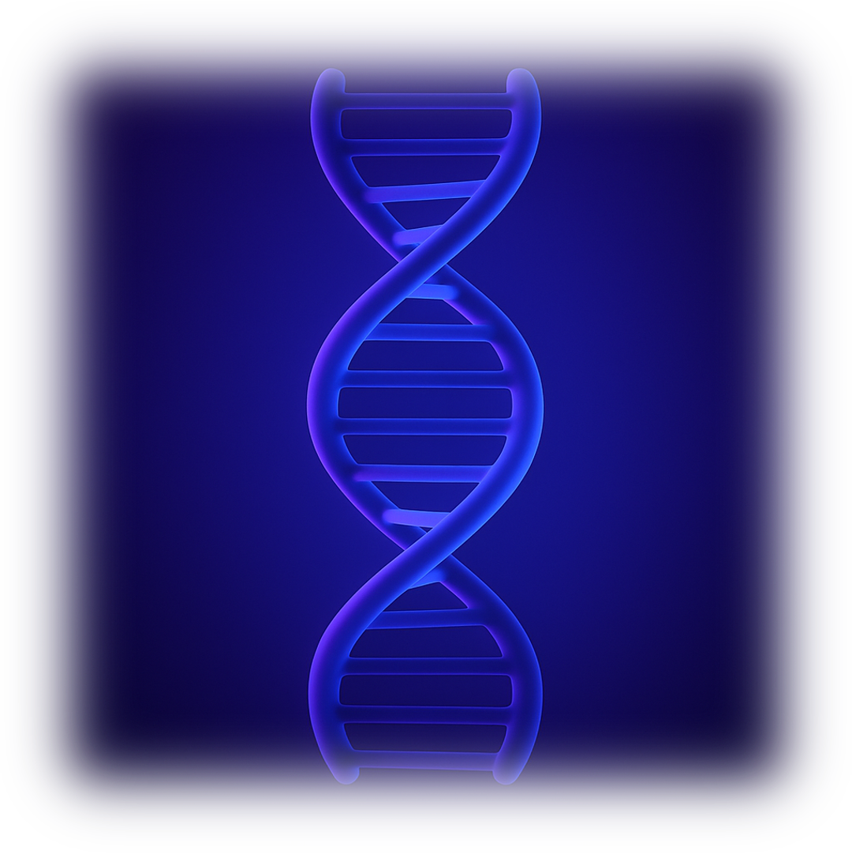

Structure of the double helix
Adenine <>Thymine (A–T), Guanine <> Cytosine (G–C)
Two antiparallel strands coiled into a helix.
Hydrogen bonds stabilize the helix.
10 base pairs per turn, 3.4 nm per helical turn.
1

Slide 3
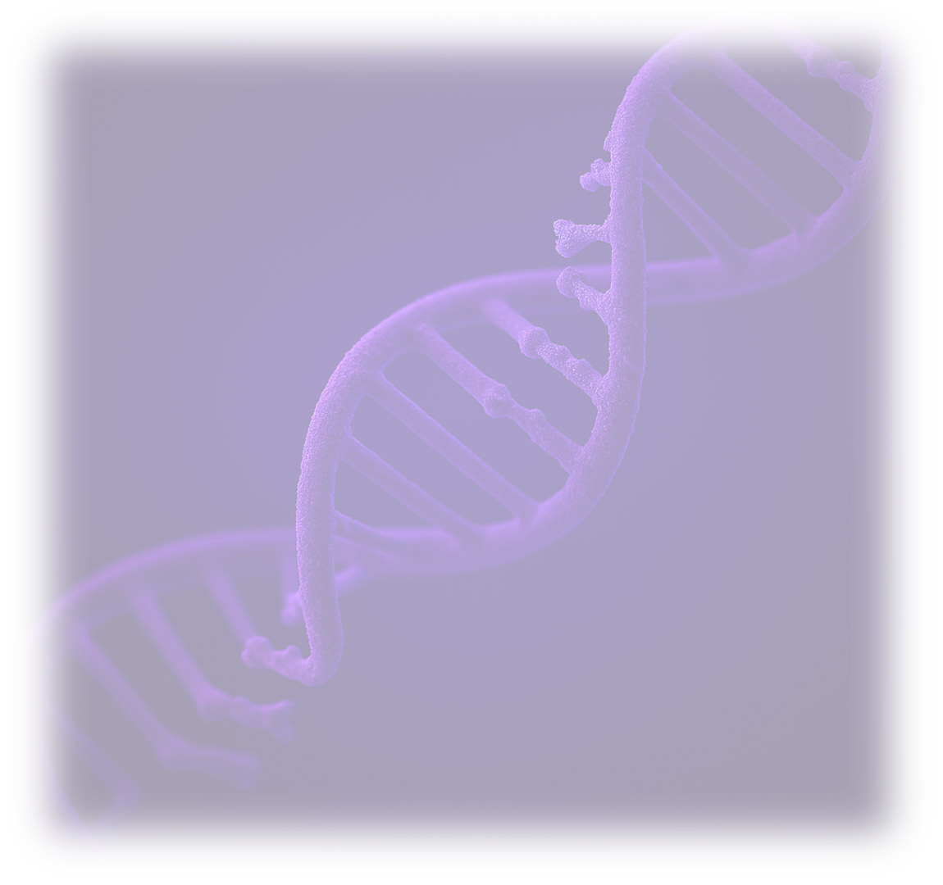
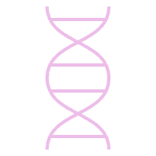
What is DNA?
Phosphate
DNA = Deoxyribonucleic Acid, the molecule carrying genetic instructions.
Found in nucleus (eukaryotes) and cytoplasm (prokaryotes).
Composed of nucleotides (sugar, phosphate, base).
Discovered by Friedrich Miescher (1869); structure identified by Watson & Crick (1953).
Sugar
Base
A T G C
2

Slide 4

DNA replication (mechanism & enzymes)
Semi-conservative process
each new DNA has one original strand
Main enzymes
Helicase - unwinds DNA Polymerase - adds bases Ligase - joins fragments
Final stage
Occurs during S phase of the cell cycle
3

Slide 5

Genes & coding
Gene
functional segment of DNA coding for a protein
Human genome
≈ 3 billion base pairs → ~20,000 protein-coding genes
Only 1.5%
of genome is coding (exons); rest = regulatory or noncoding
4

Slide 6
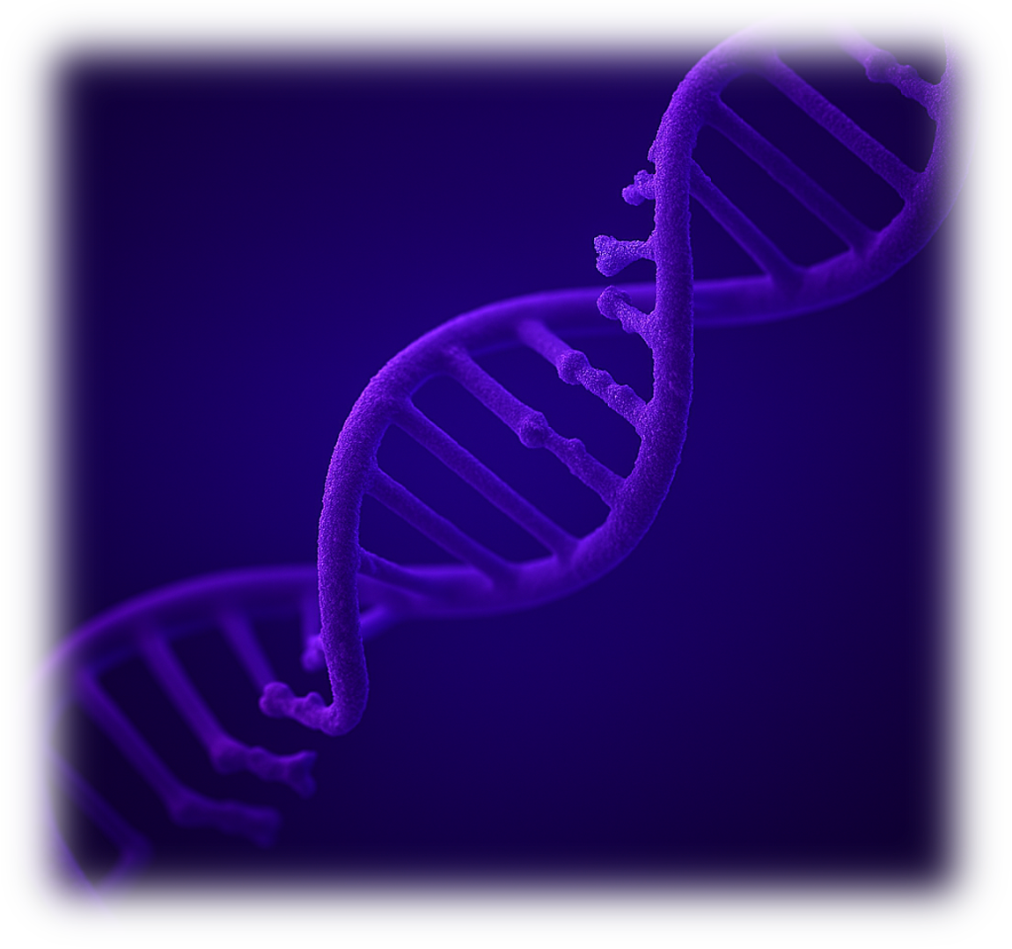
Human genome project
1990-2003: sequence the entire human genome
$2.7B cost
only ~1.5%
<$1,000 per genome (99.99% accuracy).
codes for proteins; humans share 99.9% DNA similarity.
5

Slide 7
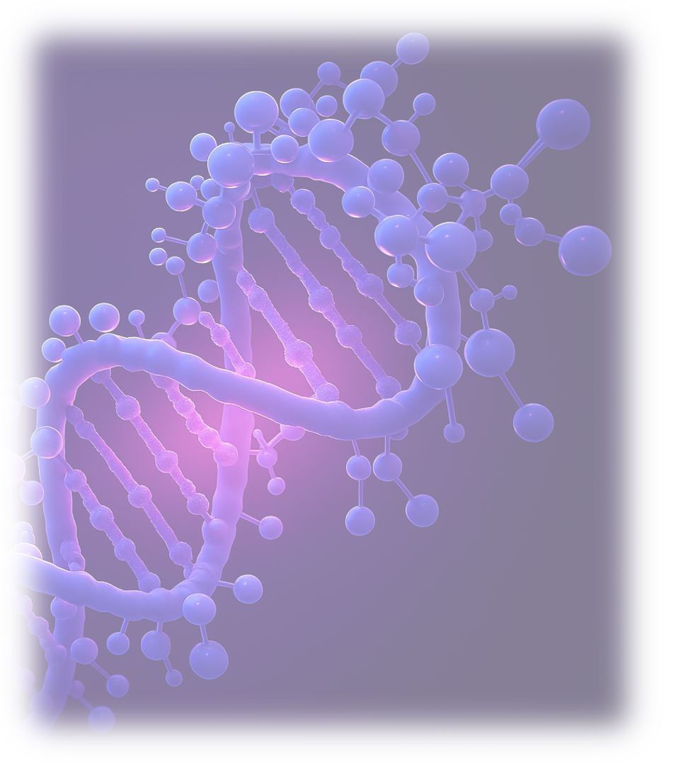
Mutations & genetic variation
Mutation
change in base sequence → can alter protein structure or function.
Type
substitution, insertion, deletion, duplication.
Mutation rate
≈ 1 in 10⁸ bases per generation.
6

Slide 8
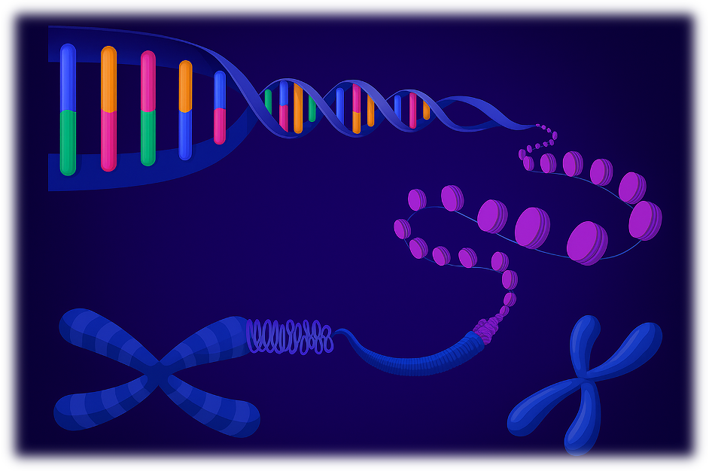
Chromosomes & DNA packaging
DNA wraps around histone proteins → nucleosome → chromatin → chromosome.
A single cell contains ≈ 2 meters of DNA compacted into nucleus (~6 µm).
Humans: 46 chromosomes (23 pairs).
7

Slide 9
DNA and genetic disorders
Genetic mutations
can disrupt normal gene function → leading to inherited diseases.
Chromosomal disorders
Down Syndrome (extra copy of chromosome 21)
Multifactorial disorders
involve both genes and environment (e.g. Diabetes, Heart disease).
8

Slide 10
Future of genomic research
Personalized Medicine Tailoring treatments based on an individual’s genetic profile.
Gene Therapy: Inserting or correcting faulty genes to treat diseases.
Synthetic Biology: Designing custom DNA to create new biological systems.
AI in Genomics: Accelerating DNA analysis and mutation prediction using machine learning.
Found in nucleus (eukaryotes) and cytoplasm (prokaryotes)
Genetic mutations can disrupt normal gene function
Global genomics market expected to reach $95B+ by 2030
9

