Slide 1
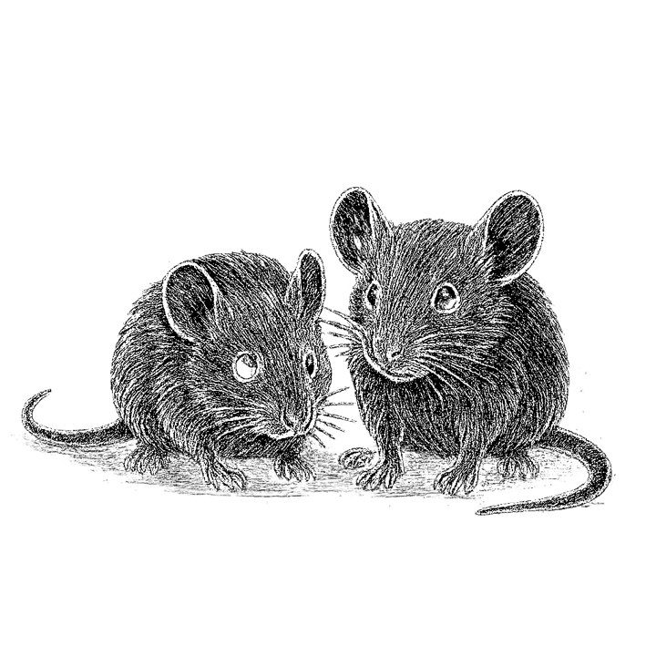
Project Title
Author · Year · Conference

Slide 2

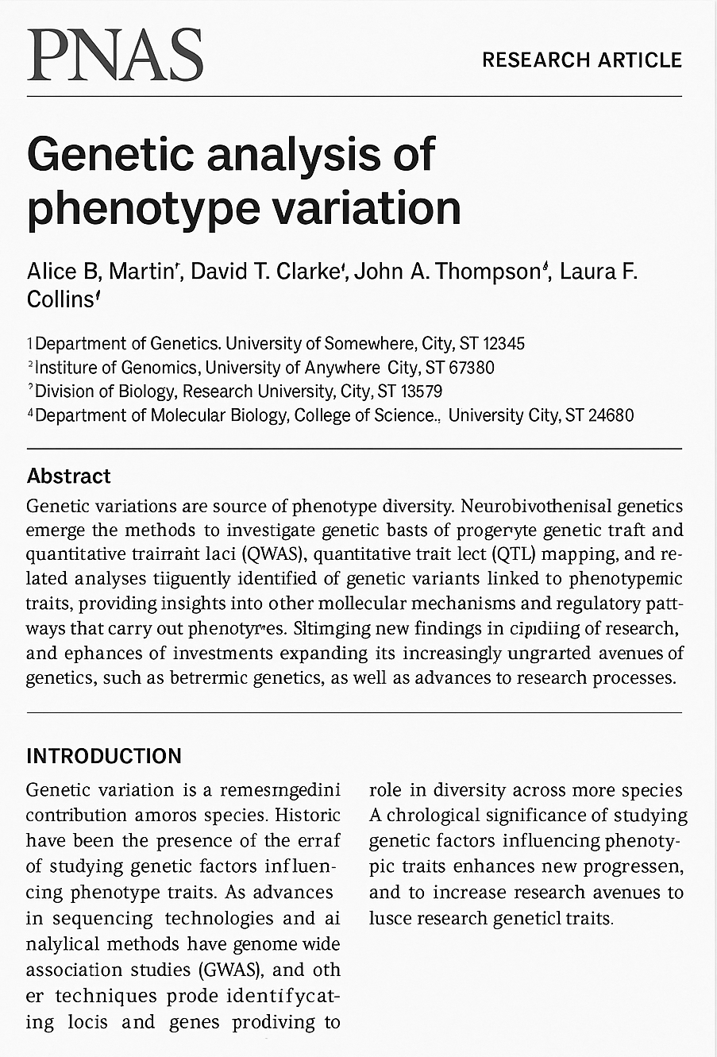
Background
A brief description of what the study is about in a standard inverted period format. For example: here is a broad medical phenomenon we all know about. Here is how that biological phenomenon applies to this specific study system. However, we still don’t understand how our independent variable affects the dependent variables more broadly. In the last sentence of this paragraph, we will specify the research question.
Down here we will describe what is already known about this question based on the above papers. It’s not important that you can read what’s in the papers, only important that you can see the titles, authors, year, and journal. The papers will likely be recognizable to the audience, but it’s not important if they’re not.

Slide 3
Objectives
1
Here is the first scientific objective. Let’s say that it’s to establish a line of genetically identical mice that have the gene of interest, setting the stage for the rest of the experiment.
2
Here is the second scientific objective. Let’s say that it’s to run an experiment with different treatment groups on the line of mice we’ve created.
3
Here is the third scientific objective. Let’s say that it’s to analyze the gene expression data for the mice in different treatment groups and to determine whether treatment has a significant effect on whatever it is we’re measuring.

Slide 4
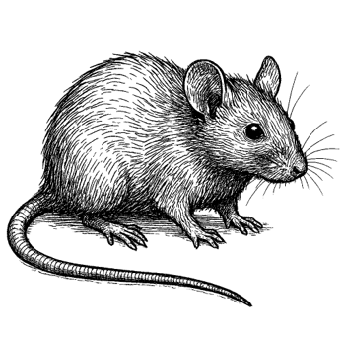
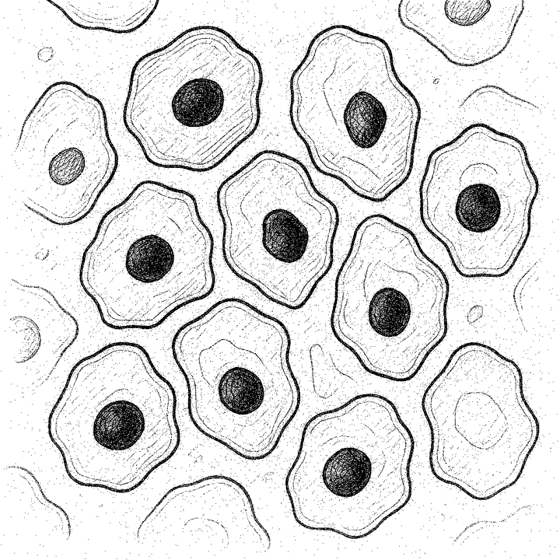
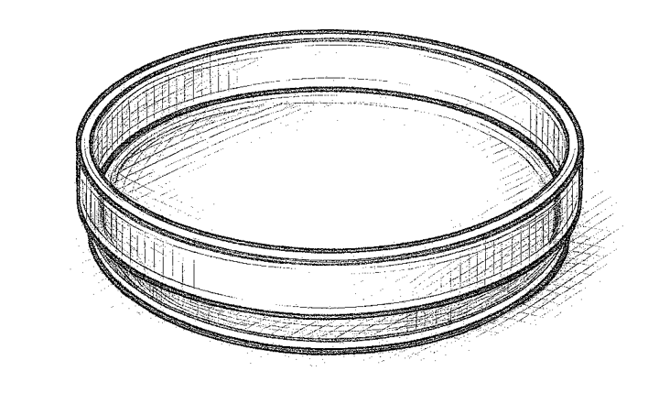
Methods
1
Details of the first part of the experiment. This will include things like subject recruitment if a human study, study subject or study system if an animal or plan experiment, or search criteria if a review. Here we’re showing mice that indicate an animal experiment.
2
Here we’ll talk about the second part of the methods for this experiment. It might include something like laboratory methods if a lab experiment, or sample collection details. Here we’re showing epithelial cells in a scientific illustration style.
3
Finally, we’ll talk about the third part of the experiment, or about the analysis details, depending on the details of the specific experiment. Here we’re showing a petri dish that might indicate culturing. As with the other parts of the methods, it’s in the style of a scientific illustration.

Slide 5
Heat Map Results
 | Category 1 | Category 2 | Category 3 | Category 4 | Category 5 | Category 6
Category
Category
Category
Category
Category
Category
Category
Category
Category
Category
3
0
-3

Slide 6
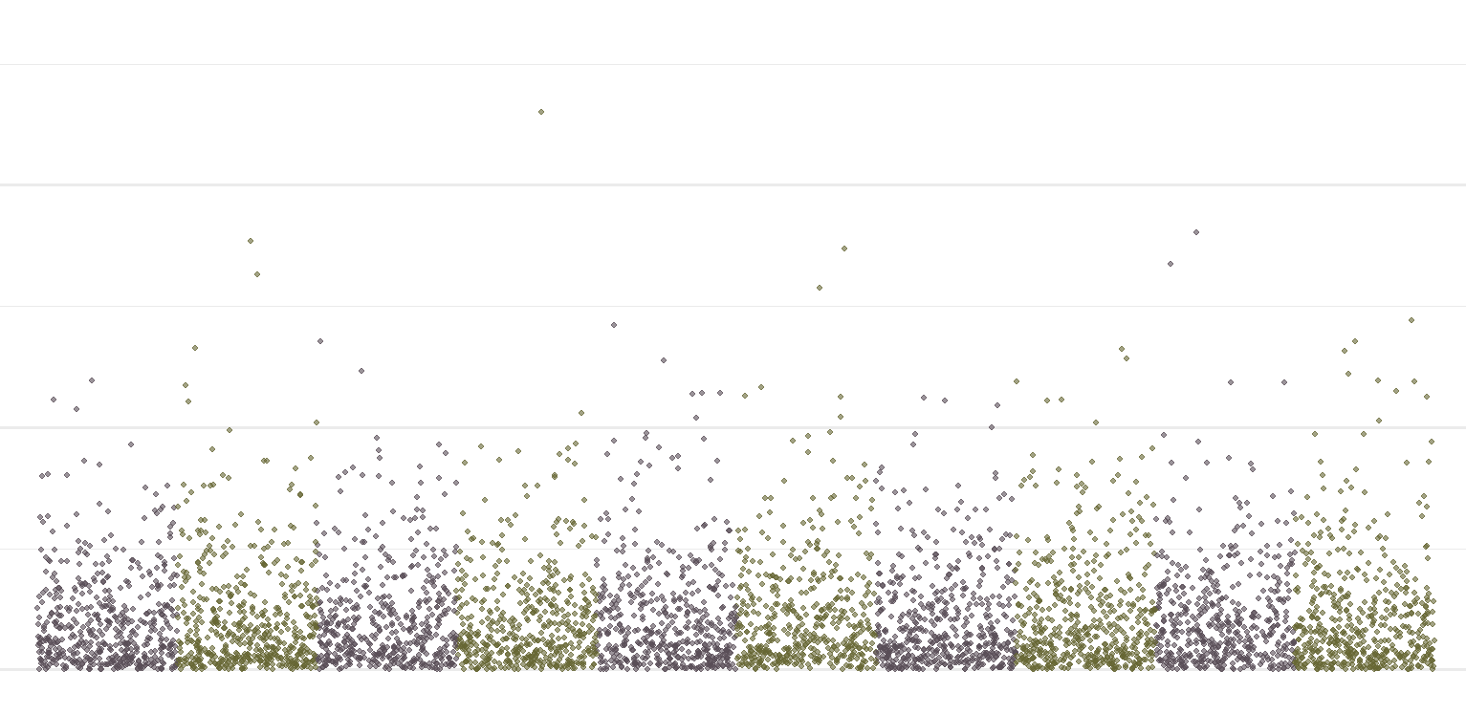
GWAS Results
Details of the chart and its results will go here. This will include things like subject recruitment if a human study, study subject or study system if an animal or plan experiment, or search criteria if a review. Here we’re showing mice that indicate an animal experiment.
p = 0.05
Chr 1
Chr 2
Chr 3
Chr 4
Chr 5
Chr 6
Chr 7
Chr 8
Chr 9
Chr 10

Slide 7
Conclusion
Here we will have a fairly long and detailed conclusion slide. The most important part is to make sure that all of the objectives have been addressed.
Final thoughts and other notes about the findings can go here as well.
1
A reminder of the first objective: to establish a line of genetically identical mice that have the gene of interest, setting the stage for the rest of the experiment. Now we discuss whether it was accomplished.
2
A reminder of the second objective: to run an experiment with different treatment groups on the line of mice we’ve created. We once again discuss whether it was accomplished.
3
Probably the most interesting objective, the one about which the most can be said. How did the analysis contribute to this analysis? Were the predictions upheld or not upheld? Here is that relevant discussion.

Slide 8
Acknowledgements
Lab group
Person who helped
Additional person who helped
Funding agency
Grant one
Grant two

Slide 9
Style guide
#666633
#584D56
#500E35
Title font: Arial Black
Text font: Aptos
#756773
#C9ADA7
#F2E9E4
#9A8C98
Illustration style: scientific sketch

