Slide 1

Project Title
Author goes here
Date goes here

Slide 2



The Problem
A fairly brief description of what the study is about in a standard inverted period format. For example: here is a broad ecological phenomenon we all learned about in undergrad. Here is how that ecological phenomenon applies to this specific study system. However, we still don’t understand how our independent variable affects the dependent variables more broadly.

Slide 3
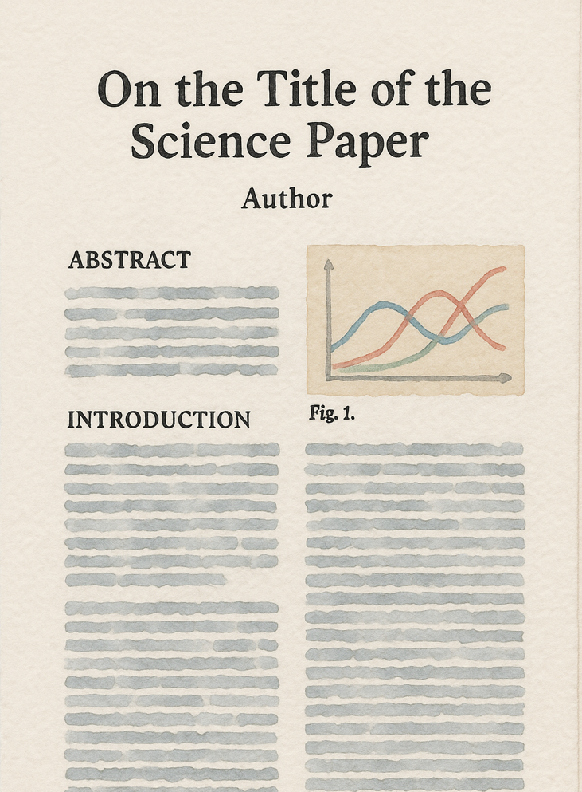
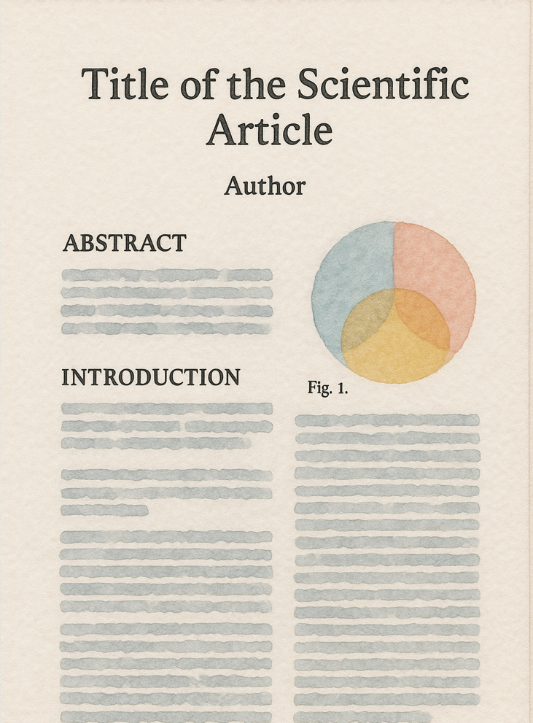
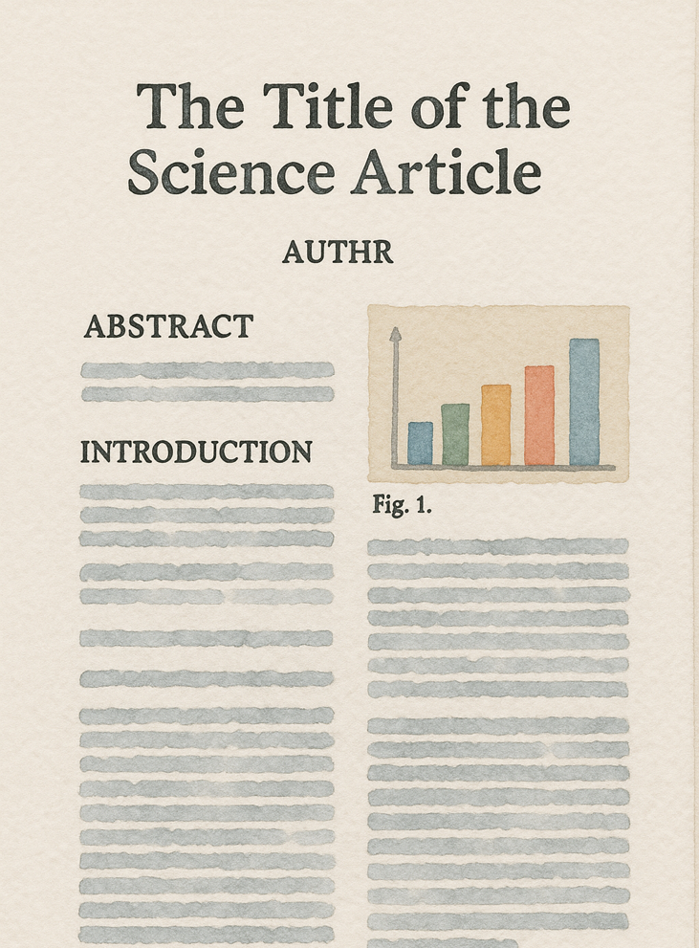
Previous Research

Slide 4
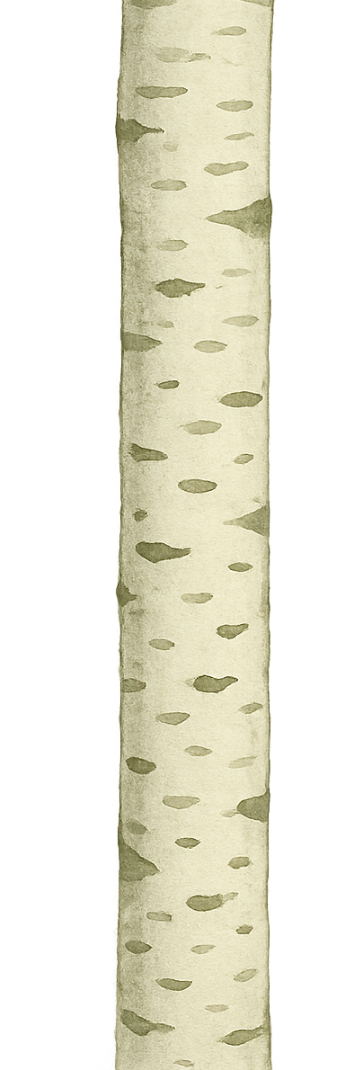
Hypothesis
The independent variable affects the dependent variable, because a mechanism connects them.

Slide 5



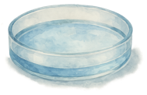
Methods
1
3
Control
Treatment 1
Treatment 2
2

Slide 6
Predictions
Treatment 2
Treatment 1
Control
Dependent Variable 1
Dependent Variable 1
Treatment Group
Dependent Variable 2

Slide 7
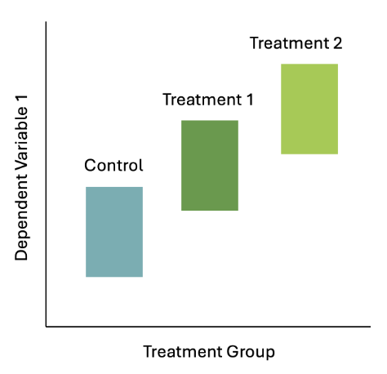
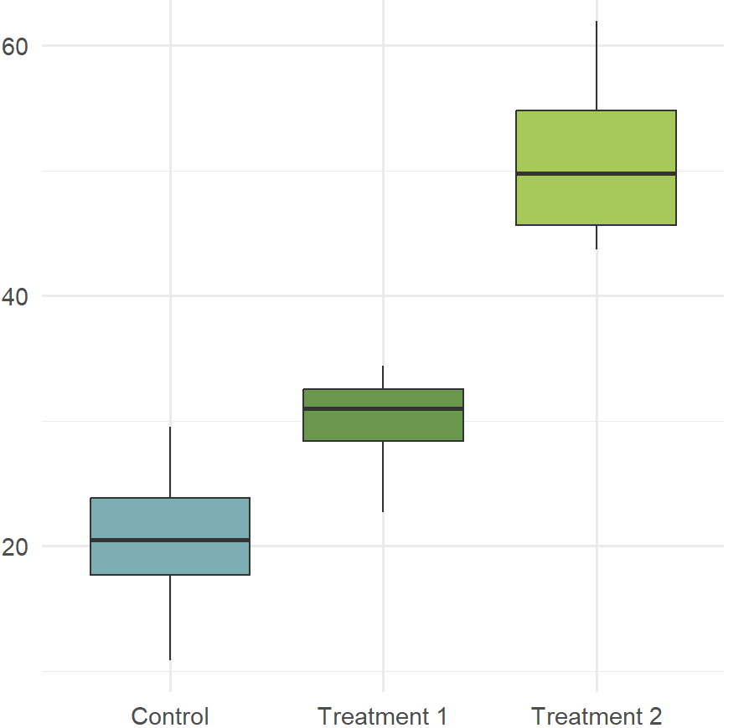
Results
Prediction
Dependent variable 1
Significant effect (p = 0.008)

Slide 8
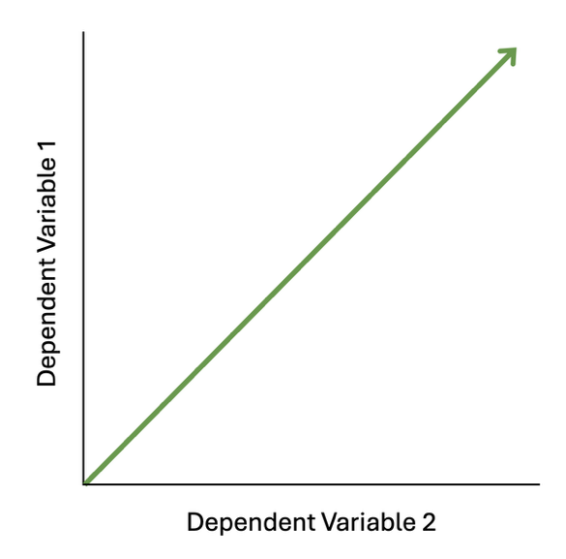
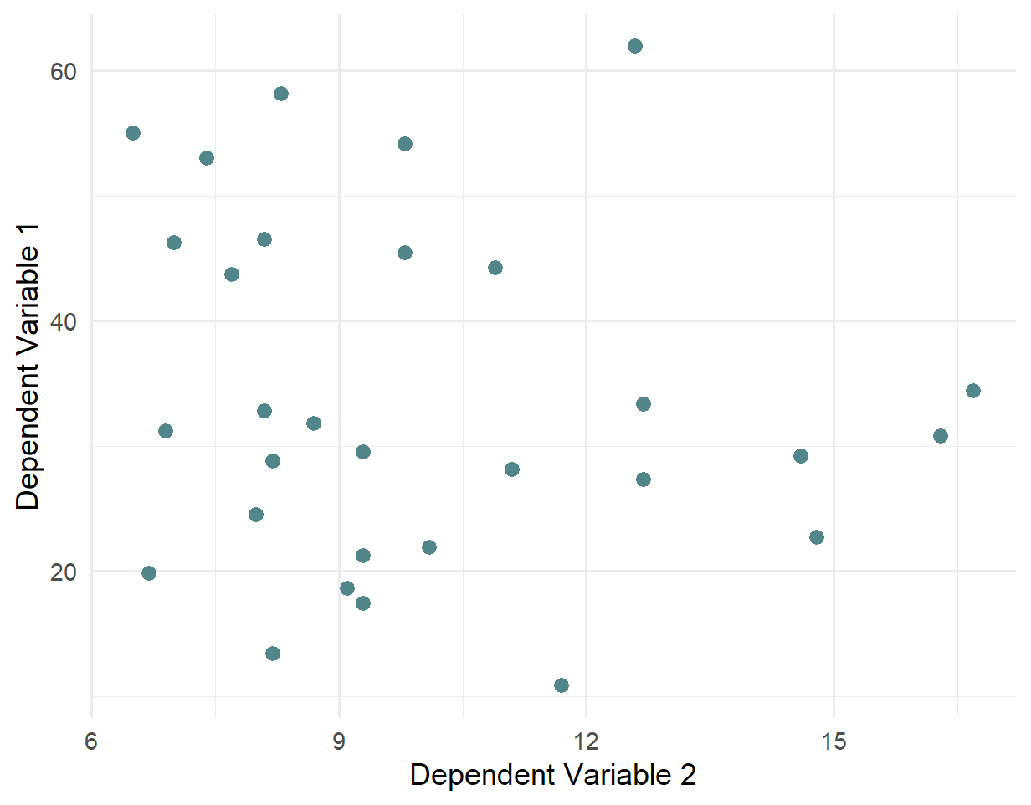
Results
Prediction
Dependent variable 1 x 2
No significant correlation

Slide 9


Conclusion
Results from the experiment were consistent with our first prediction, and inconsistent with our second prediction.
What does this mean? Here we discuss this. What does it mean about this experiment? What does it mean about the field more broadly? What are the next steps we plan to take?

Slide 10

Acknowledgements
Lab group
Person who helped
Additional person who helped
Funding agency
Grant

