Slide 1


PAGE 01 00/00/2025 COMPANY NAME
Brand Design Presentation
BRANDING GUIDELINES

Slide 2
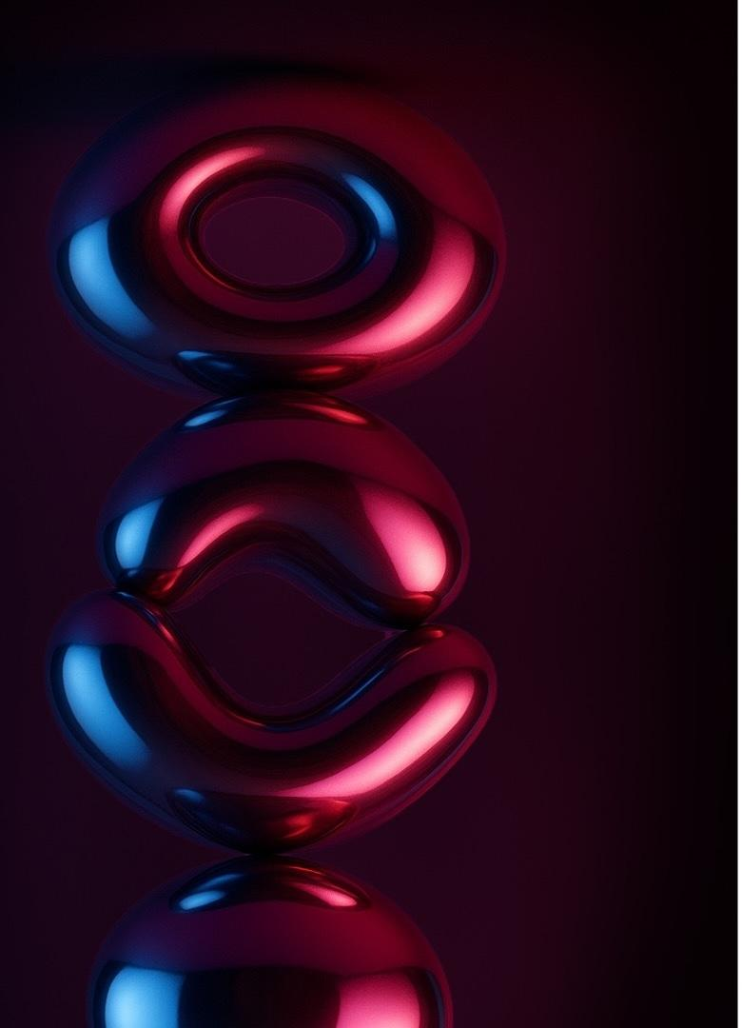



Brand Overview
We blend cutting-edge technology with human intuition to craft seamless, forward-thinking experiences that redefine what’s possible.
We're built for the long game. Our commitment to timeless design and scalable systems ensures every solution evolves with the market, adapts to new demands, and sustains growth for decades to come. Always positioned at the cutting edge of innovation.
Designed to move ideas forward. We turn bold concepts into elegant, real-world solutions that inspire progress and deliver measurable impact across industries.
PAGE 02 00/00/2025 COMPANY NAME

Slide 3
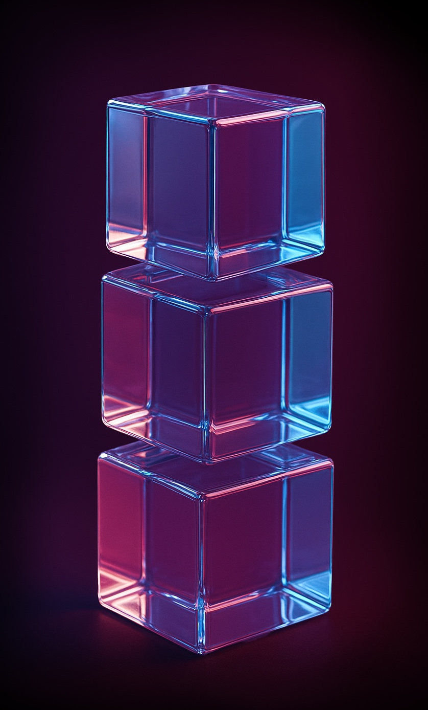



Brand Story
Born from a spark. What began as a single idea—to make technology feel beautifully human—became a mission to elevate how people connect.
Seeing what others missed. Our founders recognized a gap between innovation and empathy. They built a company where advanced technology serves real human needs, shaping experiences that feel both powerful and personal.
Purpose in every pixel. Every product we design reflects our founding vision: clarity, precision, and impact that endures beyond the latest trend.
PAGE 03 00/00/2025 COMPANY NAME

Slide 4




Brand Style
Sleek & modern
Abstract chrome
Glass- morphism
PAGE 04 00/00/2025 COMPANY NAME
Clean lines, balanced composition, and intentional spacing create a visual rhythm that feels effortless, current, and unmistakably refined.
Reflective metallic gradients add depth and movement, evoking innovation and high-end craftsmanship with a futuristic edge.
Soft transparency and layered blurs bring a luminous quality, suggesting clarity, openness, and seamless digital flow.

Slide 5
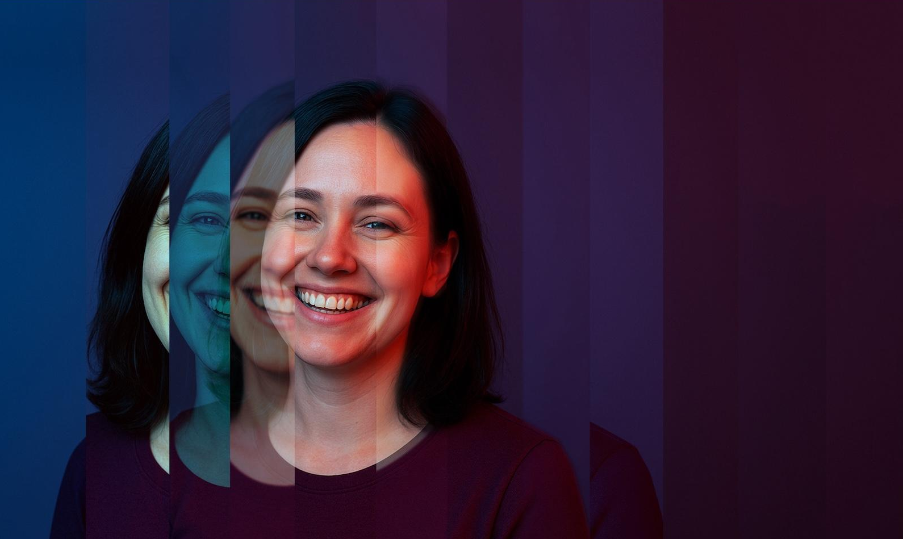
Brand
Persona
CHARACTERISTICS
PAGE 05 00/00/2025 COMPANY NAME
A visionary woman in her early 30s—tech-savvy, ambitious, and effortlessly modern, balancing innovation with an appreciation for meaningful, beautifully designed experiences.
TRENDY
ONLINE SHOPPER

Slide 6
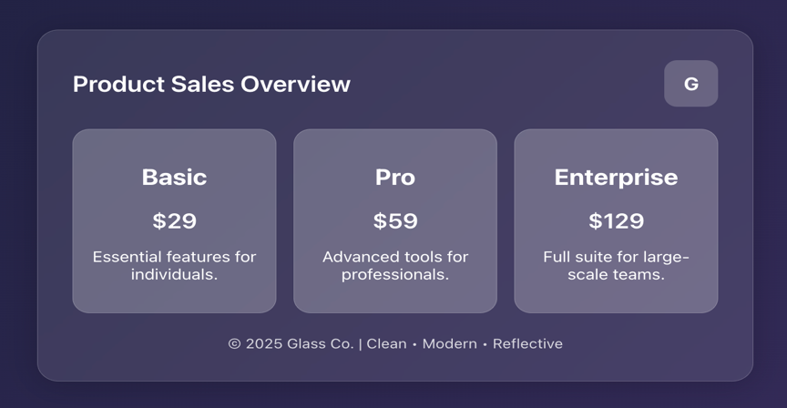




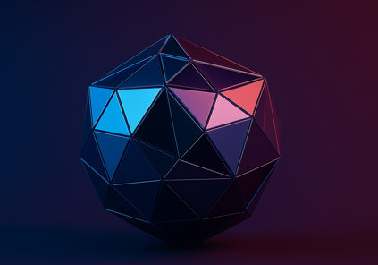
Moodboard
Futuristic design inspired by chrome, glass, and liquid metal—where texture, light, and reflection merge to create an atmosphere of elegance and innovation.
PAGE 06 00/00/2025 COMPANY NAME

Slide 7

Typography
Use the following guidelines to map out the typographic hierarchy in print and digital media.
SUBHEAD ARIAL BOLD 18PT CAPS
This is the standard body copy treatment. Arial 18pt in white. Use Arial Black to accentuate key phrases that aid in the scanability of the content.
The subhead and body copy should always be the same size.
Arial 80 pt
PAGE 07 00/00/2025 COMPANY NAME
H1
Arial 60 pt
H2
This is the secondary body copy that is smaller for more detailed information. Arial 16 pt.
Arial 48 pt
H3
This is the smallest body copy for tertiary information such as legal copy or disclaimers. Arial 12 pt

Slide 8
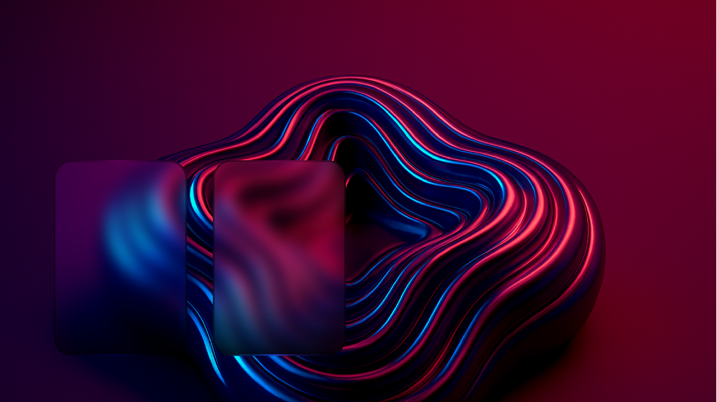


Colors
SECONDARY
Plum
Electric Blue
Periwinkle
#872D6C RGB 135 45 108
CMYK 44 100 26 6
#3FB7EB RGB 63 183 235
CMYK 73 2 00 00
#6770D6 RGB 103 112 214
CMYK 68 60 00 00
DO'S
DONT'S
PRIMARY
PAGE 08 00/00/2025 COMPANY NAME
Use white or black text overlays
Combine colors for gradients
Use tints and shades
Use single color as a background
Use colors outside of this brand palette
Use Electric Blue as a text color
Maroon
Dawn Blue
HEX #540A26 RGB 84 10 38
CMYK 40 100 63 55
HEX #002C7C RGB 0 44 124
CMYK 100 90 20 10

Slide 9

Logo
SECONDARY MARK
PRIMARY WORDMARK
Brand Design
The main mark is white with a knocked out B
Use the wordmark is the primary leading brand mark. Minimum height: 0.125in / 100px
PAGE 09 00/00/2025 COMPANY NAME
A colored variation can be used on company swag
PRIMARY LOGOTYPE
Minimum size
0.125in / 25px
Brand Design
Maximum size
0.5in / 350px
Use the logotype when the secondary mark isn't represented in the layout. Minimum height: 0.125in / 100px

Slide 10
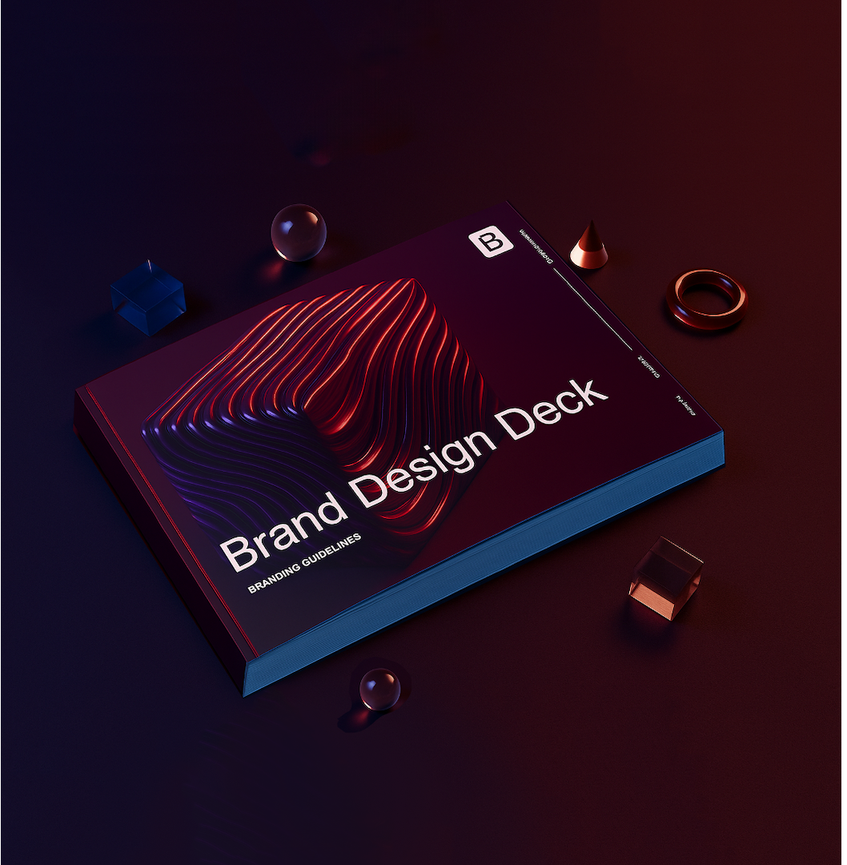
BOOKLET
Applications
APP ICON
PAGE 09 00/00/2025 COMPANY NAME
UI BROWSER NAV
Brand Design
Link Link Link

Slide 11
Reference
PAGE 10 00/00/2025 COMPANY NAME
FOR BRANDING QUESTIONS
CREDITS
Contact Jane Doe at janedoe@branddesign.com
Download brand assets at www.heresthelink.co
Branding by The Design Agency
Anchorage, AK
www.thedesignagency.co

Slide 12
Style Guide
COLORS
Plum
Electric Blue
Periwinkle
#872D6C
#3FB7EB
#6770D6
SUBHEAD ARIAL BOLD 18PT CAPS
Maroon
Dawn Blue
Arial 80 pt
PAGE 09 00/00/2025 COMPANY NAME
H1
HEX #540A26
HEX #002C7C
Arial 60 pt
H2
This is the standard body copy treatment. Arial 18pt in white. Use Arial Black to accentuate key phrases that aid in the scanability of the content.
Arial 48 pt
H3
This is the secondary body copy that is smaller for more detailed information. Arial 16 pt.
This is the smallest body copy for tertiary information such as legal copy or disclaimers. Arial 12 pt

