Slide 1


BRAND GUIDELINE
®2025
Shiftline AI
How we look

Slide 2

Shiftline AI is a consultancy that helps companies navigate the evolving AI landscape, from strategic planning to software implementation.
We bridge business insight and AI innovation, empowering organizations to shift from data-driven to intelligence-driven.
WHO WE ARE

Slide 3

OUR VALUES
Strategic We think ahead and design AI solutions with purpose.
Empathetic We humanize complex technology for real-world impact.
Innovative We embrace creativity and experimentation.
Reliable We guide every client with clarity and confidence.

Slide 4

MOCKUPS

Slide 5
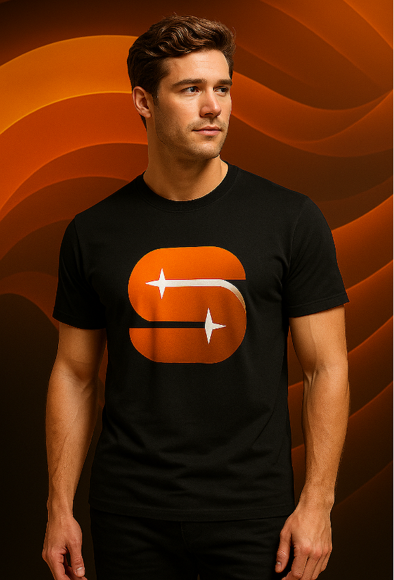
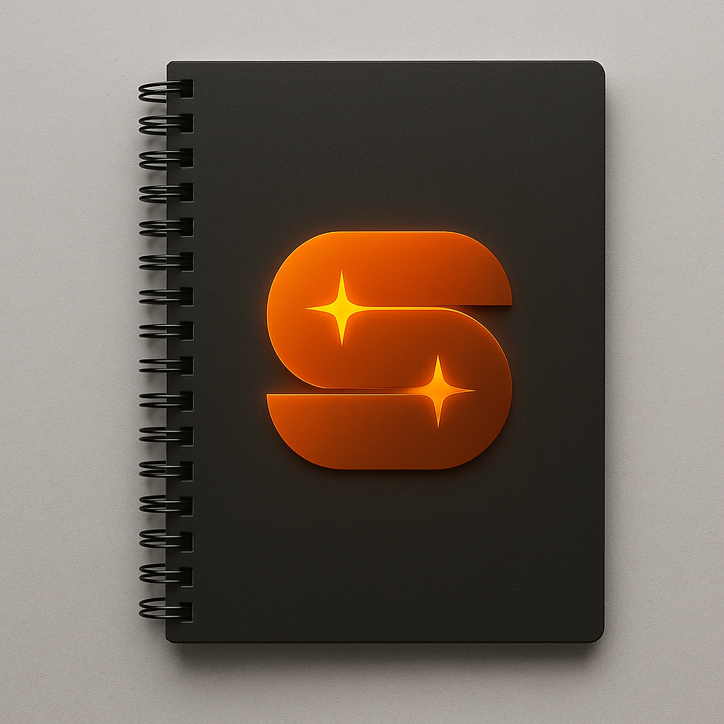
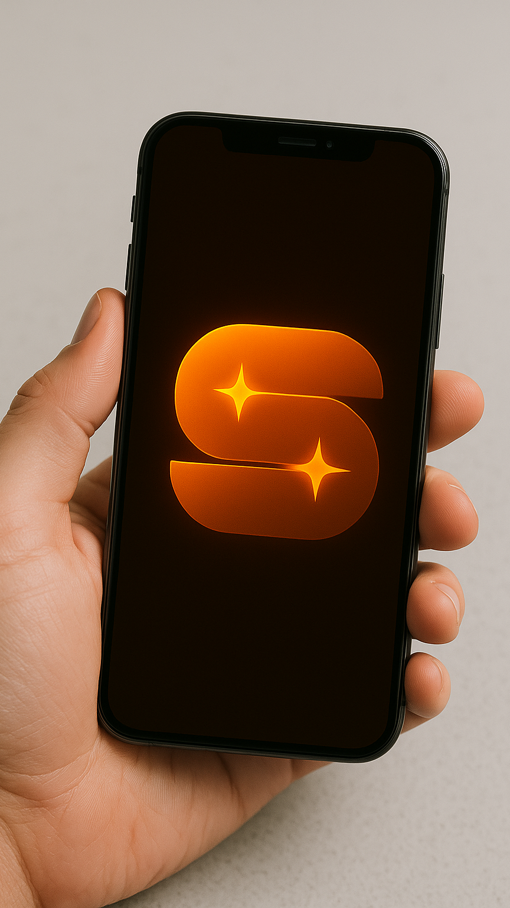
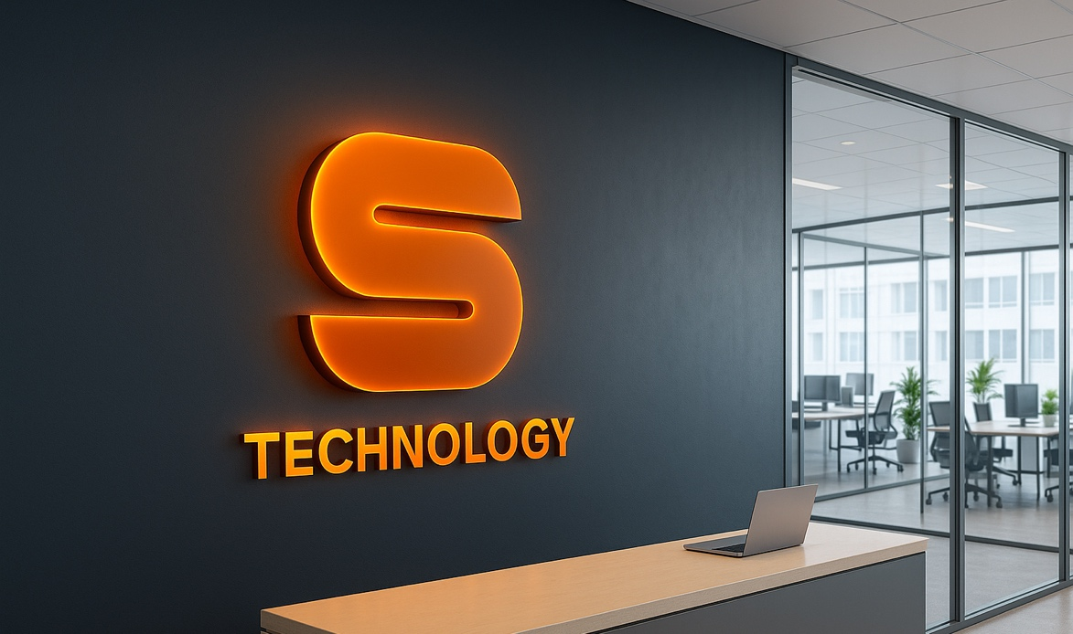

Slide 6
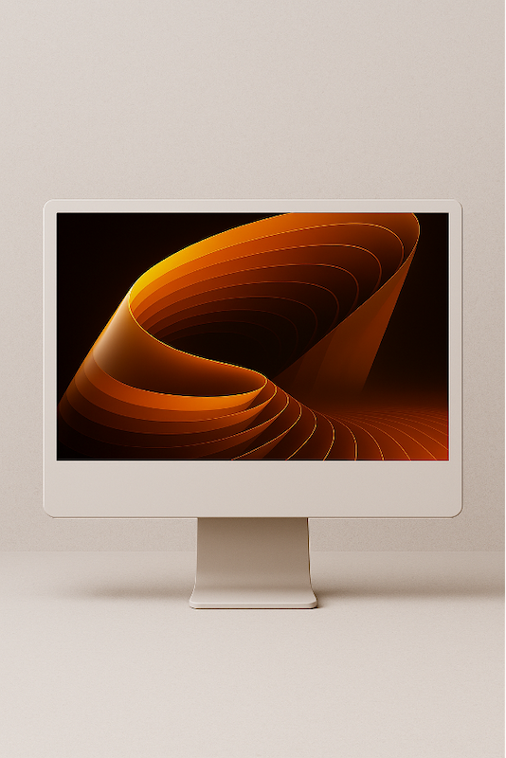
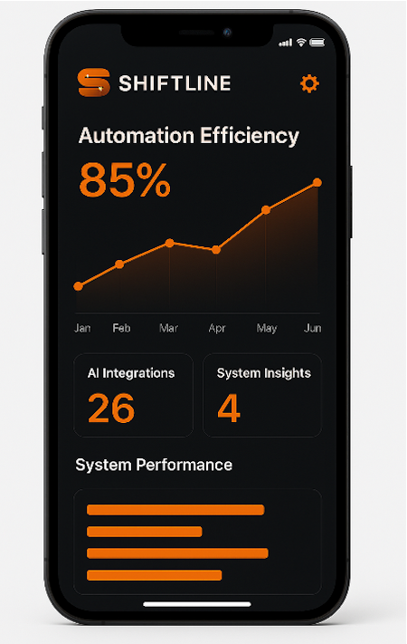

Shiftline AI

Slide 7


IMAGERY & GRAPHICS

Slide 8




Our visual system communicates intelligence and connection — balancing human and digital elements.

Slide 9
TYPOGRAPHY
Avenir font
AaBbCc
Typography is central to Shiftline AI’s clarity and professionalism. Consistent use ensures strong, unified communication across all platforms.
AaBbCcDdEeFf

Slide 10
COLOR PALETTE
#000000
#FF5E00
Our color system reflects energy and intelligence, orange symbolizes transformation and momentum, while dark tones emphasize depth and trust.
#C04F15
#F7DACC

