Slide 1
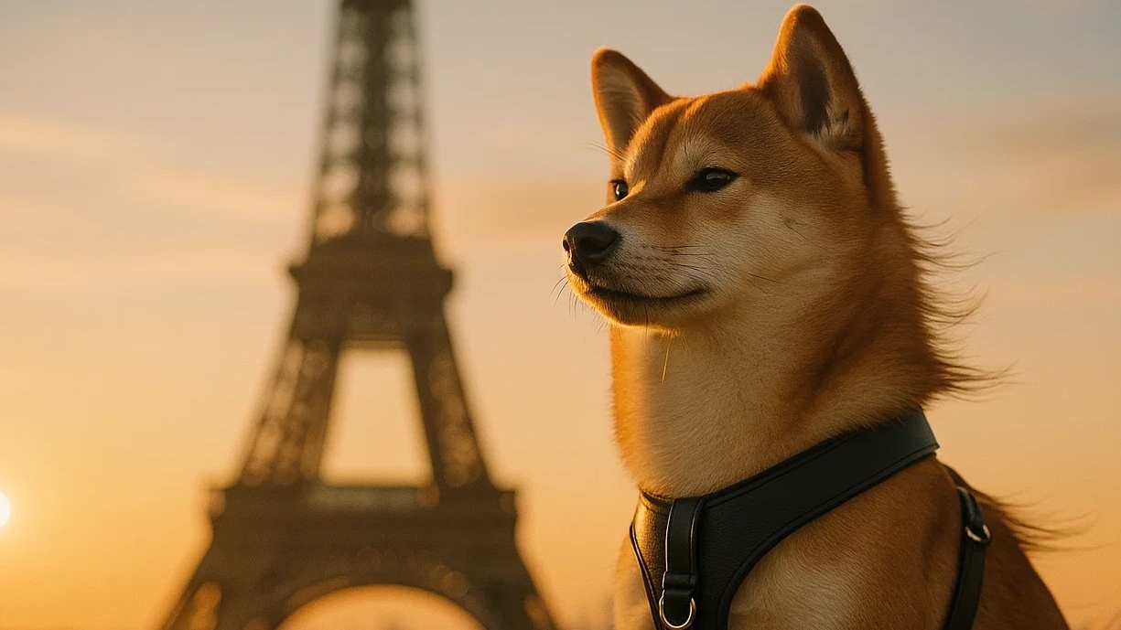
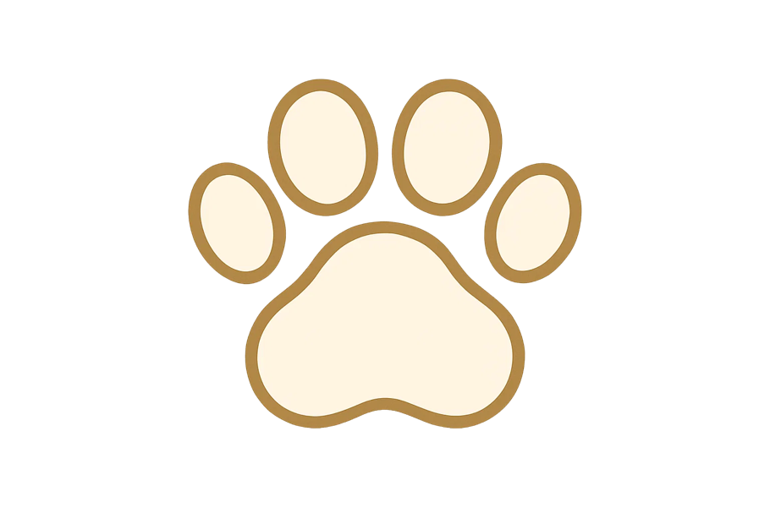
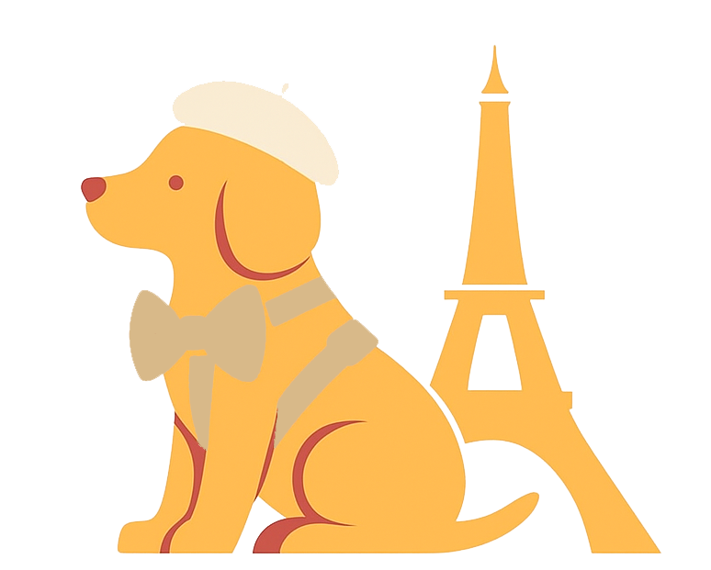
BRAND GUIDELINES
Maison Lepluplu
10/23/2025
Prepared by (name)

Slide 2

Maison Lepluplu
10/23/2025
02
Content
01
About the Brand
02
Brandmarks
03
Colors
04
Typography
05
Graphic Elements
Brand Essence & Story
Mission, Vision & Values
Tone of Voice & Personality
Primary Logo & Usage
Secondary Marks & Variations
Clear Space & Minimum Size
Incorrect Applications
Core Palette
Extended Palette & Use Cases
Primary Typeface
Secondary Typeface
Hierarchy & Scale
Usage in Layouts
Accessibility Considerations
Iconography & Illustrations
Patterns & Textures
Photography & Composition

Slide 3
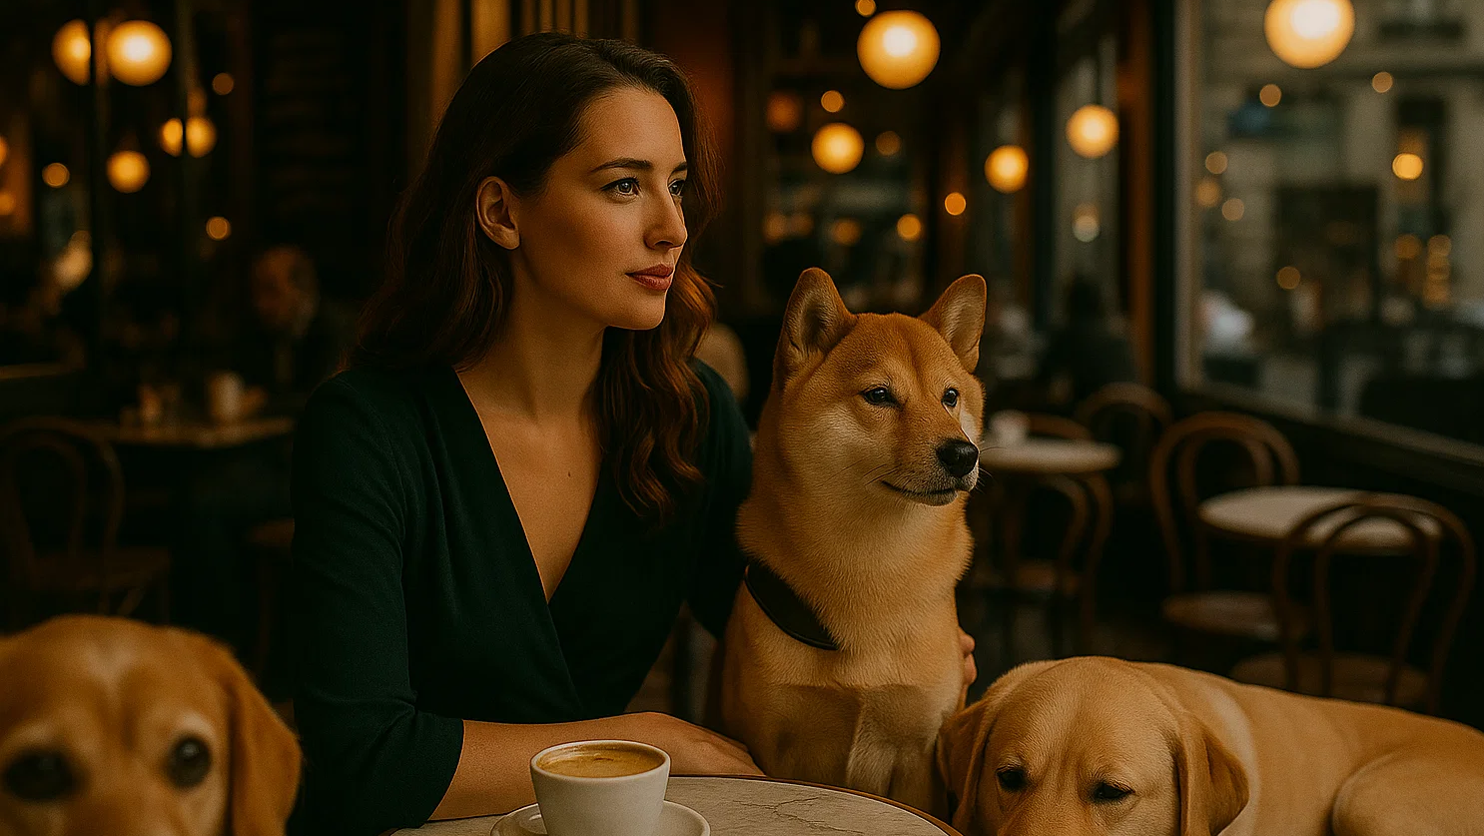
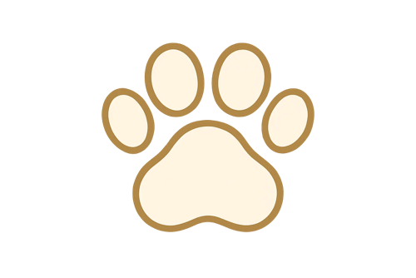
Maison Lepluplu
10/23/2025
03
01
About the Brand
1. Brand Essence & Story
2. Mission, Vision & Values
3. Tone of Voice & Personality

Slide 4
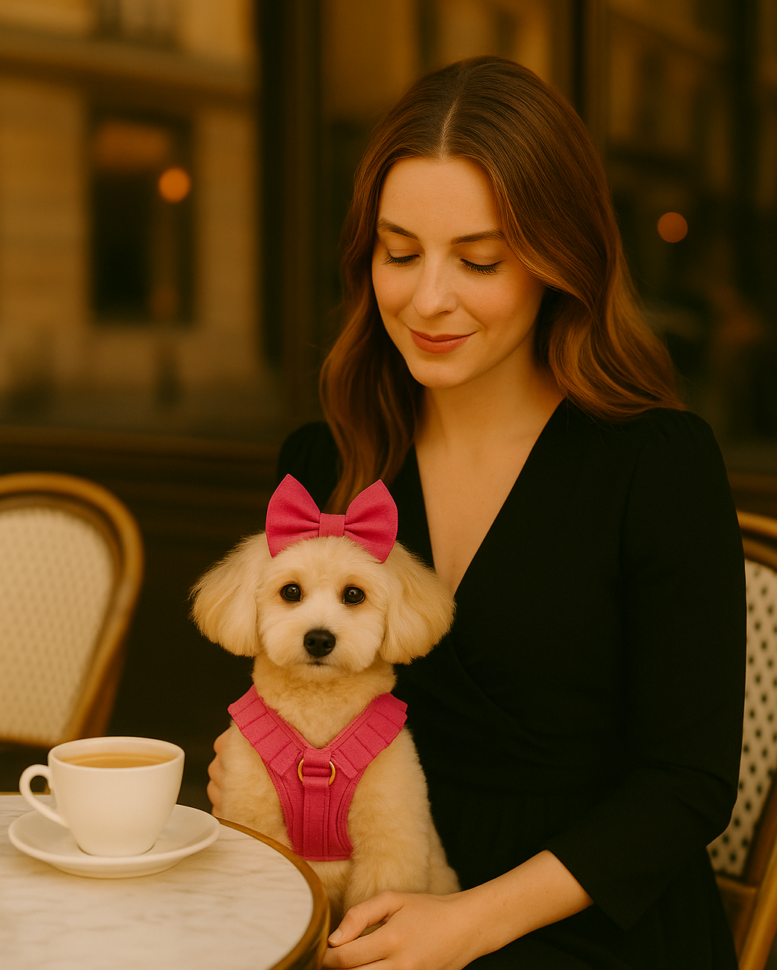


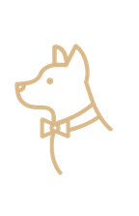

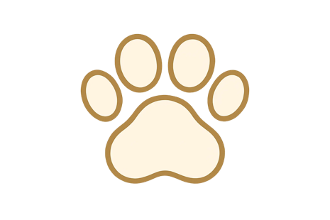
Maison Lepluplu
10/23/2025
04
About the Brand
You really want to be telling the story of the brand here—what makes it meaningful, human, and different. Focus on the values, emotions, and impact behind it, not just the products or services. This is where you set the tone, connect with your audience, and make them care.
You really want to be telling the story of the brand here—what makes it meaningful, human, and different. Focus on the values, emotions, and impact behind it, not just the products or services.
WHIMSICAL
SOPHISTICATION
CHIC &
PARISIAN
PET HAUTE
COUTURE
STROLL
IN STYLE

Slide 5
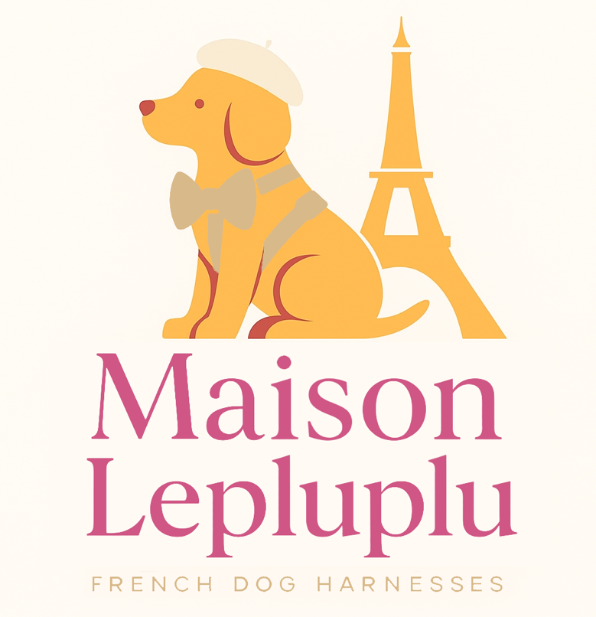
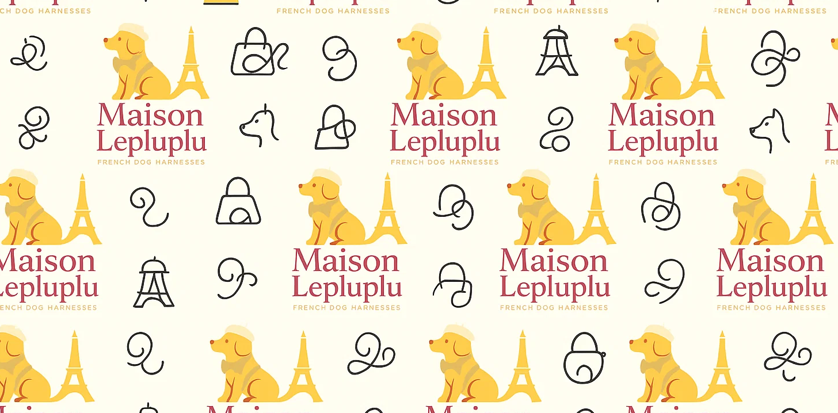
Maison Lepluplu
10/23/2025
05
Primary Logo
A logo is the visual cornerstone of a brand’s identity. It serves as the most immediate and recognizable representation of who we are, what we stand for, and how we want to be remembered. More than just a mark, a logo functions as a symbol of trust, personality, and purpose.
A well-designed logo communicates our story in a single glance — combining meaning, emotion, and distinctiveness.
PATTERN NOTES
A bold, star-inspired mark symbolizing creativity and connection.
A modern, geometric design that balances energy with simplicity.
A vibrant emblem representing innovation, unity, and forward momentum.

Slide 6
Maison Lepluplu
10/23/2025
06
Secondary Logo
A secondary logo is a simplified version of the primary mark, designed for flexible use across smaller spaces or alternate formats while maintaining brand recognition.
LOGO NOTES
A bold, star-inspired mark symbolizing creativity and connection.
A modern, geometric design that balances energy with simplicity.
A vibrant emblem representing innovation, unity, and forward momentum.

Slide 7
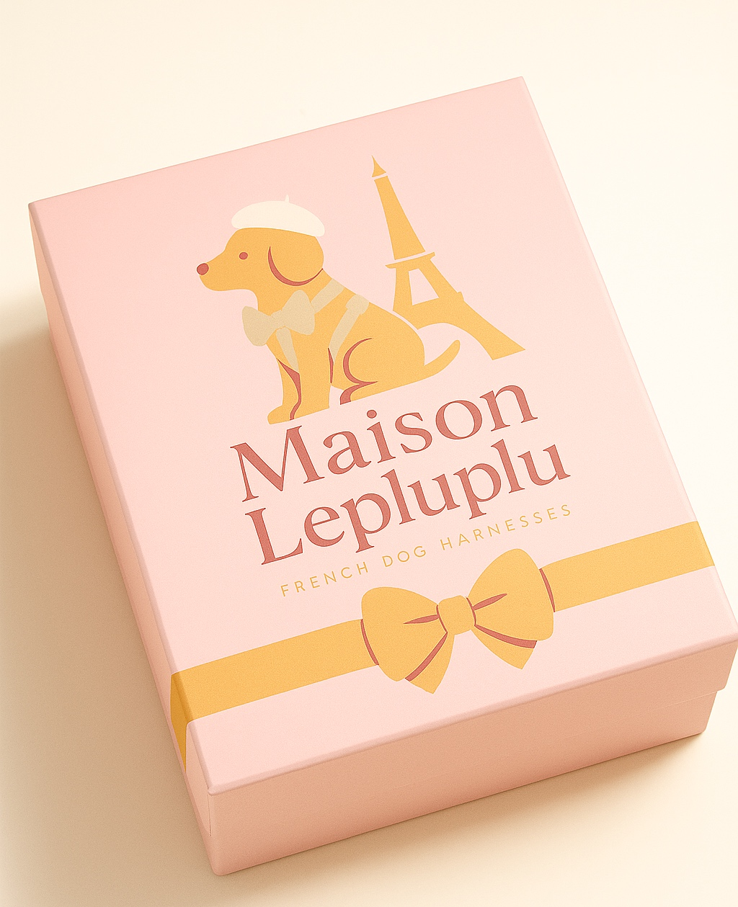
Maison Lepluplu
10/23/2025
07
Brand Marks
The Maison Lepluplu brand marks are designed to express the spirit of French sophistication and the joyful affection between a dog and its owner. Each mark — from the primary logo to its simplified and icon variations — captures a balance of couture refinement and playful warmth.
These brand marks are intended to work harmoniously across every touchpoint — from packaging and labels to digital and print — ensuring that Maison Lepluplu always feels cohesive, elevated, and unmistakably French.

Slide 8
Maison Lepluplu
10/23/2025
08
Colors
At its heart lies Fuchsia Élégance, a bold and feminine tone that symbolizes joy, style, and affection. Balanced by Crème de Paris, a gentle neutral inspired by creamy Parisian light, the palette radiates calm and understated refinement. Accents of Or Poudré, a soft powdered gold, bring a subtle sense of luxury, echoing the craftsmanship and detail found in haute couture.
Together, these colors create a visual language that feels luxurious yet inviting — celebrating beauty in the everyday moments shared between pets and their owners. Supporting tones like Gris Velours and Rosé Café add depth and versatility, allowing the brand to remain timeless while adapting to modern storytelling.
Or Poudre
#E9A150
Fuchsia
Elegance
#CF5685
Crème de
Paris
#E88D8A
Green
Velours
#194241
Blanc
#FFFFFF
Noir
#000000

Slide 9
Maison Lepluplu
10/23/2025
09
Typography
SUBHEAD LATO BOLD 18 PT CAPS
This is the standard body copy treatment. Lato Regular 18 pt in white or dark text for optimal contrast.
Use Lato Bold to highlight key phrases that improve emphasis and flow within the content.
The subhead and body copy should remain consistent in size and line spacing to preserve balance and readability.
This is the secondary body copy, slightly smaller for supporting or more detailed information. Lato 13 pt.
This is the smallest body copy, reserved for tertiary content such as footnotes, disclaimers, or annotations. Lato 11pt.
Use the following guidelines to map out the typographic hierarchy in print and digital media.
Avenir 48 pt
H1
Avenir 40 pt
H2
H3
Avenir 24 pt

Slide 10

Maison Lepluplu
10/23/2025
10
Graphic Elements
The Maison Lepluplu graphic elements are designed to enrich the brand’s visual storytelling with a touch of Parisian elegance and playful charm. Inspired by the refined world of French couture and the emotional connection between pets and their owners, each element embodies a balance of sophistication and warmth.
From the iconic Eiffel Tower and delicate rose, to the whimsical paw print and bow, these symbols express the brand’s personality—feminine, chic, and joyfully refined. The coffee cup and heart lock add a lifestyle dimension, evoking Parisian mornings and the intimacy of companionship, while the scalloped frame and flowing lines bring movement and couture-inspired detail.

Slide 11

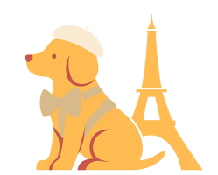
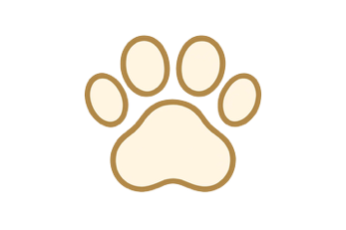

Company Name
Date
Page Number
Style guide
BRAND COLORS
Or Poudre
#E9A150
Fuchsia
Elegance
#CF5685
Crème de
Paris
#E88D8A
The Style Guide defines how the brand expresses itself visually and verbally across all touchpoints. It ensures consistency, clarity, and recognizability — allowing every piece of communication to feel cohesive, intentional, and unmistakably “us.”
Green
Velours
#194241
Blanc
#FFFFFF
Noir
#000000
FONT USE
For font treatment and typographic hierarchy, refer to the Typography section for detailed specifications on sizes, weights, and usage examples.
USE OF ICONS
BRANDMARKS
Avenir 48 pt
H1
Avenir 40 pt
H2
H3
Avenir 24 pt
Brand Logo

Slide 12
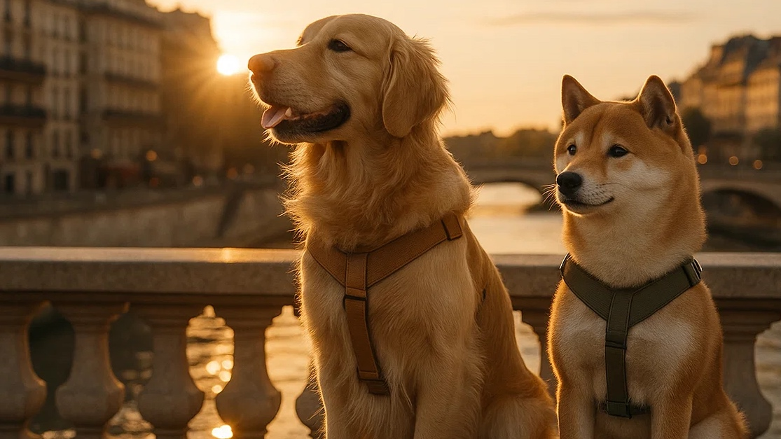

REFERENCE
For Design Questions
Credits
Contact Amelia Thermopolis
at amelia@petdesign.org
Download brand assets at
Add the link
Branding by The Pet Design CO
New York
www.petsdesign.org

