Slide 1
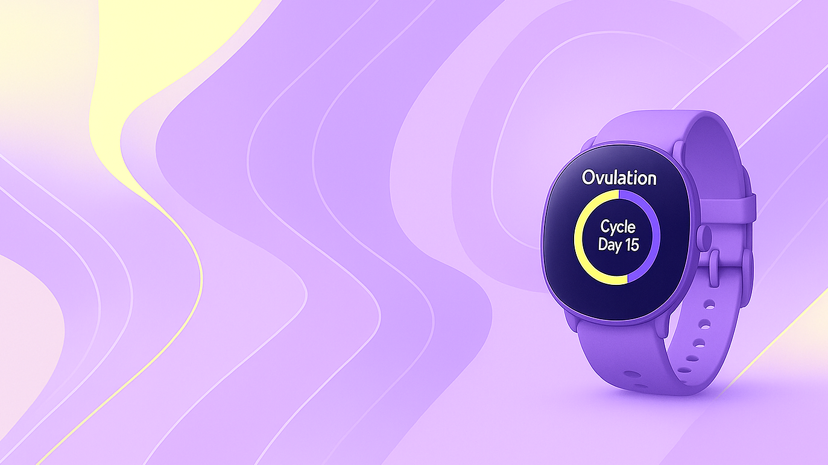

February 2026
Project
Kick off
ECLAT

Slide 2

01 /
Executive Summary
02 /
Product philosophy
What
we will
cover
03 /
Project Objectives
04/
Success Metrics
05/
Project Timeline
06 /
Roles & Responsibilities
07 /
Risk & Mitigation
08 /
Next Steps

Slide 3

01/ Executive Summary
165 MM
Making the Difference in Femtech
Global
Leadership
& Ecosystem
Building
120 MM
Diversification &
Strategic
Partnerships
85 MM
Steady growth driven by innovation, design excellence, and global expansion.
From launch to leadership, the vision evolves into a holistic FemTech ecosystem.
By 2029, it stands as a benchmark for elegant, data-driven wellness.
Brand
Recognition &
Market Growth
55 MM
30 MM
Expansion &
Product
Refinement
Launch &
Market Entry
2025
2026
2027
2028
2029
build awareness,
early adopters, premium positioning
tech upgrades, customer loyalty, expansion begins.
strong sales,
brand recognition, retail presence.
new editions,
new partnerships, international expansion
global footprint,
lifestyle ecosystem, sustained growth.

Slide 4
→ Smart innovation, data precision
02/ Product Philosophy
Our Brand
Experience
At their convergence lies the experience we strive to deliver: a perfect balance between science, aesthetics, and empathy— where innovation not only performs but feels personal, intuitive, and empowering.
Technology
Design
Wellness
Aesthetic, user experience ←
→ Health, empowerment, comfort

Slide 5




Innovate in FemTech Design
03/ Project objectives
Understanding
the Project Scope
Strong adoption from early users and influencers validating product-market fit.
Empower Women’s Wellness
Keep these as clear, high-level goals that tie to innovation, user experience, and market potential.
Provide accessible, intelligent tools that support holistic wellbeing through data insights.
Bridge Tech & Lifestyle
Position FemTech not only as functional, but as part of modern luxury living.
Establish Market Presence
Build brand credibility in the premium health and wellness segment.

Slide 6
04/ Success Metrics
Measuring Impact
& Growth
This section outlines how success will be measured across product performance, market growth, and brand impact. It reflects our commitment to innovation, design excellence — ensuring progress is tracked not only in numbers, but in the value created for users and the broader FemTech ecosystem.
40%
Product Success
Device performance, user engagement, reliability
35%
Market Growth
Sales, revenue increase, market expansion
25%
Brand Impact
Awareness, partnerships, customer satisfaction

Slide 7
2025
2026
2027
Q2
Q1
Q3
Q2
Q1
Q3
Q2
Q4
Q1
Q3
Q4
Q4
Concept & Research
Design & Prototyping
Development & Testing
Launch Preparation
Full Launch & Growth
05/ Project timeline
From Concept to Launch and Beyond
Concept & Research
Launch Preparation
Define product vision, research FemTech trends, analyze user needs and lifestyle aesthetics.
Finalize packaging, marketing assets, and influencer collaborations.
Design & Prototyping
Full Launch & Growth
Develop first wearable prototypes; refine UI/UX and physical design.
Scale production, global rollout, expand digital app ecosystem.
Each phase combines technology, design, and empathy — shaping innovation that supports women’s wellness with purpose and beauty.
Development & Testing
Integrate hardware, sensors, and AI algorithms for cycle tracking.

Slide 8
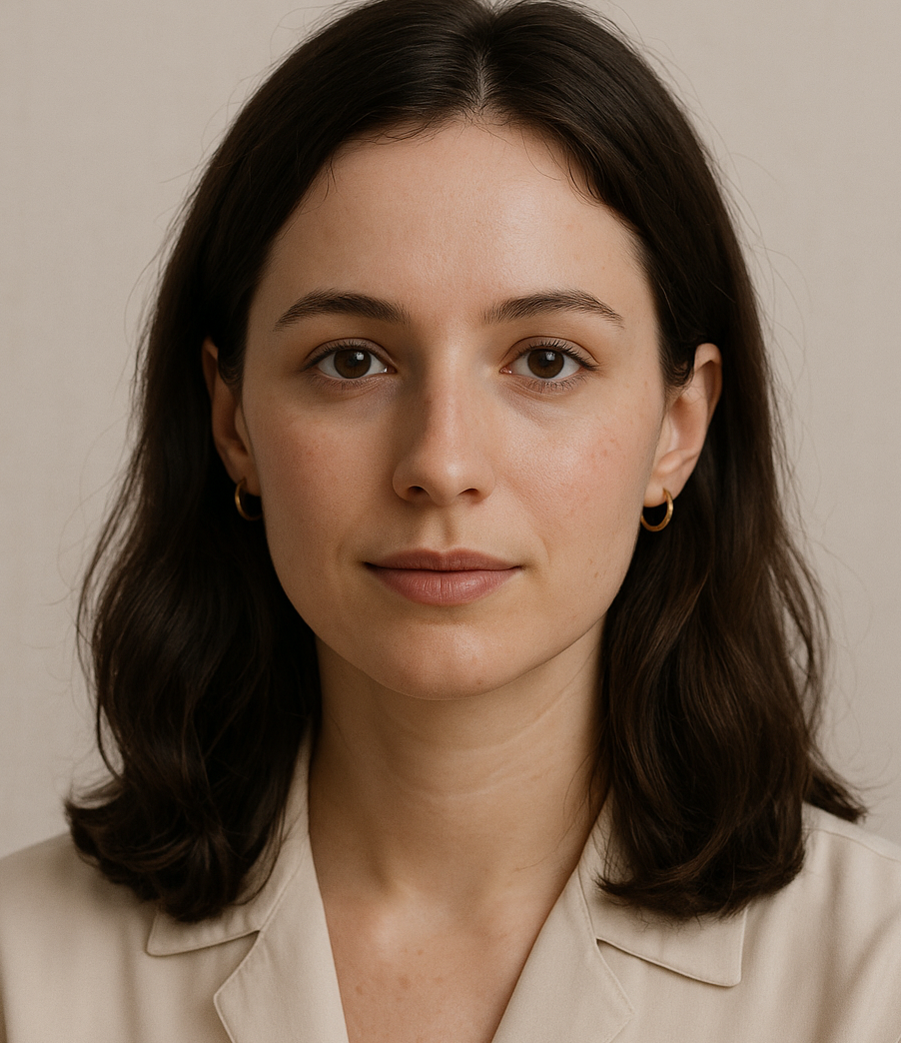

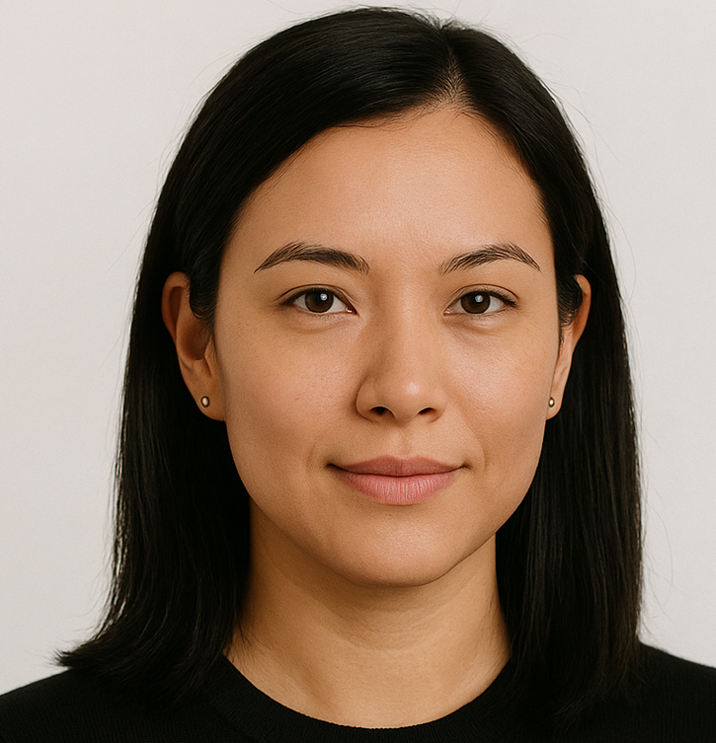
06/ Roles & Responsibilities
Meet the Team!
Clara Moreau
Maya Johnson
Olivia Kim
Head of Design & Experience
Marketing Director
Head of Community Engagement
Olivia Kim

Slide 9
07/ Risks & Mitigation
Staying Ahead for Long-Term Success
Each phase combines technology, design, and empathy — shaping innovation that supports women’s wellness with purpose and beauty.
Potential Risk
Mitigation Strategy
Product Development
Hardware or sensor performance issues during testing
Early prototyping cycles and collaboration with specialized hardware partners.
Market Adoption
Lower initial adoption due to novelty of FemTech wearables
Focused education campaigns and influencer partnerships to build awareness
Data Privacy & Security
Sensitive health data exposure risks
Implement GDPR-compliant protocols and encrypted storage systems.
Supply Chain
Delays in materials or ethical sourcing verification
Build partnerships with certified suppliers and maintain dual sourcing
Financial Stability
Slow revenue growth in early stages
Balanced funding strategy combining venture investment and strategic partnerships.

Slide 10
2
Brand
Identity Rollout
4
Marketing &
Launch Plan
08/Next Steps
From Vision to Execution
Complete visual identity, packaging, and digital assets aligned with the brand philosophy.
Prepare awareness campaign and pre-launch initiatives targeting early adopters.
Moving from concept to impact — every step brings us closer to redefining wellness through design and technology
1
Product
Development
3
Strategic
Partnerships
5
Funding &
Expansion
Finalize prototype testing and refine wearable features for comfort and accuracy.
Engage potential collaborators in health tech, luxury lifestyle, and wellness communities.
Secure next-stage investment to support production scale and app ecosystem growth.

Slide 11
Style Guide - Typography
Headline in Reddit Sans Extra Bold
Colors
#171A4D
#F0EEEA
#283287
Subhead in Reddit Sans Bold
#D4DFE8
#D6B4FB
Paragraph font is in Quicksand, Chosen for its clarity and warmth, Quicksand 12 gives our text an approachable yet confident tone. It balances readability with character, creating harmony between the visual design and the message. This choice supports consistency across materials while keeping communication light, modern, and human.
#FFFFAF
Treatment
Icons
Company Logo

Slide 12
Thank
You!
ECLAT

