Slide 1
Investing made easier
Using:
Website scraping(Scrapy), Python (Pandas, Matplotlib, Seaborn, Plotly) and natural language processing (AWS Comprehend and Translate)
By Olga Yangol

Slide 2

Daily Challenge
23 Countries
Geopolitics, domestic politics, macroeconomics
200Articles
12 Languages

Slide 3







Automate work flow
Raw data: headlines, articles, source
Clean data
Filter, detect trends → apply domain knowledge
Sentiment, key words, translation

Slide 4
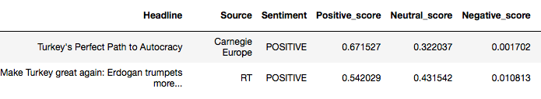
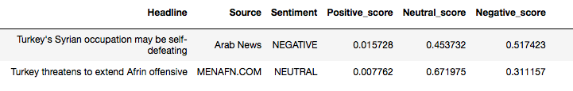
Filter extremes

Slide 5
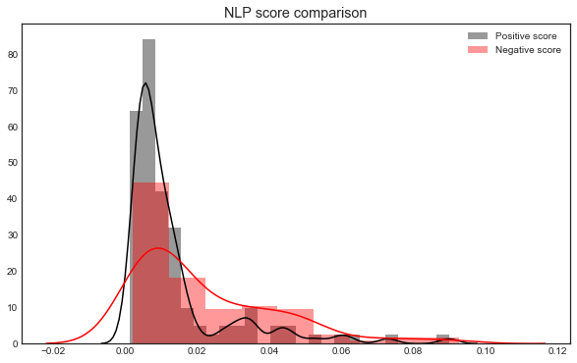
Detect sentiment
Plotly dashboard: Interactive plot

Slide 6
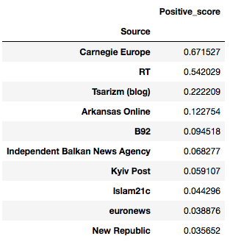
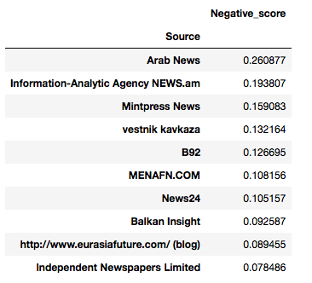
Detect source bias

Slide 7
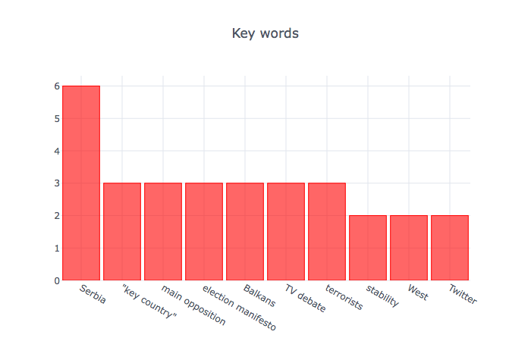
Flag further reading
Plotly dashboard: Interactive plot

