Slide 1
Agenda
Business Problem & Approach
Data Exploration & Preprocessing
Model fitting
Model Evaluation
Forecasting Results
Conclusion
Notes:
We'll talk about the business problem & our approach, data exploration, model fitting and evaluation, results and then the conclusion.

Slide 2
Business Problem & Approach
Our project involves analyzing San Francisco International Airport (SFO) passenger traffic volume dataset by applying appropriate time series forecasting techniques.
We aim to generate traffic predictions at SFO and achieve forecasting accuracy and gain insights into the underlying patterns and dynamics of passenger traffic
Our predictions aim to improve the SFO experience by increasing operational efficiency, optimizing resource utilization, and supporting future growth and development planning
These predictions will contribute to optimizing passenger traffic management at San Francisco International Airport.
Notes:
San Francisco Airport is globally recognized as one of the busiest airports.
Our predictions aim to improve the SFO experience by estimating future traffic. This will aid the airport management and airline companies and other stakeholders in their decision-making process by planning for the future accurately.

Slide 3
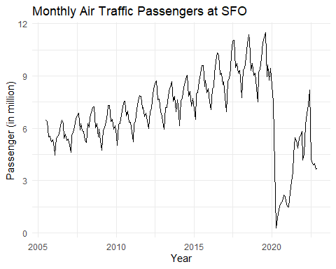
Data Exploration
The dataset captures statistical information regarding passenger traffic at SFO from July 2005 to December 2022.
We focused on examining the monthly air traffic passenger trends, and seasonality.
The data exhibits a seasonal nature.
Notes:
Properties of the dataset - The dataset captures the monthly passenger traffic at SFO.
The dataset exhibits significant monthly seasonality and trend.
We analyzed monthly air traffic passenger volume at SFO. We can see a upward trend from 2010 to start of 2020; then we see a sharp decrease in the passenger count reflecting the impact of the COVID-19 pandemic.

Slide 4
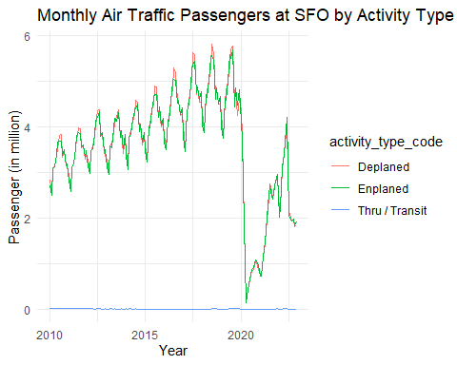
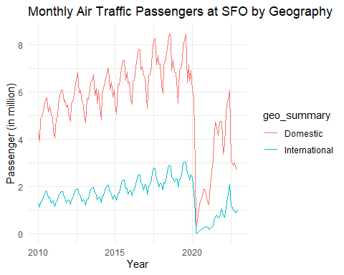
Data Exploration
77.3% of the total passenger traffic at SFO is attributed to domestic flights, while the remaining 22.7% corresponds to international flights.
United Airlines, SkyWest Airlines, & American Airlines were top 3 by passengers.
Notes:
We explored the distribution of passengers based on activity type and geography.
We see that 77% of the total flights are domestic and 23% are international.
United airline is one of the top airlines by passenger count and contributed 30% of the total passenger count.

Slide 5
Data Preprocessing
Converted data to time series tsibble object which displayed the data by month and total passenger count for that month.
Box-cox transformation
The Box-Cox transformation has applied to stabilize the variance of a time series, resulting in a lambda value of 1.69.
Decomposition using STL
STL decomposition plot reveals trends, seasonality, and residuals in forecasting.
Performed stationary test
Stationarity tests are important before fitting time series models to determine the stationarity of the data and apply transformations to achieve stationarity.
The Dickey-Fuller test yields an insignificant p-value, suggesting that the series is not yet stationary.
Notes:
We transformed the data into a time series object and converted it into a tsibble format to display the year and total passenger count for each month.
We applied the Box-Cox transformation to the "total" column of the tsibble to stabilize its variance, obtaining a calculated lambda value of 1.69 using the "Guerrero" method. However upon analyzing further we came to know that transformation is not necessarily helping us hence we used non transformed data while applying the model.
By identifying whether the data is stationary, we can apply appropriate transformations, such as differencing, to achieve stationarity. Stationary data ensures that the statistical properties of the time series remain consistent over time, enabling accurate model fitting and reliable forecasting.

Slide 6


Model Fitting
We split 10% of data into test and 90% will be on training set
Compared and fitted the performance of 15 different models, including ETS, ARIMA, and SARIMA. These models were trained using historical data, and we used them to generate forecasts for the next three years.
Simple exponential smoothing (ETS(A,A,N)) and damped multiplicative(ETS(A, Ad, M) models are the best-performing models based on RMSE, with low RMSE values.
As per Akaike Information Criterion corrected assess, Arima012011, Arima210011, and Arima011011 offer better trade-off.
Model fitting and evaluation of accuracy measures and information criteria are essential for selecting the most appropriate top 5 model for time series forecasting.
Notes:
The best-performing models on the test set were selected, with RMSE values of 1.712 and 1.776 for simple exponential smoothing ETS(A, A, N)> and damped multiplicative ETS(A, Ad, M)>, respectively.
We evaluated the model's fit using the Akaike Information Criterion(AICc), and the models with the lowest AICc values were Arima012011, Arima210011, and Arima011011.

Slide 7
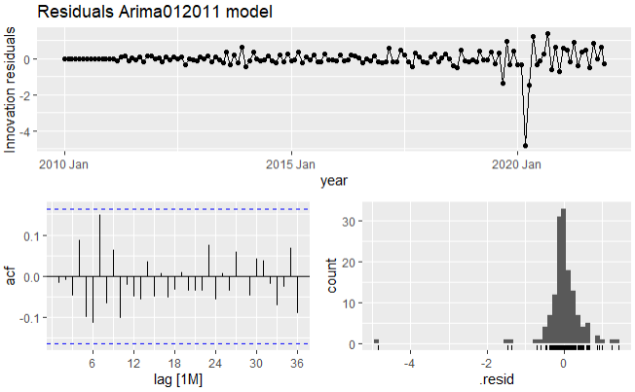

Model Evaluation
Residual Analysis: time series residuals plot shows innovation residuals within blue dotted lines, normal distribution, and stationarity.
The Ljung-Box test indicates moderate evidence of autocorrection in the Arima012011 model and White noise series accurately captures underlying data.
The Inverse Root Test: Assessing the stability of the Arima012011 model indicates that all the roots lie within the unit circle.
The Arima012011 model is stable and well-behaved, indicating its reliability and suitability for forecasting.
Notes:
The time series residuals plot showed that there are no substantial autocorrelations in the residuals, since they fall between the blue dotted lines in the ACF plot. The residuals are normally distributed. Furthermore, our innovation residuals plot showed stationarity, indicating that the model is adequate.
These analyses provide confidence in the model's accuracy, stationarity of residuals, independence of residuals, and stability, reinforcing its suitability for forecasting in the SFO air passenger traffic dataset.

Slide 8
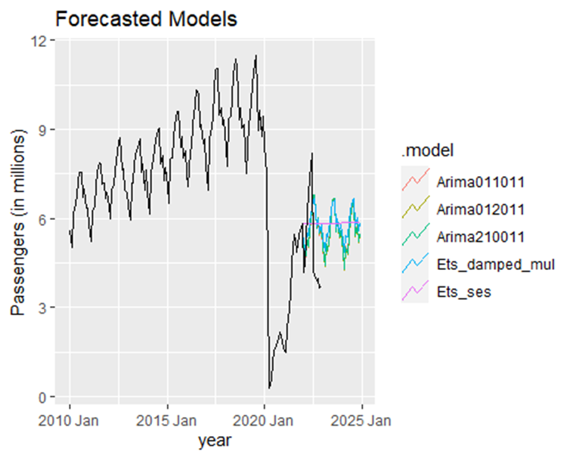
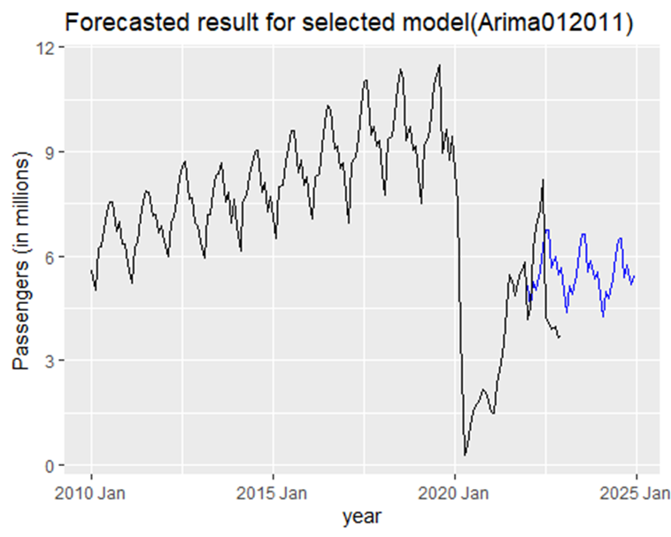
Forecasting Results
The Arima012011 model was used to forecast SFO air passenger traffic for the period from January 2023 to December 2025.
The forecast indicated fluctuations between 5 million and 7 million passengers, but the accuracy of the model can vary depending on assumptions and the circumstances within the airline and aviation industry.
Notes:
For forecasting the SFO air passenger traffic, we selected the Arima012011 model, which takes into account the non-seasonal dependencies, differencing for stationarity, and a seasonal pattern every 12-time points (monthly).
The model forecasts an estimated passenger count between 5-7 Million from Jan 2023 to Dec 2025.

Slide 9
Conclusion
Arima012011 model forecasts suggest a range of 5 million to 7 million accumulated passenger traffic from January 2023 to December 2025.
These forecasts offer valuable insights for resource allocation and operational management in the aviation industry.
External factors introduce uncertainty, and it is crucial to account for this in decision-making processes.
Regularly updating data and refining the models with new information can enhance the accuracy of the forecasts.
Notes:
There are few limitations :
Forecasted numbers should be taken as estimations, subject to potential fluctuations impacted by a variety of circumstances.
Forecast accuracy can be influenced by underlying assumptions as well as the dynamic nature of the airline and tourism industries.
Despite uncertainty, predicted values provide useful insights for planning and decision-making.

