Slide 1
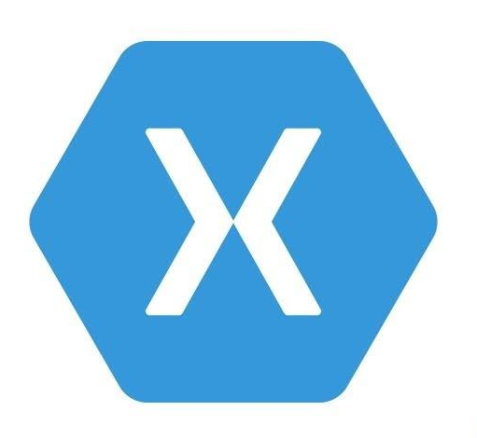


Cross-Platform App Development with Xamarin and Visual Studio App Center
Final Presentation: Peiren Yang

Slide 2
Project Target
Build an infrastructure for app development which supports:
Cross-platform app, one set of code generates at least 3 different applications for Android, iOS and Windows respectively.
Source control, which allows version control and teamwork
Automatic compilation and building
Automatic testing
Release and Deployment management in relation to different app stores (Google Play, Apple App Store etc.)

Slide 3
Project Target – Infrastructure Automation
Also known as Continuous Integration (CI), which reduces repetitive manual processes and enables:
Automatic compilation and building
Automatic testing
Continuous Delivery
Automatic feedback to the developer
CI also reduces risks in developing process:
Defects are earlier detected with the help of automatic testing, then feedback to the developer and thus fixed more efficiently
Notes:
Background information about the Continuous Integration, which is also called Infrastructure Automation
positive circle for the development

Slide 4
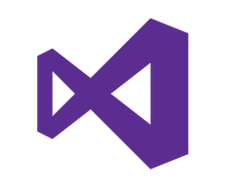
Solution Approach – Cross-Platform
Xamarin
The Xamarin meta-project generates automatically Android, iOS and Windows UWP target projects and linked the together with a primary project, compiling and debugging become easy.
C# is the programming language, XAML is the UI description language
Integrated in Visual Studio
Offers test framework “Xamarin.UITest” (based on NUnit)
Notes:
Xamarin.UITest facilitates the UI testing automation

Slide 5
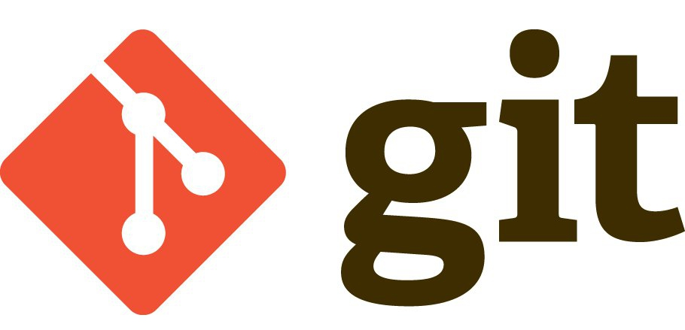
Solution Approach – Source Control
Git under the hosting of GitHub
Git is one of the most popular source control and version management tool
Operations integrated in Visual Studio
GitHub as remote hosting, so that no local Git server is needed
GitHub offers non-public repository for privacy protection ($9 each)

Slide 6
Solution Approach – Continuous Integration
Automatic Build with Visual Studio App Center
Three different platform build separately
Build can be triggered by each push to the GitHub repository
Build process can be controlled and configured with scripts
post clone script
pre-build script
post-build script

Slide 7
Solution Approach – Continuous Integration
Automatic Test with Visual Studio App Center
Test devices can be defined as device set and referenced many times
Monitoring hardware resource utilization, consumption of resources like RAM can be captured and added to statistical information
Test can be triggered with the build scripts after a successful build, so that the complete process works automatically

Slide 8
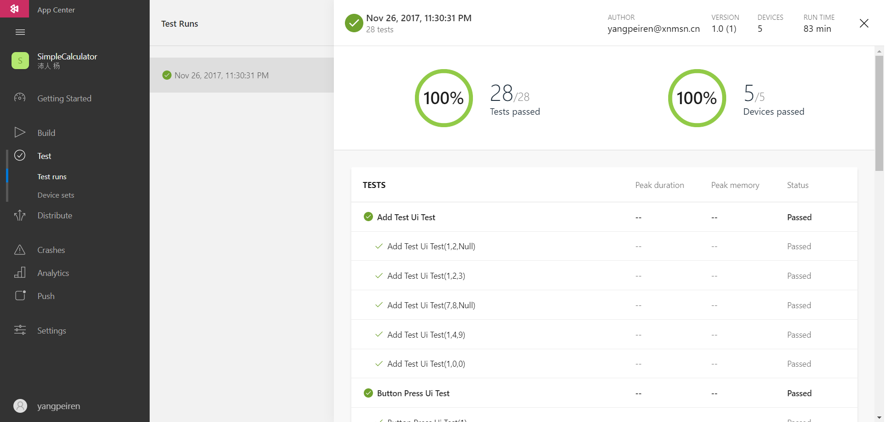
Solution Approach – Continuous Integration
Automatic Test with Visual Studio App Center
User-friendly statistical analysis

Slide 9
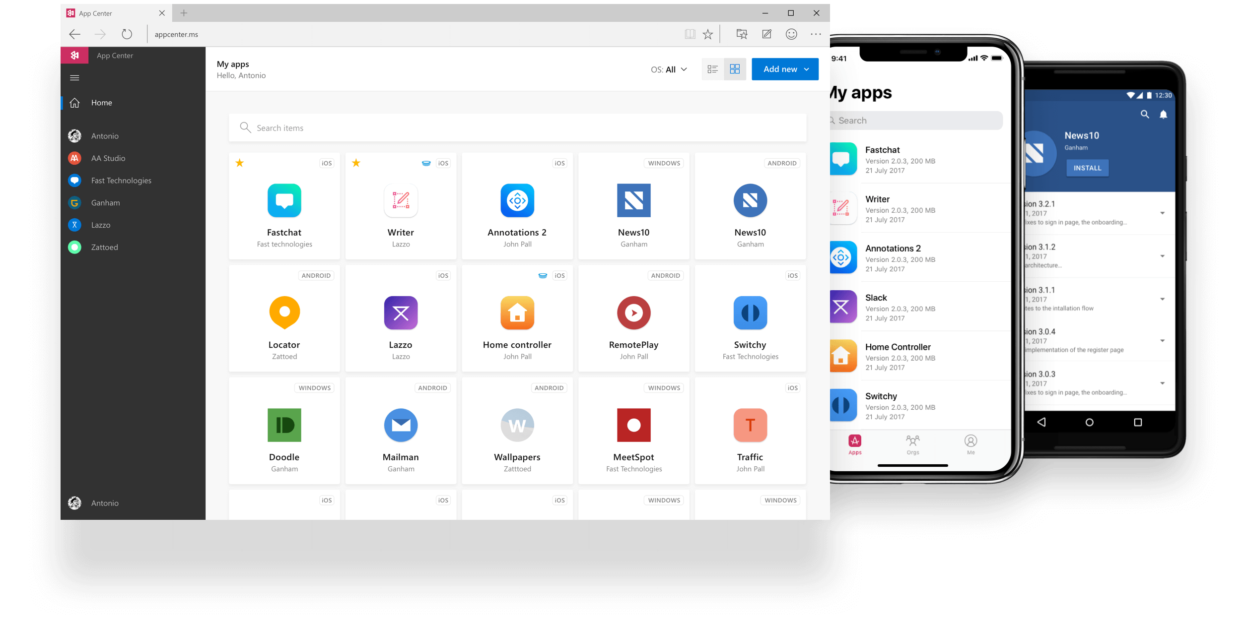
Solution Approach – Continuous Integration
Automatic Test with Visual Studio App Center
Device farm includes more than 2,000 devices with different OS versions

Slide 10
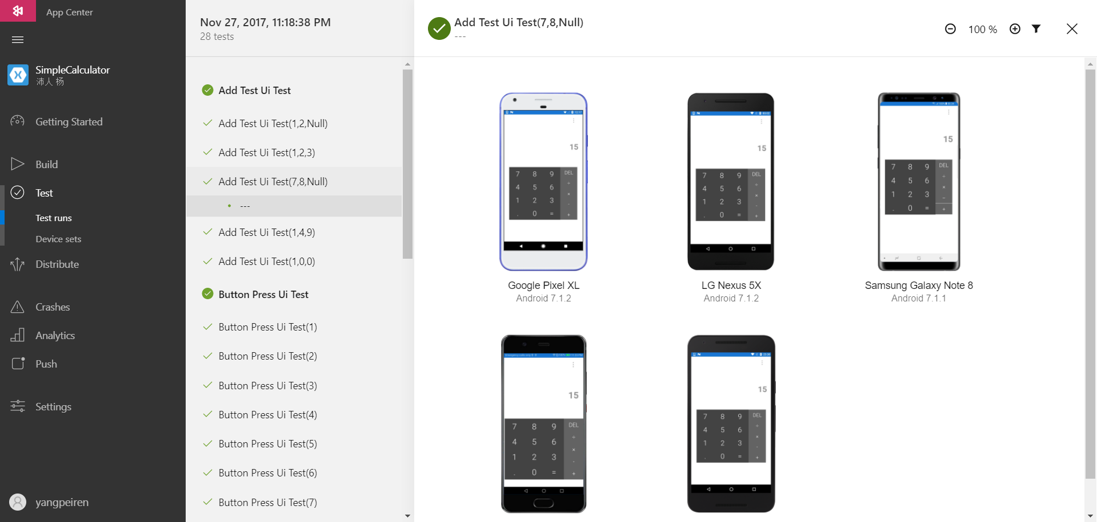
Solution Approach – Continuous Integration
Automatic Test with Visual Studio App Center
Automatic screen shots for each test device

Slide 11
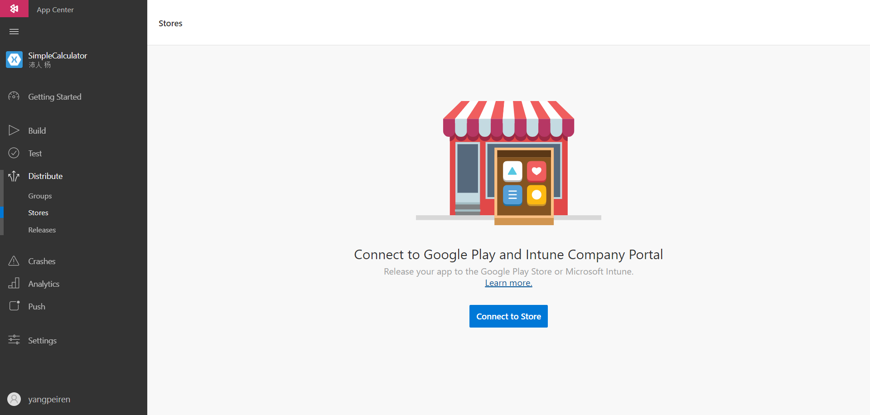
Solution Approach – Continuous Integration
Publish built apps with Visual Studio App Center
Stores can be connected to App Center, which makes the publish more efficient

Slide 12
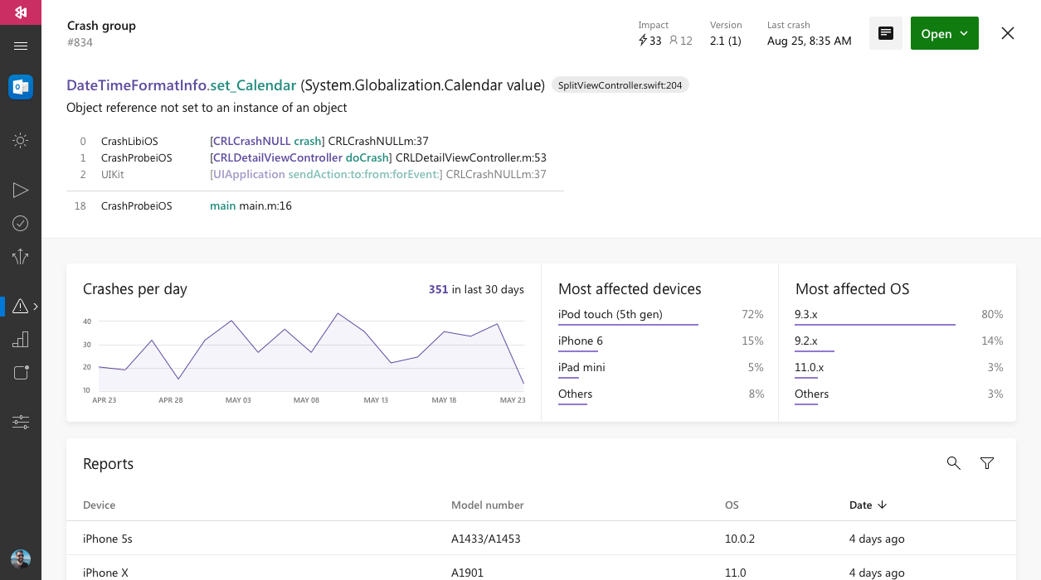
Solution Approach – Continuous Integration
App lifetime manage with Visual Studio App Center
By using the component Microsoft.AppCenter.Crashs, Each crash of the app can be captured and statistically displayed in the App Center

Slide 13
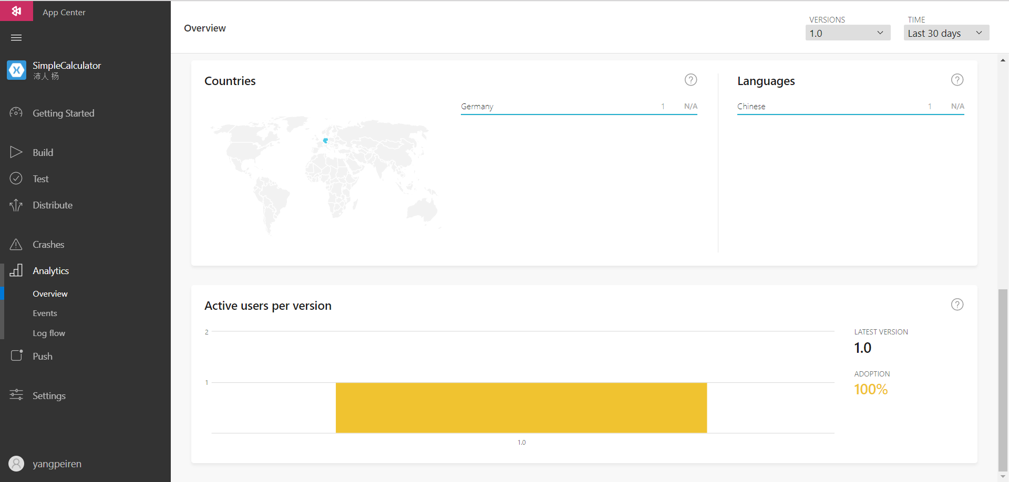
Solution Approach – Continuous Integration
App lifetime manage with Visual Studio App Center
By using the component Microsoft.AppCenter.Analytics, users who downloaded the published app are tracked by App Center, which is an important feature for the future improvement

Slide 14
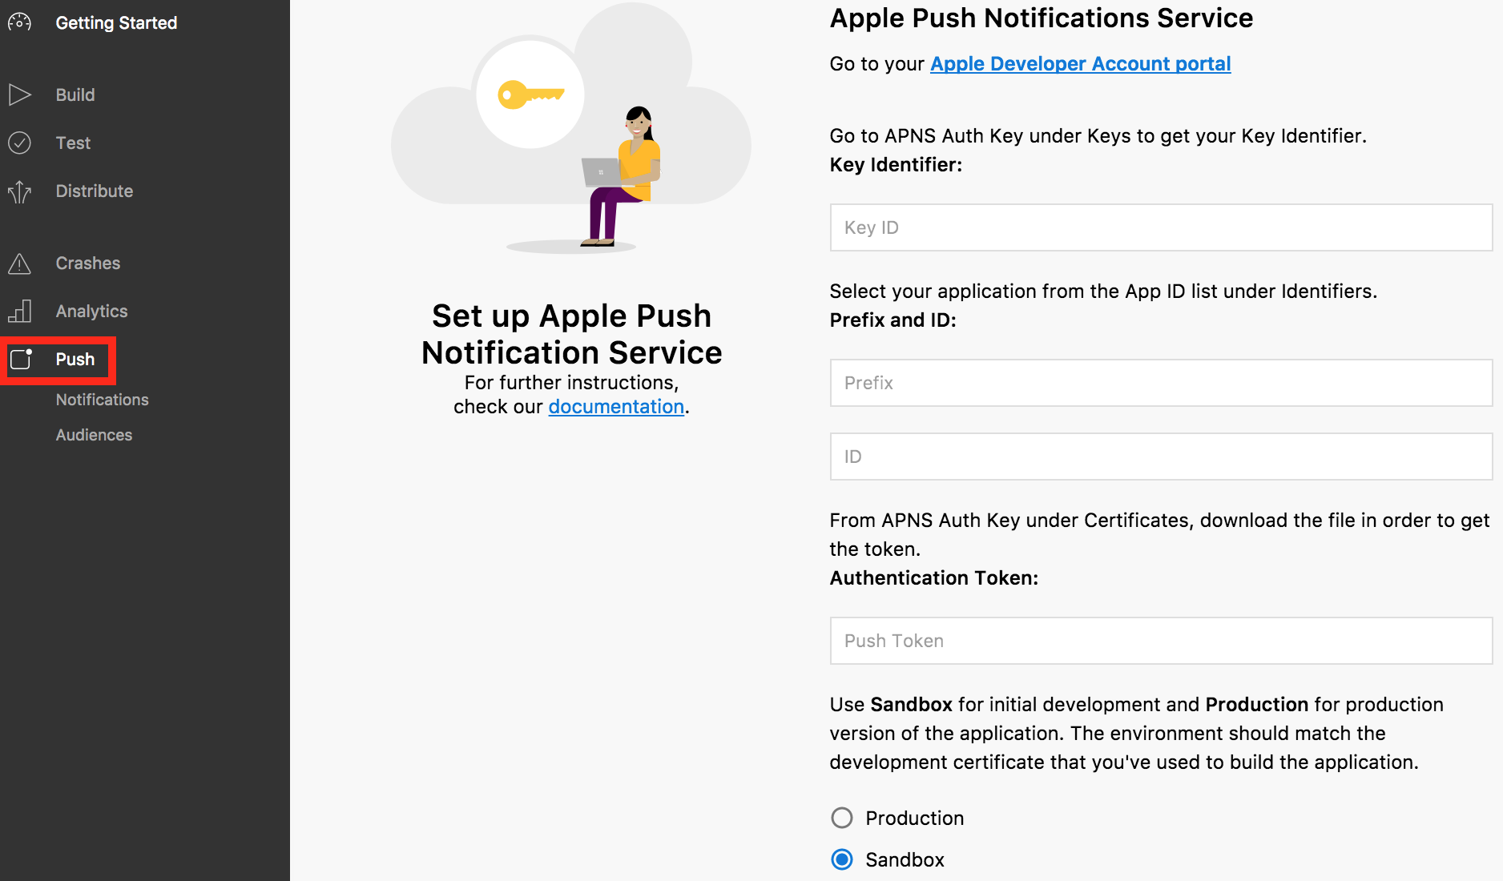
Solution Approach – Continuous Integration
App lifetime manage with Visual Studio App Center
By using the component Microsoft.AppCenter.Push, notifications can be pushed down to target groups in terms of their devices, their location, their app versions and other features

Slide 15
Conclusion
Xamarin is a powerful platform for cross-platform app development
C# is a user-friendly and intuitive OO language
The framework is integrated in Visual Studio
Offers test framework “Xamarin.UITest”
the solution is designed to use cloud resources as much as possible, GitHub is selected as Git server, so that no local Git server is needed

Slide 16
Conclusion
Visual Studio App Center is a powerful tool that particularly suitable for cross-platform app development with Xamarin
It offers project build in different platforms
It supports app tests with an enormous device farm
It offers interfaces for the management of app lifetime
The total price for using App Center as build and test platform is basically $139 per month, which includes:
$40 per month for unlimited build time (free for 400 hours)
$99 per month for unlimited tests

Slide 17
Conclusion
Disadvantage of using Visual Studio App Center
The job customization is not quite flexible, only three scripts can be configured and they must be executed consecutively
App Center is a new product of Microsoft, until now not all claimed features are available, some features are still on the way. And this have made a lot of difficulties in developing the solution.
Notes:
App center compete with Amazon AWS Device Farm

Slide 18
Alternative solution
Jenkins as an alternative solution
In most cases, Jenkins can be selected as substitution for each building or testing, or all functions above.
However, for testing a lot of physical devices with different OS version or different excessive emulators are needed, the device farm in App Center shows its advantage here.
A combination of the two solution is possible, in which Jenkins makes the automatic building and unit tests, then pass them to the App Center for UI testing.

Slide 19
Q & A

Slide 20
Thanks for your attention!

Slide 21
Appendix – Tools and Techniques used in the solution
Tools and Techniques used in the solution
Git and GitHub, Git Shell
C# and XAML, Xamarin, Visual Studio, Xamarin.UITest framework (based on NUnit)
Visual Studio App Center, App Center Command Line Interface with Node.js, Linux Shell for build scripts
Java JDK to generate keystore file for Android app
Markdown as document language

Slide 22
Appendix – Feature analysis of App Center
All three cloud platform features can be found in App Center:
IaaS (Infrastructure as a Service), device farms
PaaS (Platform as a Service), platform supported components such as Microsoft.AppCenter.Analytics, Microsoft.AppCenter.Crashs, Microsoft.AppCenter.Push. They can be integrated into the developed app.
SaaS (Software as a Service), the app management Web GUI.

