Slide 1

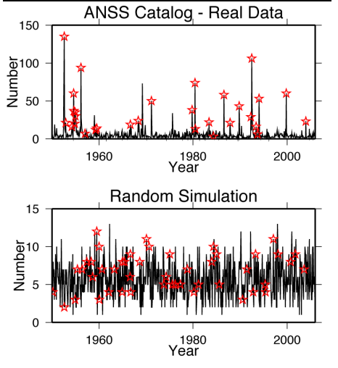
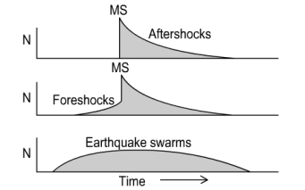
International Workshop on Statistical Seismology (StatSei)
Ultima edición 13th 2024
CORSSA: the Community Online Resource for Statistical Seismicity Analysis

