Slide 1
Introduction to geometrical multigrid and its application to Poisson equation
Xuejiao Fu
HIT

Slide 2
01
Background.
02
Multigrid method
CONTENTS
03
Examples
04
Conclusion

Slide 3
01
Background

Slide 4
Background
● Forward modelling methods
▪ Finite element method
▪ Finite volume method
▪ Finite difference method
● Methods of solving the linear equation
▪ Direct method : Gauss elimination method
▪ Iterative method : Jacobi iteration, Gauss-Seidel, conjugate method and
bicgstab …

Slide 5
This work
● Using finite difference method to discretize the 3-D Poisson equation
● Testing the convergence of multigrid method

Slide 6
02
Geometrical multigrid method

Slide 7

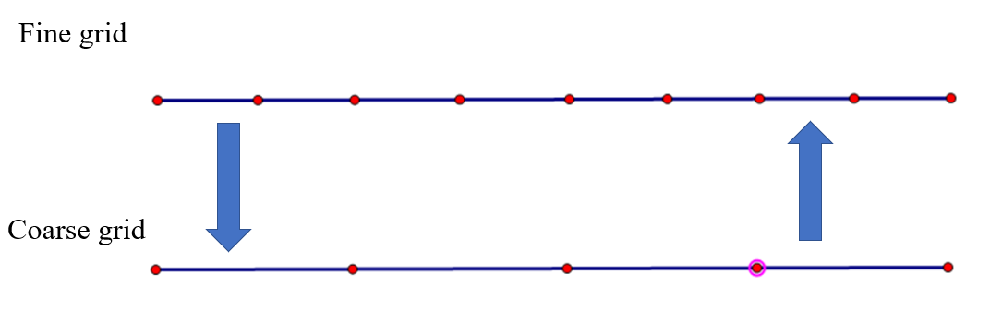
Key of geometrical multigrid method
iterative
correct

Slide 8
Key of geometrical multigrid method
The key elements of multigrid:
the residual
the smoother to find the oscillatory components,
the restriction operator to maps the residual from fine grid to coarse grid
the prolongation operator to transfer the residual on coarse to fine grid for correction.

Slide 9
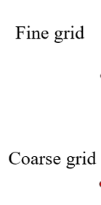
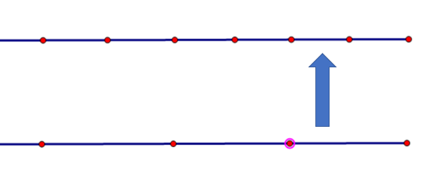
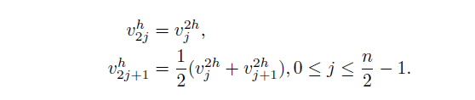
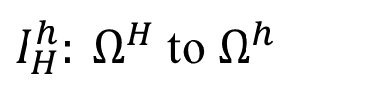
Prolongation operator
$I_{H}^{h}: Ω^{H}$ to $Ω^{h}$
For 1-D:

Slide 10
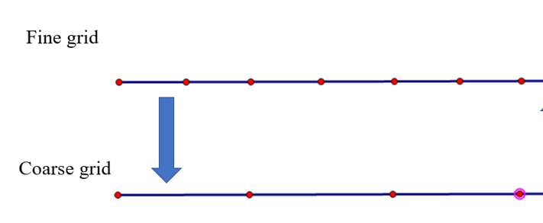


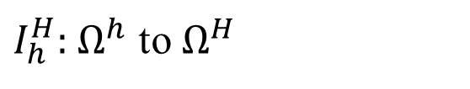
Restriction operator
$I_{h}^{H}:$ $Ω^{h}$ to $Ω^{H}$
Injection:
Full weighting

Slide 11
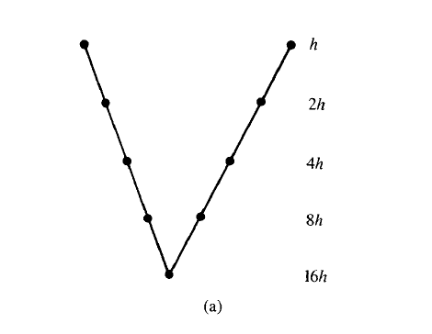
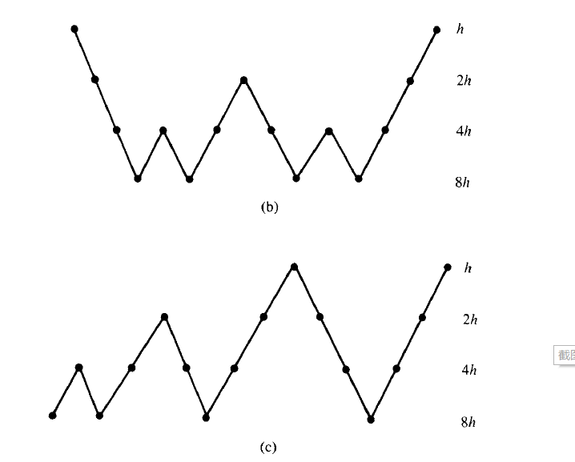
Cycle
V-cycle
W-cycle
F-cycle

Slide 12
03
Examples

Slide 13
1-D Poisson

Slide 14
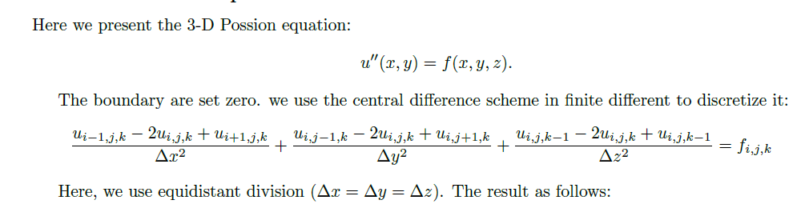
3-D Poisson

Slide 15
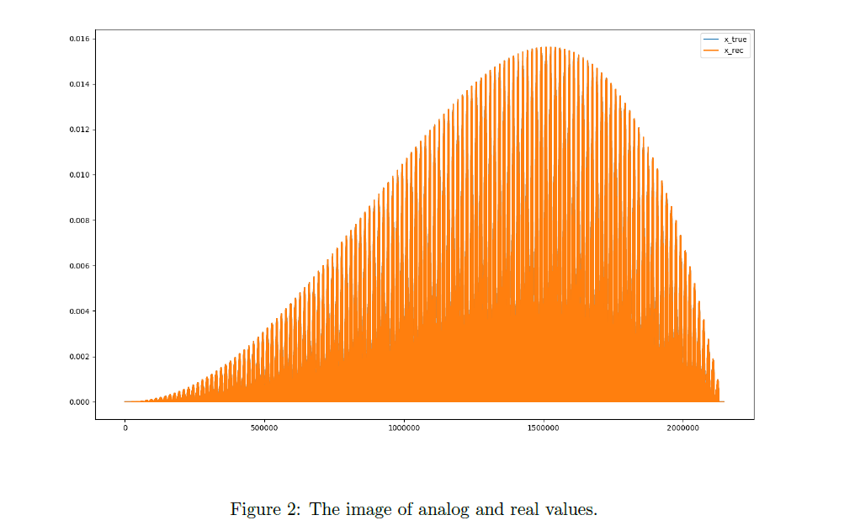
3-D Poisson equation

Slide 16
04
Conclusion

Slide 17
Conclusion
The convergence speed of F-cycle is faster than V-cycle.
2) The error of the algebraic equation decreases quickly as the number of iterations increases, indicating that GMG converges quickly to the true solution.

