Slide 1
Frequency-Stable Full Maxwell in
Electro-Quasistatic Gauge
J. Ostrowski and R. Hiptmair

Slide 2
01
Background.
02
Electromagnetic models
CONTENTS
03
Main idea
04
Weak formulations
05
Numerical Tests and Conclusion

Slide 3
01
Background

Slide 4
02
Electromagnetic Models

Slide 5
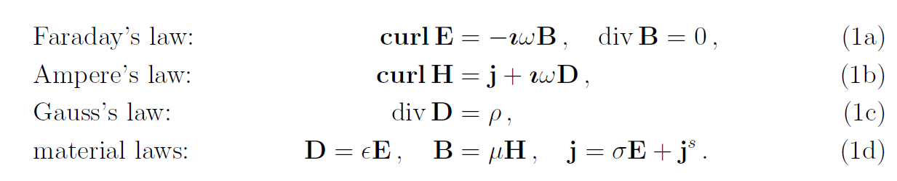
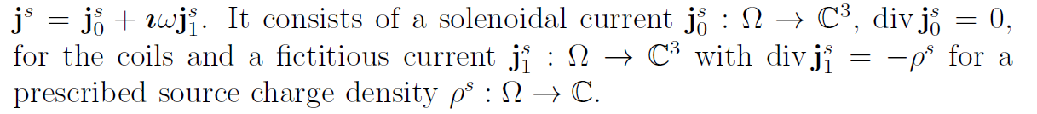

Slide 6
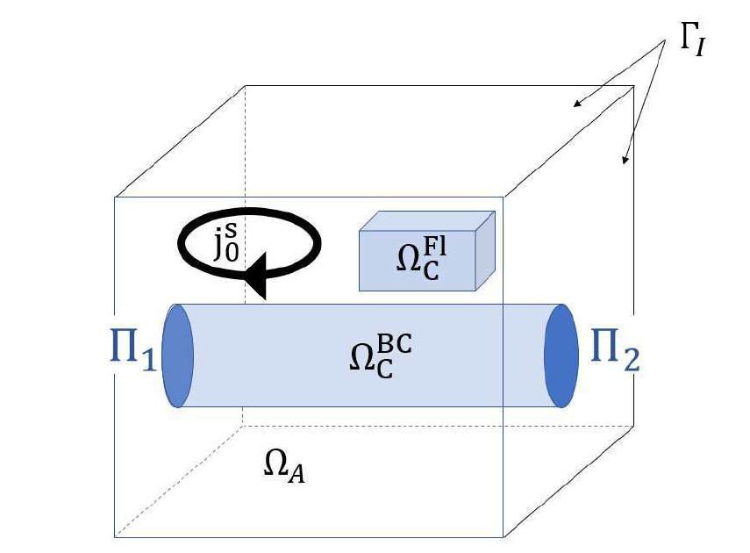

Slide 7
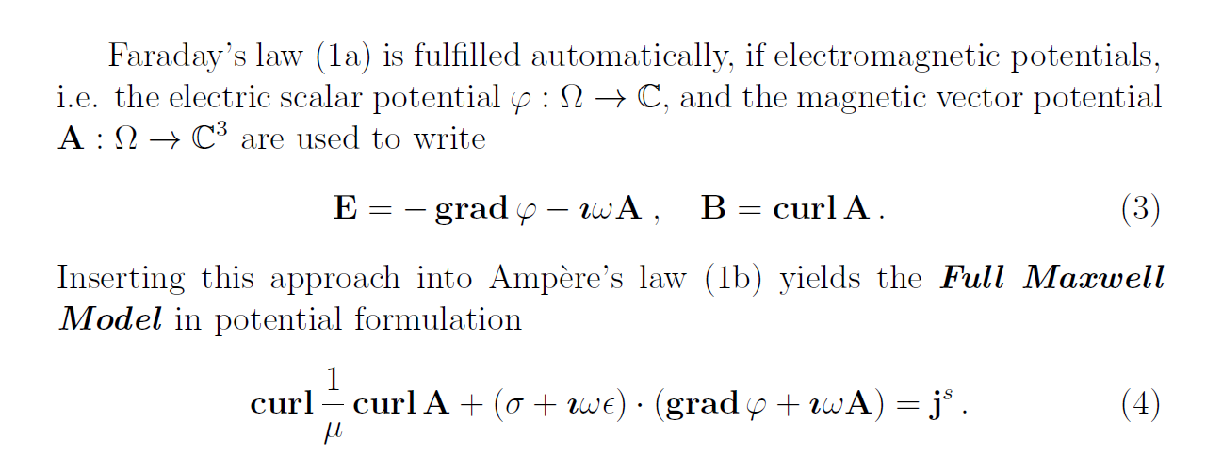

Slide 8
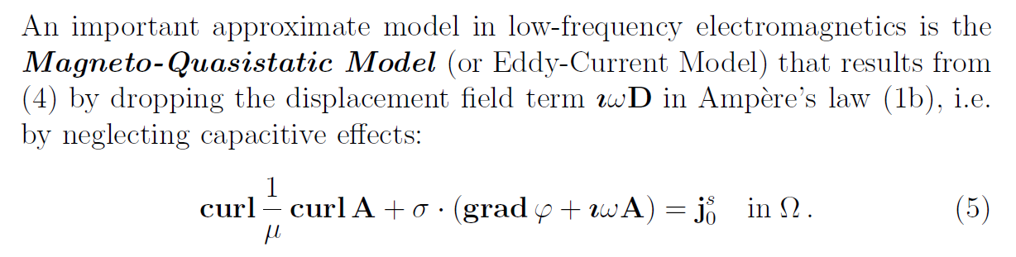
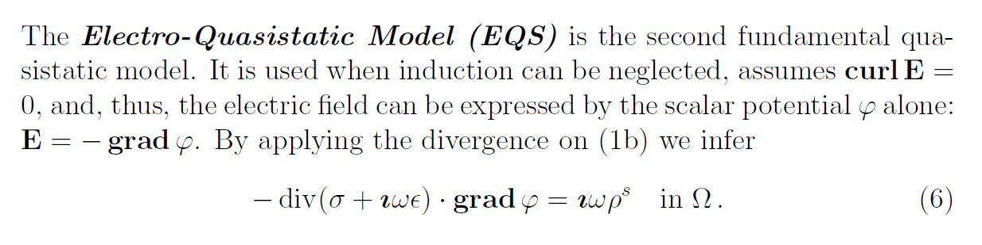
Quasistatic Models

Slide 9
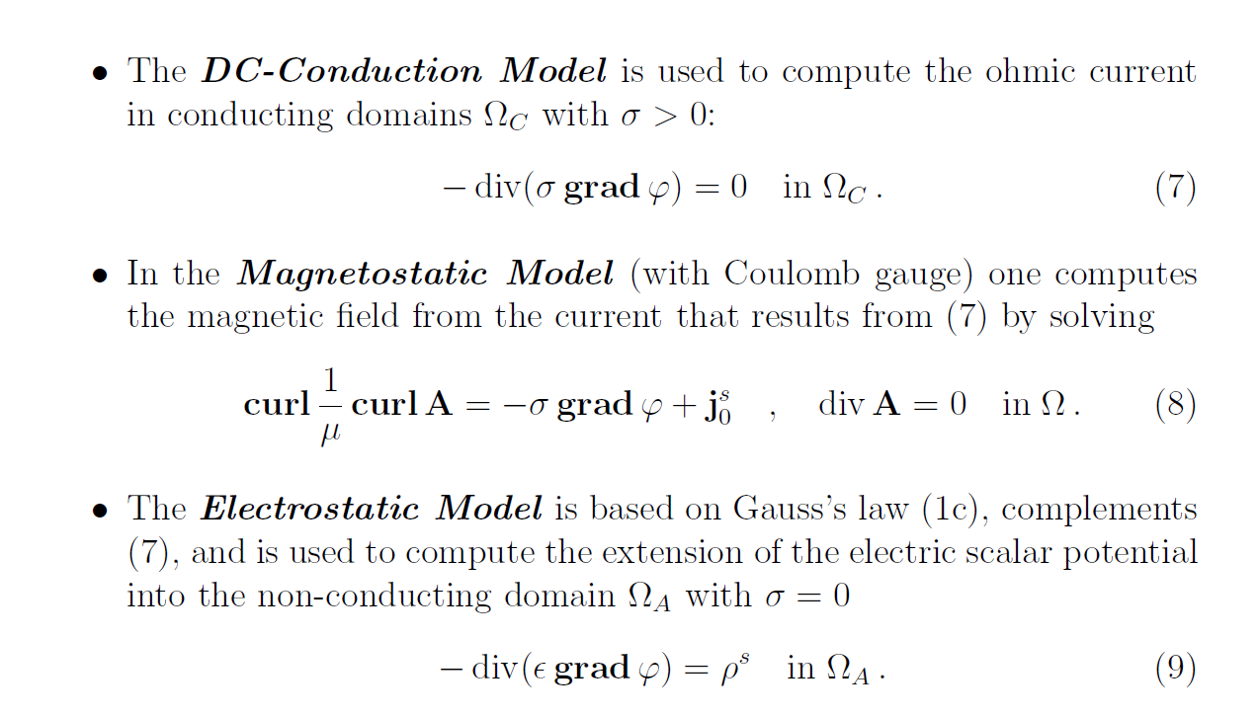
Static Models

Slide 10
03
Main Ideas

Slide 11
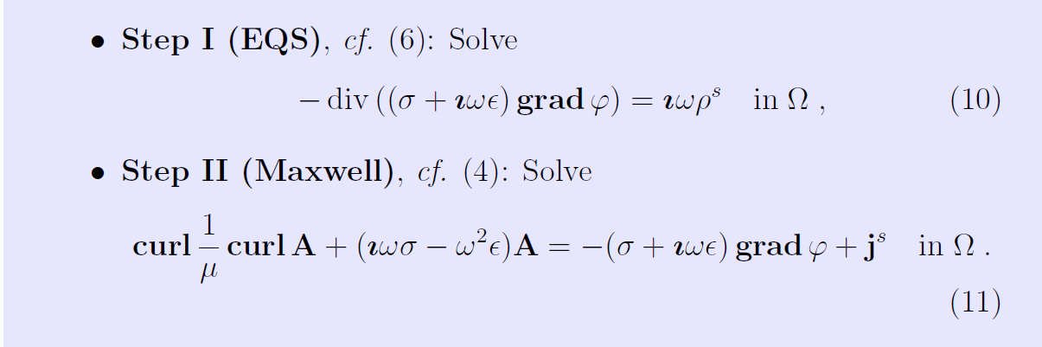
Electro-Quasistatic Gauge

Slide 12
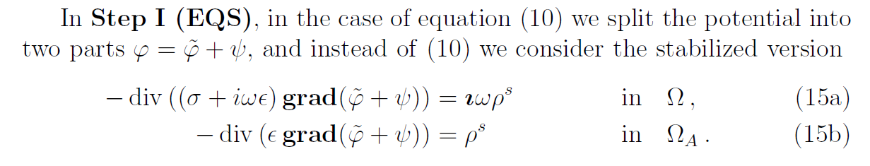
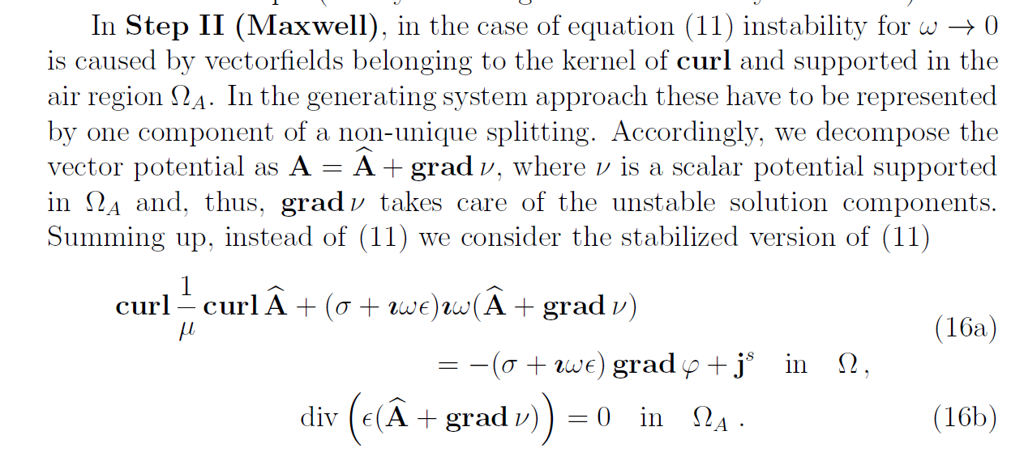
Generating System Approach For Stabilization

Slide 13
04
ECE Boundary Conditions

Slide 14
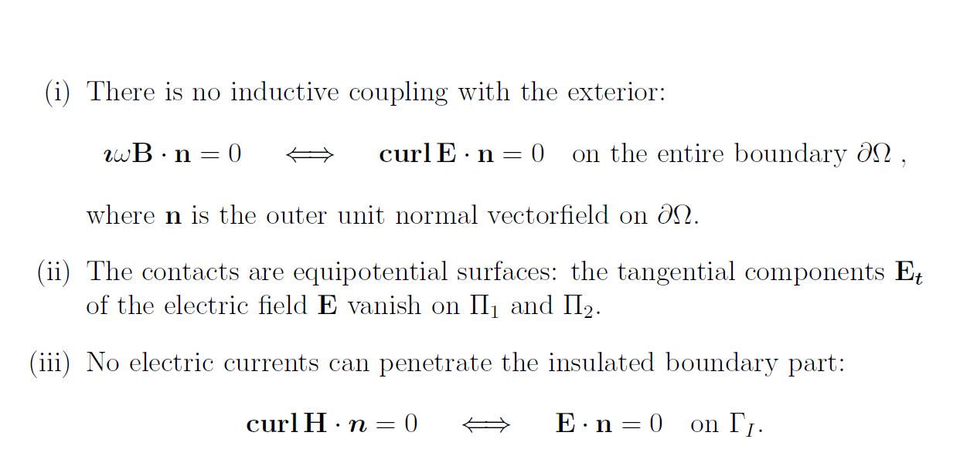
ECE Boundary Conditions

Slide 15
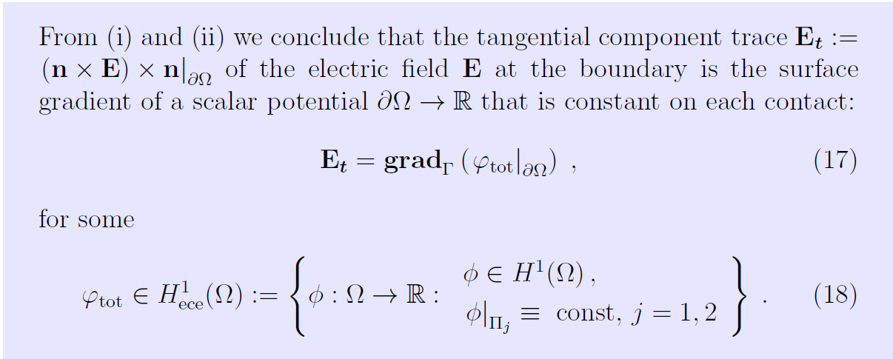

Slide 16
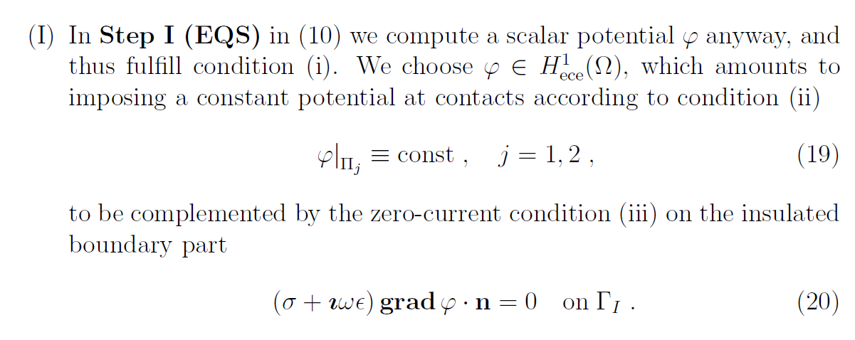
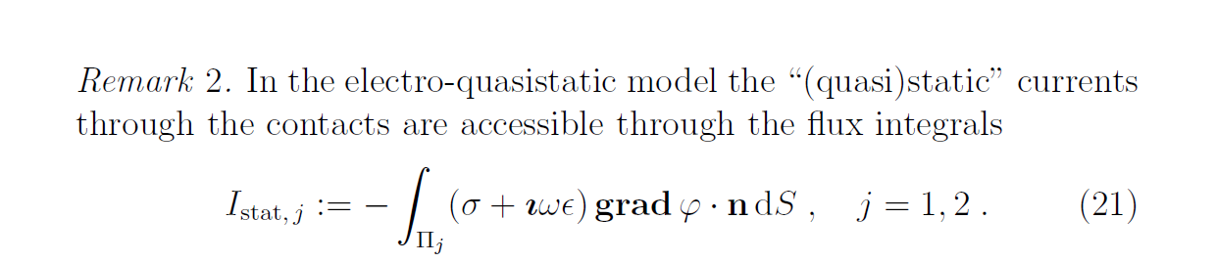

Slide 17
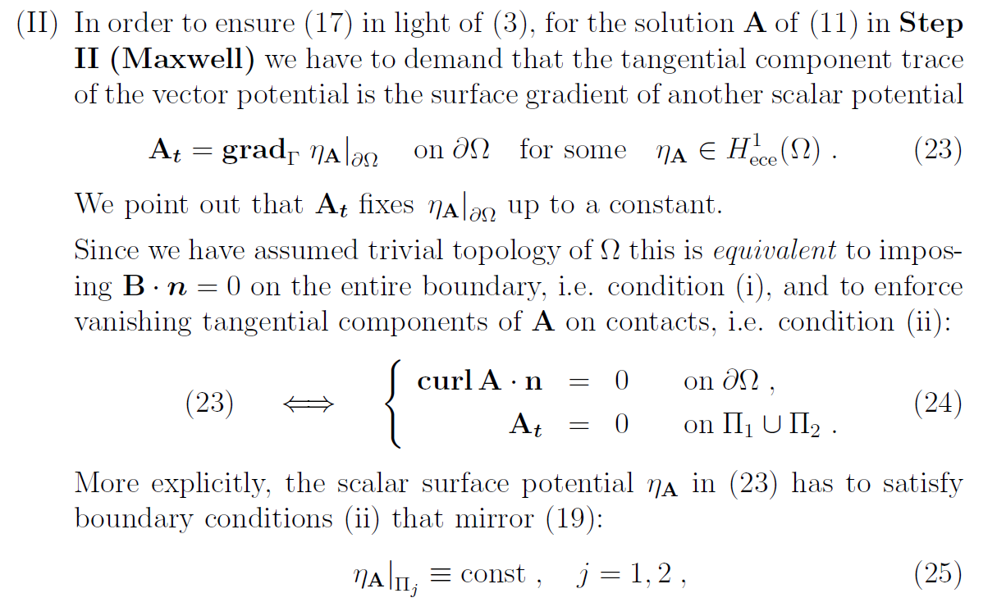

Slide 18
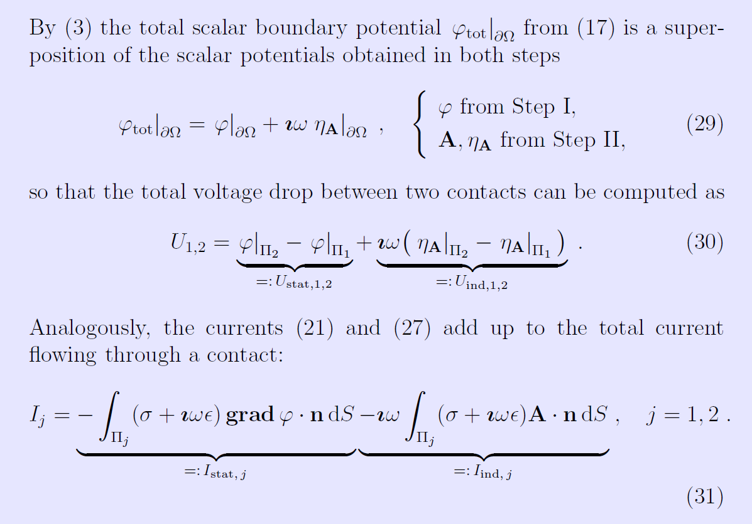

Slide 19
05
Variational(weak) Formulations

Slide 20
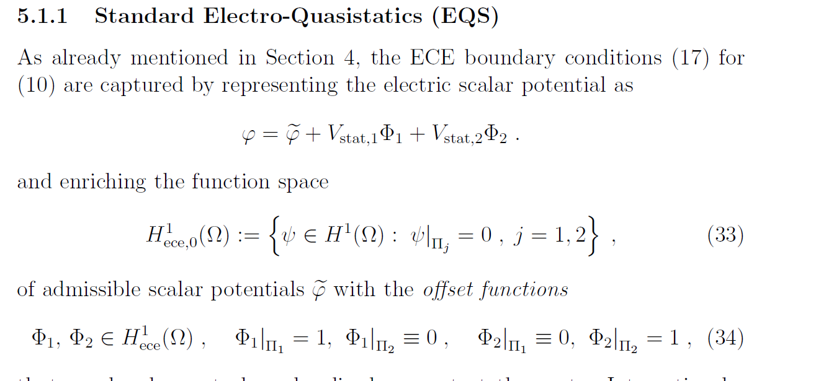
EQS: Weak formulations

Slide 21
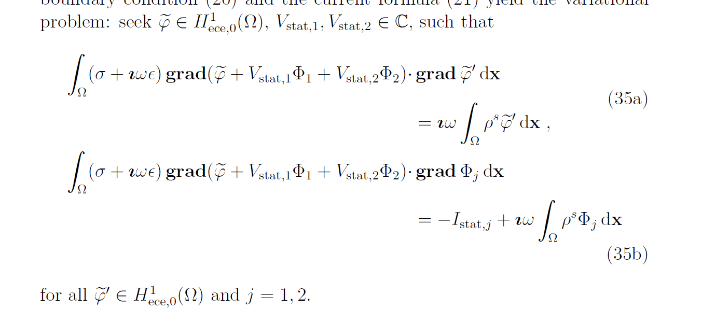
EQS: Weak formulations

Slide 22
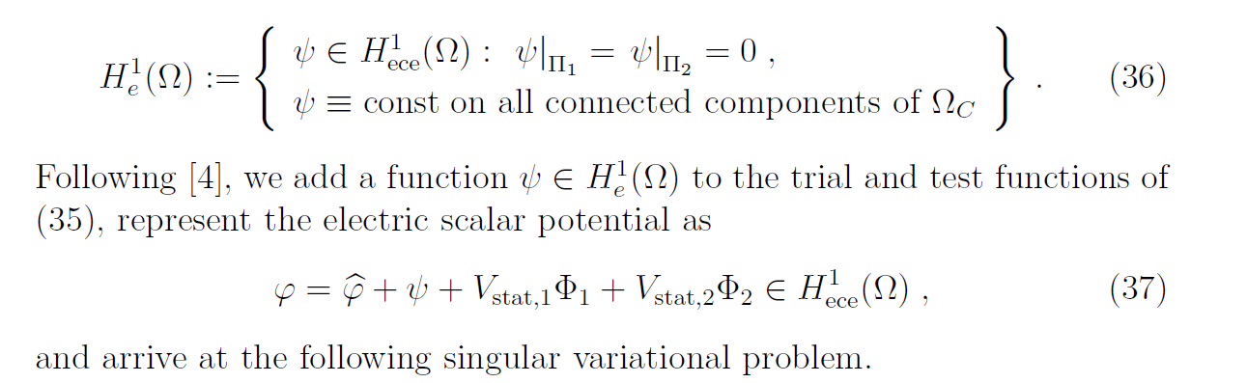
SEQS: Weak formulations

Slide 23
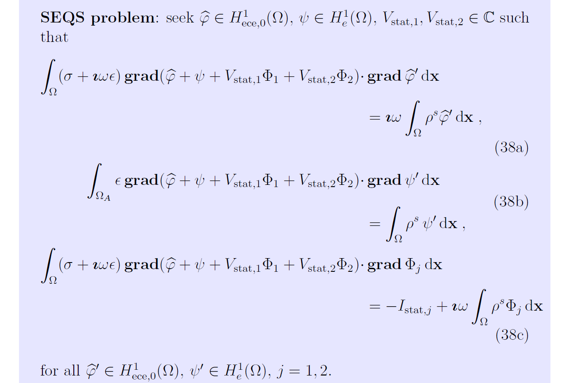
SEQS: Weak formulations

Slide 24
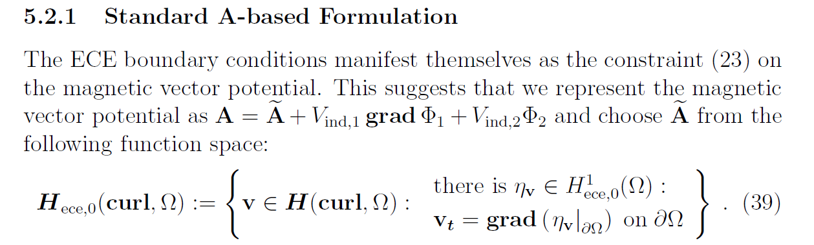
Maxwell: Weak formulations

Slide 25
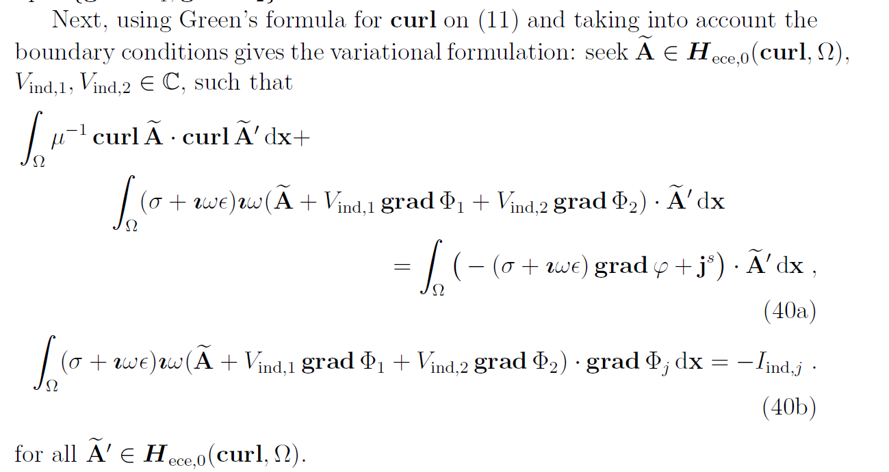
Maxwell: Weak formulations

Slide 26
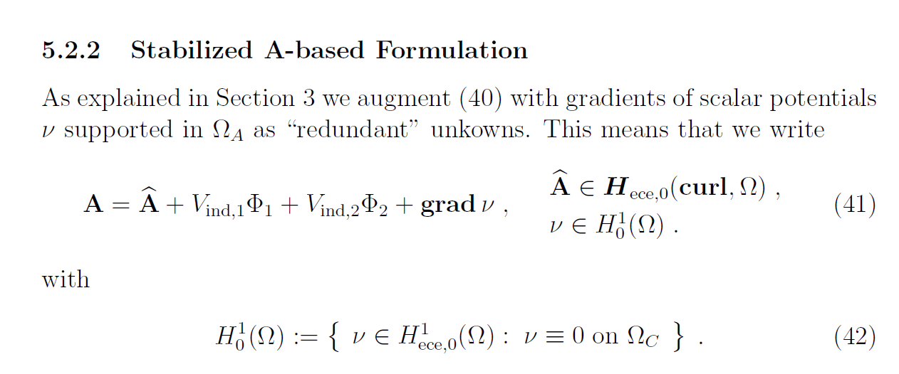
Maxwell: Weak formulations

Slide 27
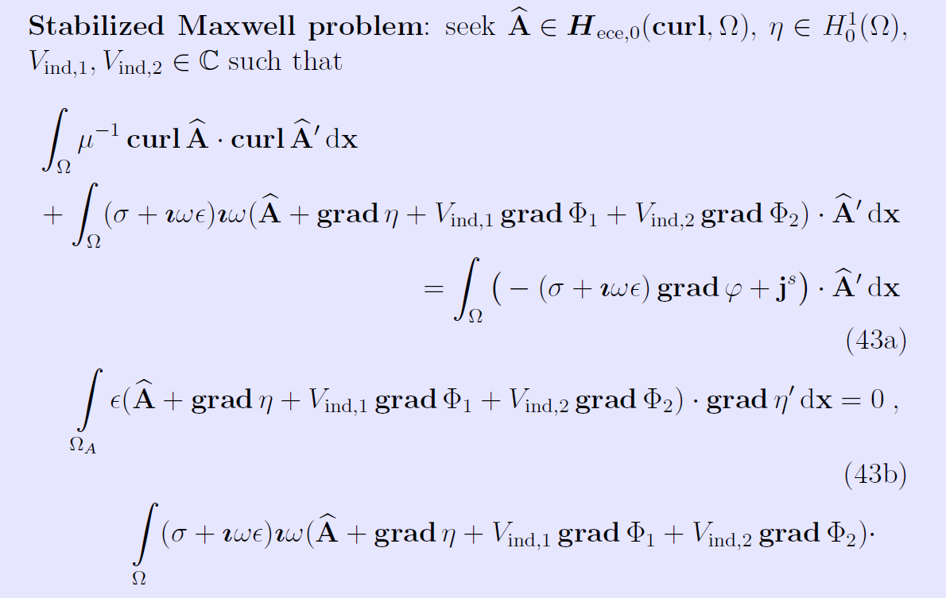
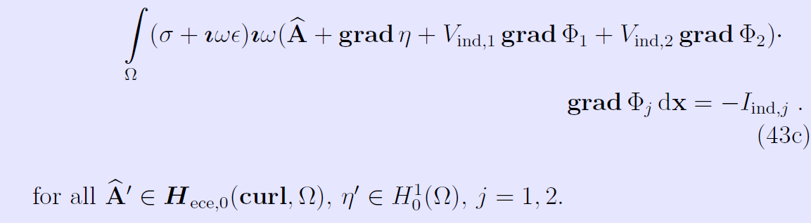
Maxwell: Weak formulations

Slide 28
05
Numerical Tests

Slide 29
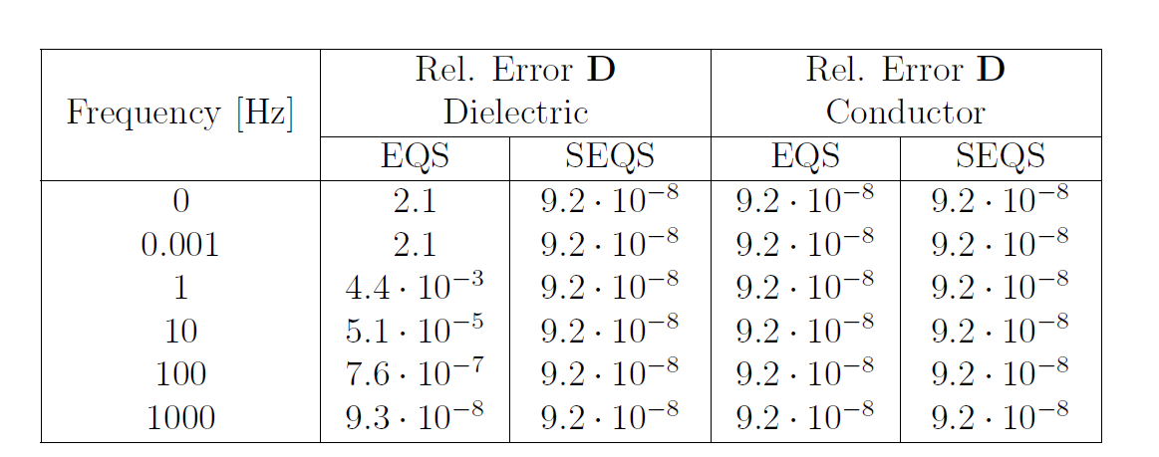
Test1

Slide 30
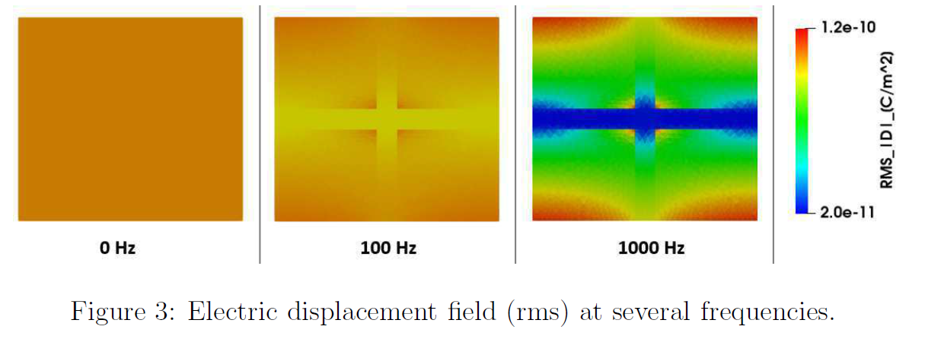
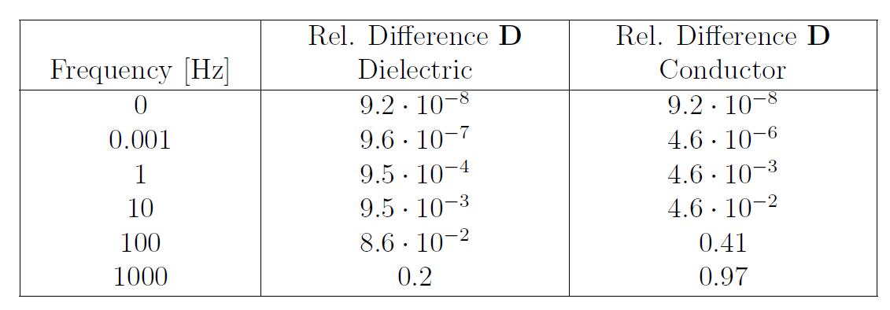
Test2

Slide 31
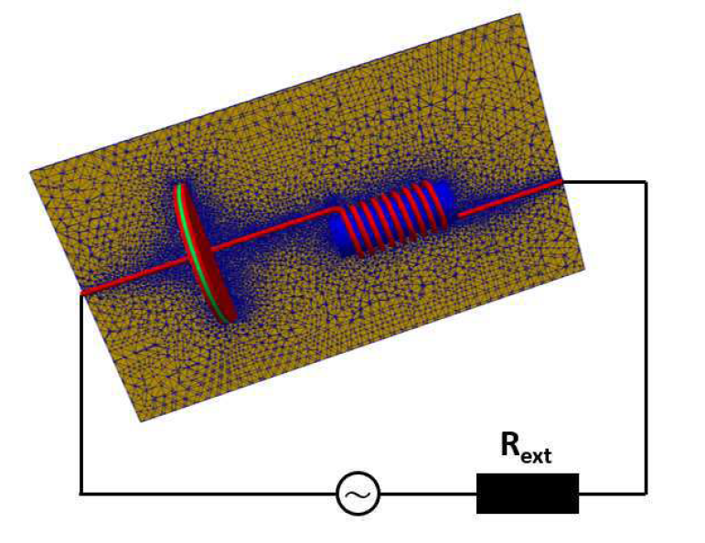
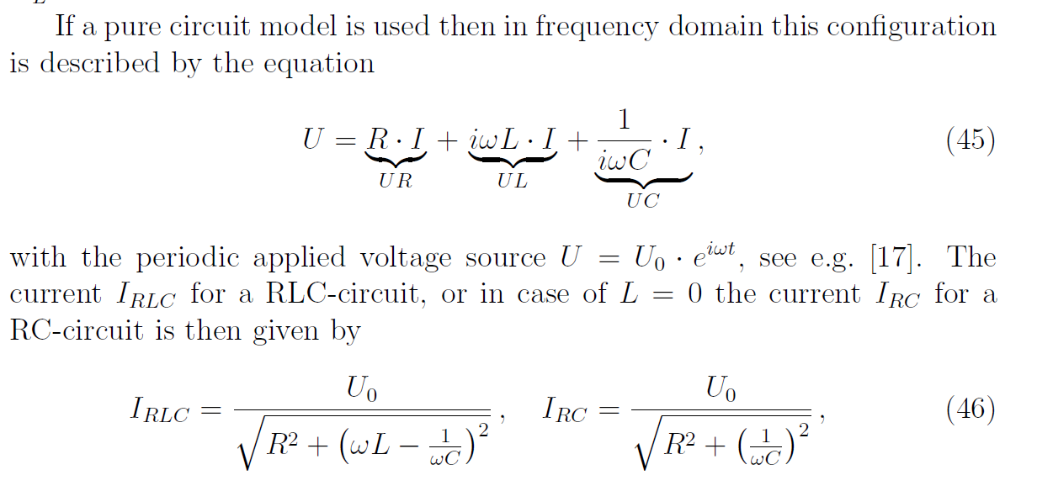
Test3

Slide 32
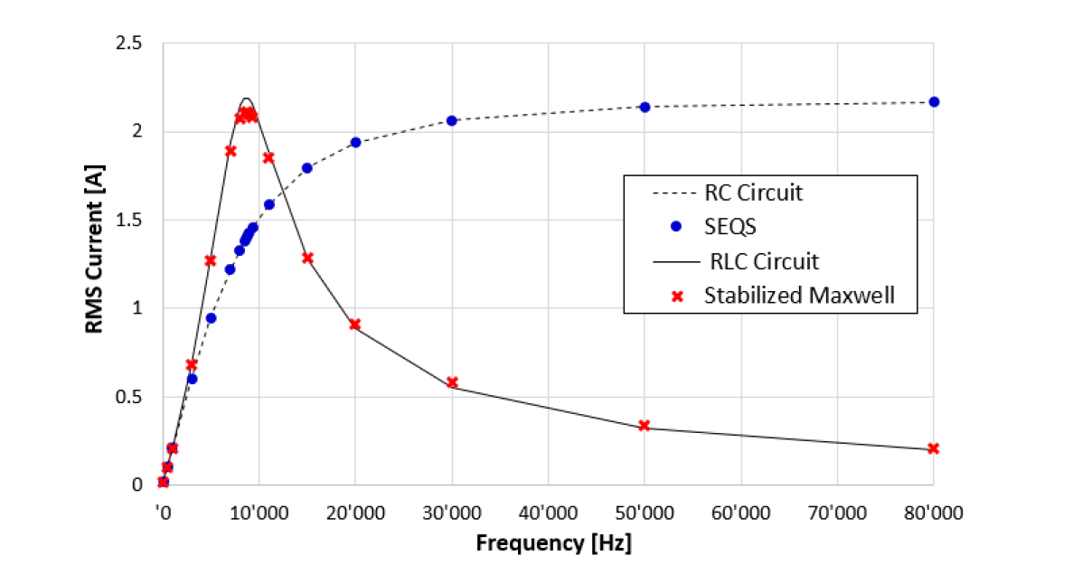
Test3

Slide 33
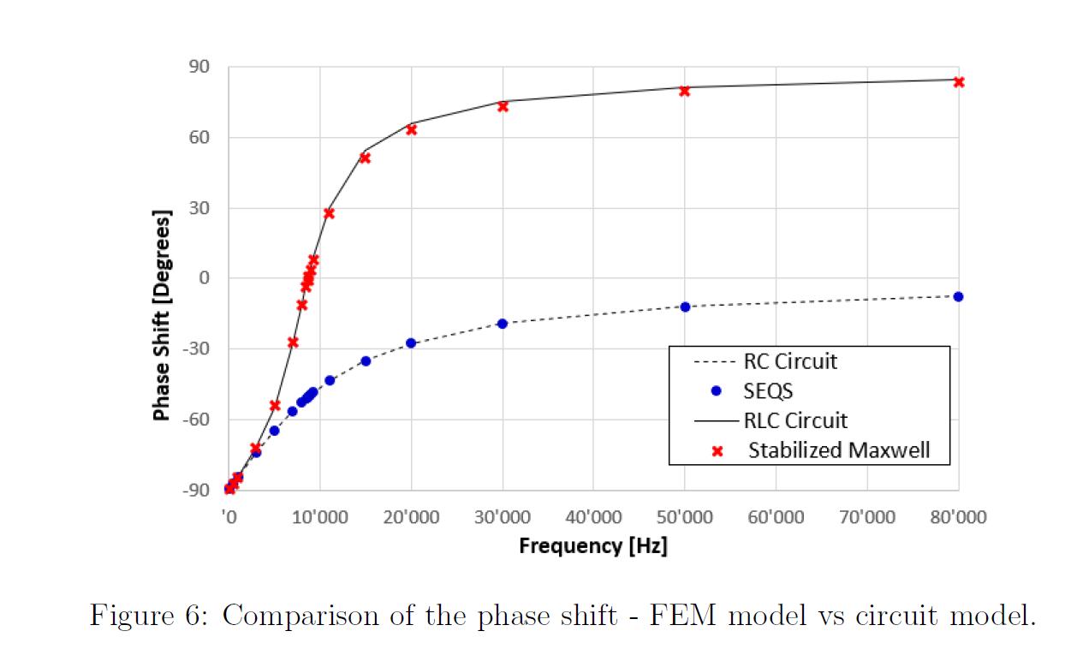
Test3

Slide 34
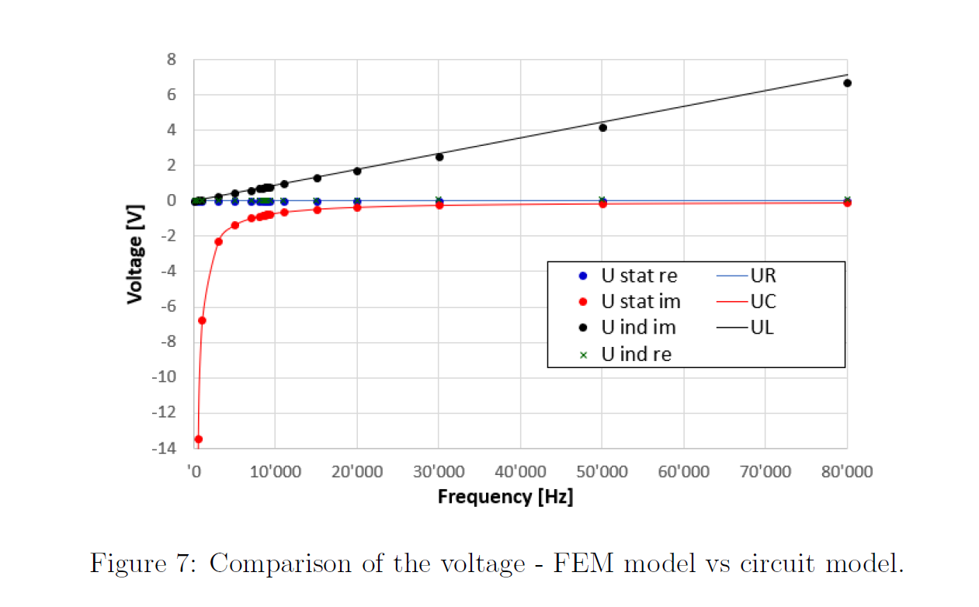
Test4

Slide 35
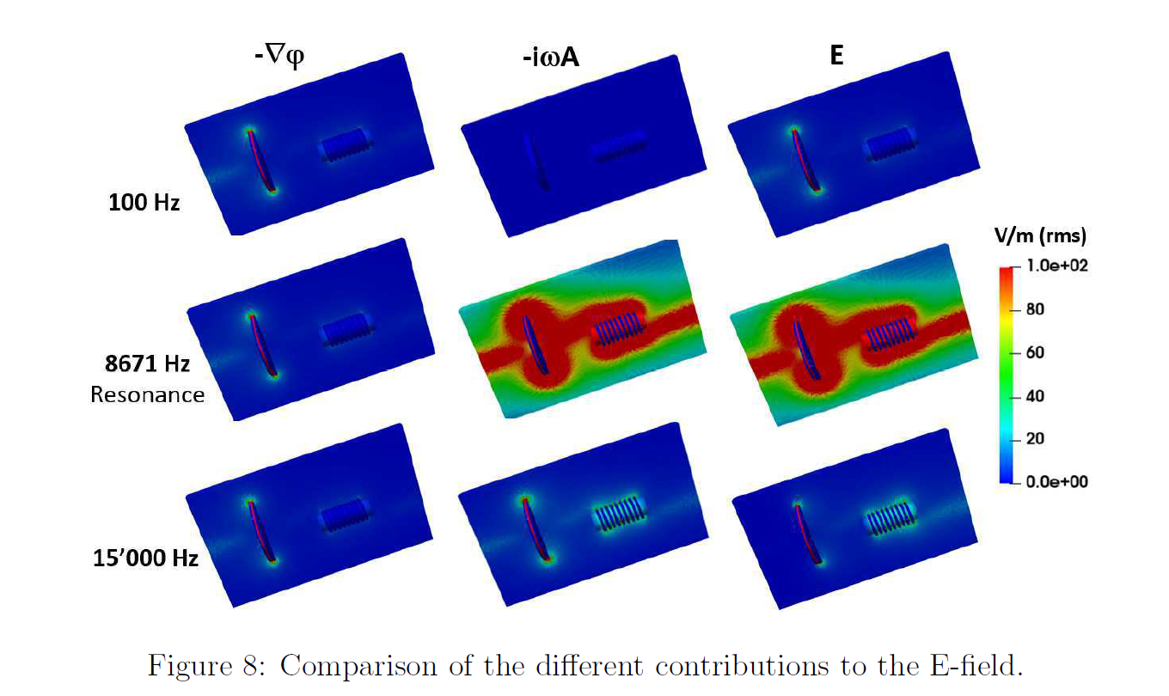
Test5

Slide 36
Thank you for your listening

