Slide 1
CS525: Advanced Software Development
Yu Zhou- 986024
Advanced Software Development

Slide 2
User cases for Recommendation

Slide 3
Collaborative filtering
public final static int customerNo = 10;
public final static int productNo = 11;
public final static double[][] rateScore = {
{3.4, 3.5, 3.6, 3.7, 3.8, 3.9, 4.0, 4.1, 4.2, 4.3, 4.23},
{0, 1, 2, 3, 4, 5, 6, 7, 8, 9, 3},
{0, 1, 2, 3, 4, 5, 6, 7, 8, 9, 3},
{3.45, 3.5, 3.6, 3.7, 3.8, 3.99, 4.10, 4.19, 4.2, 4.3, 4.2},
{0, 1, 2, 3, 4, 5, 6, 7, 8, 9, 4},
{0, 1, 2, 3, 4, 5, 6, 7, 8, 9, 4},
{0, 1, 2, 3, 4, 5, 6, 7, 8, 9, 3},
{3.46, 3.58, 3.69, 3.7, 3.80, 3.96, 4.07, 4.15, 4.28, 4.33, 4.3},
{0, 1, 2, 3, 4, 5, 6, 7, 8, 9, 3},
{0, 1, 2, 3, 4, 5, 6, 7, 8, 9, 3}
};

Slide 4
Co Occurrence
book1 book2 book3 book5 book6 book8 book2
book3 book4 book6 book8 book4 book3 book9
book2 book3 book4 book5 book6 book8 book7

Slide 5
Use cases for Data Access

Slide 6
Recommendation: Factory method

Slide 7
Recommendation: Strategy

Slide 8
Similarity computation between users
The neighborhood-based algorithm calculates the similarity between two users or items, and produces a prediction for the user by taking the weighted average of all the ratings. Similarity computation between items or users is an important part of this approach. Multiple measures, such as Pearson correlation and vector cosine based similarity are used for this.
The Pearson correlation similarity of two users x, y is defined as
where Ixy is the set of items rated by both user x and user y.

Slide 9
Recommendation
Get top m values from double[n]
Case m <=3
One Scan O(n)
Case m ~ n
O(n*n)
Heap Sort O(n+mlogn)
Case n is huge
Map reduce to compute the matrix

Slide 10
Recommendation: Observer

Slide 11
Recommendation: Template

Slide 12
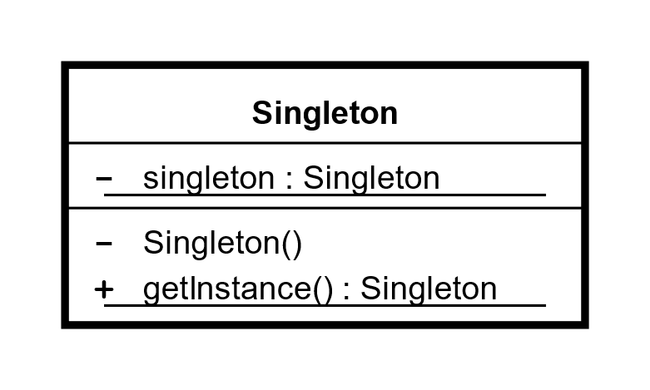
Recommendation: Singleton
RateInformation, ProducerConsumer

Slide 13
Data Access : Facade

Slide 14
The effective of FacadeJDBCExecutor

Slide 15
Data Access : Adapter

Slide 16
Data Access : Flyweight

Slide 17
Data Access : Decorator

Slide 18
Recommendation
Class of Name | Lines of code
CFRecommendation | 86
CoOccurrenceRecommendation | 85
HeapSort | 83
IRecommendation | 7
ISortMethod | 5
OnePassCompareSort | 92
PearsonCorrelationSimilarity | 60
RateInformation | 102
RecommendtaionFactory | 15
ShoppingRecommendation | 52
SimilarCustomers | 114
SortType | 16
SortUtil | 23
ProducerCosumer | 119
RecommendationService | 19
Total | 878
Class Name (Map Reduce) | Lines of code
AbstractMapper | 65
ComputeFrameWork | 170
CoOccurrenceMapper | 41
Mapper | 66
MapperSendObject | 24
Pair | 26
Reducer | 88
Utility | 111
WordCountMapper | 29
Total | 620

Slide 19
Data Access
Class of Name | Lines of code
ColumnMetaData | 35
ConnectionPool | 198
DataSourceInterface | 4
DataType | 24
FacadeJDBCExecutor | 121
JDBCConnectionInfo | 41
MappingObject | 18
PoolBuilder | 30
PoolConfigure | 24
SQLConstructor | 192
TableMetaData | 24
IDataAccess | 5
GenericDaoAccess | 26
Total | 742
Class Name (Log) | Lines of code
ILogFunctorCommand | 5
TransactionLogFunctor | 34
Total | 39

Slide 20
Work Conclusion
Implemented
DataAccess:
Connection Pool
FacadeJDBC Access
Recommendation:
A simple framework
Two algorithms for recommendations
Not done: Run out of time to final integrate into the application

Slide 21
Experience and Lessons
It’s better to finish the application first and then
extract the framework

