Slide 1
Shopping management Pro. HanHong Lu
CS525: Advanced Software Development
Quan Yang – 986029 Group 6
Advanced Software Development

Slide 2
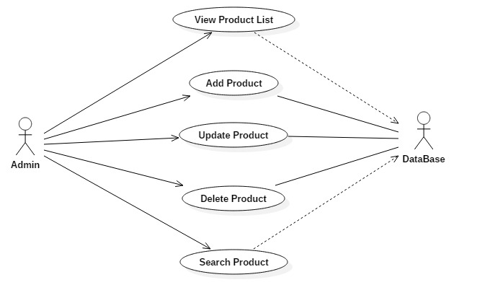
Product Management Use case

Slide 3
Application Architecture (Product Management)
GUI Layer:
Java Swing
Proxy
ProductManager
Business Logic Layer (BUS)
Domain Object
Data Access Layer (DAO)
Data Transfer Object (DTO)
DB Connection
SQLite

Slide 4
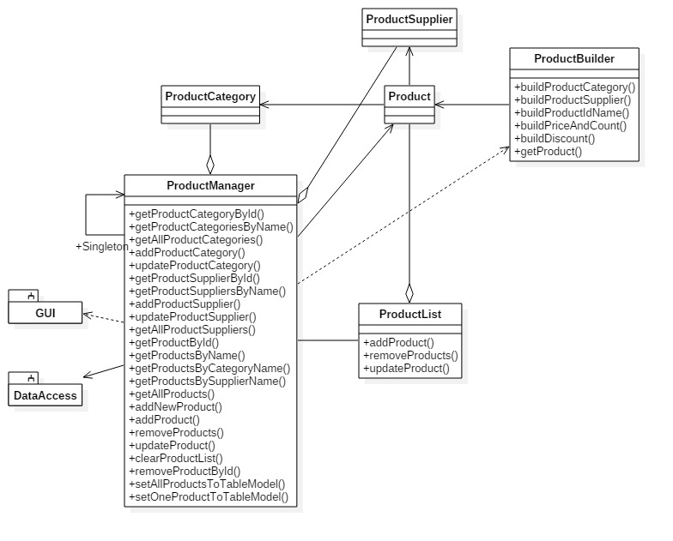
Class diagram for Application (Product Management)

Slide 5
GUI Navigation Framework
State
From A To B
State
From B To A
has
has
Mediator
navigate
navigate
Colleague A
Colleague B
navigate
navigate
Abstract Factory & Factory Method

Slide 6
GUI Navigation Architecture in App
Registration
LoginPage
MainPanel
ProductList
Page
BillPage
Purchase

Slide 7
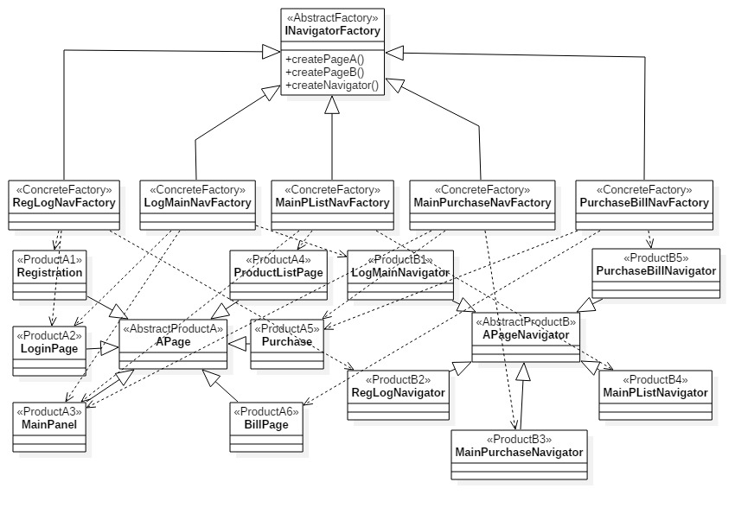
GUI Navigation Framework Class Diagram: Abstract Factory

Slide 8
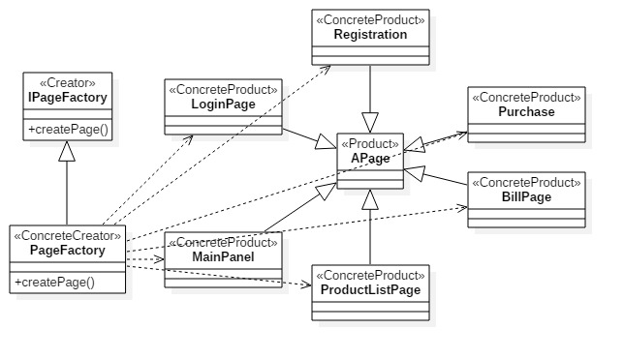
GUI Navigation Framework Class Diagram: Factory Method

Slide 9
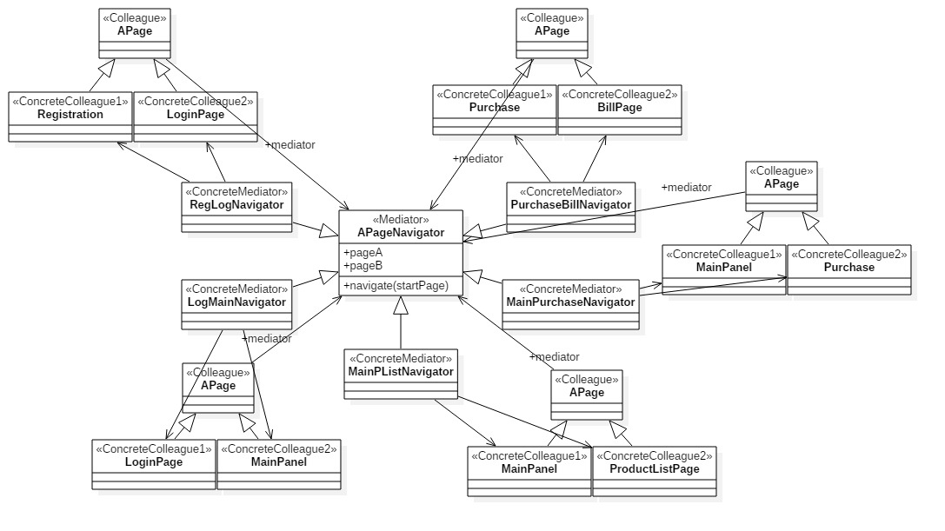
GUI Navigation Framework Class Diagram: Mediator

Slide 10
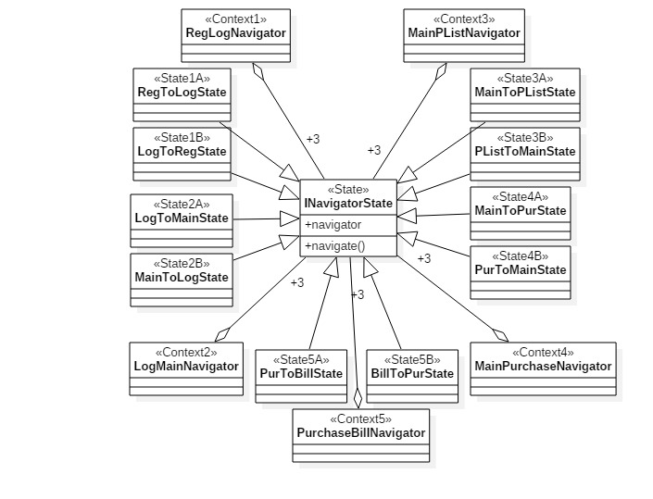
GUI Navigation Framework Class Diagram: State
From A to B State
From B to A State
Current State

Slide 11
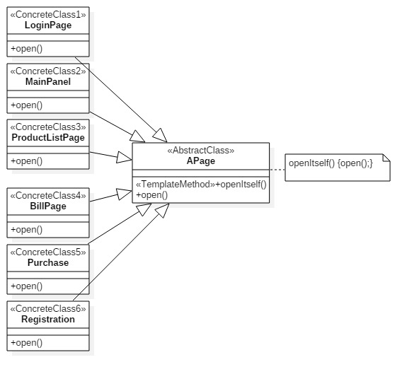
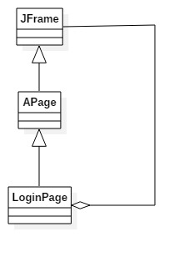
GUI Navigation Framework Class Diagram: Template Method & Composite
Template Method
Composite

Slide 12
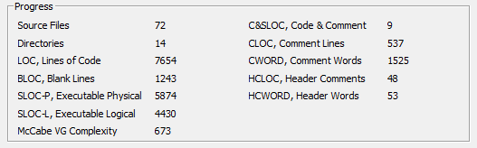
Lines of Code Application

Slide 13
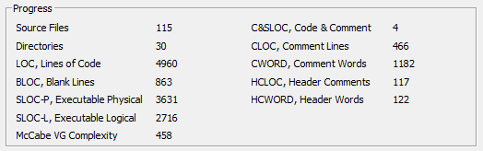
Lines of Code Framework

Slide 14

Questions and Discussion

