Slide 1
Shopping management Dr. HanHong Lu
CS525: Advanced Software Development
Duong Truong - 986043
Advanced Software Development

Slide 2
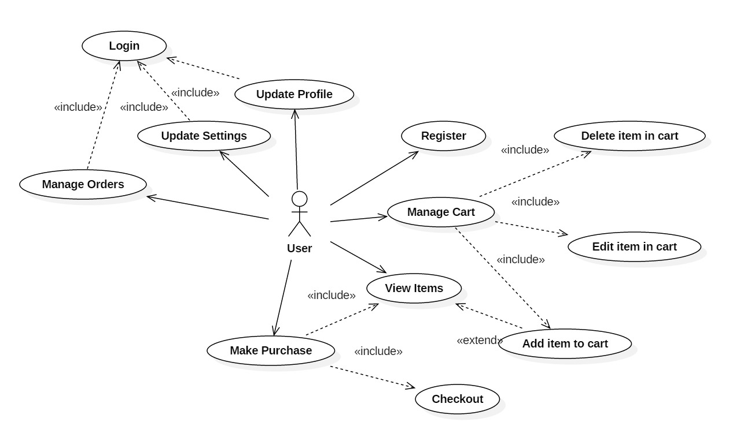
Use case

Slide 3
Architecture
GUI Layer:
Java Swing
Proxy
AbstractClass:
StandardUser
StandardUserProfile
Business Logic Layer (BUS)
Domain Object
Data Access Layer (DAO)
Data Transfer Object (DTO)
Template method:
AbstractLogin
AbstractSignUp
AbstractUpdateProfile
DB Connection
SQLite

Slide 4
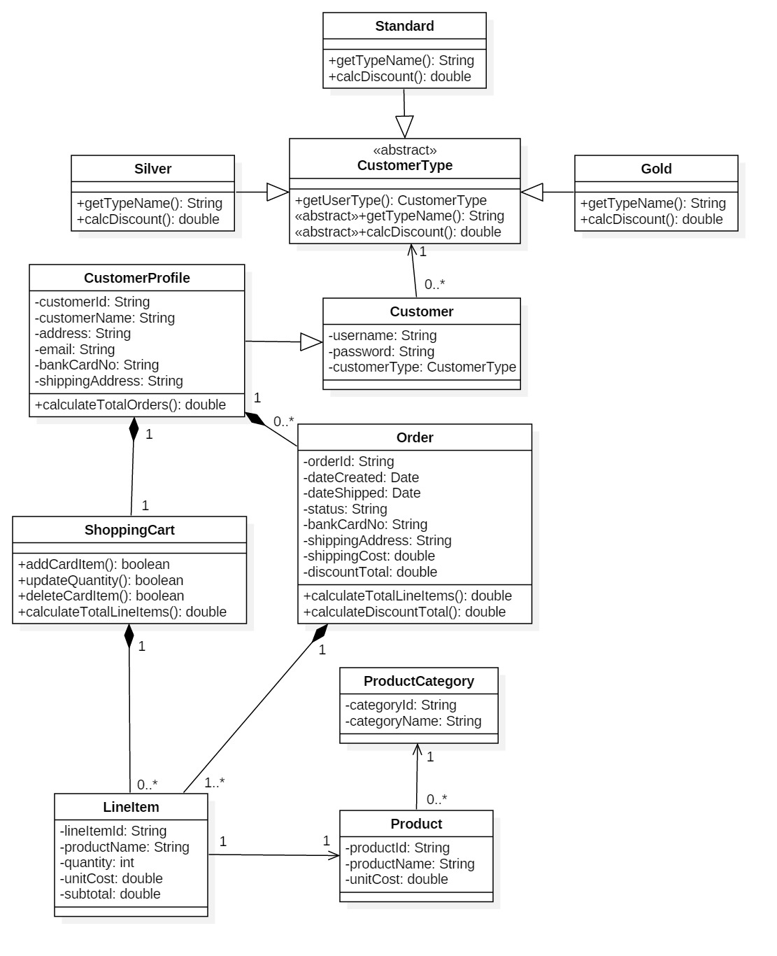
Class diagram for Domain

Slide 5
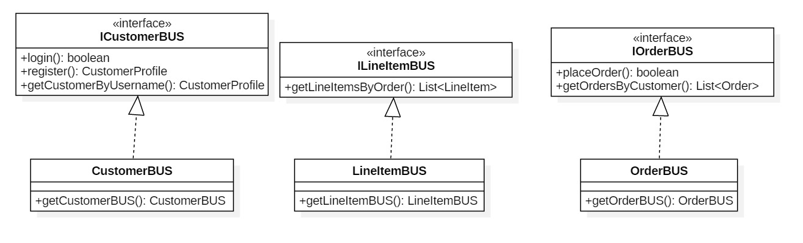
Class diagram for Business Layer

Slide 6
Class diagram for DAO Layer

Slide 7
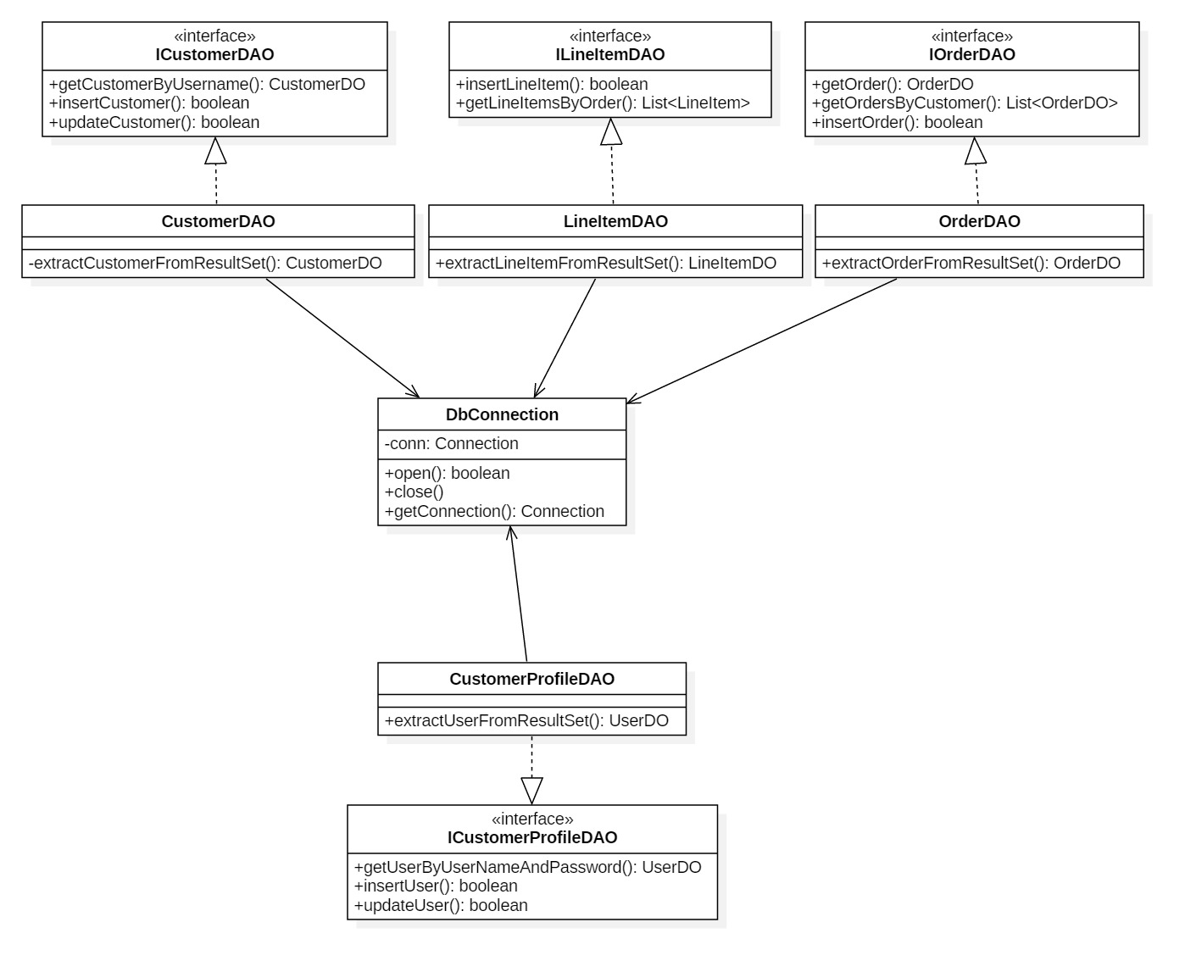

Slide 8
Class diagram for Proxy Layer (framework)

Slide 9
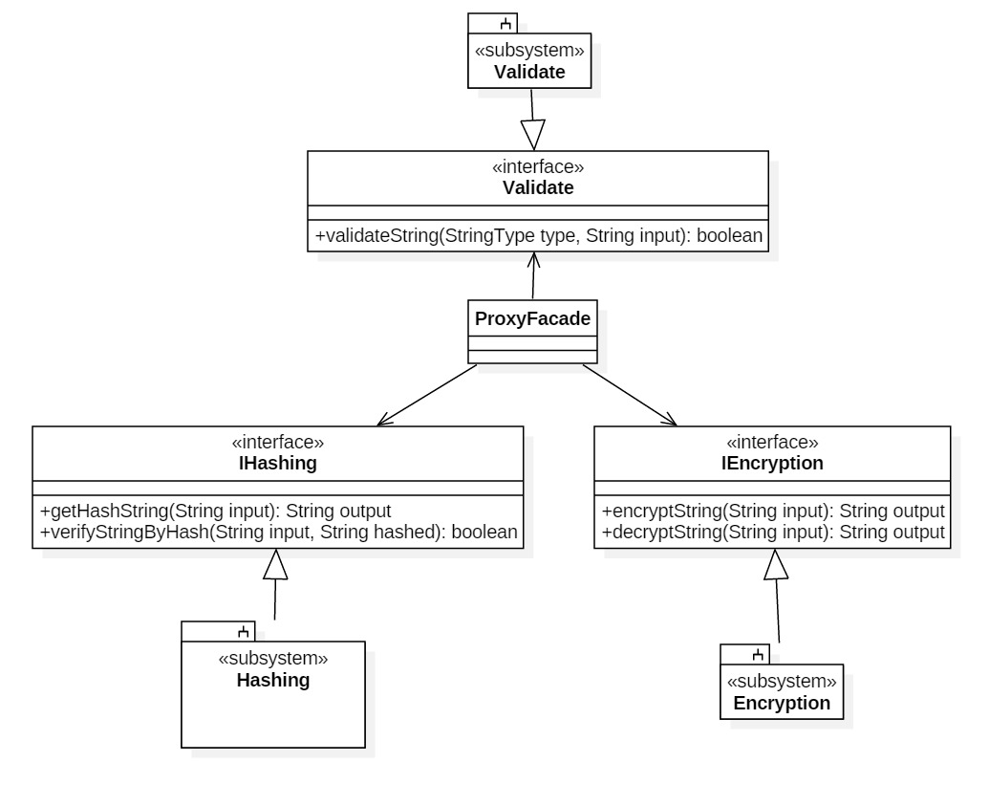

Slide 10
Lines of Code Application
Class Name | Line of Code
Domain Layer
NewCustomer | 67
NewCustomerProfile | 11
CustomerType | 9
Gold | 16
Silver | 16
Standard | 16
LineItem | 85
Order | 145
ShoppingCart | 74
Business Layer
NewCostomerBUS | 25
LoginBUS | 25
SignUpBUS | 48
UpdateProfileBUS | 49
LineItemBUS | 53
OrderBUS | 118
Total: | 757

Slide 11
Lines of Code Framework
Class Name | Line of Code
Membership Layer
Config | 17
Member | 61
StandardMember | 56
StandardUserProfile | 152
Proxy Layer
ProxyFacadeImp | 52
EncryptionFactory | 30
CipherEncryption | 80
Jasypt | 24
HashingFactory | 28
MD5 | 28
BCryptHash | 19
ArgonHash | 21
ValidateFactory | 14
ValidateImplement | 89
StringType | 8
Template Layer
TemplateFacadeImp | 26
AbstractLogin | 23
AbstractSignUp | 36
AbstractUpdateProfile | 86
Total: | 850

Slide 12
Effective code

Slide 13
Questions and Discussion

