Slide 1
Lesson 5 Spark

Slide 2
Spark Introduction
Apache Spark is a fast and general-purpose cluster computing system. It provides high-level APIs in Java, Scala, Python and R, and an optimized engine that supports general execution graphs.
It also supports a rich set of higher-level tools including Spark SQL for SQL and structured data processing, MLlib for machine learning, GraphX for graph processing, and Spark Streaming.
You can also run Spark interactively through a modified version of the Scala shell. This is a great way to learn the framework.
./bin/spark-shell --master local[2]

Slide 3
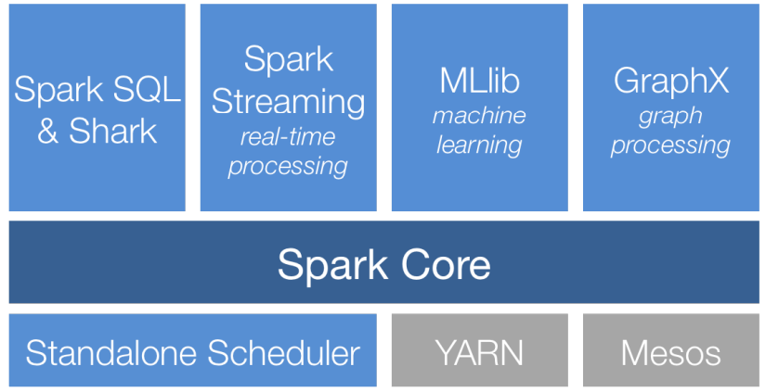
Spark Introduction

Slide 4
Spark Cluster Mode
Spark applications run as independent sets of processes on a cluster, coordinated by the SparkContext object in your main program (called thedriver program).
Driver program: the process running the main() function of the application and creating the SparkContext
To run on a cluster, the SparkContext can connect to several types of cluster managers (either Spark’s own standalone cluster manager, Mesos or YARN), which allocate resources across applications.

Slide 5

Spark Cluster Mode
Spark connects to a cluster manager which allocate resources across applications
Once connected, Spark acquires executors on nodes in the cluster, which are processes that run computations and store data for your application.
Next, it sends your application code to the executors.
Finally, SparkContext sends tasks to the executors to run.

Slide 6
RDD
Resilient Distributed Datasets (RDD) are the primary abstraction in Spark – a fault-tolerant collection of elements that can be operated on in parallel
There are currently two types:
parallelized collections – take an existing Scala collection and run functions on it in parallel. (User can create an RDD by distributing a collection of objects such as a list or a set.)
Hadoop datasets – run functions on each record of a file in Hadoop distributed file system or any other storage system supported by Hadoop. (User can create an RDD by loading an external dataset.)

Slide 7
RDD
Immutable distributed collection of objects.
Is spilt into multiple partitions (which may be computed on different nodes of the cluster)
Can contain any type of Python, Java or Scala objects, including user-defined classes.

Slide 8
RDD
Making RDD from parallelized collections:
scala> val data = Array(1, 2, 3, 4, 5)
data: Array[Int] = Array(1, 2, 3, 4, 5)
scala> val distData = sc.parallelize(data)
distData: spark.RDD[Int] = spark.ParallelCollection@10d13e3e
Spark can create RDDs from any file stored in HDFS or other storage systems supported by Hadoop, e.g., local file system, Amazon S3, Hypertable, HBase, etc.
scala> val lines = sc.textFile("README.md")!
lines: spark.RDD[String] = spark.HadoopRDD@1d4cee08

Slide 9
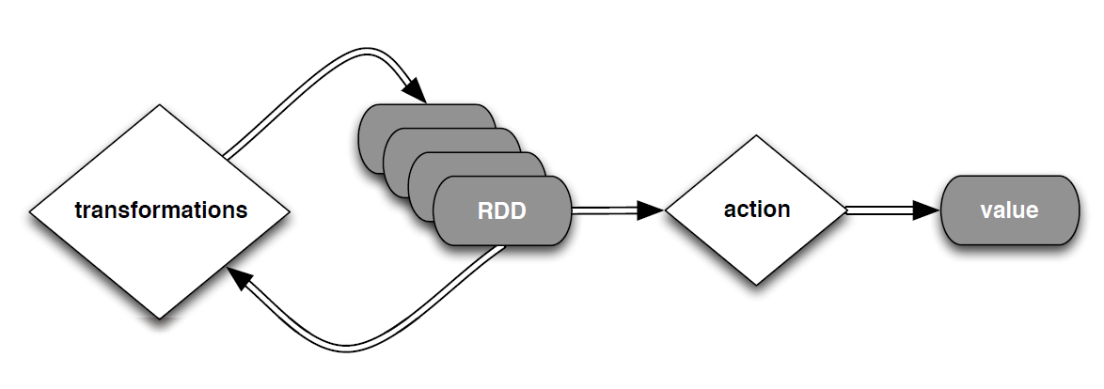
RDD
Two types of operations on RDDs: transformations and actions
Transformations are lazy (not computed immediately)
The transformed RDD gets recomputed when an action is run on it (default)
An RDD can be persisted into storage in memory or disk

Slide 10
RDD - Transformation
Transformations create a new dataset from an existing one
scala> val lines = sc.textFile("README.md")!
distFile: spark.RDD[String] = spark.HadoopRDD@1d4cee08
scala>val scalaLines = lines.filter(w => w.contains(“Scala”))
scalaLines: spark.RDD[String] = FilteredRDD[…]
All transformations in Spark are lazy: they do not compute their results right away – instead they remember the transformations applied to some base dataset for:
optimize the required calculations
recover from lost data partitions

Slide 11
RDD - Actions
Compute a result based on an RDD
Return it to either the driver program or save it to an external storage system (e.g., HDFS)
Word count
val textFile = sc.textFile("hdfs://...")
val counts = textFile.flatMap(_.split(" "))
.map((_, 1)).reduceByKey(_ + _)
counts.saveAsTextFile("hdfs://...")
Is reduceByKey a transformation or an action?

Slide 12
RDD - Actions
Word count
val textFile = sc.textFile("hdfs://...")
val counts = textFile.flatMap(line => line.split(" "))
.map(word => (word, 1))
.reduceByKey(_ + _)
counts.saveAsTextFile("hdfs://...")
reduceByKey an Transformation. Thus counts is an RDD.

Slide 13
RDD – Common Transformations and Actions
Element-wise transformations
map
val input = sc.parallelize(List(7, 5, 2, 9))
val result = input.map(x => x * x) // input.map(_*_) is an error
println(result.collect().mkString(", ")) // 49, 25, 4, 81
Note: result.foreach(println) will print each number in a separate line and result.foreach(print) will print 4925481

Slide 14
RDD – Common Transformations and Actions
Element-wise transformations
flatMap. The function must return a list;
val lines = sc.parallelize(List("Once upon a time “ , “Spark came “))
val words = lines.flatMap(w => w.split(“, “)) // or lines.flatMap(_.split(“, “))
words.foreach(println)
var numbers = sc.parallelize(List(7, 2, 9))
var numberList = numbers.flatMap(x => List(x * x, x * x * x))
println(numberList.collect().mkString(", ")) // 49, 343, 4, 8, 81, 729
var numberList1 = numbers.flatMap(x => List(x * x)) // Correct
var numberList 2= numbers.flatMap(x => x * x) // Error
flatMap “flattens”. Thus instead of an RDD of lists, we get an RDD of all elements in all those lists.

Slide 15
RDD – Common Transformations and Actions
Element-wise transformations
filter
scala> val one = sc.parallelize(List(1, 2, 3, 4))
scala> val two = one.filter(_> 2)
println(two.collect().mkString(", ")) // 3, 4
sample
scala> val three = one.sample(false, 0.5)
println(three.collect().mkString(", ")) // 2, 3

Slide 16
RDD – Common Transformations and Actions
Pseudo set operations
union, intersection, subtract and distinct. distinct is costly. use it only when necessary.
scala> val one = sc.parallelize(List(1, 2, 3, 4))
scala> val two = sc.parallelize(List(6, 5, 4, 3))
scala> val one_union_two = one union two
println(one_union_two.distinct().collect().mkString(", ")) // 4, 1, 5, 6, 2, 3
OR println(one.union(two).distinct().collect().mkString(", ")) // 4, 1, 5, 6, 2, 3
println(one.intersection(two).collect().mkString(", ")) // 4, 3
println(one.subtract(two).collect().mkString(", ")) // 2, 1
println(one.cartesian(two).collect().mkString(", ")) // see result below.
(1,6), (1,5), (2,6), (2,5), (1,4), (1,3), (2,4), (2,3), (3,6), (3,5), (4,6), (4,5), (3,4), (3,3), (4,4), (4,3)

Slide 17
RDD - Transformation
Transformation | description
map(func) | return a new distributed dataset formed by passing each element of the source through a function func
filter(func) | return a new dataset formed by selecting those elements of the source on which func returns true
flatMap(func) | similar to map, but each input item can be mapped to 0 or more output items (so func should return a Seq rather than a single item)
sample(withReplacement, fraction, seed) | sample a fraction fraction of the data, with or without replacement, using a given random number generator seed
union(otherDataset) | return a new dataset that contains the union of the elements in the source dataset and the argument
distinct([numTasks])) | return a new dataset that contains the distinct elements of the source dataset

Slide 18
RDD - Transformation
Transformation | description
groupByKey([numTasks]) | when called on a dataset of (K, V) pairs, returns a dataset of (K, Seq[V]) pairs
reduceByKey(func, [numTasks]) | when called on a dataset of (K, V) pairs, returns a dataset of (K, V) pairs where the values for each key are aggregated using the given reduce function
sortByKey([ascending], [numTasks]) | when called on a dataset of (K, V) pairs where K implements Ordered, returns a dataset of (K, V) pairs sorted by keys in ascending or descending order, as specified in the boolean ascending argument
join(otherDataset, [numTasks]) | when called on datasets of type (K, V) and (K, W), returns a dataset of (K, (V, W)) pairs with all pairs of elements for each key
cogroup(otherDataset, [numTasks]) | when called on datasets of type (K, V) and (K, W), returns a dataset of (K, Seq[V], Seq[W]) tuples – also called groupWith
cartesian(otherDataset) | when called on datasets of types T and U, returns a dataset of (T, U) pairs (all pairs of elements)

Slide 19
RDD - Transformation
val distFile = sc.textFile("README.md")
distFile.map(l => l.split(" ")).collect()
distFile.flatMap(l => l.split(" ")).collect()
distFile is a collection of lines
closure

Slide 20
Scala Closures
A closure is a function, whose return value depends on the value of one or more variables declared outside this function but in the enclosing scope. Consider the following piece of code with anonymous function:
val multiplier = (i:Int) => i * 10
Here the only variable used in the function body, i * 10, is i, which is defined as a parameter to the function. Now let us take another piece of code:
val multiplier = (i:Int) => i * factor
There are two variables in multiplier: i and factor. One of them, i, is a formal parameter to the function. Hence, it is bound to a new value each time multiplier is called. However, factor is not a formal parameter, then what is this? It is a free variable.

Slide 21
Scala Closures
Let us add one more line of code:
var factor = 3
val multiplier = (i:Int) => i * factor
Now, factor has a reference to a variable outside the function but in the enclosing scope. Let us try the following example:
object Test {
def main(args: Array[String]) {
println( "muliplier(1) value = " + multiplier(1) ) println( "muliplier(2) value = " + multiplier(2) )
}
var factor = 3
val multiplier = (i:Int) => i * factor
}

Slide 22
Scala Closures
When the code in the previous slide is compiled and executed, it produces the following result:
C:/>scalac Test.scala
C:/>scala Test
muliplier(1) value = 3
muliplier(2) value = 6
C:/>
Above function references factor and reads its current value each time. If a function has no external references, then it is trivially closed over itself. No external context is required.

Slide 23
Action
reduce
scala> val numbers = sc.parallelize(List(7, 2, 9))
scala> val sum = numbers.reduce((x, y) => x + y) // reduce(_+_) no error
scala> val squareSum = numbers.map(x => x*x).reduce((x, y) => x + y)
Can also be written as
scala> val squareSum = numbers.map(x => x*x).reduce(_+_)
NOT AS
scala> val squareSum = numbers.map(_*_).reduce((x, y) => x + y)
Problem : Given a list determine whether there are more evens or odds
Solution
scala> val numbers = sc.parallelize(List(7, 8, 9, 10, 12)).map(x => if (x %2 == 0) 1 else -1).reduce(_+_)
OR
scala> val numbers = sc.parallelize(List(7, 8, 9, 10, 12)).map(x => if (x %2 == 0) 1 else -1).reduce((x, y) => x + y)

Slide 24
RDD - Action
Transformation | description
reduce(func) | aggregate the elements of the dataset using a function func (which takes two arguments and returns one), and should also be commutative and associative so that it can be computed correctly in parallel
collect() | return all the elements of the dataset as an array at the driver program – usually useful after a filter or other operation that returns a sufficiently small subset of the data
count() | return the number of elements in the dataset
first() | return the first element of the dataset – similar to take(1)
take(n) | return an array with the first n elements of the dataset – currently not executed in parallel, instead the driver program computes all the elements
takeSample(withReplacement, fraction, seed) | return an array with a random sample of num elements of the dataset, with or without replacement, using the given random number generator seed

Slide 25
RDD - Action
Transformation | description
saveAsTextFile(path) | write the elements of the dataset as a text file (or set of text files) in a given directory in the local filesystem, HDFS or any other Hadoop-supported file system. Spark will call toString on each element to convert it to a line of text in the file
saveAsSequenceFile(path) | write the elements of the dataset as a Hadoop SequenceFile in a given path in the local filesystem, HDFS or any other Hadoop-supported file system. Only available on RDDs of key-value pairs that either implement Hadoop's Writable interface or are implicitly convertible to Writable (Spark includes conversions for basic types like Int, Double, String, etc).
countByKey() | only available on RDDs of type (K, V). Returns a `Map` of (K, Int) pairs with the count of each key
foreach(func) | run a function func on each element of the dataset – usually done for side effects such as updating an accumulator variable or interacting with external storage systems

Slide 26
RDD - Action
val f = sc.textFile("README.md")
val words = f.flatMap(l => l.split(" ")).map(word => (word, 1))
words.reduceByKey(_ + _).collect().foreach(println)
What is collect()? Is a transformation or an action?
Can we “chain” actions?

Slide 27
RDD - Action
val f = sc.textFile("README.md")
val words = f.flatMap(l => l.split(" ")).map(word => (word, 1))
words.reduceByKey(_ + _).collect().foreach(println)
collect() is an action.
We cannot “chain” actions.
In the above example foreach is not a Spark action. It is part of scala.

Slide 28
Passing Functions to Spark
Most of Spark’s transformations, and some of its actions, depend on passing in functions that are used by Spark to compute data.
In scala, we can pass in
functions defined inline,
references to methods,
static functions

Slide 29
RDD - Persistence
val f = sc.textFile("README.md")
val w = f.flatMap(l => l.split(" ")).map(word => (word, 1)).cache()
w.reduceByKey(_ + _).foreach(println)
cache is also a lazy operation.
For more details about the Scala/Java API:
http://spark.apache.org/docs/latest/api/scala/index.html#org.apache.spark.package

Slide 30
RDD - Persistence
Spark can persist (or cache) a dataset in memory across operations. A cached RDD can be made unpersit
Each node stores in memory any slices of it that it computes and reuses them in other actions on that dataset – often making future actions more than 10x faster
The cache is fault-tolerant: if any partition of an RDD is lost, it will automatically be recomputed using the transformations that originally created it

Slide 31
RDD - Persistence
Transformation | description
MEMORY_ONLY | Store RDD as deserialized Java objects in the JVM. If the RDD does not fit in memory, some partitions will not be cached and will be recomputed on the fly each time they're needed. This is the default level.
MEMORY_AND_DISK | Store RDD as deserialized Java objects in the JVM. If the RDD does not fit in memory, store the partitions that don't fit on disk, and read them from there when they're needed.
MEMORY_ONLY_SER | Store RDD as serialized Java objects (one byte array per partition). This is generally more space-efficient than deserialized objects, especially when using a fast serializer, but more CPU-intensive to read.
MEMORY_AND_DISK_SER | Similar to MEMORY_ONLY_SER, but spill partitions that don't fit in memory to disk instead of recomputing them on the fly each time they're needed.
DISK_ONLY | Store the RDD partitions only on disk.
MEMORY_ONLY_2, MEMORY_AND_DISK_2, etc | Same as the levels above, but replicate each partition on two cluster nodes.

Slide 32
References
http://spark.apache.org/docs/latest/
http://spark.apache.org/docs/latest/cluster-overview.html
http://stanford.edu/~rezab/sparkclass/slides/itas_workshop.pdf
Resources:
1. www.tutorialspoint.com//apache_spark/index.htm
2.www.monitorware.com/en/logsamples/apache.php
3.spark.apache.org ( http://spark.apache.org/docs/latest/quick-start.html is very good place to start
HOW TO START THE SHELL
/usr/bin/spark-shell or /usr/bin/spark-shell -i fileName
The configuration file location is /etc/spark/conf

