Slide 1



From Barriers Into Gateways
Next Generation Non-invasive
Trans-barrier Drug Delivery Platform

Slide 2
Executive Summary
One Dose. No Needles. Systemic-Free Recovery.
Disrupting the $6B global otitis media market with a proprietary trans-barrier drug delivery platform of $100B market potential .
Notes:
“Based on ~12 million annual episodes and ~$4.5B in U.S. healthcare spend, we estimate a U.S. addressable market of approximately $1.5–2.0B per year.
Applying conservative regional scaling for incidence and treatment spend, we estimate a global addressable market of approximately $5–6B annually.”

Slide 3

The Massive $4.6B Healthcare Gap in U.S.
16M+
Market Opportunity
ANNUAL U.S. CASES
Otitis Media (OM) is the leading cause of antibiotic prescription and surgical intervention in children globally. Despite the massive scale, no innovation has addressed the "impermeable" intact eardrum barrier in decades.
Zero
A premium, single-dose topical solution represents a blue ocean opportunity for pediatricians and parents alike.
APPROVED TOPICAL OPTIONS
source: https://pubmed.ncbi.nlm.nih.gov/37098521/

Slide 4



The Failures of the Status Quo
The Systemic Burden
The Compliance Gap
•
Standard of care: 10 days of high-dose oral antibiotics.
•
Parental non-compliance exceeds 50% in long-term regimens.
•
Causes severe gut microbiome disruption and systemic toxicity.
•
Incomplete therapy leads to chronic recurrence.
•
Significant contribution to antibiotic resistance and long term development concern for children
•
Difficult for children to tolerate, disrupts family routines, and places significant stress on caregivers
Notes:
20% of Watchful wait will heal without treatment, which leaves the 80% exposed to high doses of antibiotics.

Slide 5
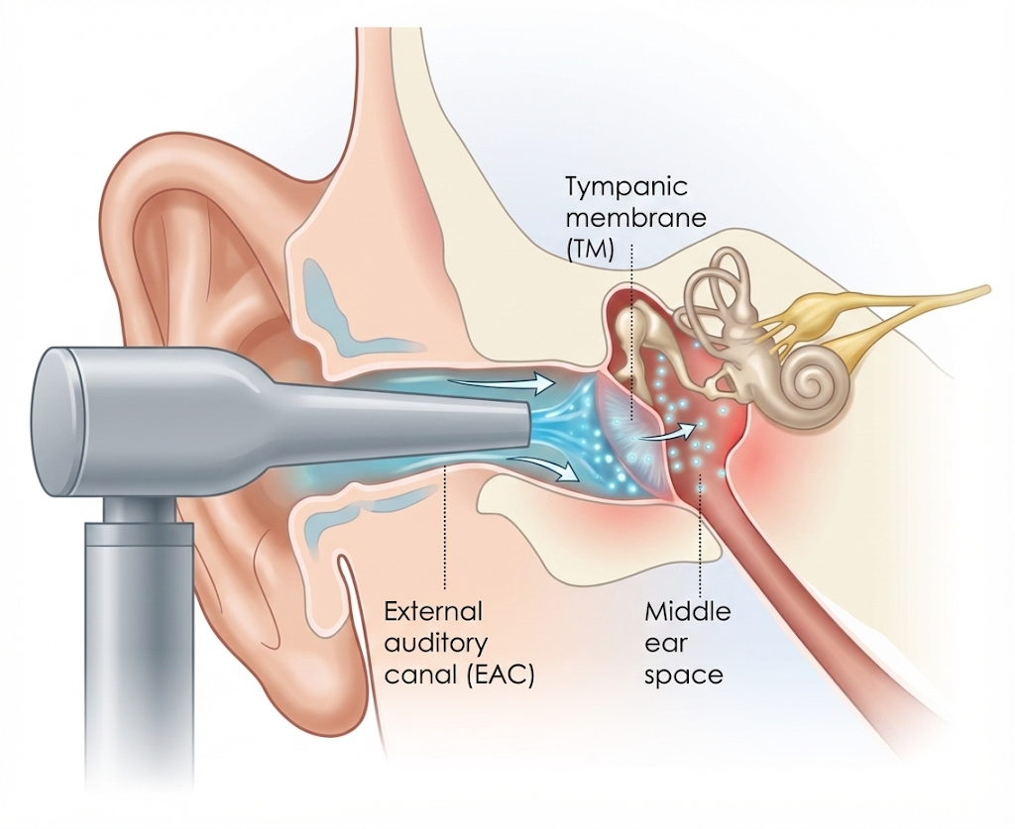
Our Breakthrough Transtympanic Delivery
Direct-to-Site Therapy: Apply once in-clinic by a pediatrician, Cure in 24 hours
Transdermal Power: Bypasses the tympanic membrane without needles.
•
Efficacy: Achieves localized therapeutic levels 100x higher than oral dosing.
•
Comfort & Safety: Painless application with no systemic exposure.
•

Slide 6
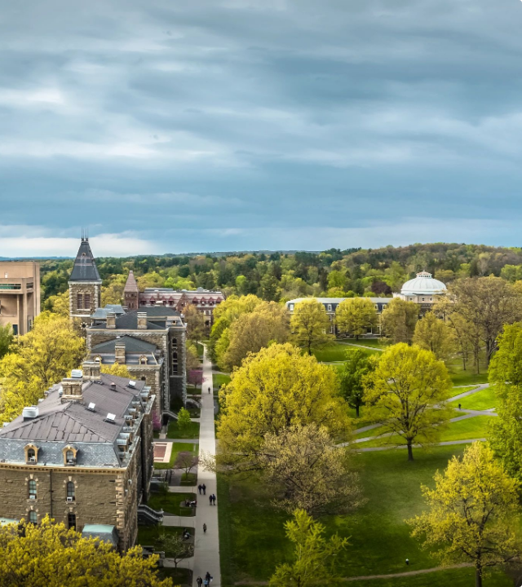
Unrivaled IP Protection
Cornell-Backed Moat
•
Exclusively licensed technology from Cornell University's School of Chemical and Biomolecular Engineering.
•
Provisional Patent filed (U.S. Utility Patent Application (63/552,616)) covering the core transdermal mechanism.
•
Invented by tenured Prof. Rong Yang (CSO), a world leader in biomaterials.

Slide 7
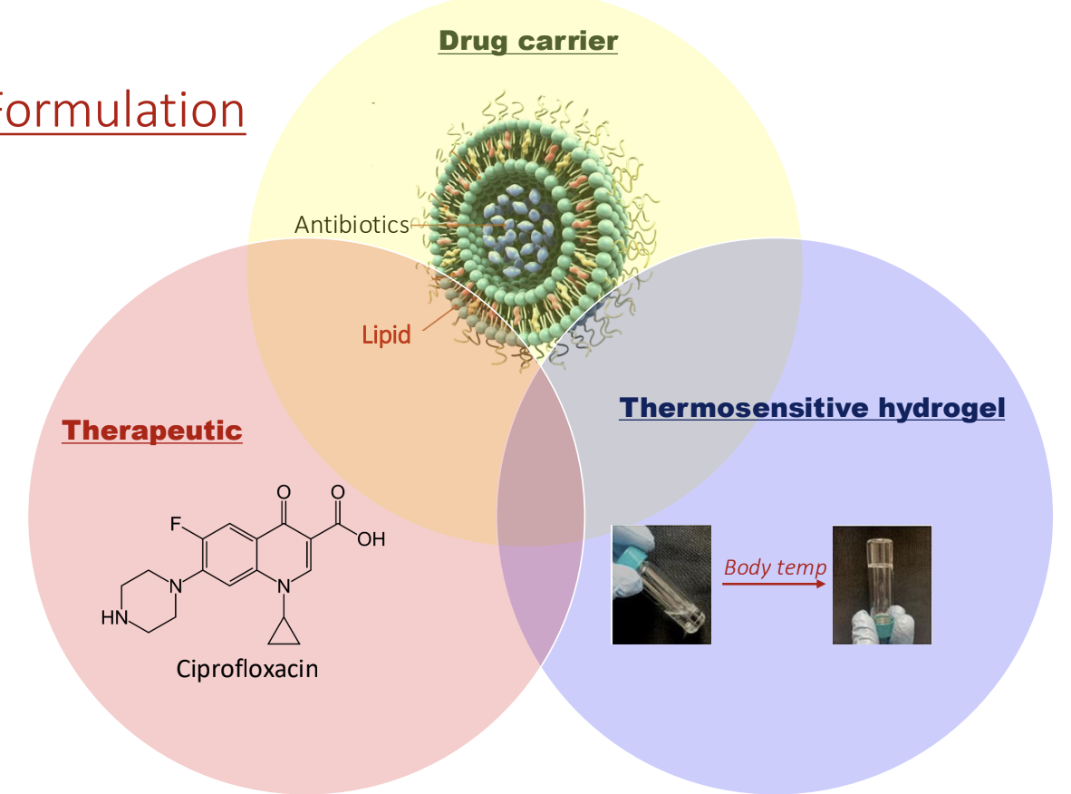

Our Propriatary Formulation
Sustained Release: Thermoresponsive hydrogel serves as a long-acting reservoir for the continuous delivery.
•
Active Traverse: Liposomes hitchhike immune cells to pass through TM effciently.
•
Targeted Delivery: Encapsulated antibotics are liberated at the infection and eradicate OM.
•

Slide 8
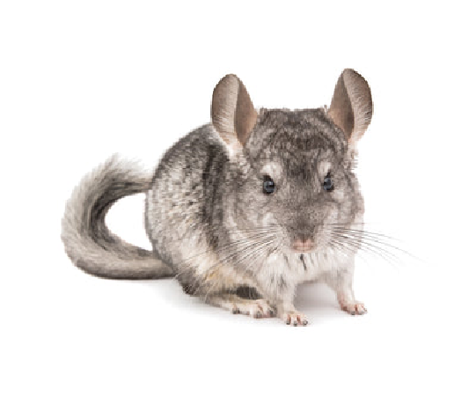
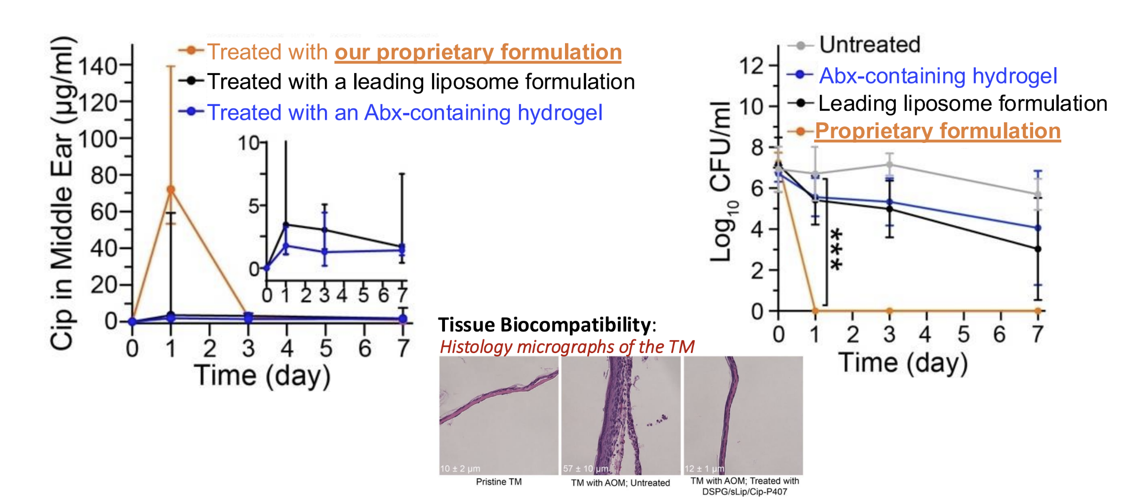
Super Efficacy: Single Dose, Rapid Sterilization
FDA-accepted preclinical animal model

Slide 9


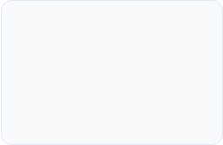
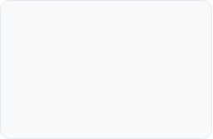

Strategic Road to Phase 1
Q3-Q4 2025
Preliminary safety and efficacy data in FDA-accepted preclinical animal model
Q1-Q2 2026
Q3 2026-Q1 2027
Q2 2027
Q3-Q4 2027
CMC & PK/PD (CRO Partners)
GLP Toxicology (CRO Partners)
Dual IND Filing (U.S. FDA & China NMPA)
Phase 1b (U.S./China Dual Track)
Notes:
We are starting at Phase 1b to get immediate human proof-of-cure. Because this is a 505(b)(2) pathway, a successful Phase 1b significantly compresses the remaining clinical timeline, potentially allowing us to jump directly into a registrational program.

Slide 10





Single Indication Valuation Model
Market Assumptions
Peak-Sales Multiple 3.0x
Addressable Market (U.S.) 16 Million
De-Risked Enterprise Value $720M
Price per Treatment $150
Market Penetration Target 10%
CURRENT RISK-ADJUSTED VALUE
~$70M
Derived from 10% Preclinical Stage Risk-Adjustment (rNPV)
* Valuation excludes pipeline expansion into Dermatology and global market royalty streams. Derived using standard biotech rNPV modeling.
Notes:
Under a base-case market model assuming 16 million addressable cases annually, $150 per treatment, and 10% U.S. market penetration, the asset supports $240 million in peak U.S. revenue. At a 3× peak-sales multiple, this implies a fully de-risked valuation of ~$720 million. Applying a preclinical-stage risk adjustment of 10%, we derive a conservative current valuation of approximately $70 million for OTO.

Slide 11

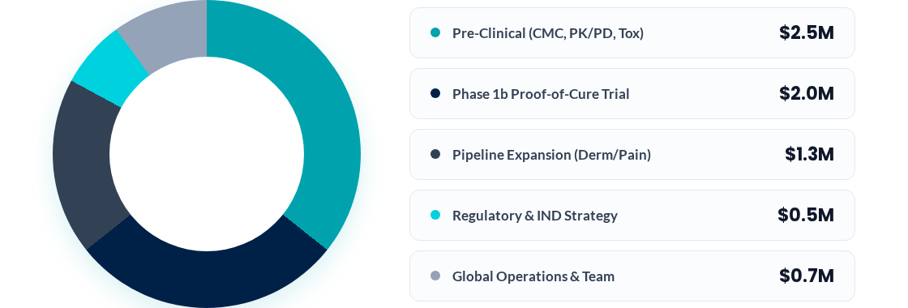
Capital Ask & Fund Allocation
Strategic deployment of capital toward human clinical
Capital Required: ~$7M , for 10% equity
Total Capital
$7.0M
83% Direct R&D Spend
24 MO Funding Runway
505(b)(2) FDA Pathway
Asset-Light Model: Leverages high-efficiency global CDMOs/CROs to maintain a lean burn rate while maximizing IP value.

Slide 12


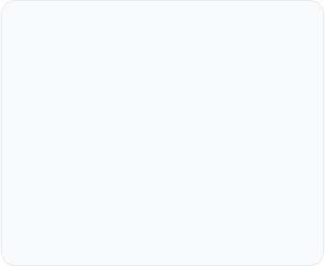
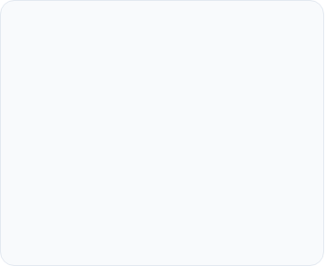



A Platform for Global Health
Otology
Dermatology
Platform Play
First indication: Acute Otitis Media. Potential pipelines include chronic inflammation and inner ear disorders.
Localized drug delivery for pain management, topical therapeutic relief, and chronic inflammatory skin diseases.
Scalable trans-barrier delivery platform for pharmaceuticals, consumer healthcare and cosmeceuticals.

Slide 13







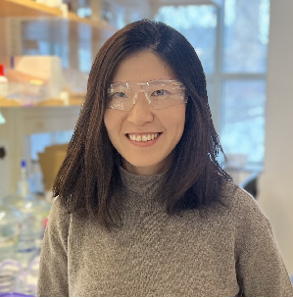

The Core Team
Di Yang, PhD
Prof. Rong Yang, PhD
Wenjing Tang, PhD
CEO & CO-FOUNDER
CSO & CO-FOUNDER
CHIEF TECH OFFICER
MIT PhD; ex-ExxonMobil R&D Lead.
Serial Entrepreneur
Tenured Professor at Cornell University. Global authority in biomaterial engineering.
Lead discovery scientist and expert in drug delivery mechanisms and formulation.

Slide 14
The Future is Local.
Join us in revolutionizing trans-barrier drug delivery.
Dr. Yang, PhD | CEO
Investment & Inquiries: info@oto-biotech.com

