Slide 1
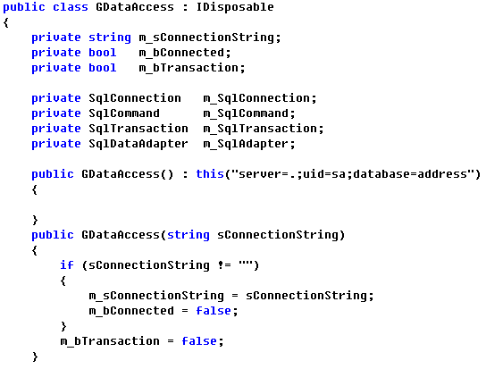
Common层 1 [GDataAccess]

Slide 2
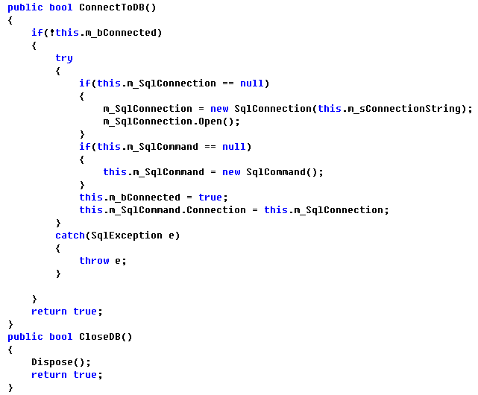
Common层 2

Slide 3
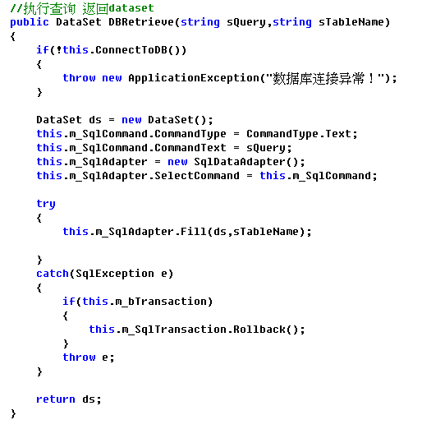
Common层 3

Slide 4
Common层 4

Slide 5
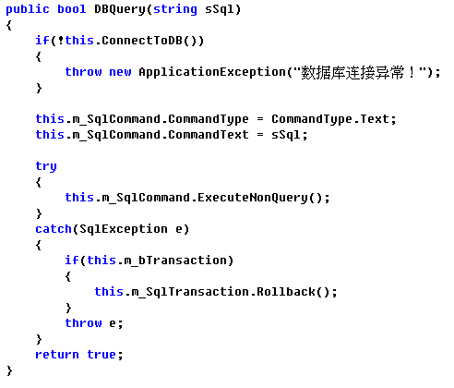
Common层 5

Slide 6
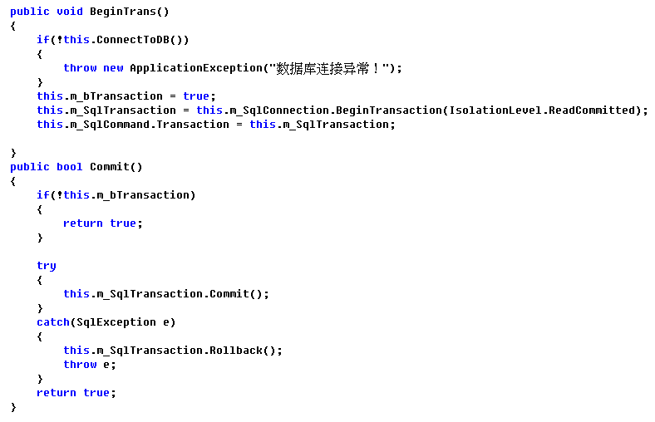
Common层 6

Slide 7
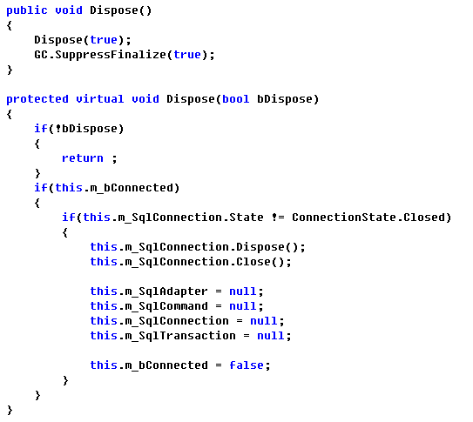
Common层 7

Slide 8
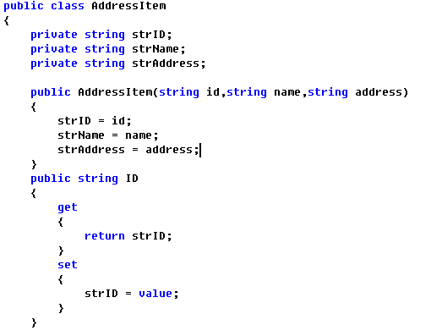
Common层 8

Slide 9
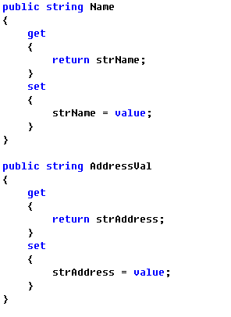
Common层 9

Slide 10
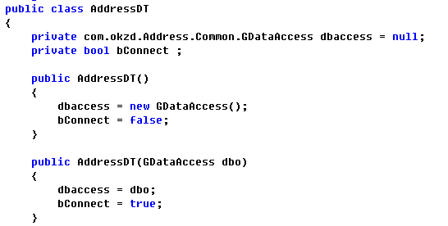
DataAccess层 1 [AddressDT]

Slide 11
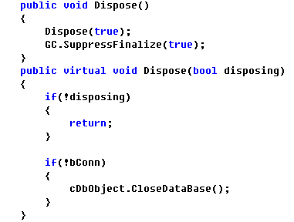
DataAccess层 2

Slide 12
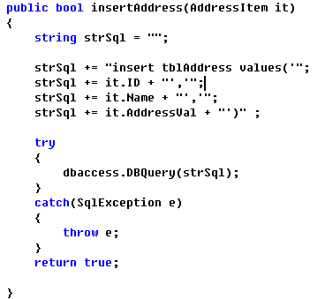
DataAccess层 3

Slide 13
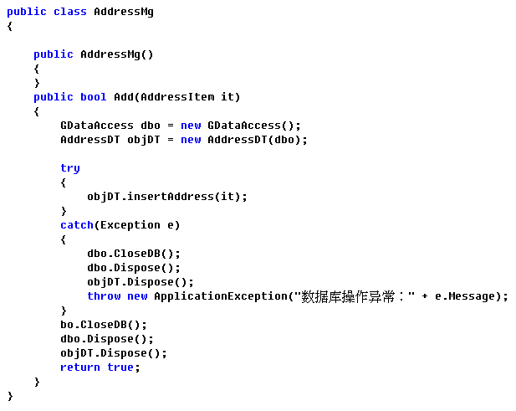
Business层 1 [AddressMg]

Slide 14
谢谢观赏！

