Slide 1
R Programming for Geospatial Applications
Instructor Information
Yang Shao
Email: yshao@vt.edu
Office: 217 Wallace Hall

Slide 2
The format of this course
Lectures, lab exercises, final project
Grading:
Labs and assignments - 85%
Final project – 15%

Slide 3
Required Materials:
An Introduction to R for Spatial Analysis and Mapping (recommended)
Laptop with Rstudio and ArcGIS installed.

Slide 4
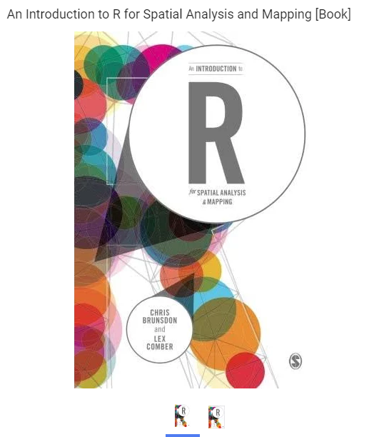
Texts

Slide 5
The format of this course
Lectures (Demos and In class exercises)
Labs
I’ll highlight key components of each lab and provide some demos on R programming; Each week I’ll have office hours for additional support (zoom?)

Slide 6
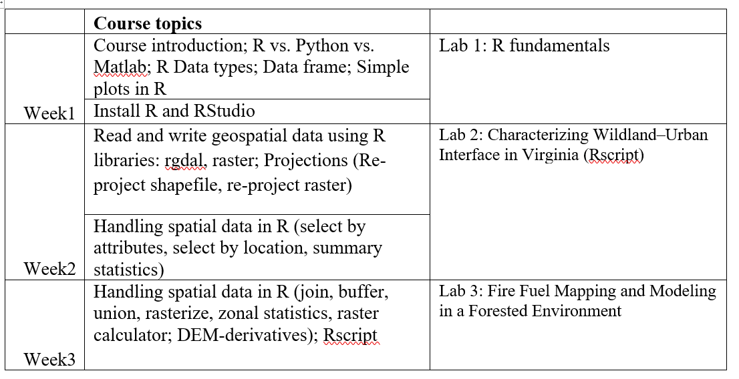
Tentative topics and schedule

Slide 7
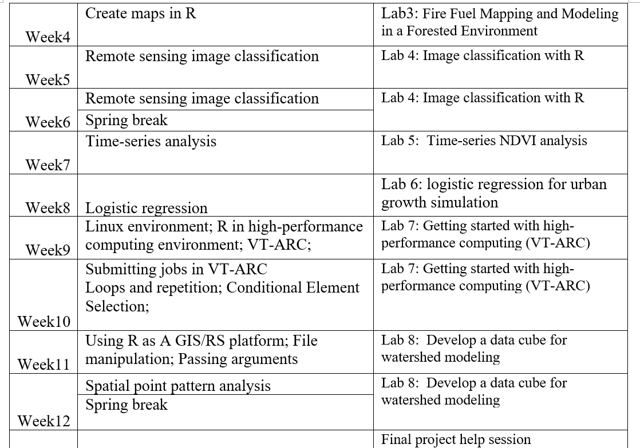

Slide 8
Labs
8 lab assignments
R fundamentals
Characterizing Wildland–Urban Interface in Virginia (Rscript)
Fire Fuel Mapping and Modeling in a Forested Environment (Rscript)
Landsat Image classification with R
Time-series NDVI analysis
Modeling land-use change in Loudoun County using logistic regression
Getting started with high-performance computing (VT ARC)
Automate data cube preparation for watershed modeling
Using R on Amazon AWS
Shiny App
Final project (presentation and final report)

Slide 9
Special Features
Homework Groups (4984 & 5984):
You may work in groups starting lab 4
You may form your own groups of 2-4

Slide 10

Lab Exercises
Software considerations
RStudio is the primary software package for this class.
Freely available; works on both Windows and Mac computers
ArcGIS pro – supporting role

Slide 11
How to succeed in this course:
Follow lectures and labs consistently
If something is not clear, ask a question
Clarify expectations with the instructor

Slide 12
Programming for Geospatial Research
Fall 2022

Slide 13
Outline
R/Python/Matlab for geospatial research
Software preparation (R, Rstudio, raster library, rgdal library)
Data types and plots in R

Slide 14


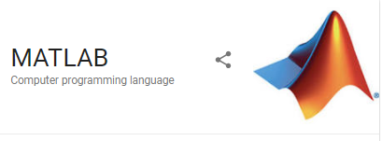
R/Python/Matlab
Freely available
Widely used in the stats, bioinformatics, data science
communities
Numerous functions and libraries
R GIS developer (many job opportunities)
Freely available
Widely used in the machine learning, data science (including geospatial) communities
Numerous functions and libraries
Python GIS Developer (many job opportunities)
A high-productivity development environment
Extensive toolboxes and apps
Faster performance and easy deployment
License, expensive

Slide 15
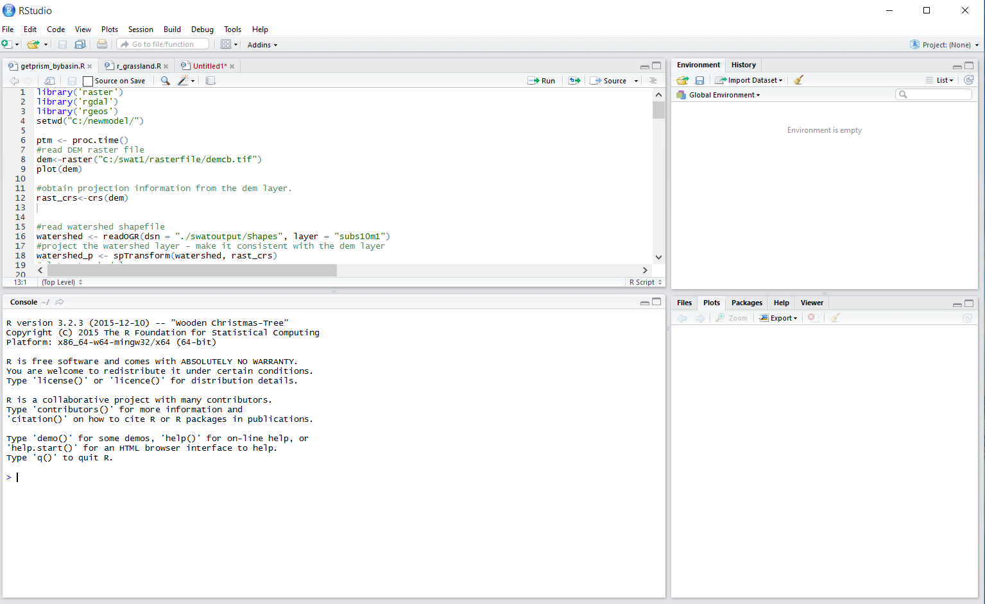
Integrated development environment for R

Slide 16
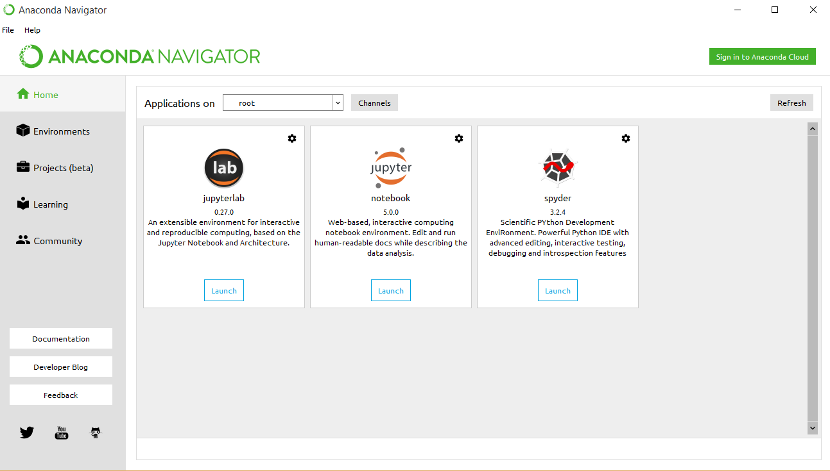
Integrated development environment for Python

Slide 17
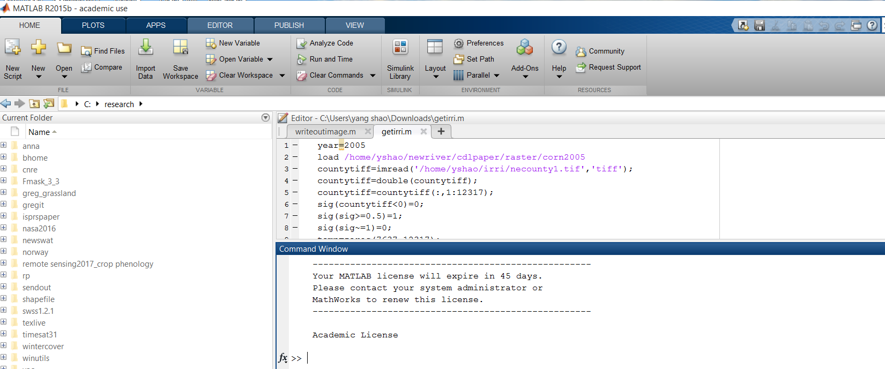
Integrated development environment for Matlab

Slide 18
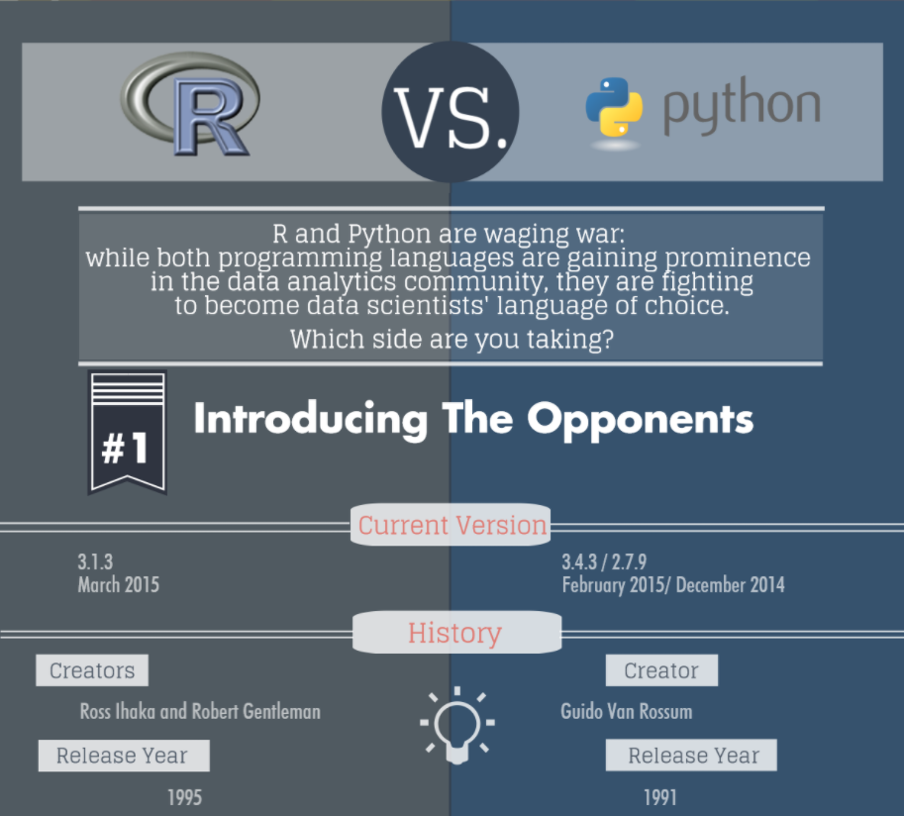
R vs. Python for data analysis
the S language for data analysis
and statistics at Bell Laboratories in the 1980s
Source: https://www.datacamp.com/community/tutorials/r-or-python-for-data-analysis

Slide 19
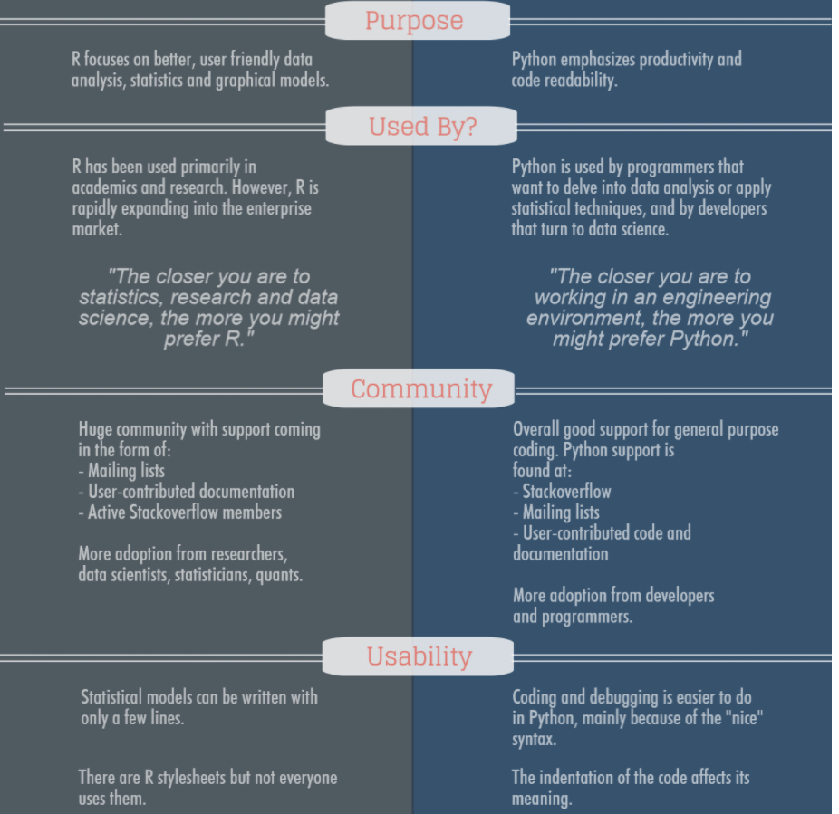
R vs. Python for data analysis
Source: https://www.datacamp.com/community/tutorials/r-or-python-for-data-analysis

Slide 20
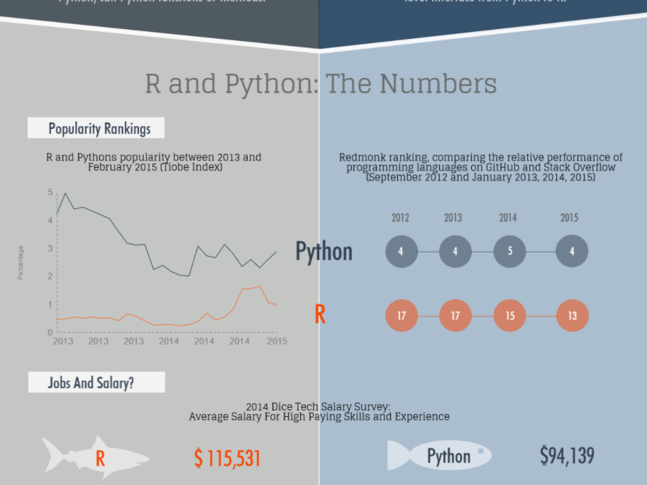
Source: https://www.datacamp.com/community/tutorials/r-or-python-for-data-analysis

Slide 21
Install R and Rstudio
https://cran.r-project.org/bin/windows/base/
4.3.0 (most recent)
https://rstudio.com/products/rstudio/

Slide 22
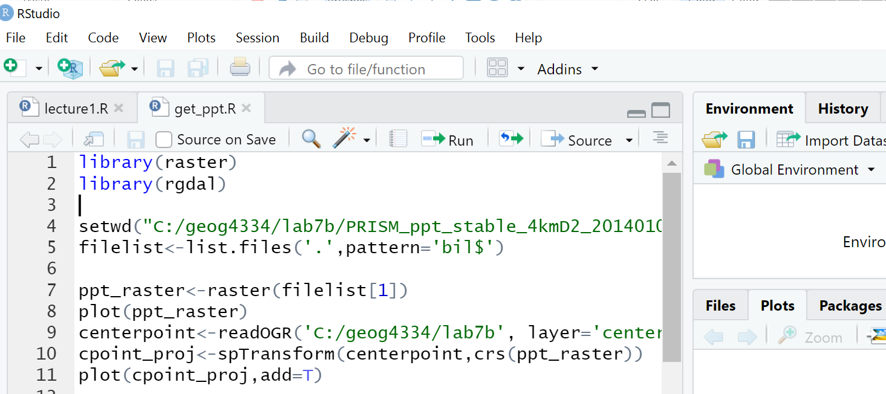
R for geospatial data analysis

Slide 23
R for geospatial data analysis
With rgdal, raster, GISToos and many other functions and libraries, R can be
considered as Integrated GIS/RS development environment
Download geospatial data (USGS gauges, climate data, land cover, dem ……)
Import/export various GIS files
Spatial analysis with GIS: buffer, select by attributes, select by location, overlay, clipping, zonal statistics, re-project, summary statistics, point-in-polygon analysis, kernel density, distance analysis, raster reclassification, vector to raster conversion, raster to vector conversion, terrain analysis, advanced spatial statistics, image classification, ….
Statistical analysis and machine learning (numerous packages), simulation models
R visualizations
Webgis: shiny-server, shiny-app

