Slide 1
R Programming for Geospatial Applications

Slide 2
The format of this course
Lectures and Lab sessions
Office Hours: Wednesday 3:30PM-4:30PM
Grading:
-Labs and assignments - 75%
-Midterm exam (or project) - 10%
-Final project – 15%

Slide 3
Recommended Materials:
-An Introduction to R for Spatial Analysis and Mapping
-Geocomputation with R (Lovelace et al.)
https://r.geocompx.org

Slide 4
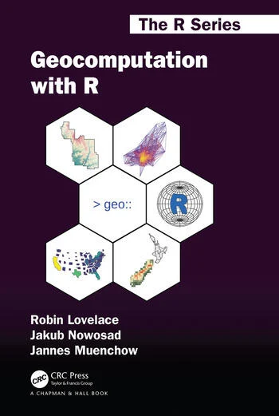
R for Geospatial Computing (https://r.geocompx.org)
R for Geospatial Computing

Slide 5
The format of this course
Lectures (include Demos and In class exercises)
Labs
I’ll highlight key components of each lab and provide some demos on R programming; Each week I’ll have office hours for additional support (zoom?)

Slide 6
Tentative topics and schedule
Week | Dates | Topics | Labs
Week 1 | Aug 25 - Aug 31 | Course introduction; R vs. Python vs. Matlab; R Data types; Data frame; Simple plots in R | Install R and RStudio
Week 2 | Sep 1 - Sep 7 | Read and write geospatial data using R libraries: sf and terra; Projections (Re-project shapefile, re-project raster); Handling spatial data in R (select by attributes, select by location, summary statistics) | Lab 1: R fundamentals
Week 3 | Sep 8 - Sep 14 | Handling spatial data in R (join, buffer, union, Spatial subsetting, raster calculator, zonal statistics; DEM-derivatives) | Lab 2: Characterizing Wildland–Urban Interface in Virginia (Rscript)
Week 4 | Sep 15 - Sep 21 | Create maps in R | Lab 3: Fire Fuel Mapping and Modeling in a Forested Environment (Rscript)
Week 5 | Sep 22 - Sep 28 | R Scripts; Loops and repetition; Conditional Element Selection; Build your R functions | Lab 4: Working with census data
Week 6 | Sep 29 - Oct 5 | Remote sensing image classification using Random Forest algorithm | Lab 5: Image classification with R
Week 7 | Oct 6 - Oct 12 | Remote sensing image classification; cross-validation; caret package | Lab 5: Image classification with R
Week 8 | Oct 13 - Oct 19 | Regression analysis; Logistic regression | Lab 6: logistic regression for urban growth simulation
Week 9 | Oct 20 - Oct 26 | Time-series analysis | Lab 6: logistic regression for urban growth simulation
Week 10 | Oct 27 - Nov 2 | Linux environment; R in high-performance computing environment; VT-ARC | Lab 7: Getting started with high-performance computing (VT-ARC)
Week 11 | Nov 3 - Nov 9 | Linux environment; R in high-performance computing environment; VT-ARC | Lab 7: Getting started with high-performance computing (VT-ARC)
Week 12 | Nov 10 - Nov 16 | Spatial point pattern analysis; Principal components | Lab 8: Spatial stats
Week 13 | Nov 17 - Nov 23 | R for web app; Shiny app | Final project help session
Week 14 | Nov 24 - Nov 30 | Thanksgiving holiday | NA
Week 15 | Dec 1 - Dec 7 | Final project (group presentation) | Final project help session
Week 16 | Dec 8 - Dec 14 | Final project (group presentation) | Final project (group presentation)

Slide 7
lab assignments
Topic
r_fundamentals
Characterizing Wildland–Urban Interface in Virginia (Rscript)
Fire Fuel Mapping and Modeling in a Forested Environment (Rscript)
Working with census data
Landsat Image classification with R
Logistic regression for urban growth simulation
Getting started with high-performance computing (VT ARC)
Spatial stats

Slide 8
Midterm Exam and Final Project
Midterm Exam (or Project)
All based on labs and in-class exercises.
Final Project
Presentation only.

Slide 9

Software considerations

Slide 10

Software considerations

Slide 11
How to succeed in this course
Follow lectures and labs consistently
If something is not clear, ask a question
Clarify expectations with the instructor

Slide 12
Why R for Geospatial Computing?
-Comprehensive Statistical and Analytical Tools
-Extensive Package Ecosystem: R has a wide range of packages tailored for spatial data analysis, such as sf, terra, and raster.
-Statistical Analysis: R is renowned for its statistical capabilities, making it ideal for geospatial analysis where statistical methods are often applied.
-Reproducibility: R scripts and R Markdown documents promote reproducible research, ensuring that analyses can be reproduced and verified by others.

Slide 13
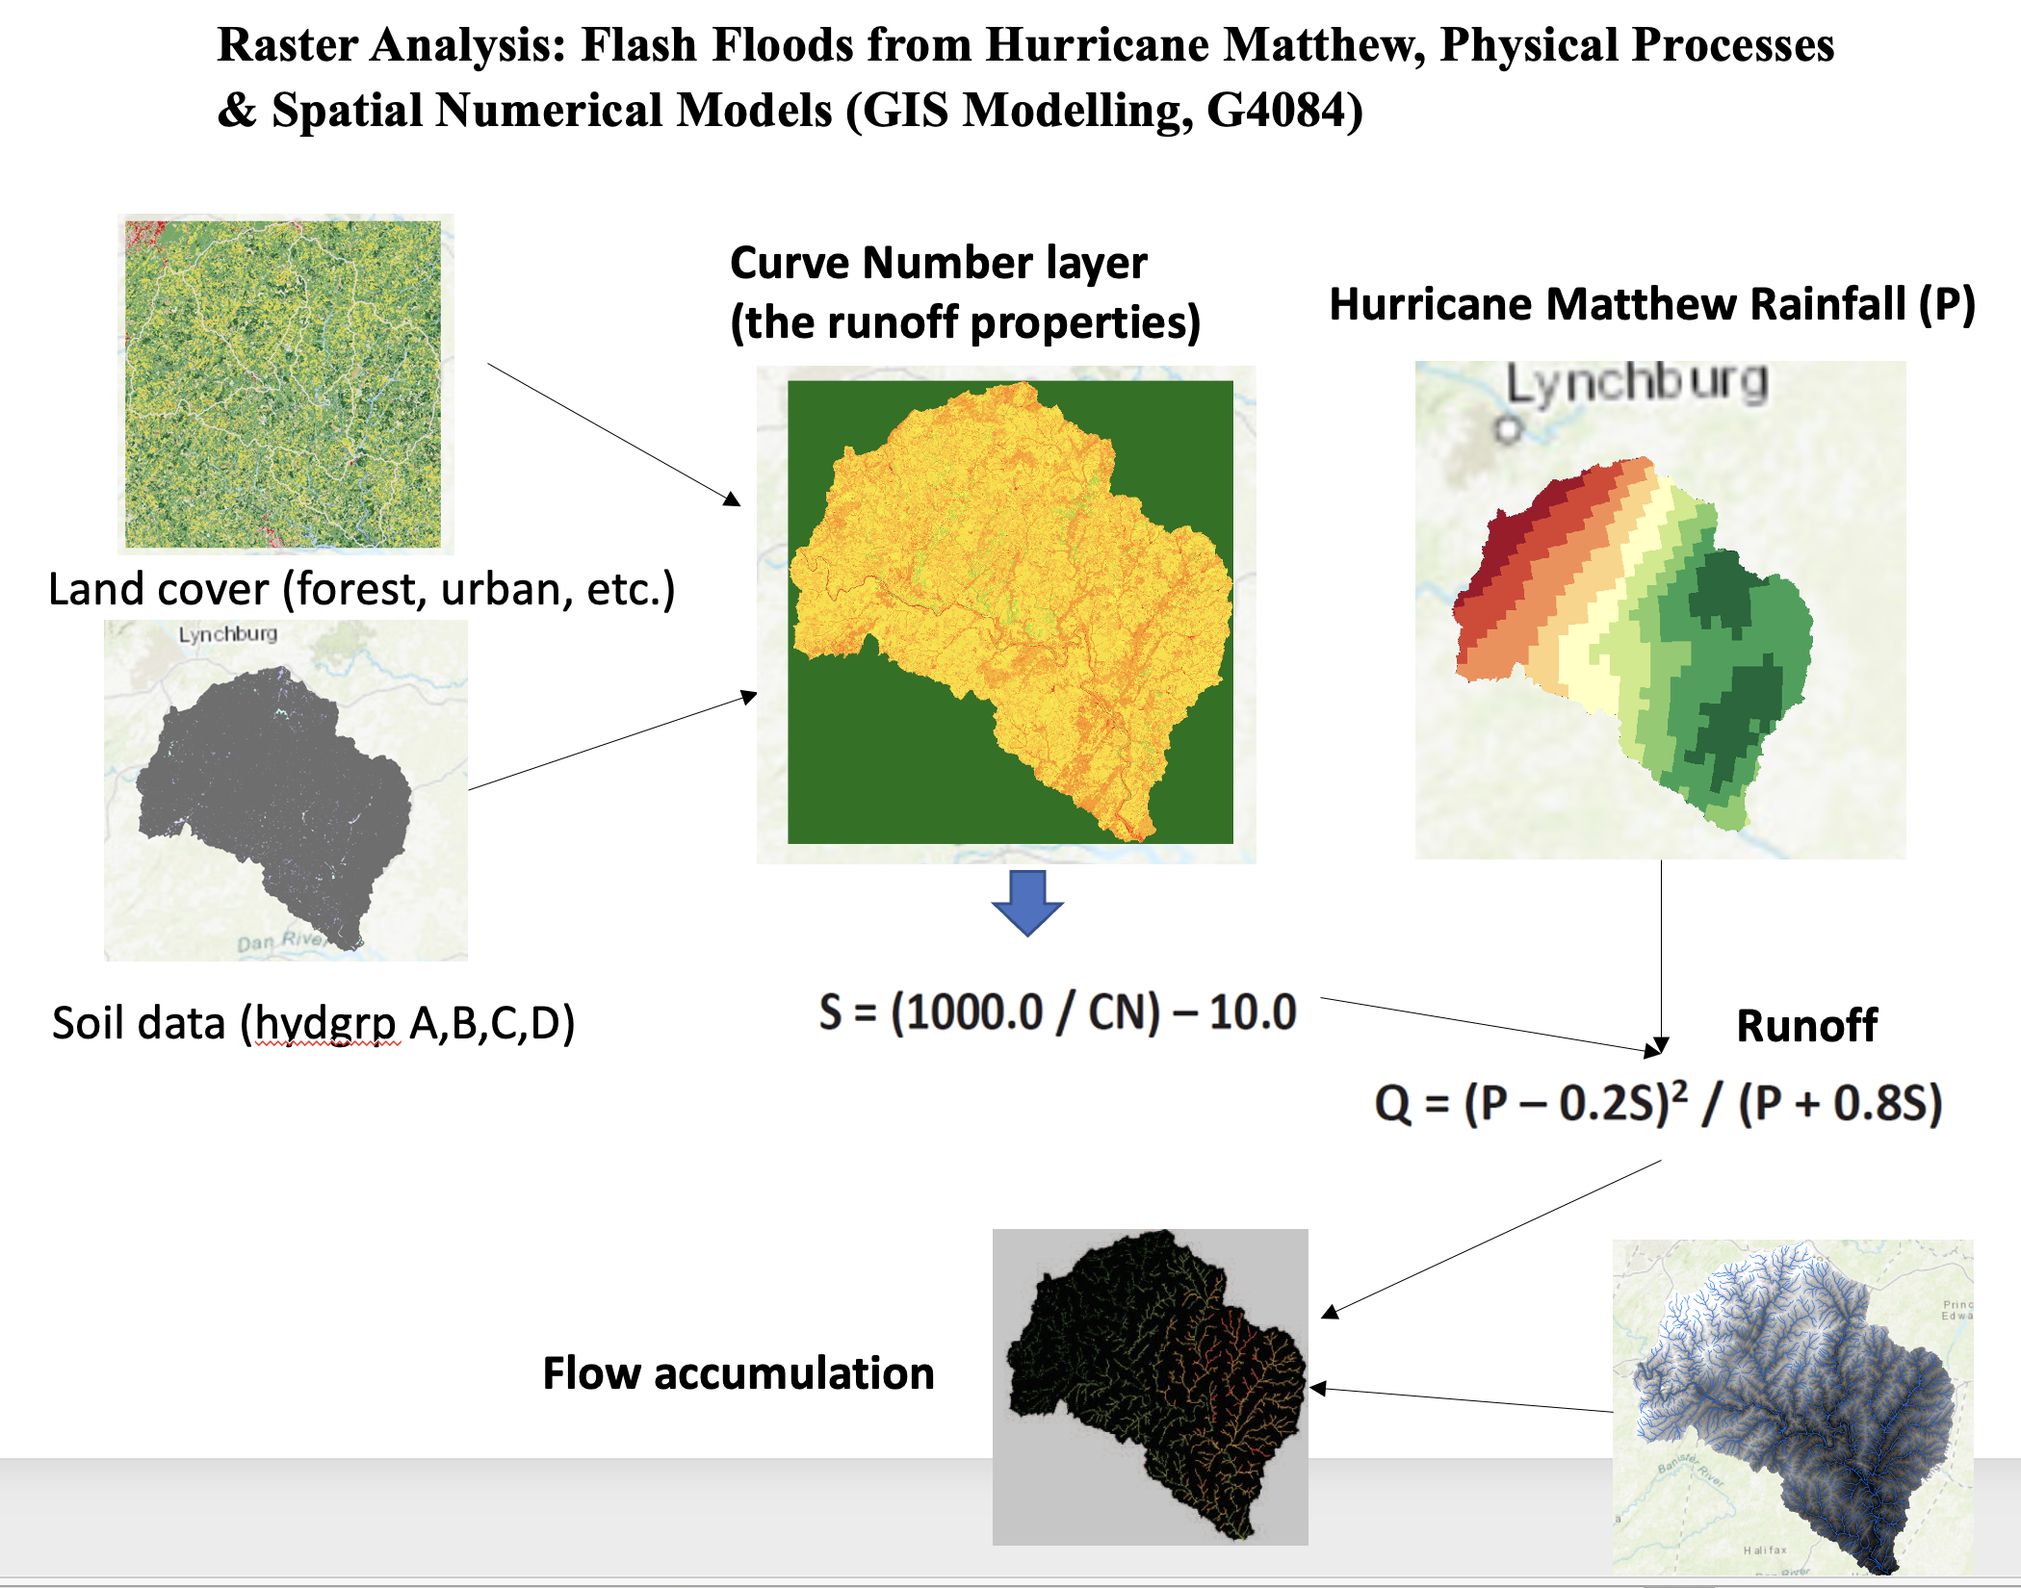
Spatial analysis, workflow, and Reproducibility

Slide 14
Why R for Geospatial Computing?
Handling Large Datasets
R is equipped with powerful tools and packages like data.table and dplyr that allow for efficient manipulation and analysis of large datasets.
R provides robust looping and iteration constructs
for loops, while loops, and the apply family of functions for efficient data processing.
R supports functional programming paradigms
create and apply functions over data structures efficiently.

Slide 15
R/Python/Matlab
Freely available
Widely used in the stats, bioinformatics, data science communities
Numerous functions and libraries
R GIS developer (many job opportunities)

Slide 16

R/Python/Matlab
Freely available
Widely used in the machine learning, data science (including geospatial) communities
Numerous functions and libraries
Python GIS Developer (many job opportunities)

Slide 17
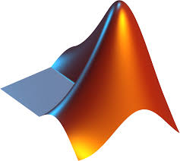
R/Python/Matlab
A high-productivity development environment
Extensive toolboxes and apps
Faster performance and easy deployment
License, expensive

Slide 18
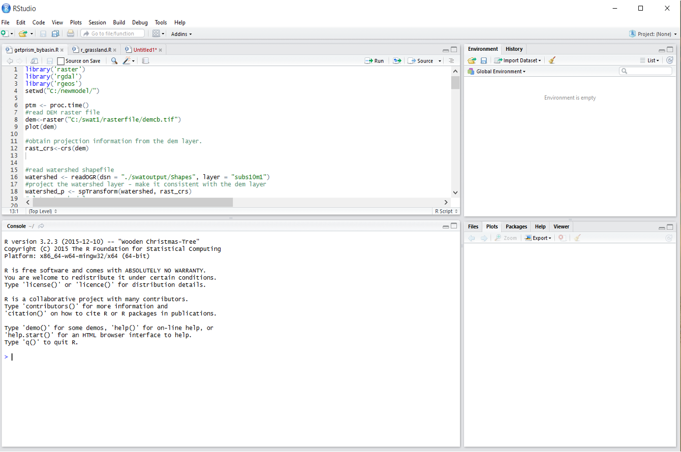
Integrated development environment for R

Slide 19
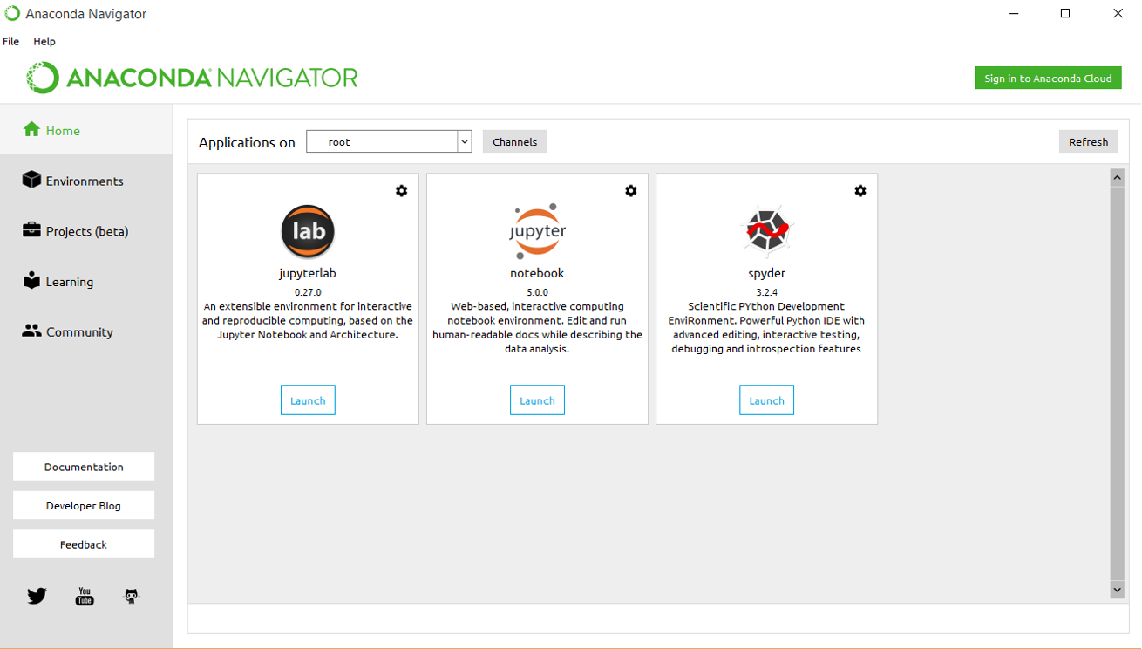
Integrated development environment for Python

Slide 20
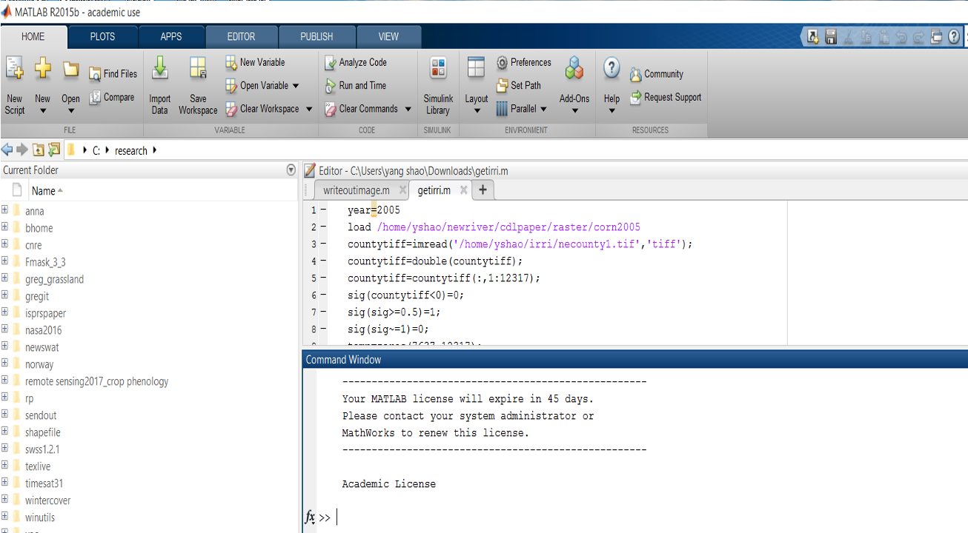
Integrated development environment for Matlab

Slide 21
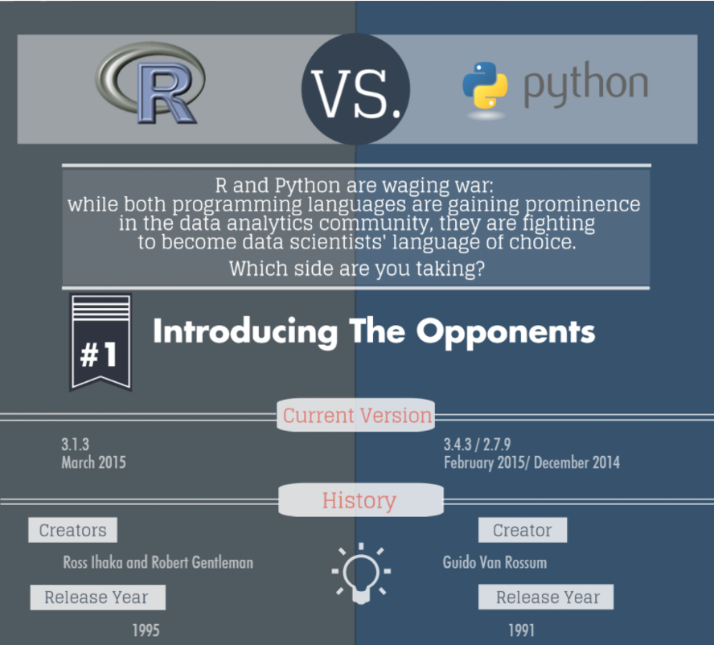
R vs. Python for data analysis
Origin of R - the S language for data analysis and statistics at Bell Laboratories in the 1980s

Slide 22
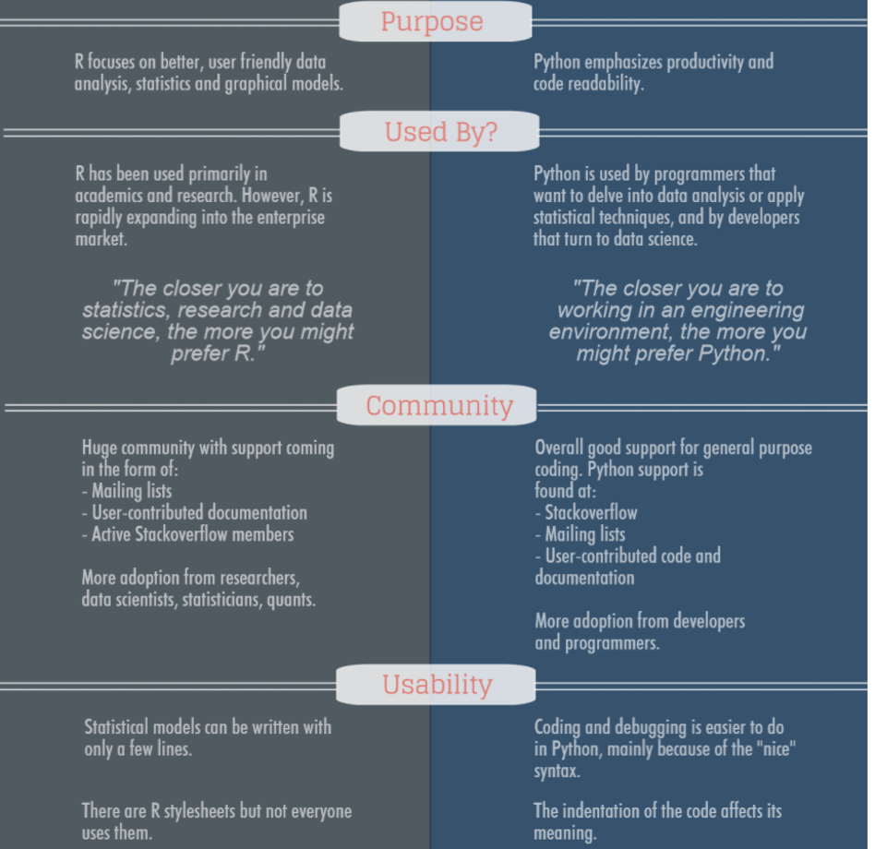
R vs. Python for data analysis

Slide 23
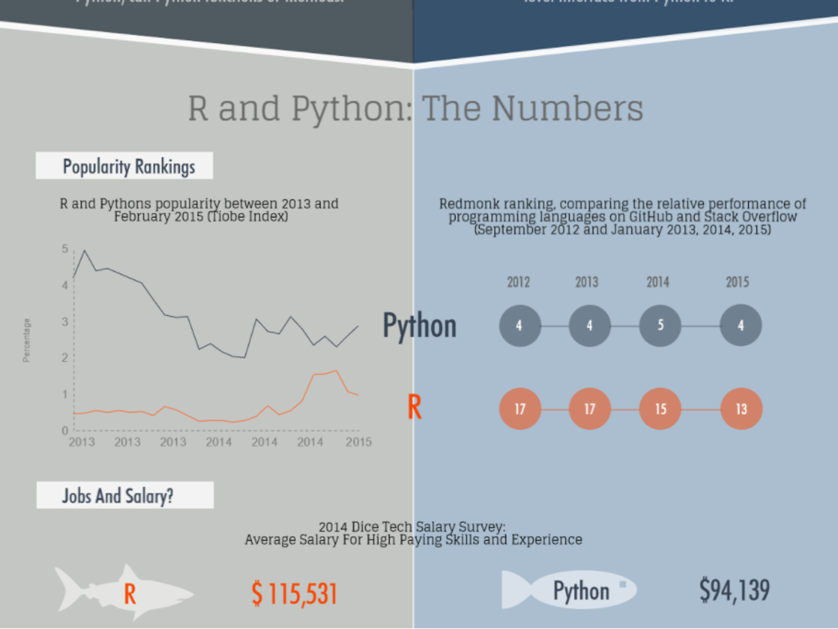
Salary Trends

Slide 24
R for geospatial data analysis
With sf, terra, tidyverse, mapview, and many other functions and libraries, R can be considered as Integrated GIS/RS development environment
- Download geospatial data (USGS gauges, climate data, land cover, dem ……)
Import/export various GIS files
Spatial analysis with GIS: buffer, select by attributes, select by location, overlay, clipping, zonal statistics, re-project, summary statistics, point-in-polygon analysis, kernel density, distance analysis, raster reclassification, vector to raster conversion, raster to vector conversion, terrain analysis, advanced spatial statistics, image classification, ….
Statistical analysis and machine learning (numerous packages), simulation models
R visualizations

