Slide 1
R Programming for Geospatial Applications

Slide 2
Outline
raster, terra,and mapview libraries (read raster and shapefile)
Handling spatial data in R (attributes, field calculator, select by attributes, select by location, summary statistics)

Slide 3
R terra package
“Methods for spatial data analysis with vector (points, lines, polygons) and raster (grid) data. Methods for vector data include geometric operations such as intersect and buffer. Raster methods include local, focal, global, zonal and geometric operations. The predict and interpolate methods facilitate the use of regression type (interpolation, machine learning) models for spatial prediction, including with satellite remote sensing data. Processing of very large files is supported. See the manual and tutorials on https://rspatial.org/ to get started. ‘terra’ replaces the ‘raster’ package (‘terra’ can do more, and it is faster and easier to use).”

Slide 4
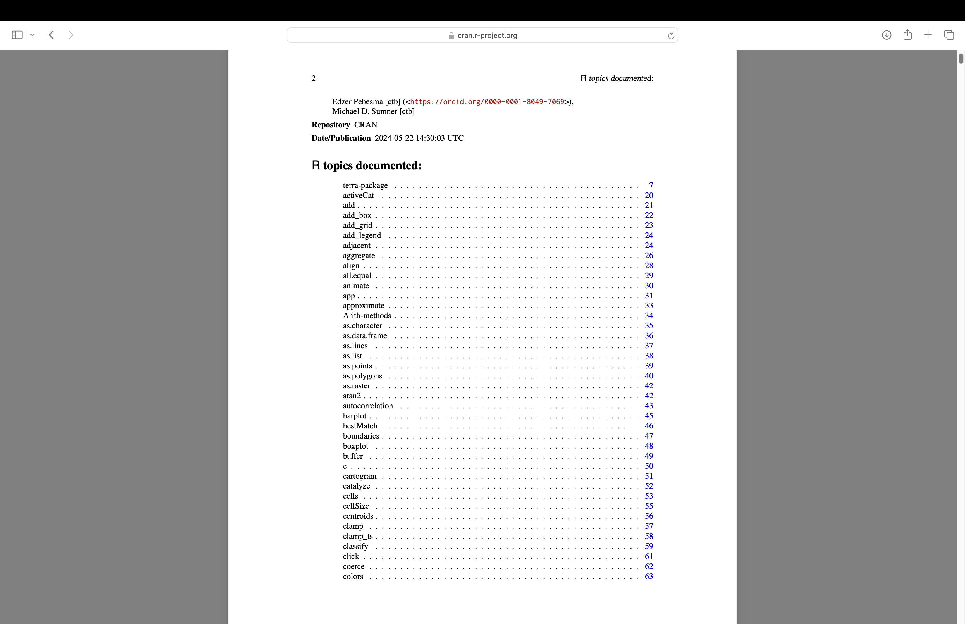
R terra package

Slide 5
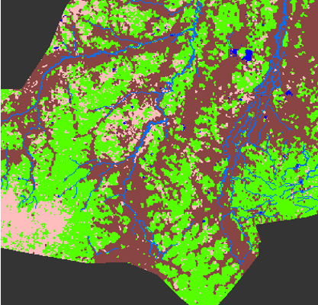
Examples of raster data

Slide 6
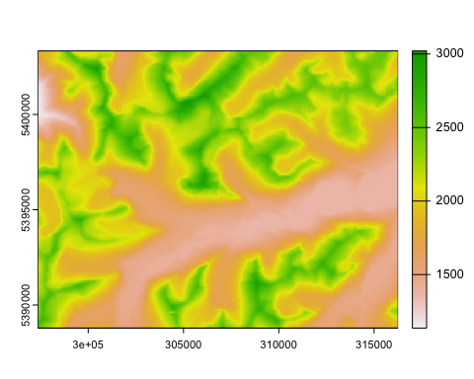
Example of raster data (DEM)
library(terra) dem<-rast('elev.tif') dem
## class : SpatRaster ## dimensions : 485, 630, 1 (nrow, ncol, nlyr) ## resolution : 30, 30 (x, y) ## extent : 297362.1, 316262.1, 5388787, 5403337 (xmin, xmax, ymin, ymax) ## coord. ref. : WGS 84 / UTM zone 12N (EPSG:32612) ## source : elev.tif ## name : elev
plot(dem)

Slide 7
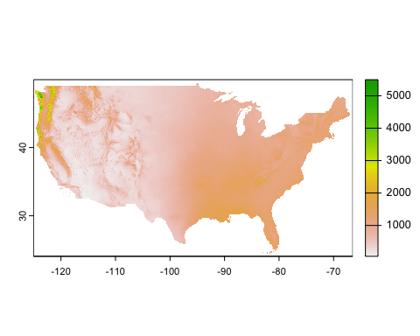
pcp data
a<-rast('PRISM_ppt_30yr_normal_4kmM2_annual_asc.asc') plot(a)

Slide 8
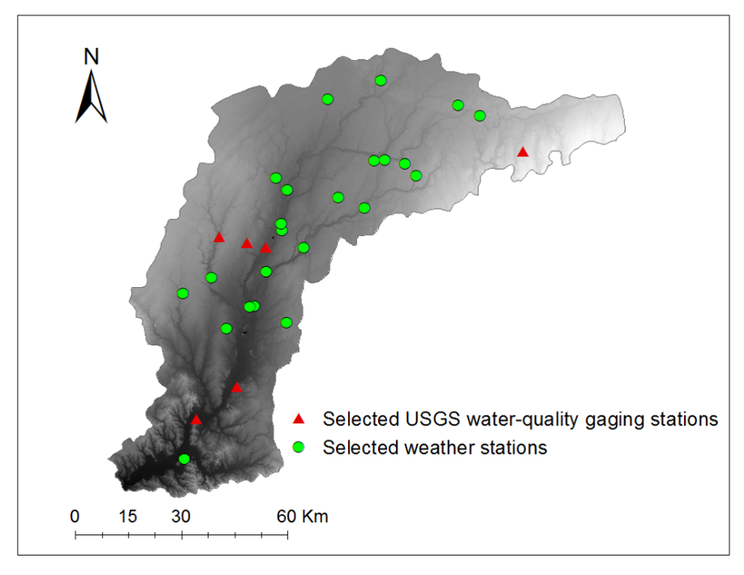
Example of vector data

Slide 9
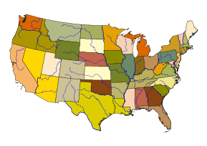
Example of vector data

Slide 10
R sf library (Simple Features for R)
R sf library (simple feature)
Represents simple features as records in a data.frame or tibble with a geometry list-column
Represents natively in R all 17 simple feature types for all dimensions (XY, XYZ, XYM, XYZM)
Interfaces to GEOS for geometrical operations on projected coordinates, and (through R package s2) to s2geometry for geometrical operations on ellipsoidal coordinates
Interfaces to GDAL, supporting all driver options, Date and POSIXct and list-columns
Interfaces to PROJ for coordinate reference system conversion and transformation
Uses well-known-binary serialisations written in C++/Rcpp for fast I/O with GDAL and GEOS
Reads from and writes to spatial databases such as PostGIS using DBI
Source: https://r-spatial.github.io/sf/

Slide 11
Read a shapefile (y2010.shp)
library(sf) pophu <- st_read('y2010.shp')
## Reading layer `y2010' from data source ## `/Users/yshao/work/Geog4254-5254G/week2/y2010.shp' using driver `ESRI Shapefile' ## Simple feature collection with 16565 features and 9 fields ## Geometry type: MULTIPOLYGON ## Dimension: XY ## Bounding box: xmin: -81.01449 ymin: 36.879 xmax: -79.83963 ymax: 37.66029 ## Geodetic CRS: NAD83

Slide 12
data frame (attribute table)
head(pophu)
## Simple feature collection with 6 features and 9 fields ## Geometry type: MULTIPOLYGON ## Dimension: XY ## Bounding box: xmin: -80.32668 ymin: 37.22773 xmax: -79.84163 ymax: 37.49369 ## Geodetic CRS: NAD83 ## STATEFP10 COUNTYFP10 TRACTCE10 BLOCKCE BLOCKID10 PARTFLG HOUSING10 ## 1 51 019 030602 2047 510190306022047 N 0 ## 2 51 045 050100 3028 510450501003028 N 145 ## 3 51 045 050100 3046 510450501003046 N 0 ## 4 51 045 050100 3030 510450501003030 N 0 ## 5 51 045 050100 2328 510450501002328 N 0 ## 6 51 045 050100 2100 510450501002100 N 0 ## POP10 ID geometry ## 1 0 1 MULTIPOLYGON (((-79.84413 3... ## 2 326 2 MULTIPOLYGON (((-80.10891 3... ## 3 0 3 MULTIPOLYGON (((-80.20565 3... ## 4 0 4 MULTIPOLYGON (((-80.18561 3... ## 5 0 5 MULTIPOLYGON (((-80.32459 3... ## 6 0 6 MULTIPOLYGON (((-80.29813 3...

Slide 13
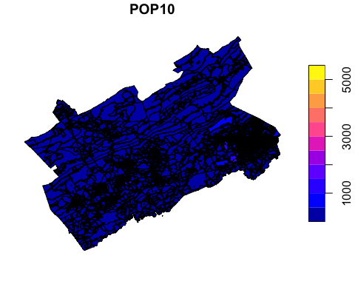
plot the sf data frame
plot(pophu["POP10"])

Slide 14
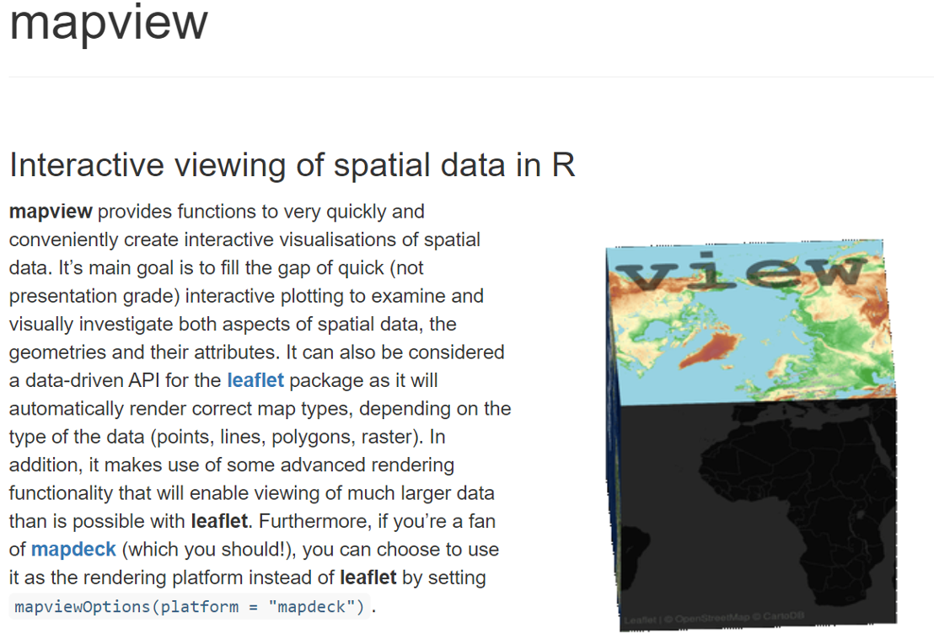
Mapview

Slide 15
A quick demo on mapview usage

Slide 16
Outline
raster, terra,and mapview libraries (read raster and shapefile)
Handling spatial data in R (attributes, field calculator, select by attributes, select by location, summary statistics)

Slide 17
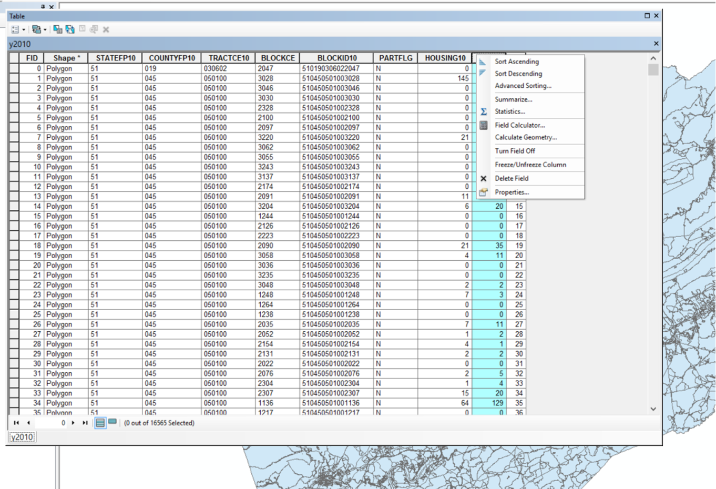
Arcmap: add a field, field calculator

Slide 18
#sf data frame - Just like the attribute table
head(pophu)
## Simple feature collection with 6 features and 9 fields ## Geometry type: MULTIPOLYGON ## Dimension: XY ## Bounding box: xmin: -80.32668 ymin: 37.22773 xmax: -79.84163 ymax: 37.49369 ## Geodetic CRS: NAD83 ## STATEFP10 COUNTYFP10 TRACTCE10 BLOCKCE BLOCKID10 PARTFLG HOUSING10 ## 1 51 019 030602 2047 510190306022047 N 0 ## 2 51 045 050100 3028 510450501003028 N 145 ## 3 51 045 050100 3046 510450501003046 N 0 ## 4 51 045 050100 3030 510450501003030 N 0 ## 5 51 045 050100 2328 510450501002328 N 0 ## 6 51 045 050100 2100 510450501002100 N 0 ## POP10 ID geometry ## 1 0 1 MULTIPOLYGON (((-79.84413 3... ## 2 326 2 MULTIPOLYGON (((-80.10891 3... ## 3 0 3 MULTIPOLYGON (((-80.20565 3... ## 4 0 4 MULTIPOLYGON (((-80.18561 3... ## 5 0 5 MULTIPOLYGON (((-80.32459 3... ## 6 0 6 MULTIPOLYGON (((-80.29813 3...

Slide 19
Use st_area() function for area calculation
add the results as a new column (new field named as area) in the attribute table
pophu$area <- as.numeric(st_area(pophu)) head(pophu)
## Simple feature collection with 6 features and 10 fields ## Geometry type: MULTIPOLYGON ## Dimension: XY ## Bounding box: xmin: -80.32668 ymin: 37.22773 xmax: -79.84163 ymax: 37.49369 ## Geodetic CRS: NAD83 ## STATEFP10 COUNTYFP10 TRACTCE10 BLOCKCE BLOCKID10 PARTFLG HOUSING10 ## 1 51 019 030602 2047 510190306022047 N 0 ## 2 51 045 050100 3028 510450501003028 N 145 ## 3 51 045 050100 3046 510450501003046 N 0 ## 4 51 045 050100 3030 510450501003030 N 0 ## 5 51 045 050100 2328 510450501002328 N 0 ## 6 51 045 050100 2100 510450501002100 N 0 ## POP10 ID geometry area ## 1 0 1 MULTIPOLYGON (((-79.84413 3... 37889.894 ## 2 326 2 MULTIPOLYGON (((-80.10891 3... 46966052.121 ## 3 0 3 MULTIPOLYGON (((-80.20565 3... 6516.172 ## 4 0 4 MULTIPOLYGON (((-80.18561 3... 18125.262 ## 5 0 5 MULTIPOLYGON (((-80.32459 3... 23095.516 ## 6 0 6 MULTIPOLYGON (((-80.29813 3... 2345.279

Slide 20
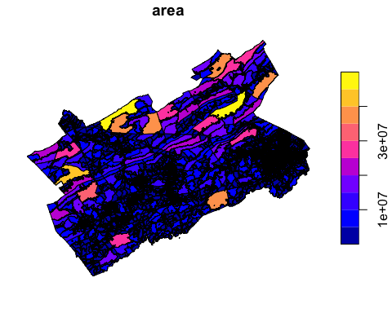
Plot
plot(pophu["area"])

Slide 21
Export data as ESRI shapefile
You can add the resultant test1.shp to ArcGIS
st_write(pophu,'test1.shp',delete_dsn = TRUE)
## Deleting source `test1.shp' using driver `ESRI Shapefile' ## Writing layer `test1' to data source `test1.shp' using driver `ESRI Shapefile' ## Writing 16565 features with 10 fields and geometry type Multi Polygon.

Slide 22
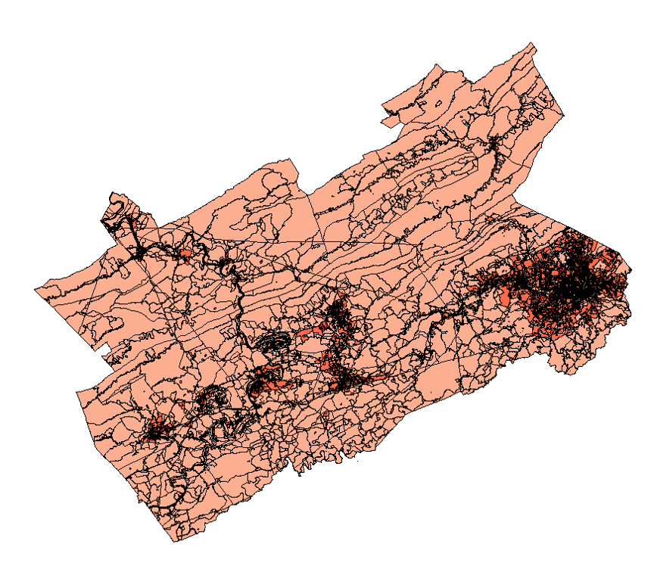
Housing density?

Slide 23
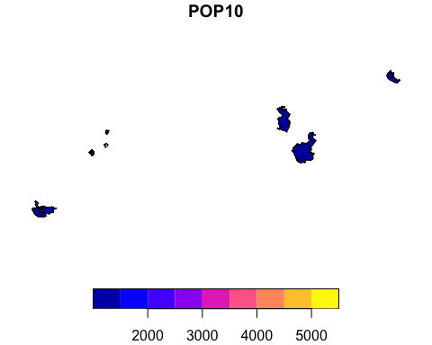
Handling spatial data in R ( select by attributes, select by location, summary statistics)
a<-pophu[pophu$POP10>1000,] plot(a["POP10"])

Slide 24
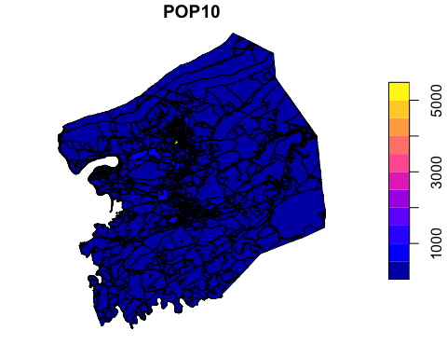
## Select by location
county<-st_read('mycounty.shp')
## Reading layer `mycounty' from data source ## `/Users/yshao/work/Geog4254-5254G/week2/mycounty.shp' using driver `ESRI Shapefile' ## Simple feature collection with 1 feature and 51 fields ## Geometry type: MULTIPOLYGON ## Dimension: XY ## Bounding box: xmin: 534153.2 ymin: 4092959 xmax: 573154.1 ymax: 4135775 ## Projected CRS: NAD83 / UTM zone 17N
county_proj<-st_transform(county,crs(pophu)) pophu_withincounty<-st_intersection(pophu,county_proj) plot(pophu_withincounty["POP10"])

Slide 25
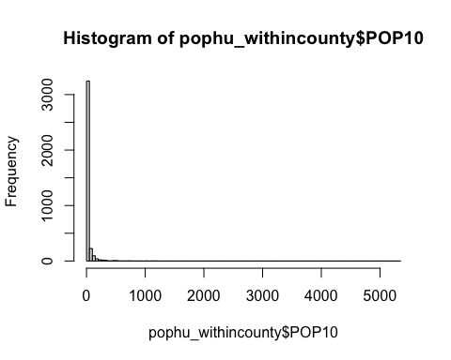
summary statistics
# Summary of a specific attribute column summary(pophu_withincounty$POP10)
## Min. 1st Qu. Median Mean 3rd Qu. Max. ## 0.00 0.00 1.00 26.78 19.00 5322.00
hist(pophu_withincounty$POP10,breaks=100)

