Slide 1
Logistic regression models

Slide 2
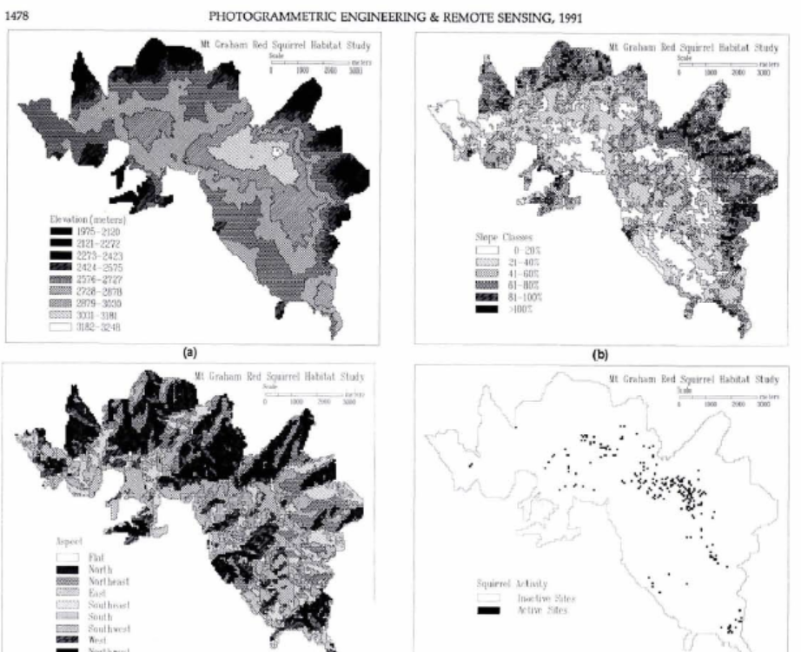
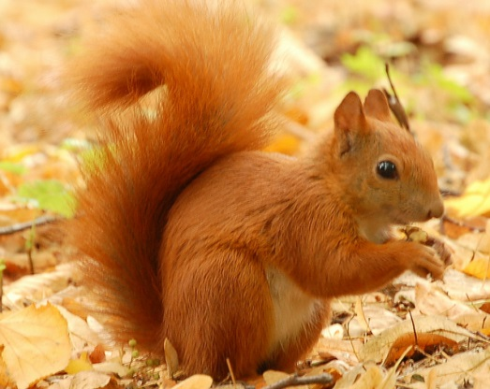
Habitat Modeling Using Logistic Regression
red squirrel presence or absence, based on
a series of environmental
and locational
descriptor variables
GIs-Based Habitat Modeling Using Logistic Multiple Regression: A Study
of the Mt. Graham Red Squirrel, PEREIRA and ITAMI, 1991.

Slide 3
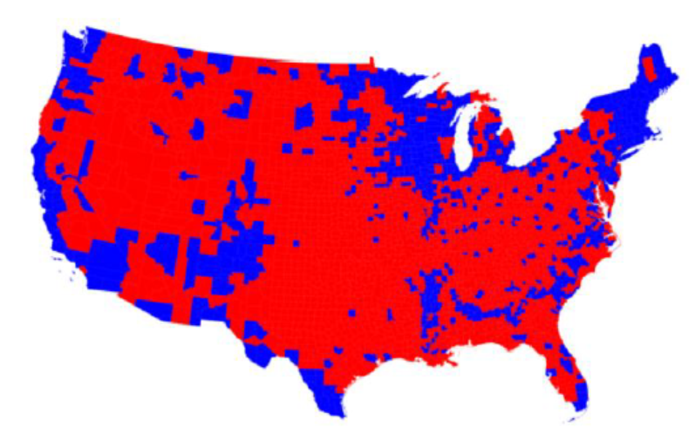
Logistic regression model (example)
Y: American voter will vote Democratic (code=1) or Republican (code = 0)
X: age, income, gender, race, state of residence, votes in previous elections, etc
Can you provide another example?

Slide 4
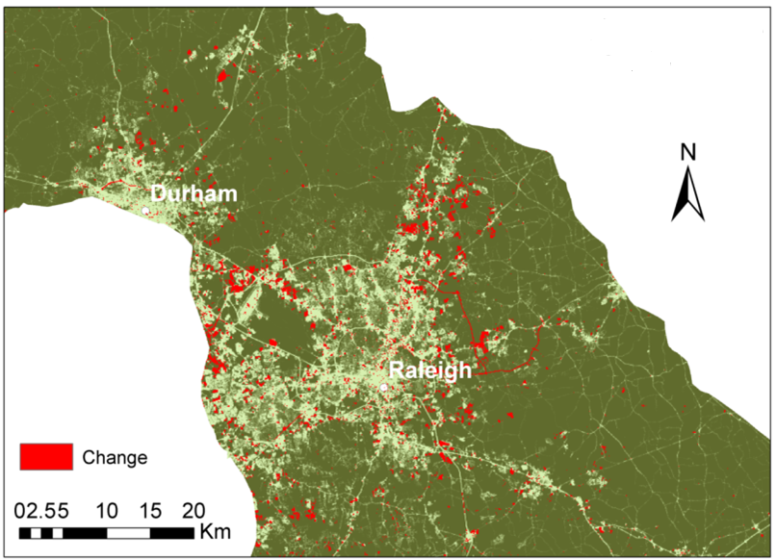
Spatially explicit model
Logistic regression model
Dependent variable (Y): Forest loss: Y=1
Others: Y=0
1 | 1 | 0 | 0
1 | 0 | 0 | 0
0 | 0 | 1 | 0
0 | 0 | 0 | 1
Each pixel has 30 m spatial resolution

Slide 5
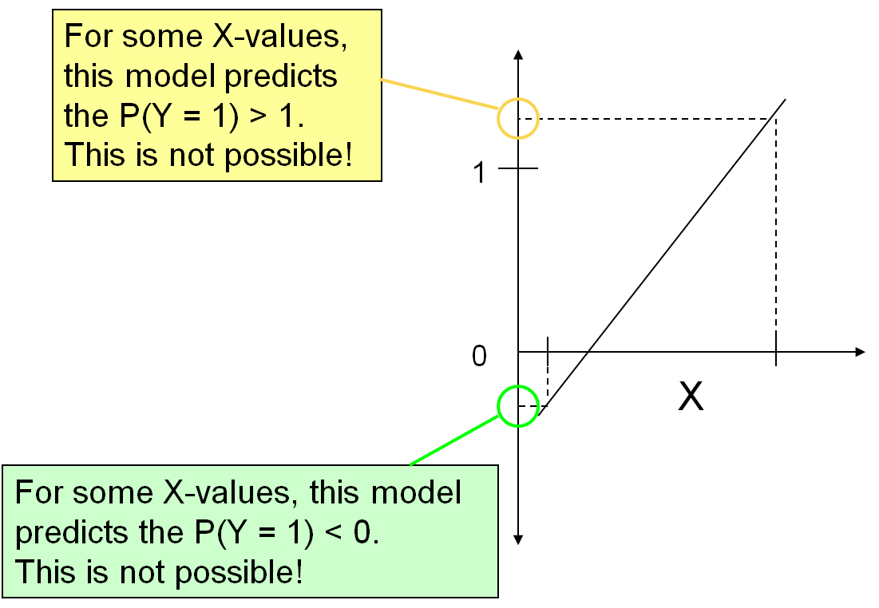
Why use logistic regression model
Dependent variable (Y): Forest loss:Y=1
Others: Y=0
the dependent variable is binary
Independent variables (X): DEM, slope, distance to road, distance to river,
soil conditions, population density, etc.
Y = a + b₁X₁ + b₂X₂ + b₃X₃ + e Linear regression is not good solution
For some X-values, this model predicted values will be larger than one or less than zero. This is not possible for our deforestation model (Y=1 or 0).

Slide 6

Logistic regression model
Predict the probability (P) of forest loss (code=1) or the odds ($\frac{P}{1−p}$) of forest loss
ln($\frac{P}{1−p}$) = $β0$+ $β$₁X₁ $+ β2$X₂ + $β3$X3 (1)
where P is the probability of forest lost for pixel or cell
Assumption: a linear relationship between the independent variables and the log odds of event (Y=1)
inverse-logit
₍₂₎
“The odds are defined as the probability that a particular outcome is a case divided by the probability that it is a noncase”

Slide 7
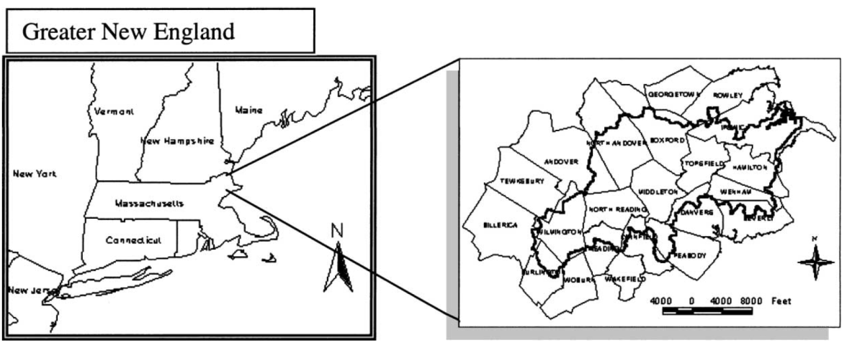
Case study
The objective: model deforestation between 1971, 1985 and 1992 in the watershed of the Ipswich River in Massachusetts
Dependent variable: the probability of forest loss for each cell (30m × 30m)
Independent variables: elevation, slope and distance from residential
areas
Source: Modeling land-use change in the Ipswich watershed, Massachusetts, USA (Schneider and Pontius 2001)

Slide 8
Case study
Logistic regression model is calibrated with data from 1971 to 1985
2. The deforestation locations were predicted for the period of 1985 to 1992
3. Model predictions were validated using the actual deforestation maps
(i.e., 1985 to 1992)
Source: Modeling land-use change in the Ipswich watershed, Massachusetts, USA (Schneider and Pontius 2001)

Slide 9
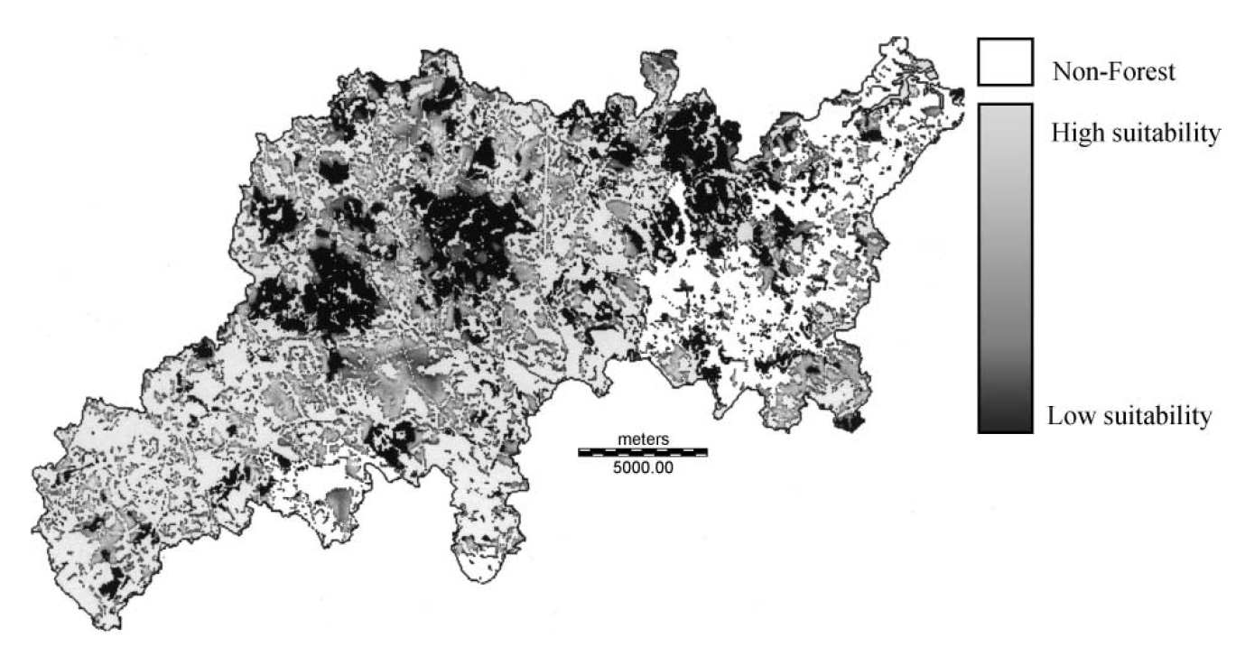
Case study
“constraint”
Suitability index for deforestation
Source: Schneider and Pontius 2001

Slide 10
Generalized Linear Models - glm()
Logistic regression is useful when you are predicting a binary outcome from a set of continuous predictor variables.
fit <- glm(y~x1+x2+x3,data=mydata,family=“binomial”)
Poisson regression is useful when predicting an outcome variable representing counts:
fit <-
glm(count ~ x1+x2+x3, data=mydata, family=“poisson”)
Source: https://www.statmethods.net/advstats/glm.html

Slide 11
Generalized Linear Models - glm()
Gaussian link function
glm(y ~ x1 + x2, data=mydata, family = "gaussian")
same as:
lm(y ~ x1+x2)

Slide 12
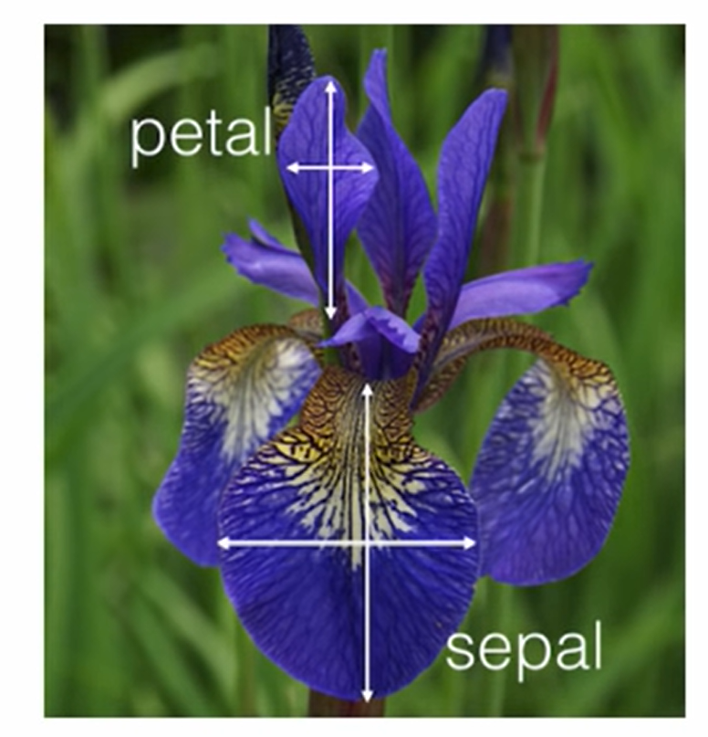
An example of logistic regressing with Iris data
50 samples for three iris species:
Setosa, versicolor, Virginica.
Measured:
Septal length, sepal width,
petal length, petal width
Species ~ sepal length

Slide 13
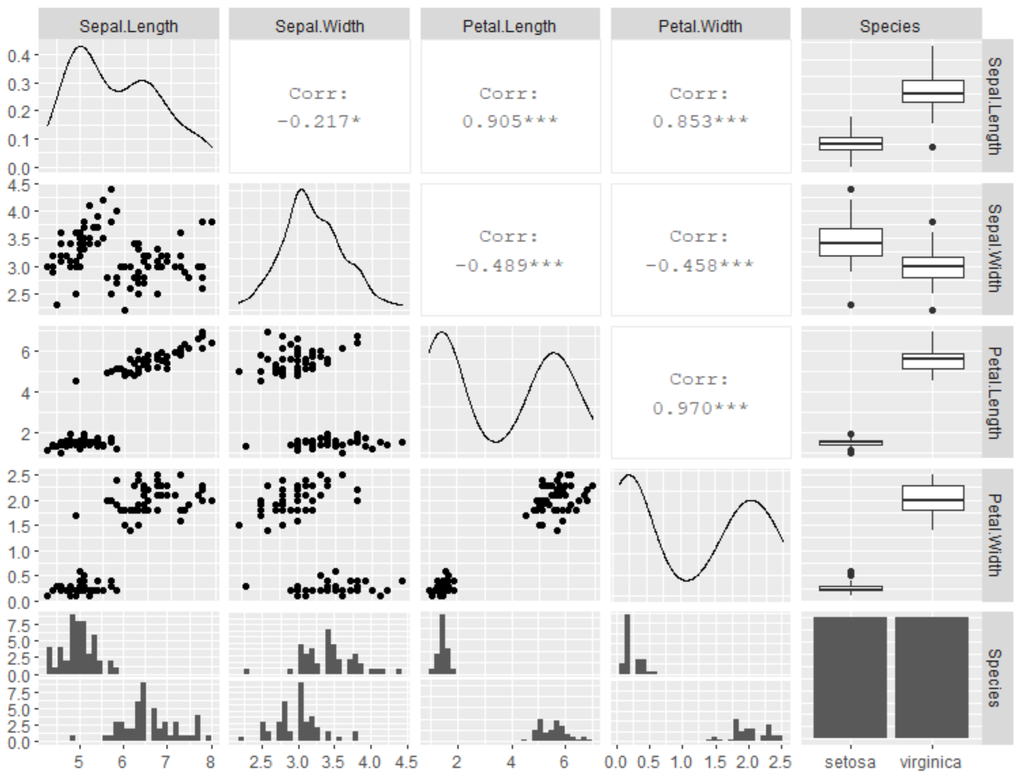
Rscript demo
library(ggplot2)
library(GGally)
#explore data
ggpairs(iris)

Slide 14
#Randomly order the data frame
df <- iris[sample(1:nrow(iris)),]
#For demo purpose, let's focus on two species (virginica and setosa only)
df<-df[df$Species!='versicolor',]

Slide 15
glfit<-glm(Species~Sepal.Length,df, family = 'binomial')

