Slide 1
R Programming for Geospatial Applications

Slide 2
Outline
Download geospatial data using R libraries
For loop (examples)

Slide 3
Commonly use geospatial data
Administrative boundaries
Census data (population by block groups, income, education level, county, etc.)
Roads
DEM
NLCD
The Global Historical Climatology Network (GHCN)
Soil

Slide 4
Recreation Park Siting Project (Geog4084/5084)
Please download population (block group level), primary and second roads, DEM, soil, and NLCD 2019 data for Loudoun County, VA

Slide 5
Automate data downloading
tidycensus: designed to help R users get Census data that is pre-prepared for exploration within the tidyverse, and optionally spatially with sf.
tigris: download census TIGER/Line Shapefiles
FedData: Functions to automate downloading geospatial data available from several federated data sources (mainly sources maintained by the US Federal government).

Slide 6
tidycensus
replace my api key with your CENSUS API key
.Renviron file so it can be called securely without being stored in your code
library(tidycensus) census_api_key("e23a9a88f3a3911be51aed1a0e9c595a10e35b59",overwrite = TRUE) readRenviron("~/.Renviron")

Slide 7
tidycensus
library(tidycensus) pop2010 <- get_decennial(geography = "county", variables = 'P001001', year = 2010, state="VA", geometry = TRUE)

Slide 8
tidycensus
head(pop2010)
## Simple feature collection with 6 features and 4 fields ## Geometry type: MULTIPOLYGON ## Dimension: XY ## Bounding box: xmin: -81.46221 ymin: 36.54417 xmax: -77.65584 ymax: 39.26462 ## Geodetic CRS: NAD83 ## # A tibble: 6 × 5 ## GEOID NAME variable value geometry ## <chr> <chr> <chr> <dbl> <MULTIPOLYGON [°]> ## 1 51021 Bland County, Virginia P001001 6824 (((-81.2251 37.23487, -81.20… ## 2 51025 Brunswick County, Virginia P001001 17434 (((-77.7442 36.57991, -77.76… ## 3 51035 Carroll County, Virginia P001001 30042 (((-80.81577 36.56022, -80.8… ## 4 51043 Clarke County, Virginia P001001 14034 (((-77.86093 39.15348, -77.8… ## 5 51045 Craig County, Virginia P001001 5190 (((-80.28257 37.53325, -80.2… ## 6 51049 Cumberland County, Virginia P001001 10052 (((-78.4021 37.31324, -78.40…

Slide 9
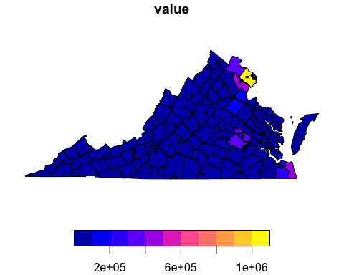
tidycensus
plot(pop2010["value"])

Slide 10
Downloading ACS Data Using tidycensus
American Community Survey (ACS): A detailed annual survey conducted by the U.S. Census Bureau.
library(tidycensus) library(dplyr) ##Download median household income for all counties in 2019. income_data <- get_acs(geography = "county", variables = "B19013_001", year = 2019, geometry=TRUE, survey = "acs5")

Slide 11
view income data
head(income_data)
## Simple feature collection with 6 features and 5 fields ## Geometry type: MULTIPOLYGON ## Dimension: XY ## Bounding box: xmin: -101.6913 ymin: 27.20931 xmax: -93.79455 ymax: 33.37719 ## Geodetic CRS: NAD83 ## GEOID NAME variable estimate moe ## 1 48081 Coke County, Texas B19013_001 45000 6161 ## 2 48273 Kleberg County, Texas B19013_001 43730 2990 ## 3 48203 Harrison County, Texas B19013_001 52220 2366 ## 4 48223 Hopkins County, Texas B19013_001 52078 2235 ## 5 48033 Borden County, Texas B19013_001 72188 20611 ## 6 48419 Shelby County, Texas B19013_001 42522 3515 ## geometry ## 1 MULTIPOLYGON (((-100.825 31... ## 2 MULTIPOLYGON (((-97.3178 27... ## 3 MULTIPOLYGON (((-94.70215 3... ## 4 MULTIPOLYGON (((-95.86333 3... ## 5 MULTIPOLYGON (((-101.6913 3... ## 6 MULTIPOLYGON (((-94.51143 3...
print(dim(income_data))
## [1] 3220 6

Slide 12
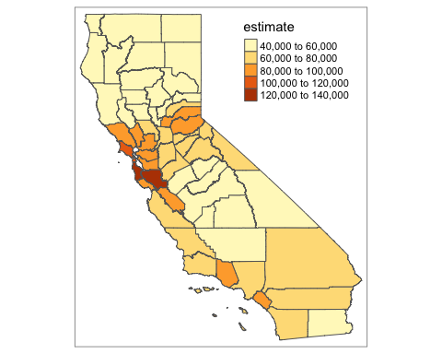
plot income data
library(tmap) library(dplyr) library(stringr) ca_income_data <- income_data %>% filter(str_starts(GEOID, "06")) qtm(ca_income_data,fill='estimate')

Slide 13
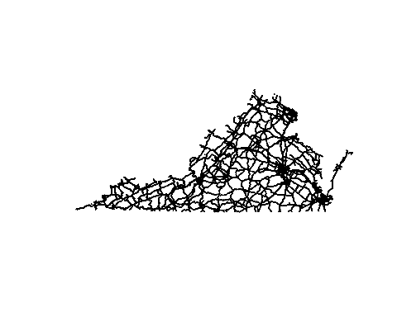
## tigris
tigris: An R package that provides access to geographic data from the U.S. Census Bureau.
library(tigris) library(sf) options(tigris_class = "sf") ca_roads <- primary_secondary_roads(state = "VA", year = 2020)
## | | | 0% | | | 1% | |= | 1% | |= | 2% | |== | 2% | |== | 3% | |== | 4% | |=== | 4% | |=== | 5% | |==== | 5% | |==== | 6% | |===== | 6% | |===== | 7% | |===== | 8% | |====== | 8% | |====== | 9% | |======= | 9% | |======= | 10% | |======== | 11% | |========= | 13% | |========== | 14% | |========== | 15% | |=========== | 15% | |=========== | 16% | |============ | 17% | |============ | 18% | |============= | 18% | |============= | 19% | |============== | 19% | |============== | 20% | |============== | 21% | |=============== | 21% | |=============== | 22% | |================ | 22% | |================ | 23% | |================= | 24% | |================= | 25% | |================== | 25% | |================== | 26% | |=================== | 27% | |=================== | 28% | |==================== | 28% | |==================== | 29% | |===================== | 29% | |===================== | 30% | |===================== | 31% | |====================== | 31% | |====================== | 32% | |======================= | 32% | |======================= | 33% | |======================= | 34% | |======================== | 34% | |======================== | 35% | |========================= | 35% | |========================= | 36% | |========================== | 36% | |========================== | 37% | |========================== | 38% | |=========================== | 38% | |=========================== | 39% | |============================ | 39% | |============================ | 40% | |============================ | 41% | |============================= | 41% | |============================= | 42% | |============================== | 42% | |============================== | 43% | |============================== | 44% | |=============================== | 44% | |=============================== | 45% | |================================ | 45% | |================================ | 46% | |================================= | 46% | |================================= | 47% | |================================= | 48% | |================================== | 48% | |================================== | 49% | |=================================== | 49% | |=================================== | 50% | |=================================== | 51% | |==================================== | 51% | |==================================== | 52% | |===================================== | 52% | |===================================== | 53% | |===================================== | 54% | |====================================== | 54% | |====================================== | 55% | |======================================= | 55% | |======================================= | 56% | |======================================== | 57% | |======================================== | 58% | |========================================= | 58% | |========================================= | 59% | |========================================== | 59% | |========================================== | 60% | |========================================== | 61% | |=========================================== | 61% | |=========================================== | 62% | |============================================ | 62% | |============================================ | 63% | |============================================= | 64% | |============================================= | 65% | |============================================== | 65% | |============================================== | 66% | |=============================================== | 67% | |=============================================== | 68% | |================================================ | 68% | |================================================ | 69% | |================================================= | 69% | |================================================= | 70% | |================================================= | 71% | |================================================== | 71% | |================================================== | 72% | |=================================================== | 72% | |=================================================== | 73% | |==================================================== | 74% | |==================================================== | 75% | |===================================================== | 75% | |===================================================== | 76% | |====================================================== | 77% | |====================================================== | 78% | |======================================================= | 78% | |======================================================= | 79% | |======================================================== | 79% | |======================================================== | 80% | |======================================================== | 81% | |========================================================= | 81% | |========================================================= | 82% | |========================================================== | 82% | |========================================================== | 83% | |========================================================== | 84% | |=========================================================== | 84% | |=========================================================== | 85% | |============================================================ | 85% | |============================================================ | 86% | |============================================================= | 86% | |============================================================= | 87% | |============================================================= | 88% | |============================================================== | 88% | |============================================================== | 89% | |=============================================================== | 89% | |=============================================================== | 90% | |=============================================================== | 91% | |================================================================ | 91% | |================================================================ | 92% | |================================================================= | 92% | |================================================================= | 93% | |================================================================= | 94% | |================================================================== | 94% | |================================================================== | 95% | |=================================================================== | 95% | |=================================================================== | 96% | |==================================================================== | 96% | |==================================================================== | 97% | |==================================================================== | 98% | |===================================================================== | 98% | |===================================================================== | 99% | |======================================================================| 99% | |======================================================================| 100%
plot(st_geometry(ca_roads))

Slide 14
FedData library
The National Elevation Dataset digital elevation models
The National Hydrography Dataset (USGS)
The Soil Survey Geographic (SSURGO) database
The Global Historical Climatology Network (GHCN)
Daymet gridded estimates of daily weather parameters for North America, version 3
The International Tree Ring Data Bank
National Land Cover Database (NLCD).

Slide 15
FedData example
library(FedData)

Slide 16
Outline
Download geospatial data using R libraries
For loop (examples)

Slide 17
For loop
A for loop allows you to iterate over a sequence of elements, performing a set of operations for each element.
for (i in 1:5) { print(i) }
## [1] 1 ## [1] 2 ## [1] 3 ## [1] 4 ## [1] 5

Slide 18
Another example
numbers <- c(1, 2, 3, 4, 5) total <- 0 for (num in numbers) { total <- total + num print(total) }
## [1] 1 ## [1] 3 ## [1] 6 ## [1] 10 ## [1] 15
print(total)
## [1] 15

Slide 19
GIS task: download ACS income data for all states

