Slide 1
R Programming for Geospatial Applications

Slide 2
Outline
R/Python/Matlab for geospatial research
Data types, Data structures, and plots in R
Software preparation (R, Rstudio, sf library, terra library, and mapview)

Slide 3
Key Data Types in R
Numeric: Represents numerical values (e.g., 42, 3.14).
Integer: Specifically for integer values (e.g., 42L).
Character: Represents text or string values (e.g., "Hello, World!").
Logical: Represents boolean values (TRUE or FALSE).
Complex: Represents complex numbers (e.g., 2 + 3i).
Factor: Represents categorical data with fixed levels (e.g.,
factor(c("Male", "Female"))).

Slide 4
Key Data Structures (how data is organized and stored)
Vector: Sequence of elements of the same type (e.g., c(1, 2, 3)).
Matrix: Two-dimensional, homogeneous data structure (e.g., matrix(1:6, nrow=2, ncol=3)).
Array: Multi-dimensional, homogeneous data structure (e.g., array(1:8, dim = c(2, 2, 2))).
Data Frame: Table-like structure with different types of data in columns (e.g., data.frame(Name = c("Alice", "Bob"), Age = c(25, 30))).
Factor: Used for categorical data with fixed levels (e.g., factor(c("high", "medium", "low"), levels = c("low", "medium", "high"))).
List: Ordered collection of elements of different types (e.g., list(1, "Hello", TRUE)).

Slide 5
Data types in R
x <- 1 y <- 3 print(x+y)
## [1] 4

Slide 6
Vectors
Using c() or combine function:
# numeric vector x <- c(1,2,5.3,6,-2,4) # character vector y <- c('VT','CNRE','Geography') #Refer to elements of a vector using subscripts. print(y[1:2])
## [1] "VT" "CNRE"

Slide 7
matrices
## Define the matrix m <- matrix(c(1,2,3,3,2,1),nrow=3,ncol=2) print(m)
## [,1] [,2] ## [1,] 1 3 ## [2,] 2 2 ## [3,] 3 1
## Refer to elements of a matrix: m[,1]
## [1] 1 2 3
m[2,]
## [1] 2 2

Slide 8
data frame:
A data frame is used for storing data tables. It is a list of vectors of equal length. For example, the following variable df is a data frame containing three vectors n, s, b.
n<-c(2,3,5) s<-c('aa','bb','cc') b<-c(TRUE,FALSE,TRUE) df=data.frame(n,s,b) print(df)
## n s b ## 1 2 aa TRUE ## 2 3 bb FALSE ## 3 5 cc TRUE

Slide 9
Lists
A list is an R data structure that can hold elements of different types (like numbers, strings, vectors, and another list). Lists are a powerful and flexible way to group related objects.
# Create a list my_list <- list(name = "John", age = 25, scores = c(90, 85, 88)) # Print the list print(my_list)
## $name ## [1] "John" ## ## $age ## [1] 25 ## ## $scores ## [1] 90 85 88
# Access elements of a list print(my_list$name)
## [1] "John"
print(my_list$scores)
## [1] 90 85 88

Slide 10
Summary Table
Data.Type | Description | Example
Scalar | A single number | x <- 1
Vector | A sequence of data elements | x <- c(1, 2, 3)
Matrix | A 2-dimensional array | m <- matrix(1:6, nrow=2)
Data Frame | A table of data | df <- data.frame(x, y, z)
List | A collection of objects | l <- list(a, b, c)

Slide 11
Key Functions
Here are some key functions for working with data types in R:
length(): Get the number of elements in a vector.
nrow(), ncol(): Get the number of rows and columns in a matrix or data frame.
str(): Display the structure of an R object.
summary(): Provide a summary of an R object.
names(): Get or set the names of elements in a list or data frame.

Slide 12
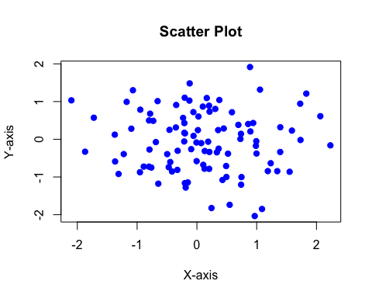
Basic R Plots
R provides a variety of plotting functions to create basic visualizations. Here are a few examples:
Scatter Plot - A scatter plot is used to plot points on a graph.
# Create sample data x <- rnorm(100) y <- rnorm(100) # Create scatter plot plot(x, y, main="Scatter Plot", xlab="X-axis", ylab="Y-axis", pch=19, col="blue")

Slide 13
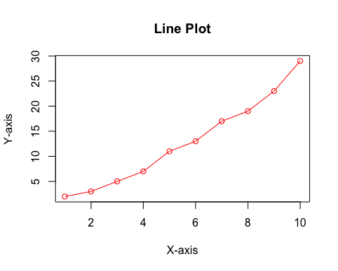
Line Plot
A line plot is used to plot lines on a graph.
# Create sample data x <- 1:10 y <- c(2, 3, 5, 7, 11, 13, 17, 19, 23, 29) # Create line plot plot(x, y, type="o", main="Line Plot", xlab="X-axis", ylab="Y-axis", col="red")

Slide 14
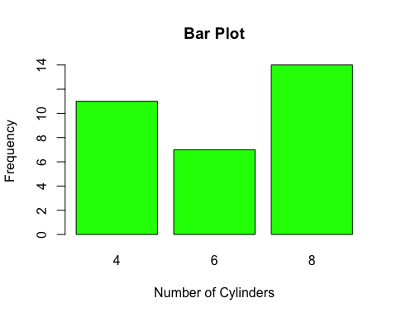
Bar Plot
A bar plot is used to display data with rectangular bars.
# Create sample data counts <- table(mtcars$cyl) # Create bar plot barplot(counts, main="Bar Plot", xlab="Number of Cylinders", ylab="Frequency", col="green")

Slide 15
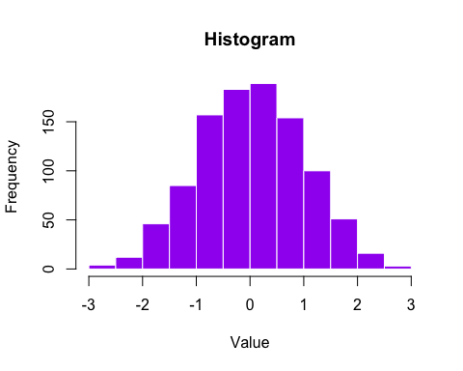
Histogram
A histogram is used to display the distribution of a dataset.
# Create sample data data <- rnorm(1000) # Create histogram hist(data, main="Histogram", xlab="Value", col="purple", border="white")

Slide 16
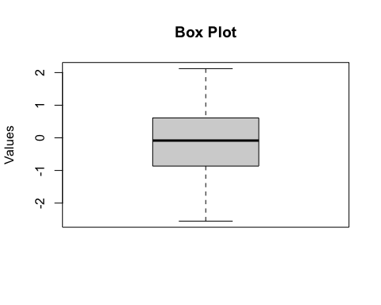
Box Plot
A box plot is used to display the distribution of data based on a five-number summary.
# Create sample data data <- rnorm(100) # Create box plot boxplot(data, main="Box Plot", ylab="Values")

Slide 17
Software Preparation: R
Installation Visit CRAN to download the latest version of R.
https://cran.r-project.org/bin/windows/base/
Follow the installation instructions for your operating system (Windows, macOS, Linux).

Slide 18
RStudio is an integrated development environment (IDE) for R.
Installation Visit RStudio to download the latest version of RStudio.
https://posit.co/download/rstudio-desktop/
Install RStudio after installing R.
Basic Features
-Script editor
-Console
-Environment/History
-Plots/Files/Packages/Help

Slide 19
Software Preparation
The sf package provides simple features for R, making it easy to handle spatial data.
The terra package is used for spatial data manipulation, providing functions to create, read, manipulate, and analyze raster and vector data.
The mapview package allows for quick and easy interactive visualization of spatial data.
install.packages(“sf”)
install.packages(“terra”)
install.packages(“mapview”)

