Slide 1
Consistent Projections
Reclassify and Raster Calculator

Slide 2
Why Consistent Projections Are Important
1. Accuracy: Different projections can distort shapes, areas, distances, and directions differently.
2. Alignment: Ensures all layers align correctly on the map.
3. Interoperability: Simplifies GIS functions and analyses, reducing the risk of errors.

Slide 3
Project vector (sf library)
library(sf)
# Read shapefiles
layer1 <- st_read('path/to/layer1.shp')
layer2 <- st_read('path/to/layer2.shp')
# Check CRS
st_crs(layer1)
st_crs(layer2)
# Transform CRS if necessary
layer2 <- st_transform(layer2, st_crs(layer1))
# Now you can perform overlay and analysis

Slide 4
Project Raster (terra library)
library(terra)
# Read raster files
raster1 <- rast('path/to/raster1.tif')
raster2 <- rast('path/to/raster2.tif')
# Check CRS
crs(raster1)
crs(raster2)
# Transform CRS if necessary
raster2 <- project(raster2, crs(raster1))
# Now you can perform overlay and analysis

Slide 5
Using mapview
library(mapview)
Assuming layer1 and layer2 are already read and possibly transformed
mapview(layer1) + mapview(layer2)

Slide 6
Reclassify and Raster Calculator in `terra`

Slide 7
Reclassify a Raster
library(terra)
raster <- rast('raster.tif')
# Define reclassification matrix
# Format: from, to, becomes
reclass_matrix <- matrix(c(0, 50, 1,
51, 100, 2,
101, 150, 3), ncol = 3, byrow = TRUE)
# Apply reclassification
reclassified_raster <- classify(raster, rcl = reclass_matrix)

Slide 8
Raster Calculator
library(terra)
# Load two rasters
raster1 <- rast('raster1.tif')
raster2 <- rast('raster2.tif')
# Perform raster calculations
result_add <- raster1 + raster2
# Example: Subtract one raster from another
result_subtract <- raster1 - raster2
# Example: Multiply two rasters
result_multiply <- raster1 * raster2
# Calculate the mean of two rasters
result_mean <- (raster1 + raster2) / 2

Slide 9
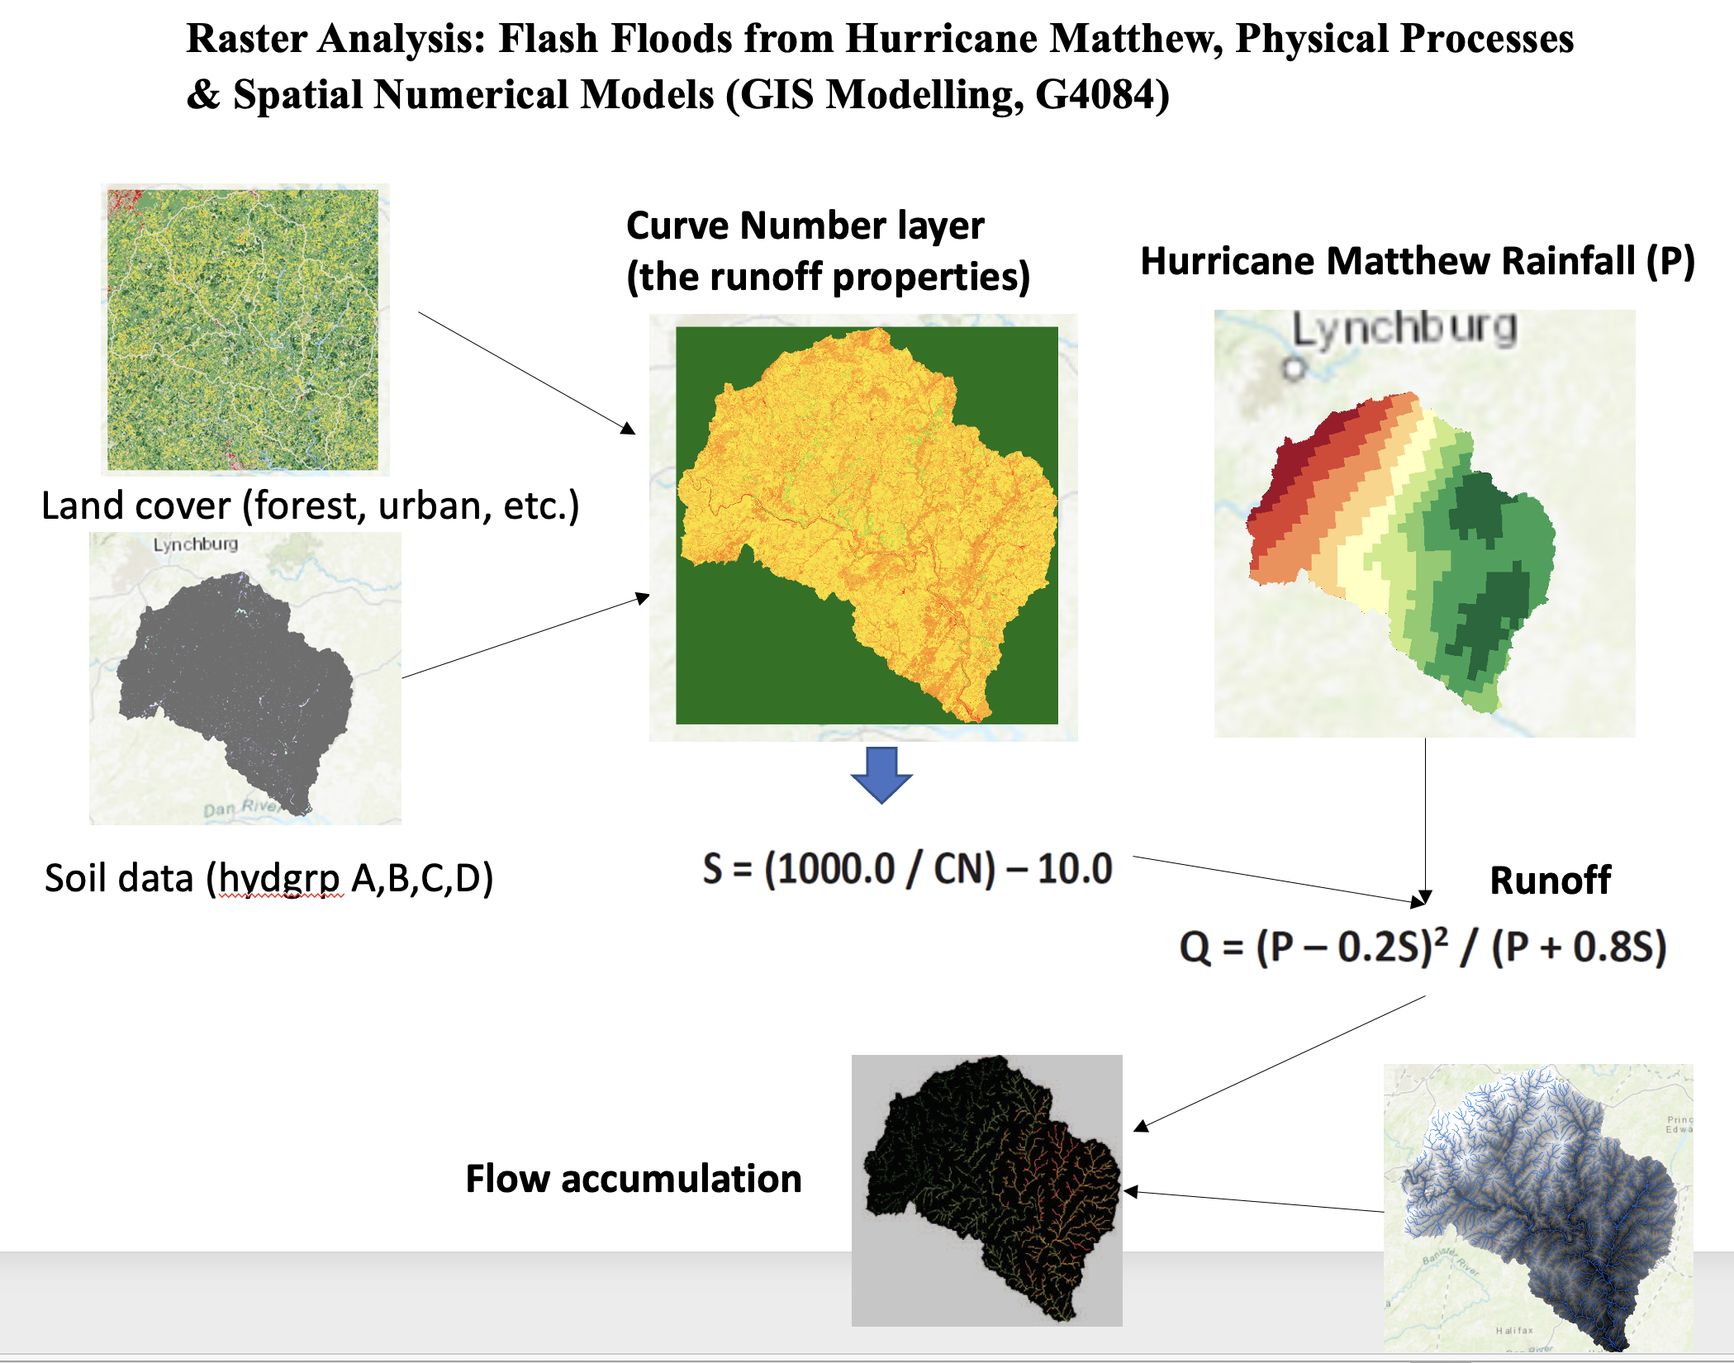

Slide 10
Importance of Consistent Raster Dimensions
For accurate raster calculations, ensure the following:
Coordinate Reference System (CRS): The CRS should be the same.
Resolution: The cell size (resolution) should be the same.
Extent: The spatial extent (bounding box) should be the same.

Slide 11
Consistent CRS
raster2 <- project(raster2, crs(raster1))
Align the extents and resolutions
aligned_raster2 <- resample(raster2, raster1, method = ‘ngb')

