Slide 1
R Programming for Geospatial Applications

Slide 2
Outline
Handling spatial data in R
Join tables (join table to shapefile)
Select features (select by attribute)
Buffer (shapefile), unionSpatialPolygons
Zonal statistics as table (for Raster data)

Slide 3
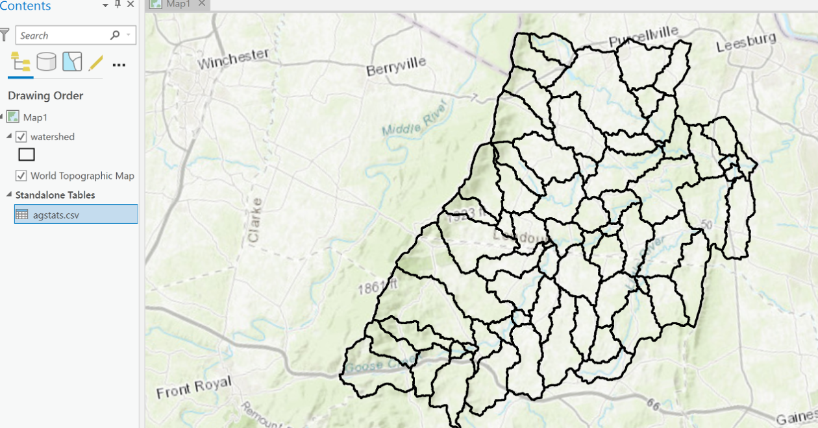
Join tables (join csv table to shapefile)

Slide 4
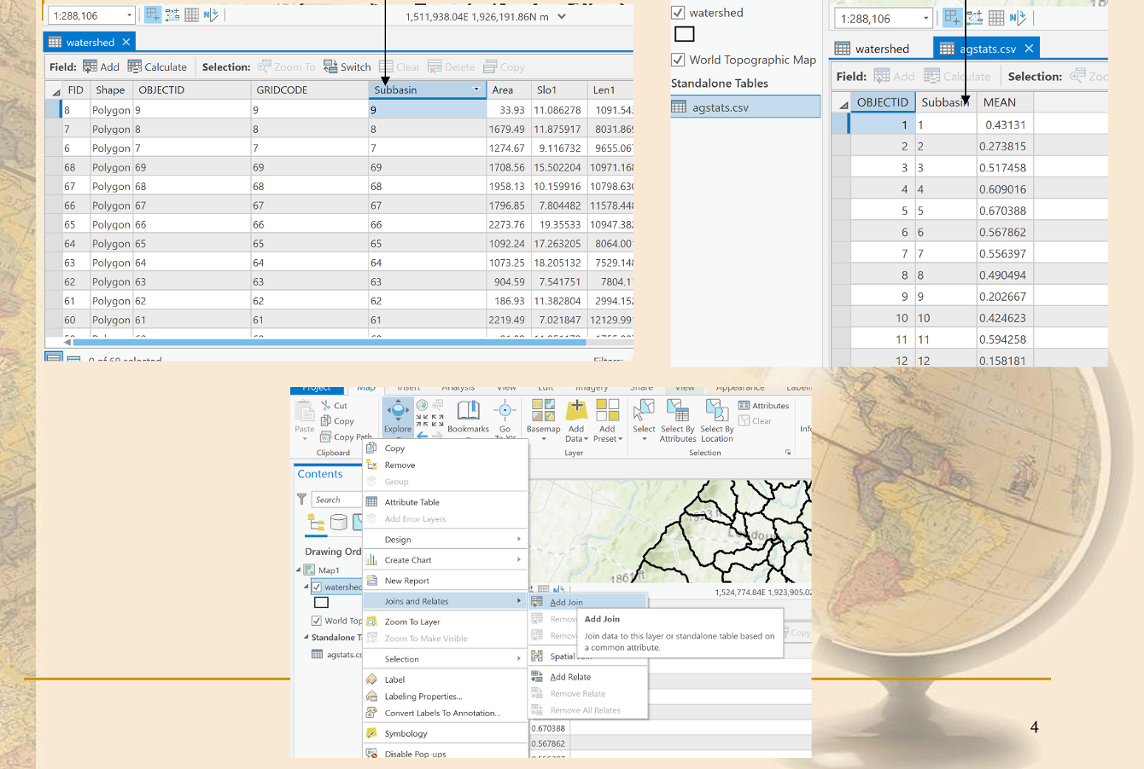
Join tables (join csv table to shapefile)

Slide 5
Joining CSV to Shapefile Using sf Library
Steps to Join CSV to Shapefile
library(sf) library(dplyr) # Load the shapefile watershed <- st_read("watershed.shp") # Read the CSV file agstats <- read.csv("agstats.csv")
# Assuming both data frames have a common key named "Subbasin" joined_data <- left_join(watershed,agstats,by='Subbasin') # Display the first few rows of the joined data names(joined_data)
## [1] "OBJECTID.x" "GRIDCODE" "Subbasin" "Area" "Slo1" ## [6] "Len1" "Sll" "Csl" "Wid1" "Dep1" ## [11] "Lat" "Long_" "Elev" "ElevMin" "ElevMax" ## [16] "Bname" "Shape_Leng" "Shape_Area" "HydroID" "OutletID" ## [21] "OBJECTID.y" "MEAN" "geometry"
# Plot the joined data plot(joined_data["MEAN"])

Slide 6
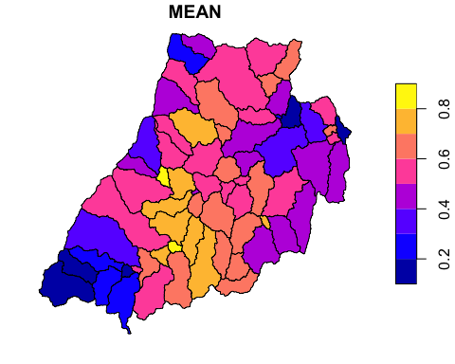

Slide 7
Outline
Handling spatial data in R
Join tables (join table to shapefile)
Select features (select by attribute)
Buffer (shapefile), unionSpatialPolygons
Zonal statistics as table (for Raster data)

Slide 8
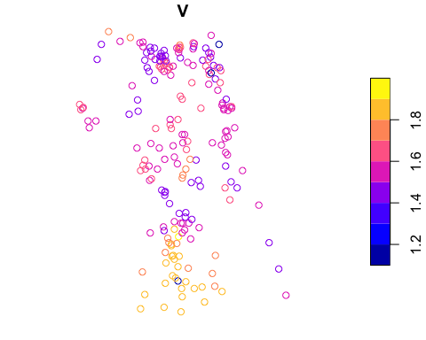
Example (select by attribute)
Each point has columns (i.e., ‘V’) indicating storm surge height
storm <- st_read('stormsub.shp')
## Reading layer `stormsub' from data source ## `/Users/yshao/work/Geog4254-5254G/week3/stormsub.shp' using driver `ESRI Shapefile' ## Simple feature collection with 203 features and 4 fields ## Geometry type: POINT ## Dimension: XY ## Bounding box: xmin: -76.222 ymin: 36.556 xmax: -75.88 ymax: 36.929 ## Geodetic CRS: GCS_unknown
plot(storm['V'])

Slide 9
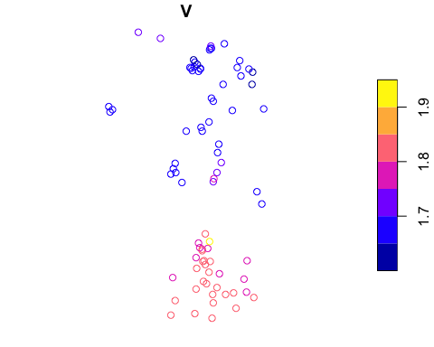
Select points based on user-defined threshold value? (e.g, >1.6m)
storm_new <- storm[storm$V>1.6,] plot(storm_new['V'])

Slide 10
Outline
Handling spatial data in R
Join tables (join table to shapefile)
Select features (select by attribute)
Buffer (shapefile), unionSpatialPolygons
Zonal statistics as table (for Raster data)

Slide 11
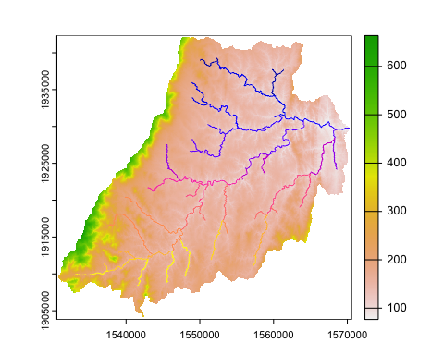
Buffer (shapefile)
library(terra) dem<-rast('dem.tif') stream<-st_read('stream.shp')
## Reading layer `stream' from data source ## `/Users/yshao/work/Geog4254-5254G/week3/stream.shp' using driver `ESRI Shapefile' ## Simple feature collection with 69 features and 17 fields ## Geometry type: LINESTRING ## Dimension: XY ## Bounding box: xmin: 1533018 ymin: 1908419 xmax: 1570308 ymax: 1939364 ## Projected CRS: NAD_1983_Albers
plot(dem) plot(stream,add=T)

Slide 12
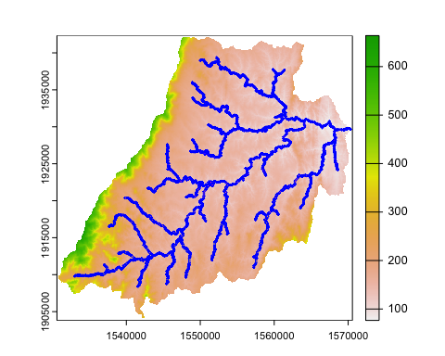
Add 90m buffer
buffer_90m <- st_buffer(stream, dist = 90) plot(dem) plot(stream,add=T) # Plot the buffer on top of the DEM and stream plot(buffer_90m, add=TRUE, border='blue')

Slide 13
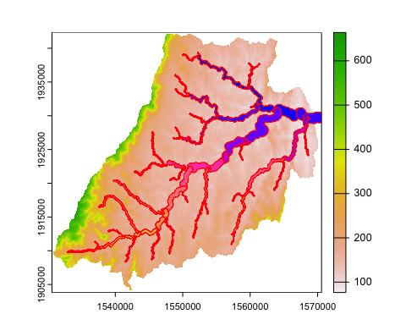
Vary buffer size based on stream attribute
# Create varying size buffers based on stream$Wid2 buffers <- st_buffer(stream, dist = stream$Wid2 *10) plot(dem) # Plot the buffers on top of the DEM and stream plot(buffers, add=TRUE, border='red')

Slide 14
Outline
Handling spatial data in R
Join tables (join table to shapefile)
Select features (select by attribute)
Buffer (shapefile), unionSpatialPolygons
Zonal statistics as table (for Raster data)

Slide 15
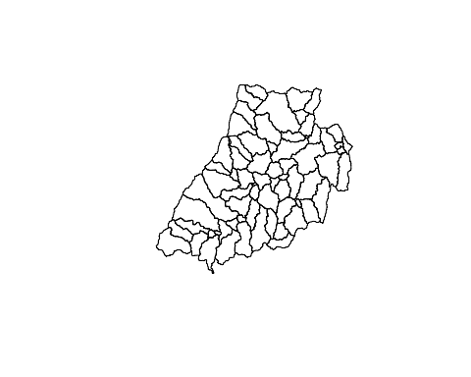
st_union function
plot(st_geometry(watershed))

Slide 16
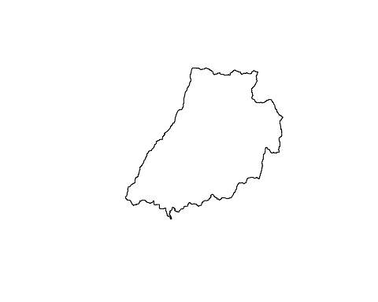
# Use st_union to merge polygons merged_watershed <- st_union(watershed) plot(merged_watershed)

Slide 17
Outline
Handling spatial data in R
Join tables (join table to shapefile)
Select features (select by attribute)
Buffer (shapefile), unionSpatialPolygons
Zonal statistics as table (for Raster data)

Slide 18
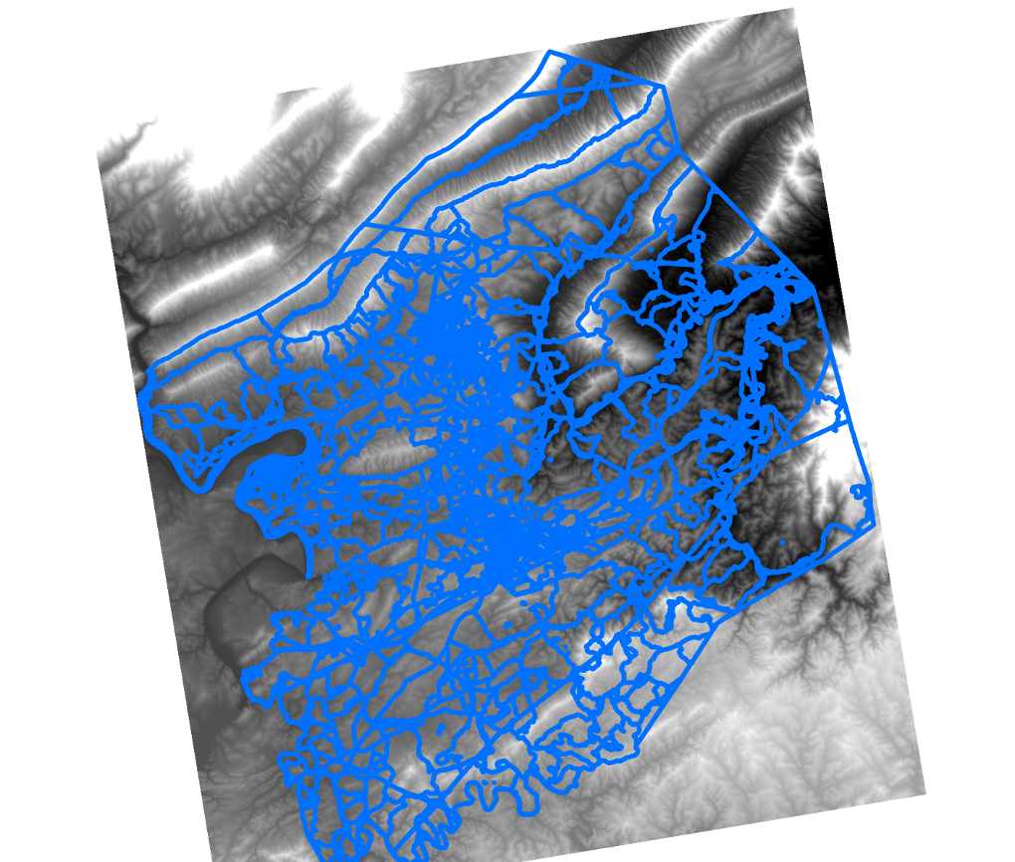
Zonal stats as table
Mean elevation for each block group?
Other examples?

Slide 19
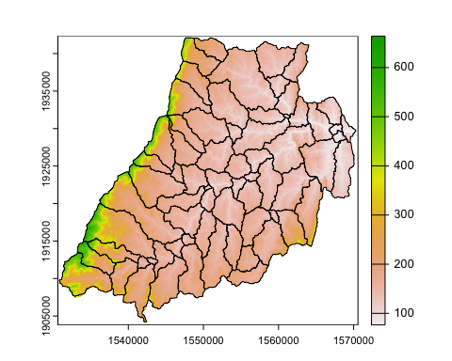
Example
dem <-rast('dem.tif') plot(dem) watershed <- st_read('watershed.shp')
## Reading layer `watershed' from data source ## `/Users/yshao/work/Geog4254-5254G/week3/watershed.shp' using driver `ESRI Shapefile' ## Simple feature collection with 69 features and 20 fields ## Geometry type: MULTIPOLYGON ## Dimension: XY ## Bounding box: xmin: 1530828 ymin: 1904204 xmax: 1570308 ymax: 1942124 ## Projected CRS: NAD_1983_Albers
plot(st_geometry(watershed),add=T)

Slide 20
zonal_stats <- terra::extract(dem, watershed, fun = mean, na.rm = TRUE)

Slide 21
Zonal stats (example)
zonal_stats <- terra::extract(dem, watershed, fun = mean, na.rm = TRUE) head(zonal_stats)
## ID dem ## 1 1 201.4263 ## 2 2 257.2389 ## 3 3 144.3227 ## 4 4 152.8894 ## 5 5 124.1636 ## 6 6 146.2609

Slide 22
Zonal stats (example)
watershed_dem <- cbind(watershed, zonal_stats) head(watershed_dem)
## Simple feature collection with 6 features and 22 fields ## Geometry type: MULTIPOLYGON ## Dimension: XY ## Bounding box: xmin: 1547058 ymin: 1932284 xmax: 1564038 ymax: 1942124 ## Projected CRS: NAD_1983_Albers ## OBJECTID GRIDCODE Subbasin Area Slo1 Len1 Sll Csl ## 1 1 1 1 846.63 7.159707 7479.260 60.95703 2.8819298 ## 2 2 2 2 1275.48 11.582822 9096.427 60.95703 3.6230700 ## 3 3 3 3 1689.84 6.194226 6712.752 60.95703 1.0154209 ## 4 4 4 4 954.27 8.749758 6970.326 60.95703 1.7553535 ## 5 5 5 5 539.01 8.037927 4734.335 60.95703 1.1133784 ## 6 6 6 6 4287.33 7.089381 17598.185 60.95703 0.8703648 ## Wid1 Dep1 Lat Long_ Elev ElevMin ElevMax Bname ## 1 4.647356 0.3055068 39.14776 -77.77326 204.5456 148 365 <NA> ## 2 5.942838 0.3599257 39.13989 -77.79659 246.9485 148 503 <NA> ## 3 7.035534 0.4027927 39.12110 -77.68260 142.4591 100 177 <NA> ## 4 4.993355 0.3204881 39.11078 -77.64879 150.8887 104 235 <NA> ## 5 3.544441 0.2550246 39.09038 -77.68311 123.4939 90 168 <NA> ## 6 12.299908 0.5845452 39.10363 -77.73203 148.7355 92 249 <NA> ## Shape_Leng Shape_Area HydroID OutletID ID dem ## 1 17760 8466300 300001 100001 1 201.4263 ## 2 23100 12754800 300002 100002 2 257.2389 ## 3 24540 16898400 300003 100003 3 144.3227 ## 4 19980 9542700 300004 100004 4 152.8894 ## 5 14700 5390100 300005 100005 5 124.1636 ## 6 45000 42873300 300006 100006 6 146.2609 ## geometry ## 1 MULTIPOLYGON (((1552398 193... ## 2 MULTIPOLYGON (((1550358 193... ## 3 MULTIPOLYGON (((1558308 193... ## 4 MULTIPOLYGON (((1562448 193... ## 5 MULTIPOLYGON (((1558308 193... ## 6 MULTIPOLYGON (((1555818 193...

Slide 23
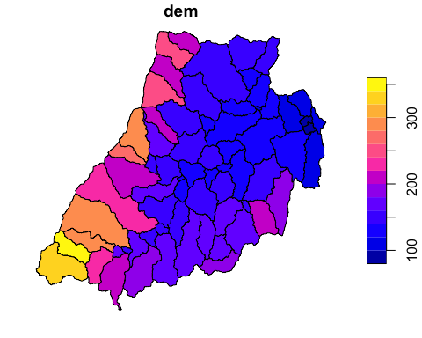
Zonal stats (example)
plot(watershed_dem['dem'])

