Slide 1
R Programming for Geospatial Applications

Slide 2
Create maps
 | Upsides | Downsides
R Programming | - Flexibility and Customization - Reproducibility - Cost-effective | - Steeper learning curve - Performance with large datasets - Lack of intuitive GUI
ArcGIS | - User-friendly interface - Comprehensive tools | - High cost - Reproducibility challenges - Dependency on proprietary software

Slide 3
Create maps in R
tmap (tmap is an R package for visualization spatial data) https://r-tmap.github.io/tmap-book/index.html
ggplot2 library (data visualization; one of the most popular packages in R) https://r4ds.had.co.nz/data-visualisation.html

Slide 4
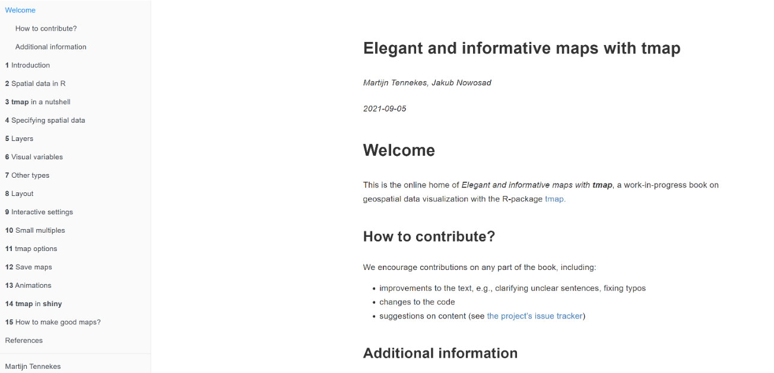
tmap
Tennekes M (2018). “tmap: Thematic Maps in R.” Journal of Statistical Software,84(6), 1–39.doi:10.18637/jss.v084.i06.

Slide 5
tmap
tmap works well with vector data (sf library) and raster data (terra library)
The spatial data can be used to create simple, quick maps (qtm) and more complex and expandable maps.
These maps can be presented in two modes as a static map and an interactive one:
tmap_mode(‘plot’) or tmap_mode(‘view’)

Slide 6
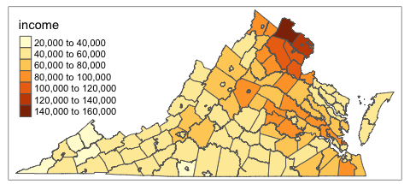
tmap - quick maps
library(sf) library(tmap) income_va <- st_read("income.shp")
qtm(income_va, fill='income')
qtm is good for data exploration

Slide 7
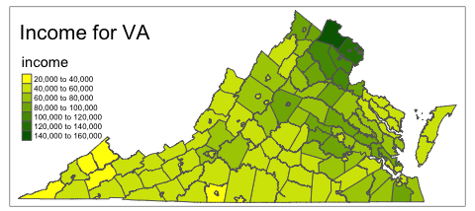
tmap – regular maps
tm_shape(income_va)+ tm_polygons("income",palette = c("yellow", "darkgreen"))+ tm_layout(title='Income for VA', legend.text.size = 0.5)
“The first element always is tm_shape(), which specified the input shape object. Next, map layers, additional map elements, and overall layout can be customized.”

Slide 8
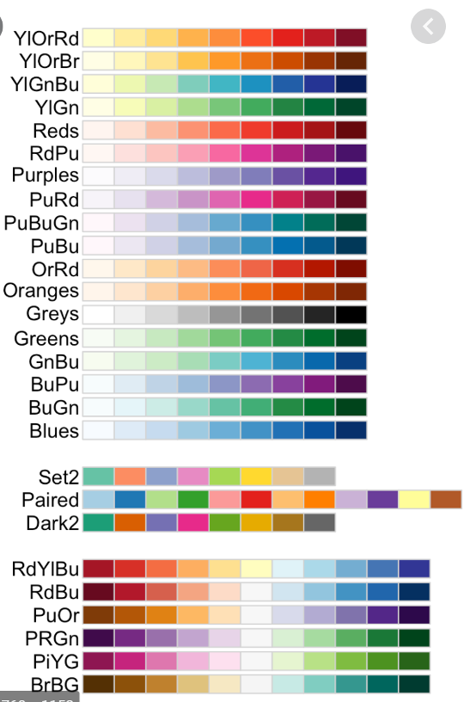
tmap – regular maps
Select color for your map

Slide 9
Map title, scale bar, and north arrow
tm_shape(income_va)+ tm_polygons("income",palette=c('yellow','darkgreen'))+ tm_layout(title='Income for VA', title.position=c("center","top"), legend.text.size = 0.5, legend.position=c("left","top"))+ tm_scale_bar(breaks = c(0, 10,20), text.size = 0.5, position=c("right", "bottom"))+ tm_compass(type = "4star", size = 3, position = c("right", "top"))

Slide 10
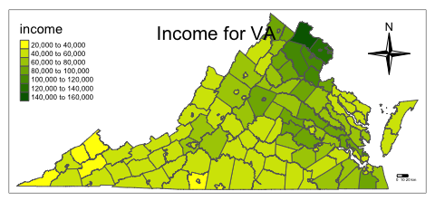

Slide 11
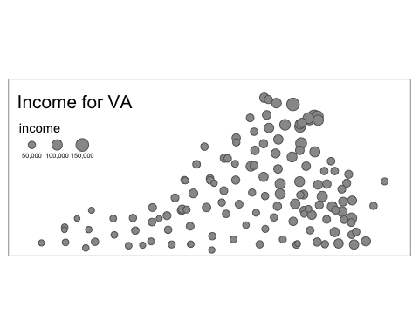
tmap – regular maps
tm_shape(income_va)+ tm_symbols("income")+ tm_layout(title='Income for VA',legend.text.size = 0.5)

Slide 12
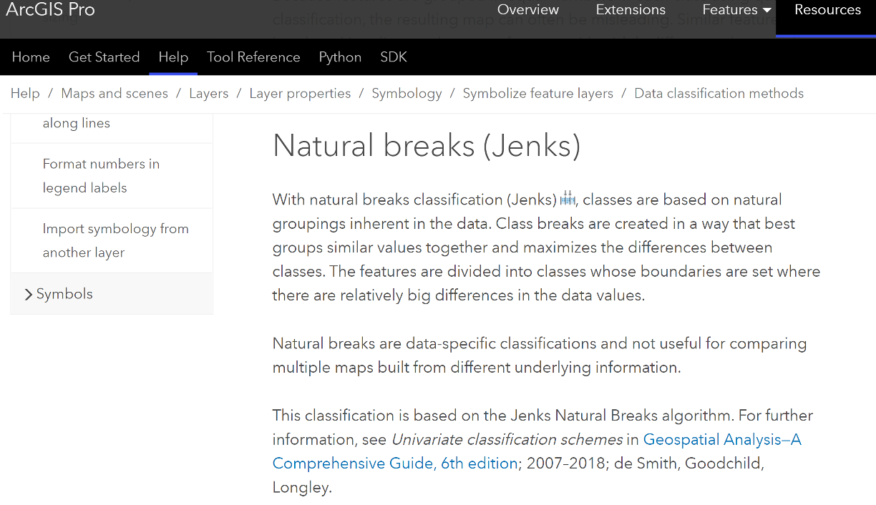
Mapping values (e.g., population) into user-defined groups (Natural breaks or Jenks)

Slide 13
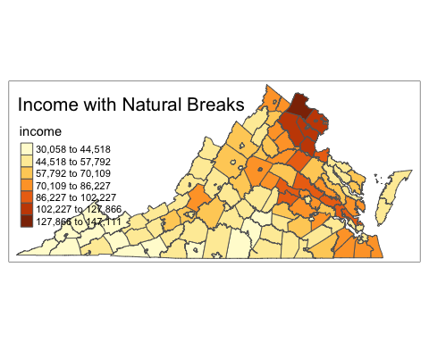
Example uisng tmap
tm_shape(income_va) + tm_polygons("income", style = "jenks",n=7) + tm_layout(title = "Income with Natural Breaks")

Slide 14
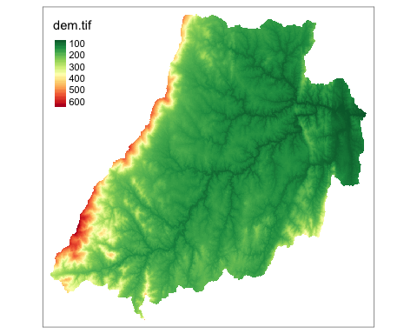
Mapping with raster data (continuous variable)
library(terra)
dem<-rast('dem.tif')
tm_shape(dem) + tm_raster(style = "cont", palette = "-RdYlGn")

Slide 15
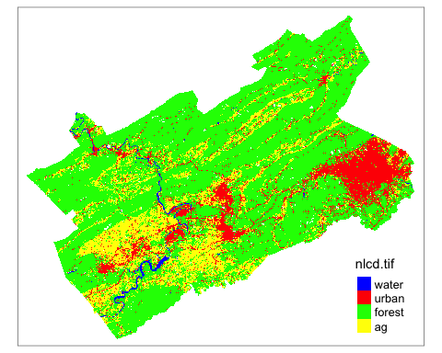
Mapping with raster data (categorical variable)
nlcd<-rast('nlcd.tif') # Define the palette and labels pal4 <- c("blue", "red", "green", "yellow") # Example colors, adjust as needed labels <- c('water', 'urban', 'forest', 'ag') # Create the map tm_shape(nlcd) + tm_raster(style = "cat", palette = pal4, labels = labels) + tm_layout(legend.text.size = 0.8, legend.position = c("right", "bottom"))

Slide 16
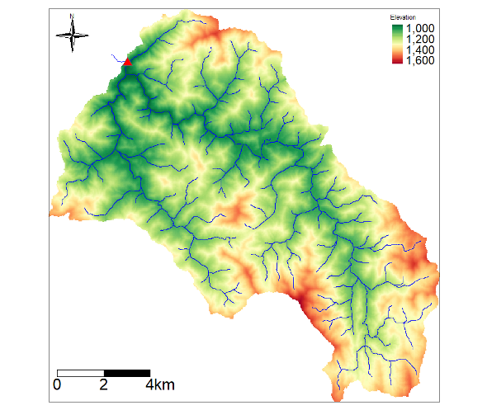
Three layers (usgs site, streams, and dem)

Slide 17
tm_shape(raster_layer) +
tm_raster() +
tm_shape(vector_layer) +
tm_layout(title = "Raster with Vector Overlay")

Slide 18
Create maps in R
tmap (tmap is an R package for visualization spatial data) https://r-tmap.github.io/tmap-book/index.html
ggplot2 library (data visualization; one of the most popular packages in R) https://r4ds.had.co.nz/data-visualisation.html

Slide 19
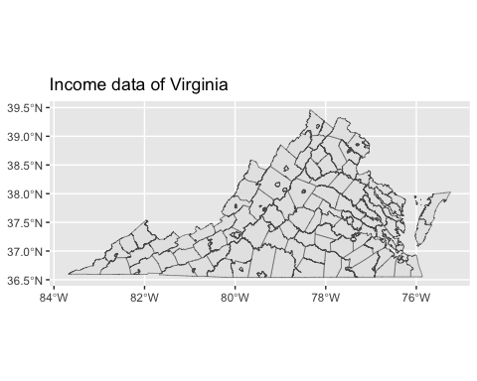
Using ggplot2
library(ggplot2) # Basic map using ggplot2 ggplot(data = income_va) + geom_sf() + labs(title = "Income data of Virginia")

Slide 20
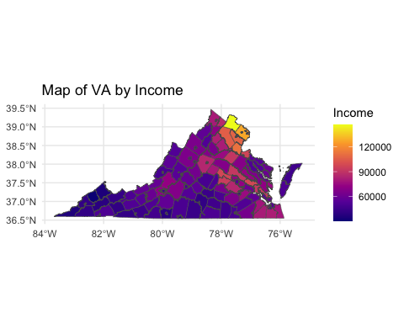
## ggplot2- Custom Styling
library(ggplot2) # Basic map using ggplot2 ggplot(data=income_va)+ geom_sf(aes(fill = income)) + scale_fill_viridis_c(option = "plasma") + theme_minimal() + labs(title = "Map of VA by Income", fill = "Income")

Slide 21
north arrow and scale bar using the ggspatial package
library(ggplot2) library(ggspatial) # Define margins to make space for the scale bar plot_margin <- theme(plot.margin = unit(c(1, 1, 1, 1), "cm")) # Basic map with north arrow and scale bar placed outside the plotting area ggplot(data = income_va) + geom_sf(aes(fill = income)) + scale_fill_viridis_c(option = "plasma") + annotation_scale(location = "bl", width_hint = 0.5, pad_x = unit(0.5, "in"), pad_y = unit(0, "in"), height = unit(0.2, "cm")) + annotation_north_arrow(location = "tl", which_north = "true", pad_x = unit(0.1, "in"), pad_y = unit(0, "in"), style = north_arrow_fancy_orienteering) + labs(title = "Map of Income distribution, VA") + plot_margin

Slide 22
