Slide 1
Immunogenicity Analysis
Shuang Liang, Jenn Schneider, Frank Engler, Wenyu Liu, Shu-Pei Wu, Philip Chang, Michelle Li

Slide 2
Background
Anti-Drug Antibodies (ADA) are antibodies formed in response to therapeutic proteins and peptides
ADA may impact PK, safety and efficacy
PK: ADA binding may increase or decrease the CL
Safety: infusion reactions, anaphylaxis, cytokine release syndrome, cross-reactivity to endogenous proteins, and other non-acute reactions
Efficacy: loss of efficacy due to interfering with target binding (neutralizing ADA) or altered PK
FDA recommend evaluating clinical relevance of immunogenicity during the clinical development and post-marketing monitoring (if applicable)
FDA guidance for evaluating and mitigating immunogenicity risk—Immunogenicity Assessment for Therapeutic Protein Products, 2014
FDA guidance for ADA bioanalysis—Immunogenicity Testing of Therapeutic Protein Products
Integrated summary of immunogenicity
A living document throughout clinical development and life-cycle management of a medicinal product
Central place for immunogenicity assessment in BLA submission (optional)
Immunogenicity information summarized in 12.6 of USPI
FDA 2022 draft guidance Immunogenicity Information in Human Prescription Therapeutic Protein and Select Drug Product Labeling

Slide 3
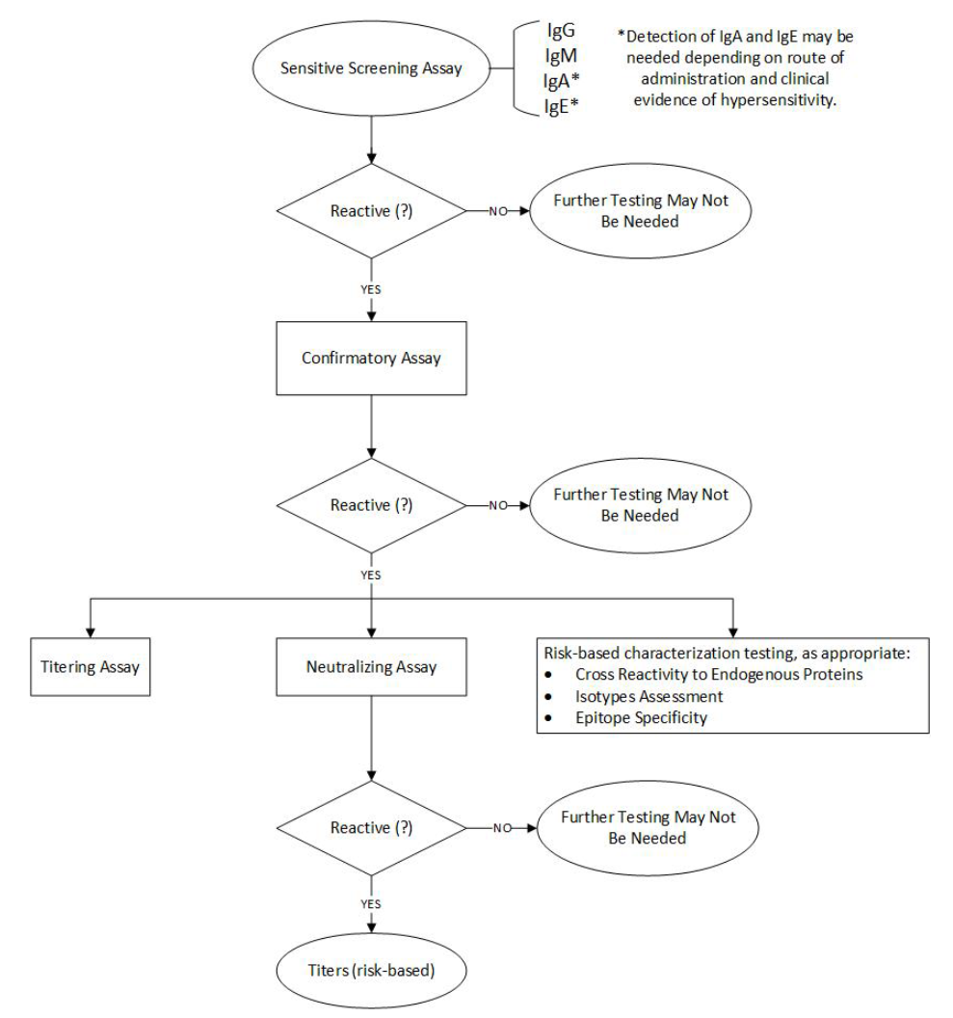
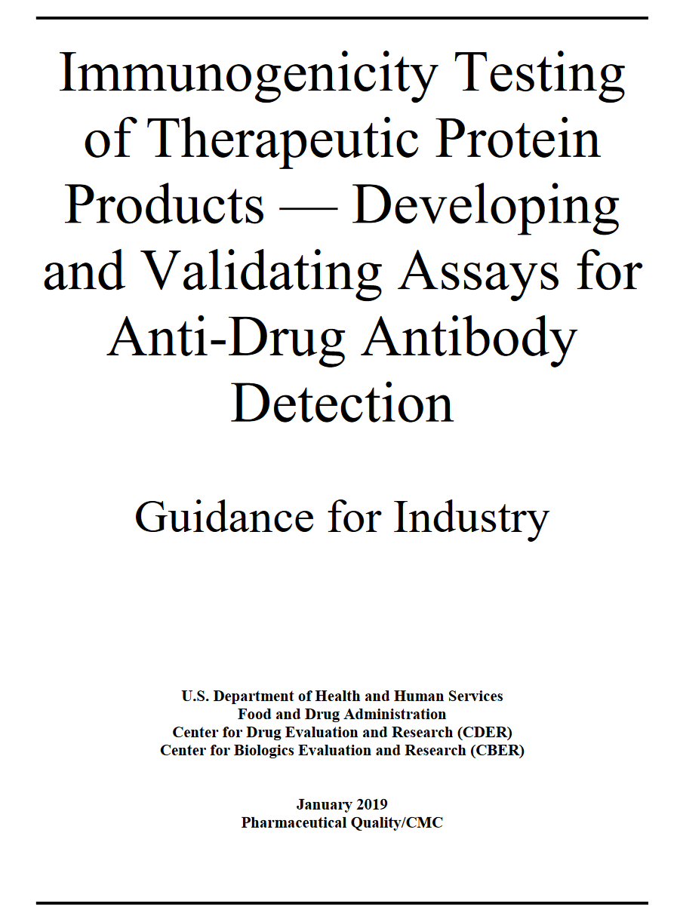
ADA Bioanalysis—Tiered ADA Testing Approach
Subject ID | Sample ID | Collection Time | Screening Assay | Confirmatory Assay | Titer | NAb
101-001 | 55552930 | C1D1 | Negative | - | - | -
101-001 | 55552931 | C1D8 | (Potential) Positive | Negative | - | -
101-001 | 55552932 | C2D1 | (Potential) Positive | Positive | 320 | Negative

Slide 4
ADA Reporting—Listing
Subject ID | Sample ID | Collection Time | Test Name | Results
101-001 | 652355552930 | C1D1 | Anti-BNTxzy Antibody Screening | Negative
101-001 | 652355552931 | C1D8 | Anti-BNTxzy Antibody Screening | (Potential) Positive
101-001 | 652355552931 | C1D8 | Anti-BNTxzy Antibody Confirmatory | Negative
101-001 | 652355552932 | C2D1 | Anti-BNTxzy Antibody Screening | (Potential) Positive
101-001 | 652355552932 | C2D1 | Anti-BNTxzy Antibody Confirmatory | Positive
101-001 | 652355552932 | C2D1 | Anti-BNTxzy Antibody titer | 320
101-001 | 652355552932 | C2D1 | Anti-BNTxzy Antibody NAb | Negative
Negative at C1D1
Lab results
Negative at C1D8
Positive at C2D1 with a titer of 320, NAb negative
Subject ID | Collection Time | Anti-BNTxzy Antibody | Titer | NAb
101-001 | C1D1 | Negative
101-001 | C1D8 | Negative
101-001 | C2D1 | Positive | 320 | Negative
Listing

Slide 5
Common Terminology (Shankar 2014)
Pre-existing ADA: ADA that exists before treatment
Treatment-induced ADA: ADA developed de novo following biologic drug administration
Treatment-boosted ADA: Pre-existing ADA that were boosted to a higher level following biologic drug administration
Higher level threshold: usually 2 dilution step (dilution factor^2) due to the quasi-quantitative nature of the ADA titer assay
Treatment-emergent ADA: treatment-induced and treatment-boosted ADA
Titer: a quasi-quantitative expression of the level of ADA in a sample
Highest fold of dilution of the sample that yields a positive result above a predetermined cut point value
ADA prevalence: The proportion of all individuals having drug-reactive antibodies (including pre-existing antibodies) at any point in time.
ADA incidence: The proportion of the study population with treatment-emergent ADA during the study period.

Slide 6
ADA Categorization Examples (I)
Pre-treatment ADA Status
Post drug administration ADA Status
ADA Categorization
Negative
ADA negative
Negative
Treatment-emergent
Positive
Treatment-induced
ADA incidence
Positive, titer > x*n
Treatment-boosted
ADA Prevalence
Positive, titer=n
Positive, titer ≤x*n
Treatment-unaffected
*some literature refer this scenario as "treatment-reduced". However, suggest not to use as this term did not reach consensus in the field. Plus, it may lead to confusion with "treatment-unaffected" where titer may be lower than baseline
Negative
Baseline-positive only*

Slide 7
Common Analysis
Ideally, for IMPs with moderate to high immunogenicity, immunogenicity information should be summarized in the Integrated Summary of Immunogenicity (ISI), a central document for reviewers to assess all immunogenicity related information.
ADA summary
Prevalence: the proportion of all individuals having drug-reactive antibodies at any point in time (including pre-existing antibodies) during the study period.
Incidence: the proportion of the study population found to have treatment-emergent ADA (induced or boosted their preexisting ADA) during the study period.
Titer
NAb
Onset: time period between the initial administration of the biologic drug (in a study) and the first instance of treatment-induced ADA
Duration: time period between the first and last instance of treatment-induced ADA
Transient or persistent ADA: duration < or ≥ 16 weeks (~5 half-life of human IgG)
For oncology products, the duration of ADA often confounded by follow up duration; more meaningful to summarize treatment, FU and ADA collection schedule &duration
Impact on PK
PK parameter subgroup analysis
Limitation: PK parameters usually from C1 and C3, may be before ADA onset
Graphical comparison of PK profile
popPK covariate testing
As consistent or time-varying covariate
Impact on safety
Key AE endpoints (i.e. TEAE, AESI, immune-related AE) by ADA status
Impact on efficacy
Key efficacy endpoints (i.e. ORR, PFS, OS, etc.) by ADA status

Slide 8
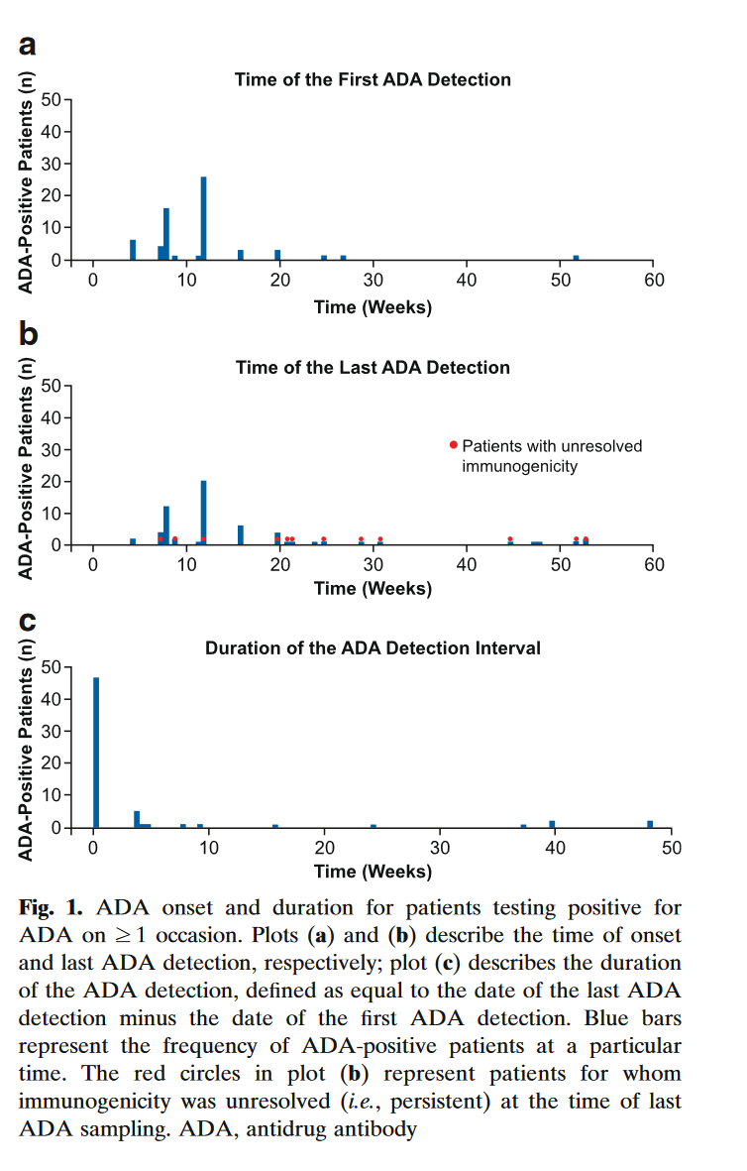
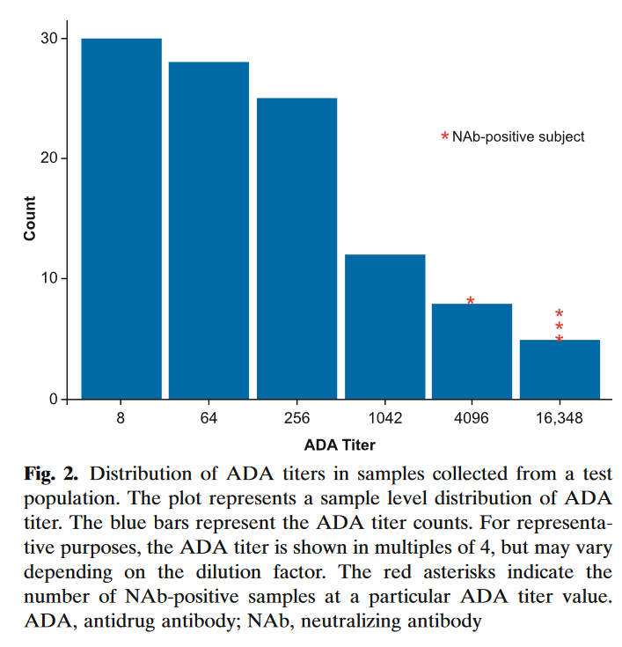
Titer vs time plot

Slide 9
Recommendations for Common Questions

Slide 10
Definition of Immunogenicity Analysis Set
Recommended definition: trial participants from the FAS who have received at least one dose of IMP and with at least one valid ADA result post-first dose.
Considerations:
No industry consensus, several options co-exist:
Option 1: with one valid ADA any time (baseline or post-baseline)
Not recommended, as this option includes subjects with only baseline ADA but no post baseline ADA
Treatment-emergent status can not be determined if no post-baseline ADA
Should not be included in either denominator or numerator of ADA incidence calculation
Create discrepancy when calculating ADA prevalence as they are included in the denominator
Not meaningful to interpret the impact on PK, safety, efficacy
Option 2: with at least 1 ADA post-first dose*
Recommended definition, consistent with the “ADA evaluable subject” definition in immunogenicity white paper (Shanker 2014)
Post-baseline ADA status is most relevant for PK, safety, efficacy evaluation
Baseline missing should be minimal; Clin op should further reinforce site compliance if missing baseline occurs often
Assume baseline missing as negative
Option 3: with a valid ADA result at baseline and at least one valid ADA result post-baseline *
Acceptable alternative option
May be useful under certain circumstances (i.e. high baseline positive rate & high baseline missing)
* For option 2 and 3, the number of pts with baseline only or with post-baseline only can be seen from summary table “Analysis Sets with Inclusion and Exclusion”

Slide 11
Definition of Treatment-Induced ADA
Recommended definition:
Treatment induced ADA (at sample level) is defined as a sample that is reported as positive after trial treatment administration in a participant with no pre-treatment ADA positive samples.
“no pre-treatment ADA positive samples” include the scenario of baseline missing if the immunogenicity analysis set option 2 definition is used (with at least 1 ADA post-first dose)
Baseline ADA positive rate generally in low to moderate range for oncology patients
may consider revising it to “negative pre-treatment ADA samples” if baseline ADA positive rate is high (i.e. >50%)
The definition is also valid if the immunogenicity analysis set option 3 is used (with a valid ADA result at baseline and at least one valid ADA result post-baseline)

Slide 12
Subject Level Subgroup Analysis for Evaluating ADA’s Impact on PK, Efficacy and Safety
A clear definition is needed for what is considered as “ADA positive/negative trial participants” when assessing ADA’s impact on PK, efficacy, and safety:
Several options may be considered:
Option 1: subjects with treatment-emergent ADA (Shankar 2014, the “ADA-incidence” population)
Option 2: subjects with positive ADA at any time post baseline (post-baseline positive)
Option 3: subjects with positive ADA any time (at either baseline or post baseline, the “ADA-prevalence” population) Brolucizumab review, section 4.3 Immunogenicity Evaluation: Reviewer’s Analyses
Recommendation:
Default is option 1, although option 2 or 3 may also be explored depending on data (i.e. if the % of treatment-unaffected or baseline-positive only is high)
Not necessary to define "ADA positive/negative" in protocol/SAP or assess ADA impact on PK/efficacy/safety at study level, particularly for early phase study
Use language such as “ The effect of ADA… will be evaluated by summarizing the key efficacy and safety endpoints by ADA status of the trial participants” in contrast to “ in ADA positive trial participants and ADA negative trial participants”.
Existing languages in certain BNT protocols/SAPs
The effect of ADA on efficacy and safety, if data available, will be evaluated by summarizing the key efficacy and safety endpoints in the ADA positive trial participants and ADA negative trial participants

Slide 13
ADA Categorization Diagram (Option 1)
Pre-treatment ADA Status
Post drug administration ADA Status
ADA Categorization
Negative
ADA negative
Negative
Treatment-emergent
=ADA positive subjects
Positive
Treatment-induced
Positive, titer > x*n
Treatment-boosted
Positive, titer=n
Positive, titer ≤x*n
Treatment-unaffected
Negative
Baseline-positive only/treatment-reduced

Slide 14
ADA Categorization Diagram (Option 2)
Pre-treatment ADA Status
Post drug administration ADA Status
ADA Categorization
Negative
ADA negative
Negative
Treatment-emergent
Positive
Treatment-induced
Positive, titer > x*n
Treatment-boosted
ADA positive subjects
=
postbaseline positive
Positive, titer=n
Positive, titer ≤x*n
Treatment-unaffected
Negative
Baseline-positive only/treatment-reduced

Slide 15
ADA Categorization Diagram (Option 3)
Pre-treatment ADA Status
Post drug administration ADA Status
ADA Categorization
Negative
ADA negative
Negative
Treatment-emergent
Positive
Treatment-induced
Positive, titer > x*n
Treatment-boosted
ADA positive subjects
Positive, titer=n
Positive, titer ≤x*n
Treatment-unaffected
Negative
Baseline-positive only/treatment-reduced

Slide 16
Timing of ADA/NAb Assay Development/Validation
ADA: for low-risk compound, start assay development when compound moving into clinic, target validating assay before the start of the trial
Low risk compound: most mAb based therapeutic proteins without structure modification or engineering that may increase immunogenicity
ADA clinical assay development start when FIH is endorsed (CP lead submit clinical assay development request through service portal)
Expect assay validated at the time of the FIH trial for clinical samples
BASE would like to be involved from preclinical stage.
CP leads will try to help inform BASE team early if aware of new programs
NAb: start assay development when ph3 is endorsed
BASE proposal:
Complete assay development (8 to 12 months cell-based assay) by the time efficacy readout
Assay validation (6-8 wks for validation) and sample analysis depends on the ADA rate or upon HA request
BASE team will provide support language for this strategy in possible HA interactions and queries
Clin pharm position:
Absence of validated NAb unlikely to pose a substantial risk for BLA, although likely result in a PMC
Above proposal is acceptable

Slide 17
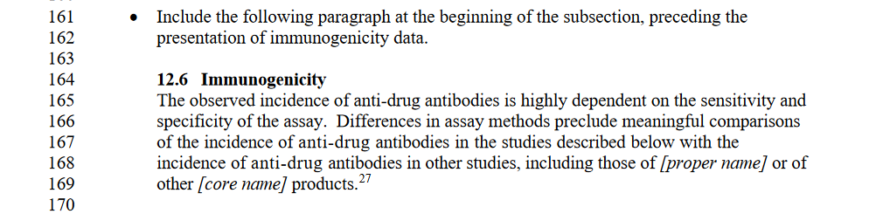
Considerations When Multiple ADA Assays Developed for Same Compound
No concordance/cross-validation needed, and reasonable to report results from different assays
Agency recognized the fact that ADA may be analyzed by different assays (below from FDA draft guidance immunogenicity labeling)
Example: c-Met ADC (Telisotuzumab Vedotin) used two ADA assays (both validated, FDA review page 68)
FDA draft guidance immunogenicity labeling

Slide 18
Reporting Persistent or Transient ADA
Definition of persistent vs transient ADA per immunogenicity white paper:
Persistent ADA: time between first and last positive ADA ≥ 16 weeks (~ 5 T1/2 of IGg)
Transient ADA: time between first and last positive ADA < 16 weeks
Recommend not using this terminology for oncology programs, as ADA dynamic is often confounded by follow up duration.
Duration of ADA will still be summarized (suggest using KM estimate or separate “censored” vs. “non-censored” for ADA assessment)
For oncology programs, more meaningful to summarize ADA sampling schedule and duration (time from C1D1 to last ADA sample) in the context of the treatment duration and follow up duration
ADA sampling schedule
Synchronize with PK sampling schedule
FIH: C1D1, one sample between C1D6-15 depending on PK scheduling, D1 of C2,4,6,8 and then every 4C (~ 3mo) until EOT, FU up to D120, and depending on the protocol survival FU
One sample between C1D6-15 to account for the detection of early response and short t1/2 of IgM (occurring in 4-7 days, t1/2 ~ 5 days)
Survival FU usually not require onsite visits; in case of protocol requiring onsite visit, collection of ADA samples may also be considered
Ph2/3 (after basic understanding from FIH) schedule can be further reduced depending on the understanding of ADA from ph1/2 trial
Example: C1D1, C1D6-15, D1 of C2,4,6, 8 and then every 4C until C16 (if ADA rate is low or mostly occurring before C16; alternatively, every 8C until EOT), and EOT, FU up to D120

Slide 19
Scope of ADA Analysis
The scope of ADA analysis may depend on ADA rate & development stage
Scope of ADA analysis basic to comprehensive:
Basic summary & listing (prevalence, incidence, titer, etc.),
PK, key safety & efficacy endpoint by ADA status,
ADA dynamics (titer dynamics, time to onset, duration, etc.)
Recommended analysis for low ADA rate programs (i.e., <5%):
Basic summary for CSR, key safety & efficacy endpoint by ADA status as a place holder for TFL shell;
Basic summary + listing of key efficacy & safety for ADA positive subjects for BLA
ISI may not be necessary (particularly is ADA assay is also straightforward), although nice to have as a central document
For moderate and high ADA rate programs:
Basic summary for CSR;
Key safety & efficacy endpoint by ADA status, impact on PK, ADA dynamics for BLA;
ISI is highly recommended
Notes:
High ADA rate oncology product examples:
Asparaginase(Elspar), 32-75%, https://www.accessdata.fda.gov/drugsatfda_docs/label/2013/101063s5169lbl.pdf
Rituximab 32-56% using new assay https://www.accessdata.fda.gov/drugsatfda_docs/label/2021/103705s5467lbl.pdf

Slide 20
New Directions of ADA Assay—BASE Proposal
More details of S/N methods, including how MSR (minimum significant ratio) was used to determine treatment-boosted ADA, can be found in the paper below.
Proposal 1: Report signal to noise ratio instead of titer for future ADA analysis
BASE rationale:
Both are semi-quantitative methods
Titer: fold of dilution until signal no longer above the pre-specified cut-off
Signal to noise ratio: ratio of the sample's signal to the background noise in the initial screening assay
Simple & cost-effective
Supported by scientific community and demonstrated success in regulatory interactions (examples to be shared)
Caveat: assay validation needs to characterize and document the S/N relationship with concentration (i.e., the signal may plateau)
Clin pharm position: titer remains FDA preferred method. Recommend develop titer assay and compare with the results from S/N approach. To skip the development of titer assay, examples needed of recent initial BLA where S/N is used in lieu of titer
Proposal 2: Singlet instead of doublet in PK/ADA Assay:
BASE rationale: singlet approach well-accepted in the scientific field as the duplicate approach was utilized before the assay automation age to reduce operation error
Clin pharm position: no objection if assay meets all required validation criteria

Slide 21
ADA titer, MRD, dilution factor, treatment boosted

Slide 22
Standard Protocol and SAP Language

Slide 23
Protocol Language
Objectives and endpoints
Secondary objectives (usually secondary, can be exploratory) | Secondary endpoints
To evaluate the immunogenicity of BNTXXX in indication | The prevalence and incidence of anti-XXX antibodies (current protocol template language. TEM-060-066E_Protocol Template for Oncology_v5_2024-04-30)
8 TRIAL ASSESSMENTS AND PROCEDURES
8.xx Immunogenicity
Anti-drug antibody specimen collection timepoints are given in the SoAs (Section xx) and Table xx. The scheduled ADA blood collection can be performed together with the scheduled laboratory test blood collection timepoint on the same visit (such cases are not considered to be protocol deviation). The IMP, IMP dose, and IMP administration time, and the ADA sample collection time should be recorded accurately on the eCRF.
The actual date and time (24-h clock time) of each sample should be recorded. Blood samples for ADA analysis should be collected, handled, stored, and shipped as outlined in the Laboratory Manual.
ADA will be analyzed using validated bioanalytical assays. For samples that are ADA positive, the presence of neutralizing antibodies may be analyzed if necessary.
9 STATISTICAL CONSIDERATIONS
Include in protocol : definition of ADA prevalence and incidence; May include immunogenicity analysis set definition | Not necessary to include in protocol but in SAP: further details of immunogenicity analysis
ADA prevalence and ADA incidence will be summarized and reported. ADA prevalence is the proportion of trial participants with positive ADA against <BNTXXX> at any point in time (baseline or post-baseline) during the trial period. ADA incidence is the proportion of trial participants with treatment-emergent ADA against <BNTXXX> during the trial period. Participants with treatment-emergent ADA includes trial participants who were ADA negative or missing at baseline and became ADA positive post-baseline (treatment-induced ADA), and trial participants who were ADA positive at baseline and post-baseline but had an increase in ADA titer of defined threshold from baseline to post-baseline (treatment-boosted ADA). | The effect of ADA on PK may be evaluated, if data permits, by summarizing the <PK profile and or PK parameter> by ADA status of the trial participants. In addition, the effect on PK will also be evaluated by including ADA as a covariate in population PK analysis. The effect of ADA on efficacy and safety, if data permits, will be evaluated by summarizing the key efficacy and safety endpoints by ADA status of the trial participants. (optional) The effect of ADA on PD biomarker may be evaluated, if data permits, by summarizing specify PD biomarkers by ADA status of the trial participants. The assessment of neutralizing ADA prevalence will be evaluated if data permits.

Slide 24
Study SAP Language
At least one post dose ADA is required, as subject level ADA status cannot be defined for subjects with pre-treatment ADA only.
Subject with missing baseline but valid post-first dose ADA will be included.
Immunogenicity Analysis Set: This population consists of trial participants from the FAS who have received at least one dose of IMP and with at least one valid ADA result post-first dose. This set will be used for all immunogenicity analyses.
ADA Sample Category
ADA Positive Sample | A sample confirmed to be positive for the presence of reactive antibodies. A sample must be positive in both the screening assay and the confirmation assay.
ADA Negative Sample | A sample that is reported as negative by the screening assay or by the confirmation assay.
Treatment-emergent ADA | Treatment-emergent ADA includes Treatment-induced ADA and Treatment-boosted ADA
Treatment-induced ADA | A sample that is reported as positive after trial treatment administration in a participant with no pre-treatment ADA positive samples.
Treatment-boosted ADA | A sample of which the ADA titer increases by a pre-defined threshold relative to baseline in a participant with an ADA positive sample before trial treatment administration. For this trial, a xx-fold increase is the pre-defined threshold.
Treatment-unaffected ADA | A sample that does not increase to a level higher than a pre-defined threshold relative to baseline in a participant with an ADA-positive sample before trial treatment administration. For this trial, a xx-fold increase is the pre-defined threshold.
Include pre-treatment ADA missing

Slide 25
Study SAP Language
Immunogenicity analyses
ADA prevalence and ADA incidence will be summarized and reported.
ADA prevalence is the proportion of trial participants with positive ADA against <BNTXXX> at any point in time (baseline or post-baseline) during the trial period.
ADA incidence is the proportion of trial participants with treatment-emergent ADA against <BNTXXX> during the trial period. Participants with treatment-emergent ADA includes trial participants who were ADA negative or missing at baseline and became ADA positive post-baseline (treatment-induced ADA), and trial participants who were ADA positive at baseline and post-baseline but had an increase in ADA titer of defined threshold from baseline to post-baseline (treatment-boosted ADA).
The effect of ADA on PK may be evaluated, if data permits, by summarizing the <PK profile and or PK parameter> of ADA positive trial participants and ADA negative trial participants. (optional) In addition, the effect on PK may also be evaluated by including ADA as a covariate in population PK analysis.
The effect of ADA on efficacy and safety, if data permits, will be evaluated by summarizing the key efficacy and safety endpoints in the ADA positive trial participants and ADA negative trial participants.
(optional) The effect of ADA on PD biomarker may be evaluated, if data permits, by summarizing specify PD biomarkers in the ADA positive trial participants and ADA negative trial participants.
The assessment of neutralizing ADA prevalence will be evaluated if data permits.
See Q&A 1 about definition of "ADA positive and ADA negative participant"
Notes:
Alternative endpoint: The number and proportion of patients who are with detectable anti-drug antibody (ADA) during the trial

Slide 26
ADA Summary TFL Shell Example
Old table
Updated table format in next slide
Table Summary of Participant Immunogenicity Status by Dose Level Immunogenicity Analysis Set
Immunogenicity Response, n (%) | Dose Level 1 N=xxx | Dose Level 2 N=xxx | Total N=xxx
Baseline (pre-first dose)
Positive | n (%) | n (%) | n (%)
negative | n (%) | n (%) | n (%)
missing | n (%) | n (%) | n (%)
Post-baseline (post-first dose)
Positive in post-baseline sample(s) | n (%) | n (%) | n (%)
Negative in all post-baseline samples | n (%) | n (%) | n (%)
ADA prevalence | n (%) | n (%) | n (%)
Baseline-positive only | n (%) | n (%) | n (%)
ADA incidence (Treatment Emergent ADA) | n (%) | n (%) | n (%)
Treatment Induced ADA | n (%) | n (%) | n (%)
Treatment boosted ADA | n (%) | n (%) | n (%)
NAb
Positive at baseline | n (%) | n (%) | n (%)
Positive post baseline | n (%) | n (%) | n (%)
NAb Treatment Emergent | n (%) | n (%) | n (%)
NAb prevalence | n (%) | n (%) | n (%)
(optional, for compound with moderate to high ADA rate) Table Summary of ADA Titer and ADA Dynamics Immunogenicity Analysis Set
 | Dose Level 1 | Dose Level 2 | Total
Highest ADA titer of each participant with positive ADA any time | Median (range) n=xxx | Median (range) n=xxx | Median (range) n=xxx
Highest ADA titer of each participant with treatment-emergent ADA | Median (range) n=xxx | Median (range) n=xxx | Median (range) n=xxx
Time of ADA onset, participant with treatment-induced ADA | Median (range) n=xxx | Median (range) n=xxx | Median (range) n=xxx
ADA duration, participant with treatment-induced ADA* | Median (95% CI) n=xxx | Median (95% CI) n=xxx | Median (95% CI) n=xxx
 | Q1, Q3 | Q1, Q3 | Q1, Q3
ADA Sampling Duration (time from C1D1 to last ADA sample) | Median (range) n=xxx | Median (range) n=xxx | Median (range) n=xxx
*Suggest using KM estimate to summarize ADA duration for oncology compounds due to censoring
Note: Recommend summary at subject level instead of visit level
Immunogenicity set: all trial participants from the FAS who have received at least one dose of IMP and with at least one valid ADA result post-first dose.

Slide 27
ADA Summary TFL Shell Example
Table Summary of Participant Immunogenicity Status by Dose Level Immunogenicity Analysis Set
Immunogenicity Response, n (%) | Dose Level 1 N = xxx | Dose Level 2 N = xxx | Total N = xxx
Baseline | xx (xx.x) | xx (xx.x) | xx (xx.x)
Positive | xx (xx.x) | xx (xx.x) | xx (xx.x)
Negative | xx (xx.x) | xx (xx.x) | xx (xx.x)
Missing | xx (xx.x) | xx (xx.x) | xx (xx.x)
Post-baseline | xx (xx.x) | xx (xx.x) | xx (xx.x)
Positive | xx (xx.x) | xx (xx.x) | xx (xx.x)
Negative | xx (xx.x) | xx (xx.x) | xx (xx.x)
ADA positive at baseline or post baseline (ADA prevalence) | xx (xx.x) | xx (xx.x) | xx (xx.x)
ADA positive at baseline and negative all post-baseline | xx (xx.x) | xx (xx.x) | xx (xx.x)
ADA negative at baseline and post-baseline | xx (xx.x) | xx (xx.x) | xx (xx.x)
Treatment-emergent ADA (ADA incidence) | xx (xx.x) | xx (xx.x) | xx (xx.x)
Neutralizing antibody positive (NAb+), n | xx | xx | xx
Treatment-induced ADA | xx (xx.x) | xx (xx.x) | xx (xx.x)
Neutralizing antibody positive (NAb+), n | xx | xx | xx
Treatment-boosted ADA | xx (xx.x) | xx (xx.x) | xx (xx.x)
Neutralizing antibody positive (NAb+), n | xx | xx | xx
Treatment-unaffected ADA | xx (xx.x) | xx (xx.x) | xx (xx.x)
Neutralizing antibody positive (NAb+), n | xx | xx
The percentages are based on the number of IAS participants in the trial arm, N. ADA = anti-drug antibody; Nab = neutralizing antibody.
(optional, for compound with moderate to high ADA rate) Table Summary of ADA Titer and ADA Dynamics Immunogenicity Analysis Set
Immunogenicity Response, n (%) | Dose Level 1 N = xxx | Dose Level 2 N = xxx | Total N = xxx
Highest ADA titer of each participant with positive ADA any time | Median (range) n=xxx | Median (range) n=xxx | Median (range) n=xxx
Highest ADA titer of each participant with treatment-emergent ADA | Median (range) n=xxx | Median (range) n=xxx | Median (range) n=xxx
Time of ADA onset, participant with treatment-induced ADA | Median (range) n=xxx | Median (range) n=xxx | Median (range) n=xxx
ADA duration, participant with treatment-induced ADA* | Median (95% CI) n=xxx | Median (95% CI) n=xxx | Median (95% CI) n=xxx
 | Q1, Q3 | Q1, Q3 | Q1, Q3
ADA Sampling Duration (time from C1D1 to last ADA sample) | Median (range) n=xxx | Median (range) n=xxx | Median (range) n=xxx
*Suggest using KM estimate to summarize ADA duration for oncology compounds due to censoring
Note: Recommend summary at subject level instead of visit level
Immunogenicity set: all trial participants from the FAS who have received at least one dose of IMP and with at least one valid ADA result post-first dose.

Slide 28
Summary Table of Analysis Sets
Use this table to display the number of subjects not met the Immunogenicity Analysis Set criteria
Table usually available for CSR, although immunogenicity set may not be included by default. Clin pharm lead to discuss with stats to include such info.
Table 14.1.1.5a Analysis Sets with Inclusion and Exclusion Enrolled Set
 | Group 1 N = xxx n (%) | Group 2 N = xxx n (%) | Etc. | Group n N = xxx n (%) | Total N = xxx n (%)
Included in the full analysis set | xx (xx.x) | xx (xx.x) |  | xx (xx.x) | xx (xx.x)
Excluded from the full analysis set | xx (xx.x) | xx (xx.x) |  | xx (xx.x) | xx (xx.x)
Reason(s) for exclusion
Did not receive treatment | xx (xx.x) | xx (xx.x) |  | xx (xx.x) | xx (xx.x)
Included in the response evaluable set | xx (xx.x) | xx (xx.x) |  | xx (xx.x) | xx (xx.x)
Excluded from the response evaluable set | xx (xx.x) | xx (xx.x) |  | xx (xx.x) | xx (xx.x)
Reason(s) for exclusion
Did not receive treatment | xx (xx.x) | xx (xx.x) |  | xx (xx.x) | xx (xx.x)
Did not have any post-baseline evaluable response assessment and still on trial treatment | xx (xx.x) | xx (xx.x) |  | xx (xx.x) | xx (xx.x)
Included in the DLT evaluation set | xx (xx.x) | xx (xx.x) |  | xx (xx.x) | xx (xx.x)
Excluded from the DLT evaluation set | xx (xx.x) | xx (xx.x) |  | xx (xx.x) | xx (xx.x)
Reason(s) for exclusion
Did not receive treatment | xx (xx.x) | xx (xx.x) |  | xx (xx.x) | xx (xx.x)
Did not experience DLT and did not receive at least 85% of the intended dose of both IMPs at the first dose | xx (xx.x) | xx (xx.x) |  | xx (xx.x) | xx (xx.x)
Did not experience DLT and did not complete the DLT evaluation period following the first dose | xx (xx.x) | xx (xx.x) |  | xx (xx.x) | xx (xx.x)
Did not experience DLT and had a major deviation from the visit schedule and/or laboratory assessments crucial for safety assessment during the DLT evaluation period. | xx (xx.x) | xx (xx.x) |  | xx (xx.x) | xx (xx.x)
Participants were enrolled as backfill | xx (xx.x) | xx (xx.x) |  | xx (xx.x) | xx (xx.x)
Included in the Pharmacokinetic (PK) analysis set | xx (xx.x) | xx (xx.x) |  | xx (xx.x) | xx (xx.x)
Excluded from the Pharmacokinetic (PK) analysis set | xx (xx.x) | xx (xx.x) |  | xx (xx.x) | xx (xx.x)
Reason(s) for exclusion
Did not receive treatment | xx (xx.x) | xx (xx.x) |  | xx (xx.x) | xx (xx.x)
Did not have any measurable blood concentration of [IMPs or related analytes] | xx (xx.x) | xx (xx.x) |  | xx (xx.x) | xx (xx.x)
Included in the immunogenicity analysis set | xx (xx.x) | xx (xx.x) |  | xx (xx.x) | xx (xx.x)
Excluded from the immunogenicity analysis set | xx (xx.x) | xx (xx.x) |  | xx (xx.x) | xx (xx.x)
Reason(s) for exclusion
Did not receive treatment | xx (xx.x) | xx (xx.x) |  | xx (xx.x) | xx (xx.x)
Had no valid ADA result at baseline and postbaseline | xx (xx.x) | xx (xx.x) |  | xx (xx.x) | xx (xx.x)
Had no valid postbaseline ADA result following the first dose of IMP | xx (xx.x) | xx (xx.x) |  | xx (xx.x) | xx (xx.x)
Full analysis set includes all trial participants who received (i.e., at least one dose of) IMP. PK analysis set includes all trial participants enrolled and who received at least one dose of IMPs, and who had at least one measurable blood concentration of [the IMP or related analytes]. Immunogenicity analysis set includes all trial participants enrolled and received at least one dose of IMPs, and with at least one valid ADA result post-first dose against IMPs. n is the number of participants in each category in the respective trial arms. The numbers of participants enrolled in the respective trial arms, N, are used as the denominator for percentages. ITT = intent-to-treat; PK= pharmacokinetic.

Slide 29
Backup

Slide 30
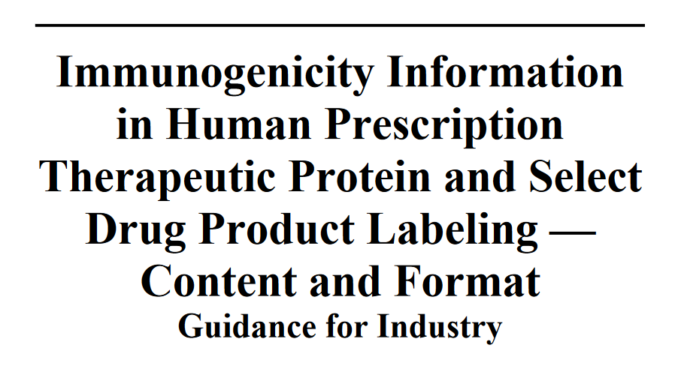
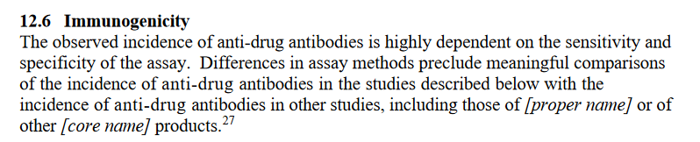
Immunogenicity Labeling
2022 Draft Guidance
Labeling language when
BA method inadequate
BA method adequate
2.1 ADA impact clinically significant
2.2 insufficient data to characterize ADA’s clinical impact
2.3 sufficient data to demonstrate ADA impact clinically insignificant
Language highlight the sensitivity and specificity of ADA assay
ADA incidence should be in context of treatment duration & follow up duration

Slide 31
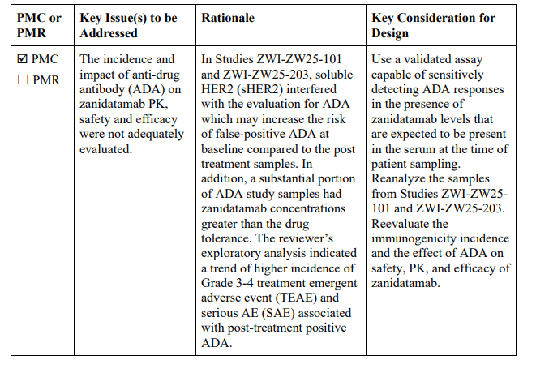
Labeling language example
Ziihera, zanidatamab-hrii, unresectable or metastatic HER2-positive (IHC 3+) biliary tract cancer (accelerated approval)
https://www.accessdata.fda.gov/drugsatfda_docs/label/2024/761416s000lbl.pdf
12.6 Immunogenicity There is insufficient information to characterize the anti-drug antibody response to zanidatamab-hrii and the effects of anti-drug antibodies on pharmacokinetics, pharmacodynamics, safety, or effectiveness of zanidatamab-hrii.

Slide 32
Labeling language example
Alhemo concizumab-mtci 12/20/2024 For routine prophylaxis to prevent bleeding episodes in hemophilia A and B
https://www.accessdata.fda.gov/drugsatfda_docs/label/2024/761315s000lbl.pdf
12.6 Immunogenicity The observed incidence of anti-drug antibodies is highly dependent on the sensitivity and the specificity of the assay. Differences in assay methods preclude meaningful comparisons of the incidence of anti-drug antibodies (ADA) in the studies described below with the incidence of ADA in other studies, including those of concizumab-mtci or of other concizumab products. During the treatment period in 4 trials with a duration of 11 weeks, ≥76 weeks, ≥76 weeks, and ≥32 weeks, 47 out of the 185 treated patients (25.4%) developed anti-concizumab-mtci antibodies. Among the 47 patients who tested positive for ADA, 12 patients (25.5%) developed neutralizing antibodies (NAbs) against concizumab-mtci. In 1 patient who developed NAb against concizumabmtci, free TFPI levels were restored to baseline indicative of effectiveness likely being compromised. In the remaining 46 patients, there was no identified clinically significant effect of the antibodies on pharmacokinetics, pharmacodynamics, safety, or effectiveness of concizumab-mtci.

Slide 33
Labeling language example
Unloxcyt cosibelimab-ipdl 12/13/2024 To treat cutaneous squamous cell carcinoma
https://www.accessdata.fda.gov/drugsatfda_docs/label/2023/761297s000lbl.pdf
12.6 Immunogenicity The observed incidence of anti-drug antibodies is highly dependent on the sensitivity and specificity of the assay. Differences in assay methods preclude meaningful comparisons of the incidence of anti-drug antibodies in the studies described below with the incidence of anti-drug antibodies in other studies, including those of UNLOXCYT or of other cosibelimab products. Anti-drug antibody (ADA) and neutralizing antibody (nAb) responses were monitored throughout the treatment period where the benefit to risk ratio was assessed. ADAs were detected in 65/133 (49%) of patients treated with UNLOXCYT and nAbs were detected in 2/65 (3.0%) of the patients. UNLOXCYT-treated patients who developed anti-cosibelimab antibodies had reduced UNLOXCYT concentrations (20% lower compared to UNLOXCYT-treated subjects who did not develop anti-cosibelimab-ipdl antibodies). There was no clinically significant effect of anti-cosibelimab-ipdl antibodies on the efficacy or safety of cosibelimab-ipdl.

Slide 34
Labeling language example
Bizengri zenocutuzumab-zbco 12/4/2024 To treat non-small cell lung cancer and pancreatic adenocarcinoma
12.6 Immunogenicity The observed incidence of anti-drug antibodies is highly dependent on the sensitivity and specificity of the assay. Differences in assay methods preclude meaningful comparison of the incidence of anti-drug antibodies in the studies below with the incidence of anti-drug antibodies in other studies, including those of BIZENGRI or of other zenocutuzumab products. In patients who received BIZENGRI at the approved recommended dosage for up to 30 months, 7 of 153 (4.6%) patients developed anti-zenocutuzumab antibodies. Because of the low occurrence of anti-drug antibodies, the effect of these antibodies on the pharmacokinetics, pharmacodynamics, safety, and efficacy of zenocutuzumab is unknown.

