Slide 1
CYB003-101 Study PKPD Analyses: BP and Hallucination
Tairan Yang
Aug 18, 2026
NASDAQ: HELP | Cboe CA: HELP

Slide 2
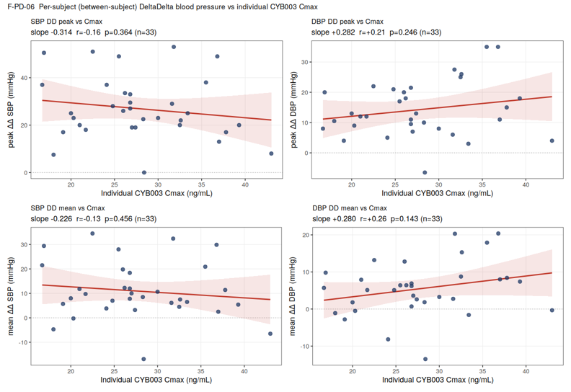
CYB003 Blood-Pressure Exposure–Response: BP vs C_{max}
Individual peak and mean day 1 corrected SSBP and DBP vs individual Cmax (between-subject) relationship is flat and non-significant (slightly negative for SBP, slightly positive for DBP)
Figure 1. Subject-level ΔΔ (peak and mean) vs individual Cmax (between-subject). No significant gradient for either endpoint; SBP slightly negative, DBP slightly positive.

Slide 3
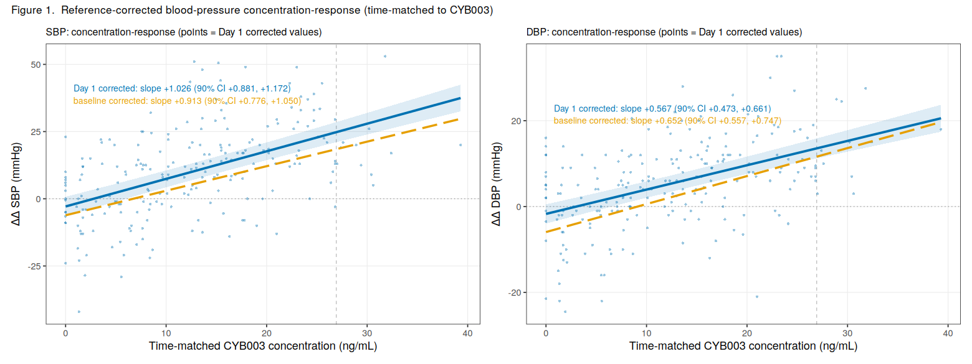
CYB003 Blood-Pressure Concentration–Response
Figure 2. ΔΔ SBP and DBP vs time-matched CYB003 concentration (within-subject). Green = reference-corrected fit; navy dashed = uncorrected single-Δ fit. The positive slope persists - and steepens for SBP - after Day-1 correction, so it is not circadian.
Against the time-matched CYB003 concentration (within-subject), ΔΔSBP and ΔΔDBP rise steeply and significantly with drug concentration

Slide 4
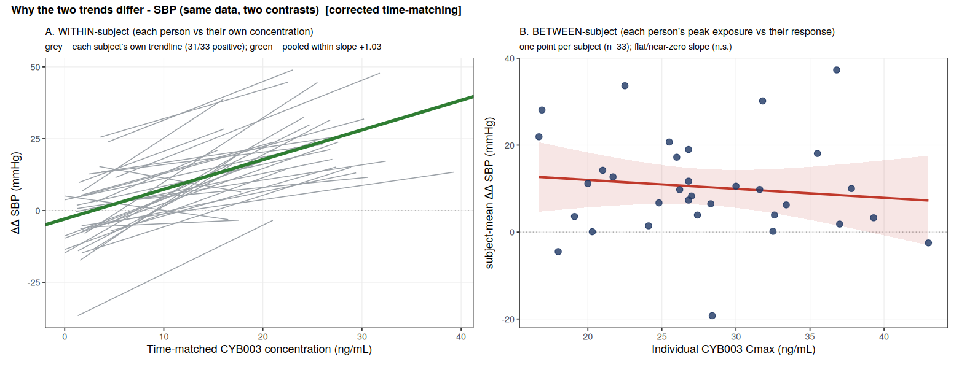
Two Analyses: Why the Trends are Opposite?
Within-subject SBP data show 31/33 individual patients exhibit strong day 1 corrected SBP increase with CYB003 concentration
Between-subject SBP data show flat day 1 corrected SBP increase with individual CYB003 Cmax

Slide 5
Conclusions and Key Takeaways
Three reasons the within-subject relationship is strong but the between-subject one is not:
Exposure range: within a participant, concentration goes from 0-43 ng/mL. Across participants, Cmax spans only ~17–43 ng/mL (2.6-fold) at a single 16 mg dose - little between-subject range to detect a slope.
Noise: the within-subject normalizes baseline characteristics. The between-subject is dominated by interindividual differences
Data richness: a single Cmax value does not represent the time-integrated exposure each patient’s BP actually tracks
CYB003 produces a real, transient, concentration-linked increase in blood pressure: BP rises and falls with drug concentration, reproducibly across nearly all participants.
Magnitude at 16 mg: ≈ +20/+11 mmHg (SBP/DBP) at peak concentration, transient (peak ~2 h, resolving by 8–12 h).
Peak exposure (Cmax) does not identify who responds most over this narrow single-dose range

Slide 6
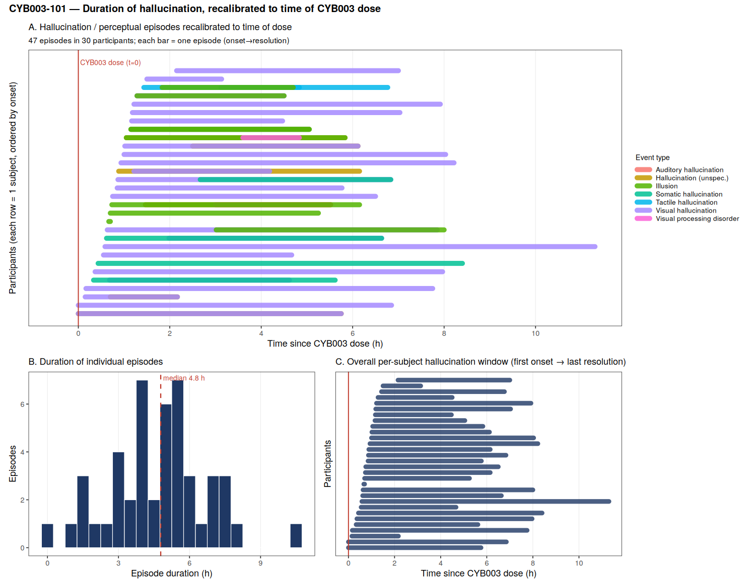
Hallucination Episodes Were Transient Following CYB003 Dosing
Across 30 participants, 47 hallucination/perceptual episodes were reported following CYB003 administration.
Most events occurred within the first few hours after dosing and resolved on the same day.
The median duration of an individual episode was 4.8 hours.
Per-subject hallucination windows were generally limited to ~4-8 hours post-dose, with a small number extending longer.
Visual hallucinations were the most commonly reported event type

Slide 7
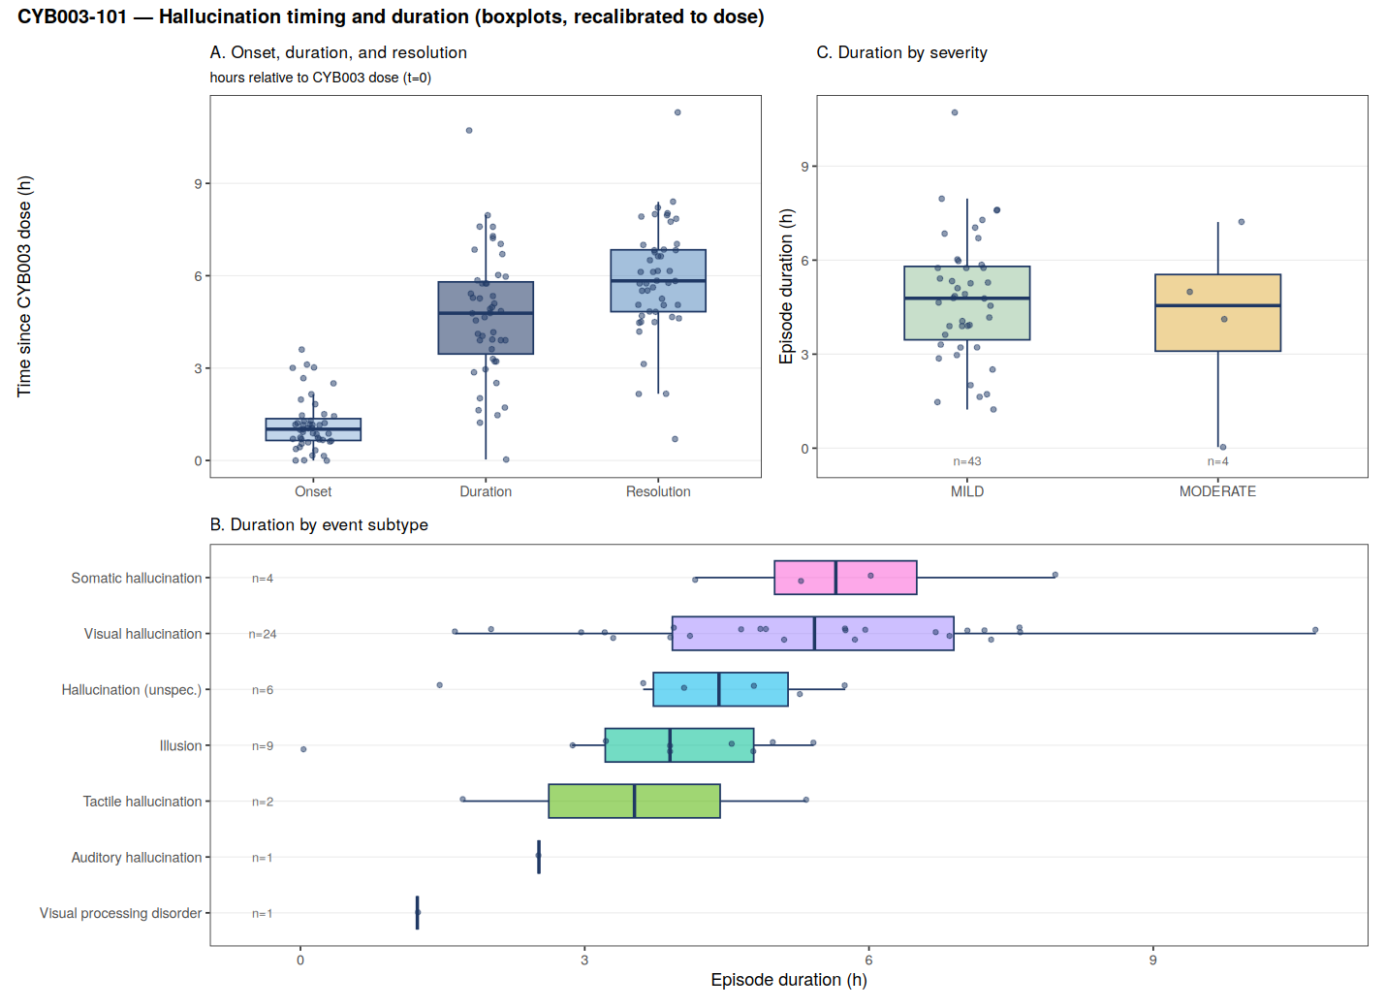
CYB003-Associated Hallucinations Were Time-Limited, With Median Resolution by ~6 Hours
Onset was early post-dose, with most hallucination events beginning around ~1 hour after CYB003 dosing.
Episodes were transient, with median duration approximately 4.8 hours.
Resolution typically occurred by ~6 hours post-dose, consistent with a time-limited post-dose effect.
Events were predominantly mild, with 43 mild episodes and 4 moderate episodes, with no significant duration difference

Slide 8
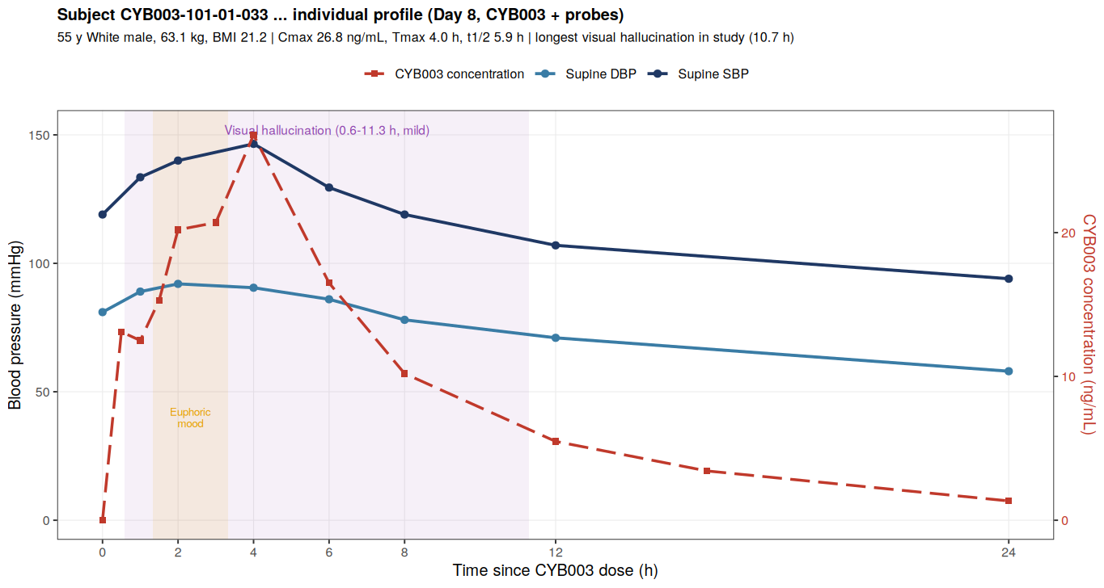
Subject 01-033: Longest Visual Hallucination in the Study
Subject: 55 y White male, healthy volunteer; 63.1 kg, BMI 21.2
Event: Longest visual hallucination in study -~10.7 h (onset 0.6 h, resolved 11.3 h post-dose); mild, drug-related, resolved same day, no treatment
Also: Mild euphoric mood (~1.9–3.9 h post-dose), overlapping the peak
Exposure: Cmax 26.8 ng/mL (≈ study average) but late Tmax 4 h, long t½ 5.9 h → delayed, sustained exposure
Blood pressure: Transient rise tracking drug concentration - SBP +28 mmHg (peak 146 at 4 h), DBP +11; back to/below baseline by 24 h

