Slide 1
Clin Pharm Working Group
Tairan Yang
July 30, 2026

Slide 2
Introduction
Recent Work Experience:
Associate director, Clin Pharm & Pharmacometrics, Praxis Precision Medicines (Sept 2024-July 2026)
Principal Scientist, Quantitative Clinical Pharmacology, Legend Biotech (Jan 2022-Sept 2024)
Principal Scientific Researcher, Genentech (May 2020-Dec2021)
Therapeutic area and modality experience:
Immunology, Oncology, hematology, neurology
Small molecules, mono/bispecific antibodies, cell and gene therapies (CAR-T, ASO)
Education:
Georgia Tech; MS Computer Science, 2022
University of Toronto; MS Chemistry and PharmD, 2020
University of British Columbia; BS Chemistry, 2013

Slide 3
What is Pharmacokinetics?
PK describes the fate of the drug you take:
Absorption (How much? How fast? Is it affected by food?)
Distribution (Limited or extensive?)
Metabolism (What metabolites are formed? What enzymes are involved? DDIs?)
Excretion (Urine or feces? Intact or as metabolites?)
Relevant information gleaned from an analysis:
Bioavailability: Fraction of a dose that reaches the plasma
Overall exposure: AUC
Peak concentration: C_{max}
Time of peak concentration: t_{max}
Half-life for elimination: t_{½}
Rate of irreversible removal of drug from plasma: CL
Volume of distribution: V_{d}
PK analyses give “parameter estimates” that can be important on their own (e.g., bioavailability, t_{½}, t_{max}) or useful only within the context of clinical response (e.g., AUC, C_{max}).
PK is a key component of dose selection, which combines PK information with efficacy, safety, and tolerability information to determine the dose strength and dosing frequency that produces a good balance between efficacy and safety/tolerability.

Slide 4
Three Type of PK Analyses We’ll Cover Today
Noncompartmental analyses:
Typical for Phase 1 studies, when subjects are housed and readily available
Serial samples are collected after a dose to provide a full concentration-time profile
PK parameter estimates are calculated for each profile
Parameter estimates are summarized across profiles

Slide 5
Three Type of PK Analyses We’ll Cover Today
Population PK (popPK) analyses:
Typical for Phase 2/3 studies, when subjects are not housed and readily available
Only 1 or 2 PK samples are collected at a visit
Individual profiles are not available
The popPK analysis combines all data and uses specialized software to develop a model that describes the PK in the population, not in individuals.
This is an empirical “top-down” approach
The model calculates PK parameter estimates and their variability
The model can then be used to predict individual exposures that are used in exposure-response analyses for efficacy and safety

Slide 6
Three Type of PK Analyses (Not Covered Today)
Physiologically based PK (PBPK) analysis:
Can be used across all phases, from preclinical to late development
Mechanistic “bottom-up” approach that develops a physiological model to predict exposures and compare scenarios
Especially useful to:
scale in vitro and animal data to predict human PK
predict exposure in first-in-human studies
predict the magnitude of drug-drug interactions
predict the effects of organ impairment.
Regulatory agencies accept the results of PBPK modeling, so a good model can negate the need to conduct a $1,000,000+ clinical study.

Slide 7
Non-Compartmental Analysis (NCA)

Slide 8
Model-Based vs. Model-Independent PK
There are two major approaches to analyzing PK data (also called “Bioanalytical data,” “Concentration-time data”):
Non-Compartmental Analysis (NCA)
Does not assume any body compartments
Uses simple math to estimate key PK parameters directly from data
Faster, simpler, and very common in early clinical studies
Often used for Phase 1 studies, bioavailability, and PK summaries
NCA = model-independent, easy to interpret, quick.
Compartmental Analysis
Assumes the body is like “boxes” (compartments) where the drug moves
Builds a model with equations and fits it to the data

Slide 9
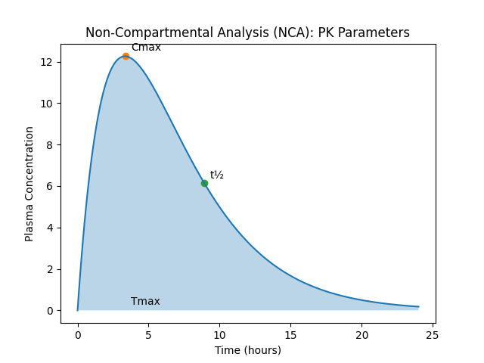
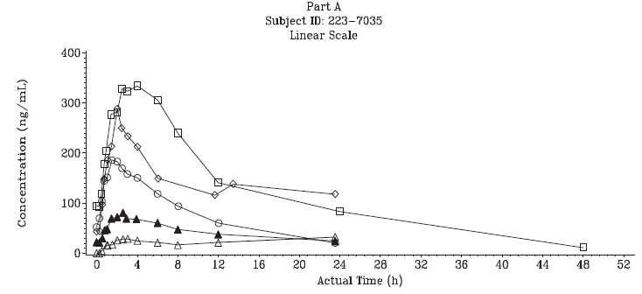
How Non-Compartmental Analysis (NCA) Works
NCA uses observed drug concentration data over time; usually from blood samples; to create a concentration-vs-time curve.
Non-Compartmental Analysis (NCA)
C_{max}: Highest concentration observed
T_{max}: Time of highest concentration
AUC: Total drug exposure
Half-life (t_{½}): Time for concentration to reduce by half
AUC

Slide 10
When & Why NCA is Used
Used when:
Early clinical/phase 1 studies
Rich sampling over time
Need basic exposure metrics
Advantages
Does not assume how many “compartments” the body has
Simple, robust, and reproducible
Commonly accepted by regulators for PK summaries
Limitations
Not good for sparse sampling designs
Cannot predict future levels under new conditions (e.g., new dose)
No mechanistic insight like compartmental or PBPK models

Slide 11
Population PK Modeling

Slide 12
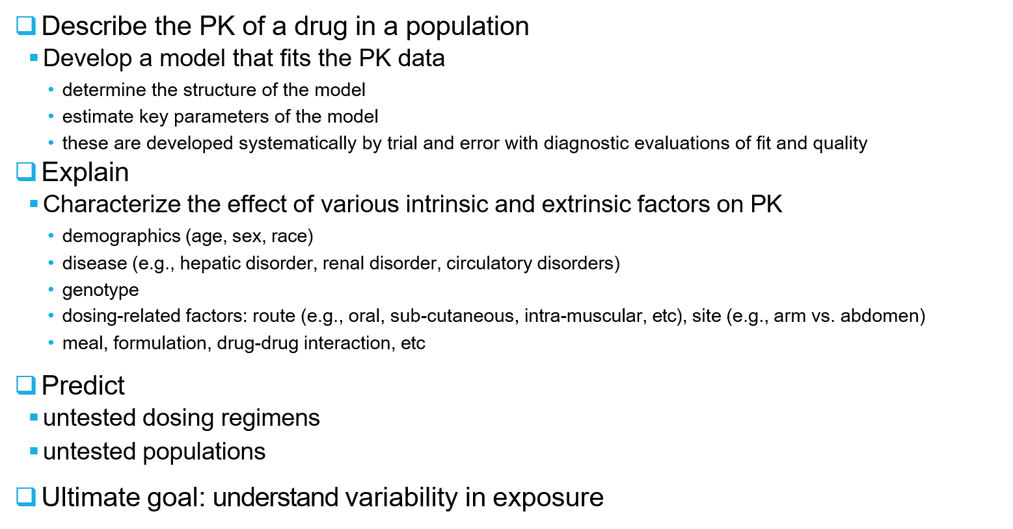
Why Do We Need PopPK Models?

Slide 13
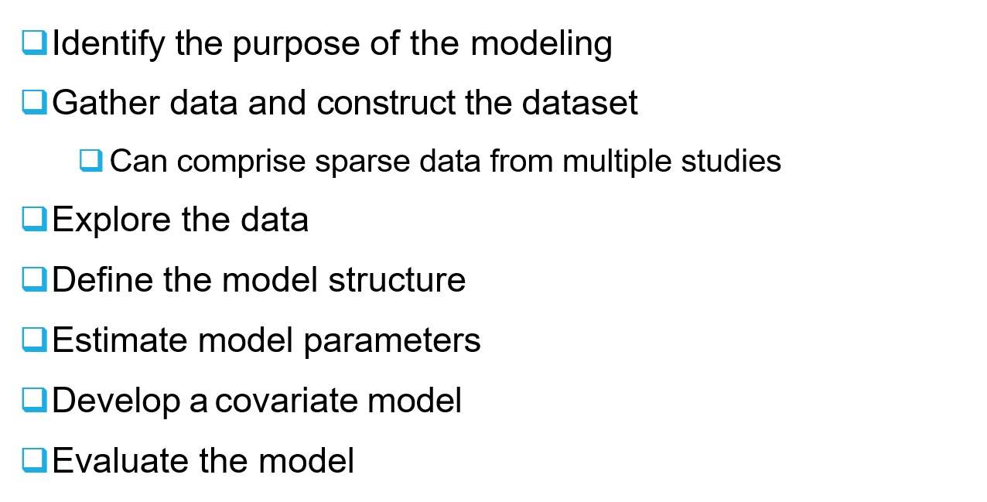
Modeling Steps

Slide 14
Data Gathering and Dataset Construction
Design the analysis (number of subjects, number of samples, timing of sample collection)
✴ how much information does the data contain for the parameter of interest?
Collect dosing history (amount, rate, and time), sample collection, concentration values
✴ data errors lead to problems in parameter estimation and inflated inter-subject variability
Collect other important covariate information
Create a dataset conforming to specific format requirement of a software (e.g., NONMEM, Monolix, Phoenix NLME)

Slide 15
Compartmental Modeling
Compartment: a region of the body in which the drug is well mixed and kinetically homogenous
input
input
Ka
Ka
Central Compartment (Vc)
 | CL
Q
Central Compartment (Vc)
Peripheral Compartment (Vp)
CL
One-compartment model
Two-compartment model

Slide 16
Covariate Modeling
Identify candidate covariates, biological relevance (e.g., height vs. shoe size, body weight, BMI or lean body weight)
Evaluate range of covariates and correlation between covariates (to avoid collinearity), sample size
Screening: plot Empirical Bayesian Estimate of each parameter or random effect against covariates
identify covariates to be formally tested in the model
identify proper candidate parameter-covariate relationship (some should be based on knowledge of biology, physiology, and allometric principles)

Slide 17
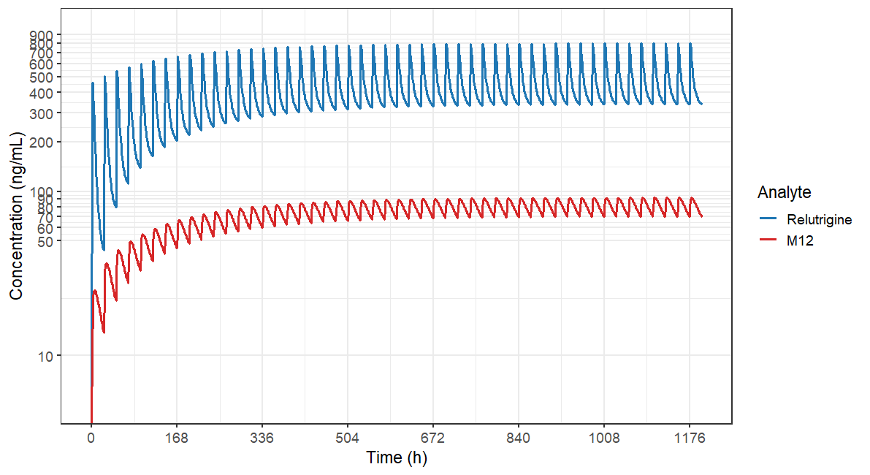
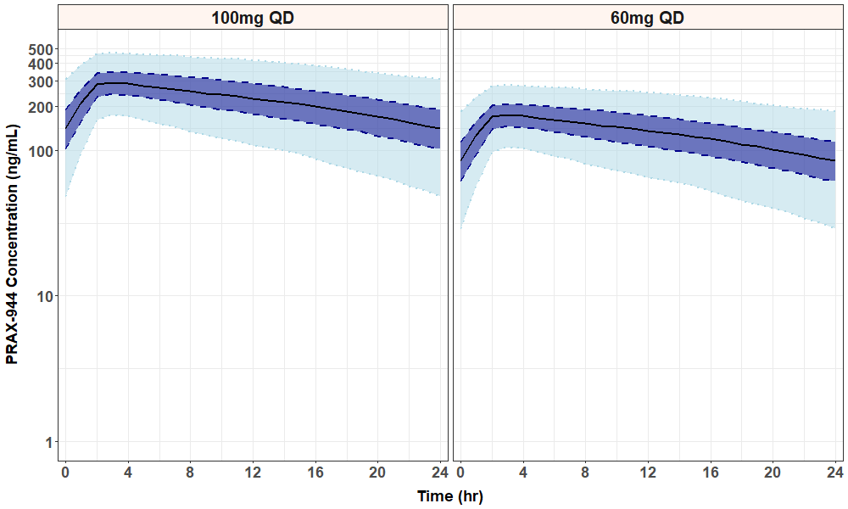
Simulation Based on a PopPK Model
Question to be addressed
Type of simulations
✴ Typical profile
✴ Range of exposures across a population (random effect)
Simulation design
✴ Dosing regimen
✴ Sampling time points
✴ Number of subjects
✴ Realistic distribution for covariates
Choice of parameters
✴ Final estimate
✴ Uncertainty in parameter estimates
✴ Correlation between parameters
PRAX-XXX 60mg and 100mg Population PK Model Predicted Steady State Concentration: Shaded areas representing 5%, 27.5%, 50%, 72.5% and 95%ile of 1000 simulated patients

Slide 18
Useful Outputs
A model that describes the PK we have seen in studies, with parameter estimates that can used in labeling and to explain observed data.
The model can be used to simulate scenarios that have not been tested clinically (e.g., different dosing regimens).
Predicted exposures can be used in exposure-response analyses for efficacy and safety, to support dose selection.

Slide 19
Case Study

Slide 20
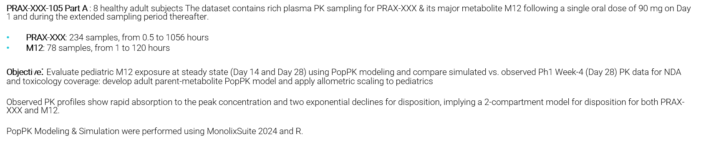
Exploratory Data Analysis
PRAX-XXX

Slide 21
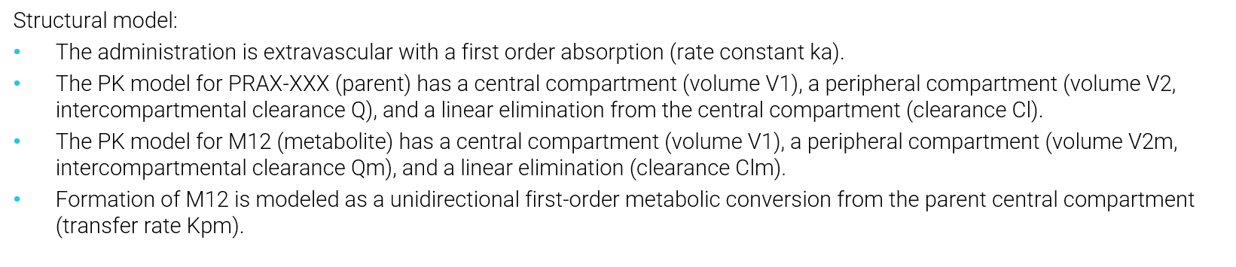
Model Structure
Parent (PRAX-XXX)
Metabolite (M12)
Dose
ka
Cl
Central
(V1)
Kpm
Central
(V1)
Clm
Q
Qm
Peripheral
(V2)
Peripheral (V2m)

Slide 22
Estimated Population PK model Parameters
Parameter | Value |  | Stoch. Approx.
 |  |  | S.E. | R.S.E.(%) | P2.5 | P97.5
Fixed Effects
ka_pop | 0.232 |  | 0.0312 | 13.442 | 0.179 | 0.301
V1_pop | 19.825 |  | 2.24 | 11.3 | 15.919 | 24.688
Cl_pop | 6.88 |  | 2.794 | 40.605 | 3.352 | 14.123
Q_pop | 23.731 |  | 1.182 | 4.979 | 21.528 | 26.159
V2_pop | 1093.622 |  | 44.957 | 4.111 | 1009.066 | 1185.263
Clm_pop | 6.462 |  | 1.226 | 18.977 | 4.497 | 9.285
Qm_pop | 23.281 |  | 16.595 | 71.284 | 7.745 | 69.981
V2m_pop | 53.657 |  | 10.795 | 20.118 | 36.578 | 78.71
Kpm_pop | 0.0571 |  | 0.016 | 28.09 | 0.0339 | 0.0963
Standard Deviation of the Random Effects
 | Value | C.V.(%)
omega_ka | 0.328 | 33.747 | 0.0884 | 26.926 | 0.199 | 0.543
omega_V1 | 0.0607 | 6.077 | 0.115 | 190.175 | 0.00943 | 0.391
omega_Cl | 1.023 | 135.832 | 0.255 | 24.961 | 0.64 | 1.634
omega_V2 | 0.0282 | 2.818 | 0.0432 | 153.493 | 0.00517 | 0.154
omega_Qm | 0.844 | 101.917 | 0.406 | 48.113 | 0.37 | 1.926
omega_Kpm | 0.502 | 53.54 | 0.145 | 28.864 | 0.294 | 0.857
Error Model Parameters
aParent | 5.627 |  | 0.393 | 6.989 | 4.909 | 6.45
bParent | 0.163 |  | 0.0117 | 7.143 | 0.142 | 0.188
aM12 | 3.432 |  | 0.311 | 9.061 | 2.877 | 4.095

Slide 23
PRAX-XXX-105 (hAME) Study Goodness-of-fit: Individual fits
PRAX-XXX
M12 metabolite
Observed PK concentrations (blue dots) overlapped well with model-predicted plasma concentrations over PK sampling time for both PRAX-XXX (left panel) and M12 (right panel)

Slide 24
Goodness-of-fit: Observation vs Predictions (PRAX-XXX-105 hAME Study)
PRAX-XXX
M12
Individual model-predicted and observed PK data are in a line of unity.

Slide 25
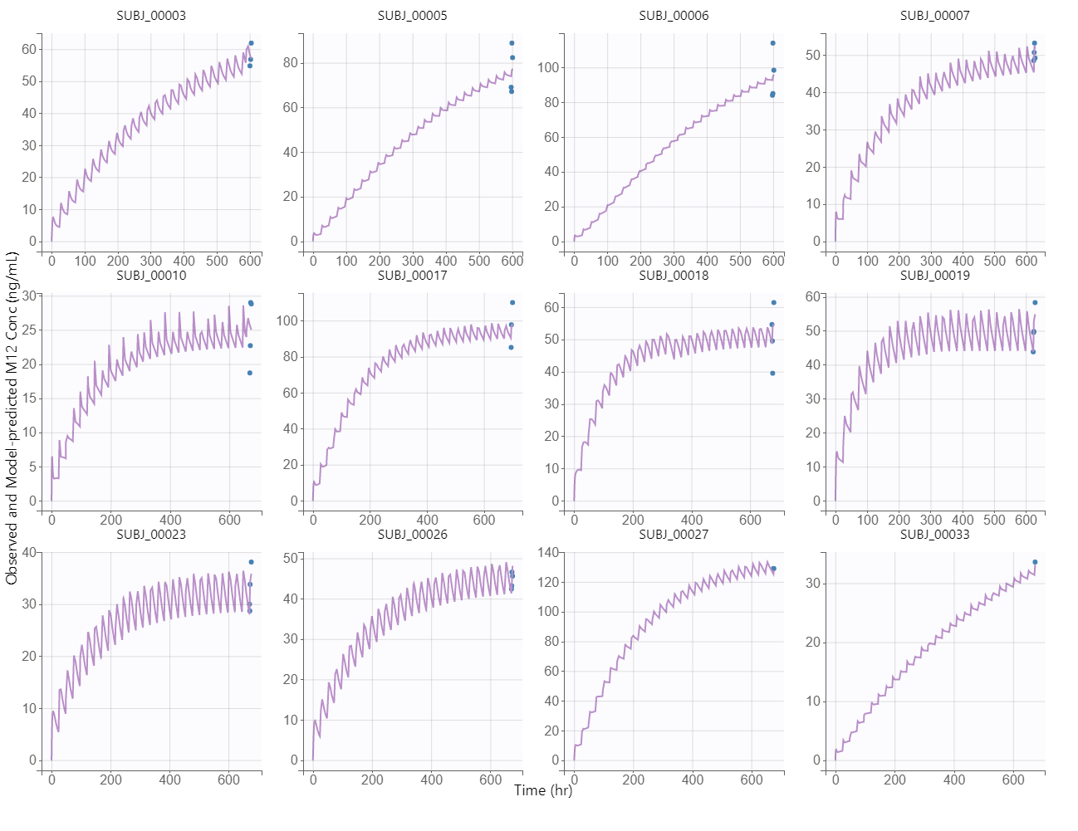
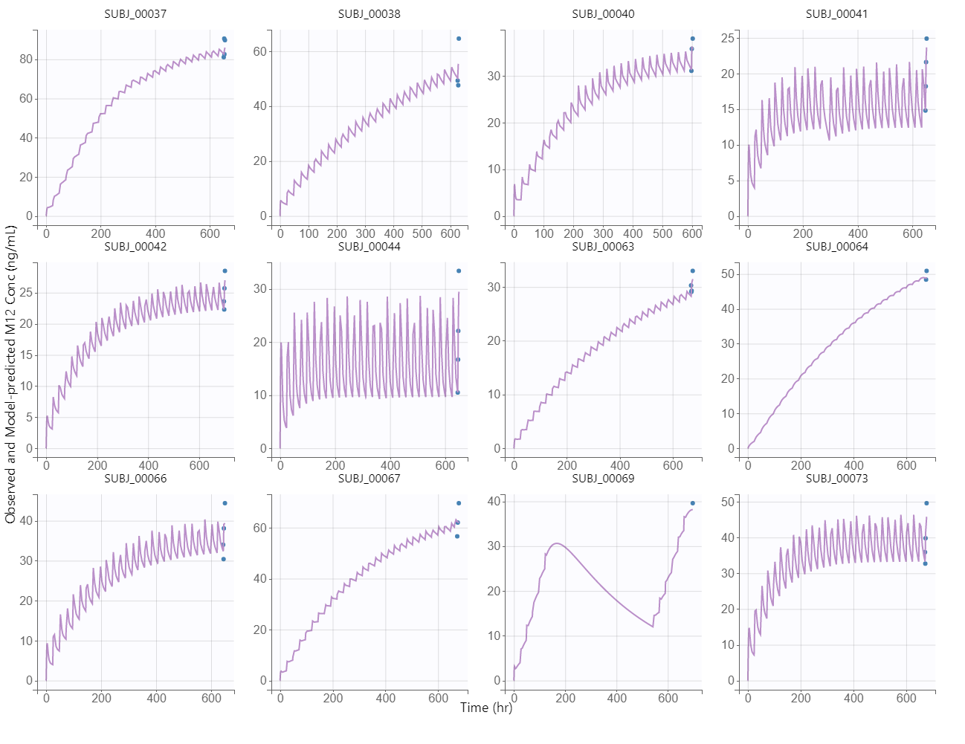
Ph1 Study M12 Goodness-of-fit: Individual fits
Observed PK concentrations (blue dots) overlapped well with model-predicted plasma concentrations for M12 in Ph1 study

Slide 26
Goodness-of-fit: Visual Predictive Check (VPC)
PRAX-XXX
VPC is a simulation-based model diagnostic tool to validate a PK model by graphically comparing simulated data from the model to the original observed data: 95, 50 and 5 percentile prediction intervals overlaid with empirical and predicted percentiles

Slide 27
Model-predicted Typical Conc vs Time Profile (90 mg QD)
PRAX-XXX
Adult M12 Median Model-Predicted PK Parameters at Steady State (n=1000)
Cmin (ng/mL) | Cmax (ng/mL) | AUCtau (ng/mL*hr) | Tmax (hr) | Half-life (hr) | Accu. Ratio
63.3 | 87.3 | 1820.0 | 4.0 | 52.8 | 4.0
What we observe in Ph1 median concentration at V5 Double Blind Treatment Week 4
Predose: 33 ng/mL, 1st hour: 32.7ng/mL, 2nd hour: 31.9ng/mL, 4th hour: 31.1ng/mL, 6th hour: 32.7ng/mL
Median model-predicted steady state exposure (Cmin and Cmax) is higher in adults from 105 study than observed pediatric concentration in Ph1.

Slide 28
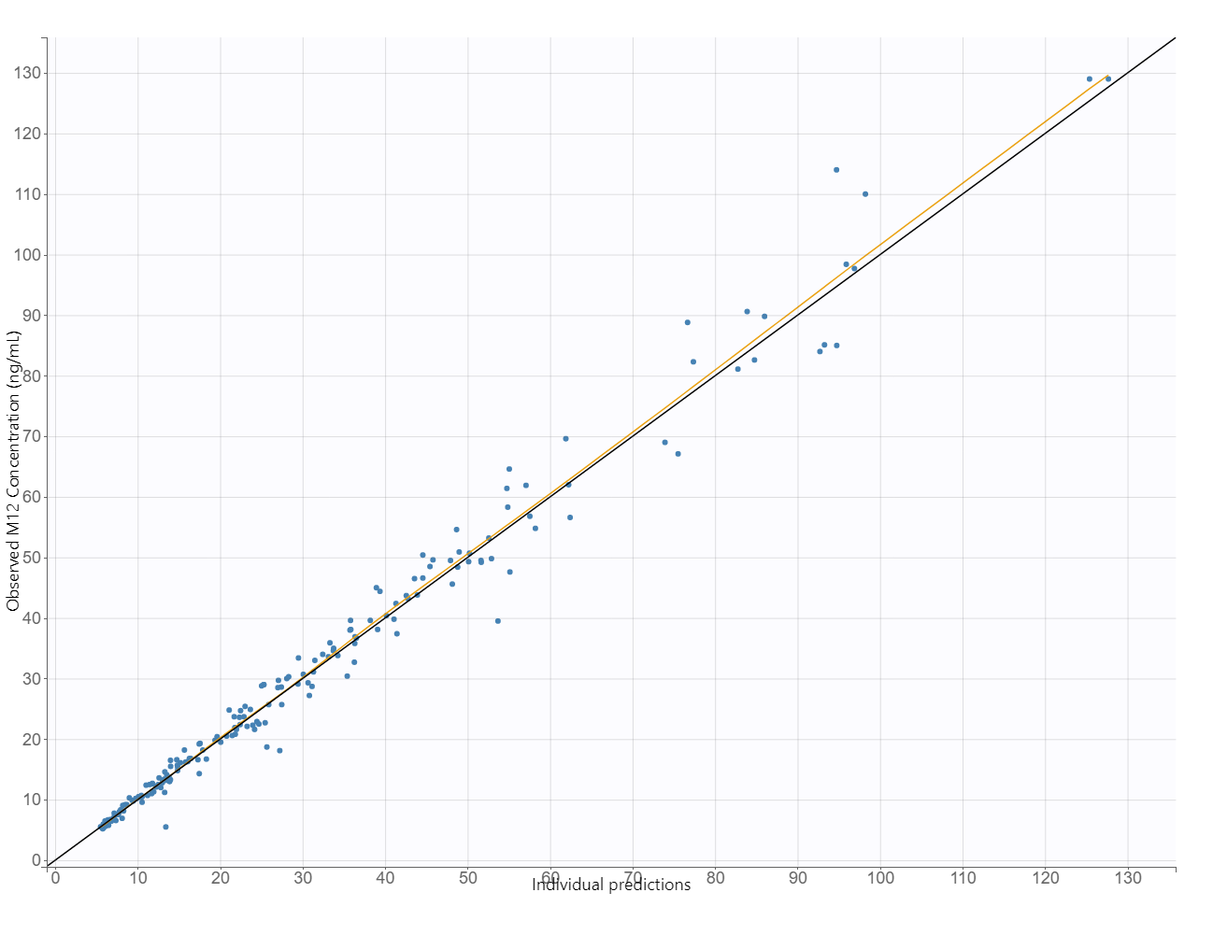
M12: Model-predicted Ph1 Pediatric 1mg/kg/day
Key Conclusions
PopPK model accurately predicts pediatric M12 exposures.
Observed Ph1 data confirm predictable and consistent M12 accumulation.
Minimal diurnal fluctuation indicates low PK variability and stable exposure.
Current pediatric dosing achieves exposures aligned with model expectations.
Rat toxicology coverage at Day 14 is approximately 55–56%
Ph1 M12 Median Model-Predicted PK Parameters (n = 24 at true steady state)
Day 14 | Cmin (ng/mL) | Cmax (ng/mL) | AUCtau (ng/mL*hr)
 | 36.9 | 44.6 | 970
Day 28 | Cmin (ng/mL) | Cmax (ng/mL) | AUCtau (ng/mL*hr)
 | 46.7 | 53.4 | 1195
Day 28 Observed | Cmin (ng/mL) | Cmax (ng/mL) | AUCtau (ng/mL*hr)
 | 41.0 | 50.3 | 1125* (extrapolated)

