Slide 1
Base PK Model
Presented 6/11/26

Slide 2
Model Development Overview

Slide 3
Study Overview

Slide 4
EDA

Slide 5
Data Review
Dataset:
BNT317-01-RawClinicalNonCRF-EXT_IQVIA_PK_biontech_20260514053510 1.xlsx
BNT317-01-RawClinicalCRF-EX_biontech_20260515090724.xlsx
BNT317-01-RawClinicalCRF-VSAM_biontech_20260514043654.xlsx
Actual time used for PK and dosing
Studies:
BNT317-01/PM1086-A001
Observations:
317 plasma concentration (ng/mL)
Body weight (kg)
“Day 1 of Cycle 1” bodyweight used when available, if not available “Screening” bodyweight used

Slide 6
PK Sample Summary
Dose | Frequency | Subjects with PK Dataª |  | Total PK Samples | Quantifiable PK Samples |  |  |  | BLQ Samples
 |  | Total | Included |  | Total | Included | Excluded1^{b} | Excluded9^{c} | Pre-Dose | Post-Dose | Post-Dose %^{d}
70 | Q2W | 1 | 1 | 30 | 15 | 15 | 0 | 0 | 1 | 14 | 48.2
200 | Q2W | 7 | 7 | 113 | 96 | 96 | 0 | 0 | 8 | 9 | 8.6
600 | Q2W | 10 | 9 | 133 | 123 | 119 | 1 | 3 | 8 | 1 | 0.8
1200 | Q2W | 6 | 6 | 59 | 52 | 52 | 0 | 0 | 6 | 1 | 1.9
1800 | Q2W | 0 | 0 | 0 | 0 | 0 | 0 | 0 | 0 | 0 | -
Total | Q2W | 24 | 24 | 335 | 286 | 282 | 1 | 3 | 23 | 25 | 8.1
a: Subjects with at least 1 PK observations besides dosing records.
b:Excluded for pre-dose non-BLQ.
c: Excluded for DFLAG = 9 (mislabeled)
d: post-dose BLQ% = (# post-dose BLQ)/(# post-dose BLQ + #Included quantifiable)

Slide 7
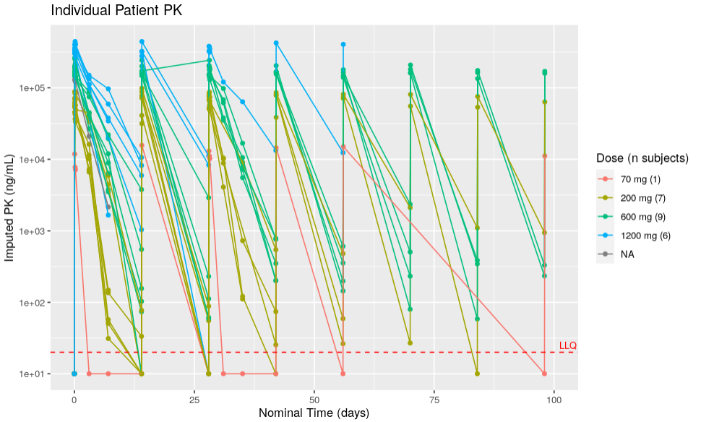
PK EDA Plots – Concentration-Time Profile

Slide 8
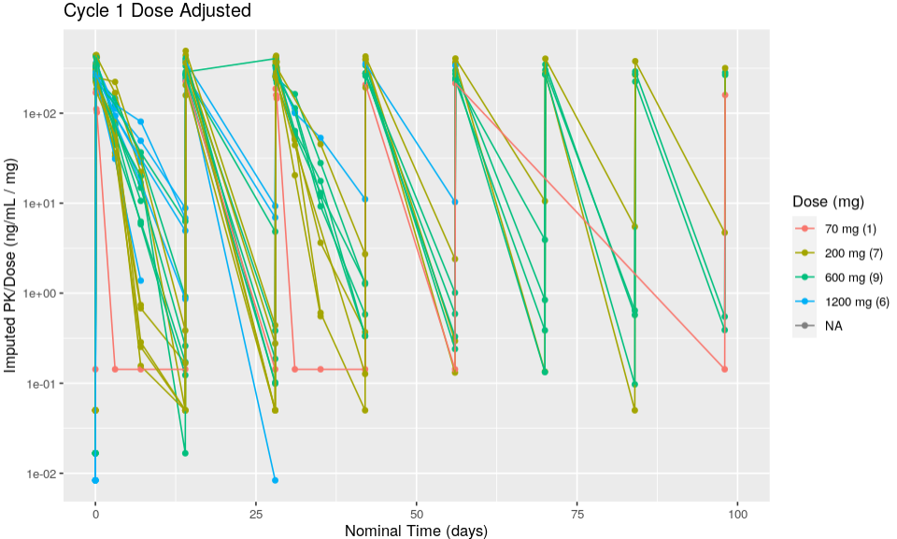
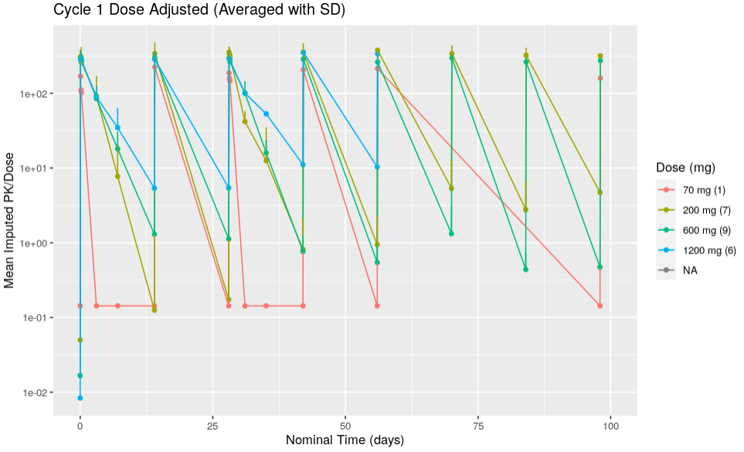
PK EDA Plots – Dose-Normalized Concentration-Time Profile

Slide 9
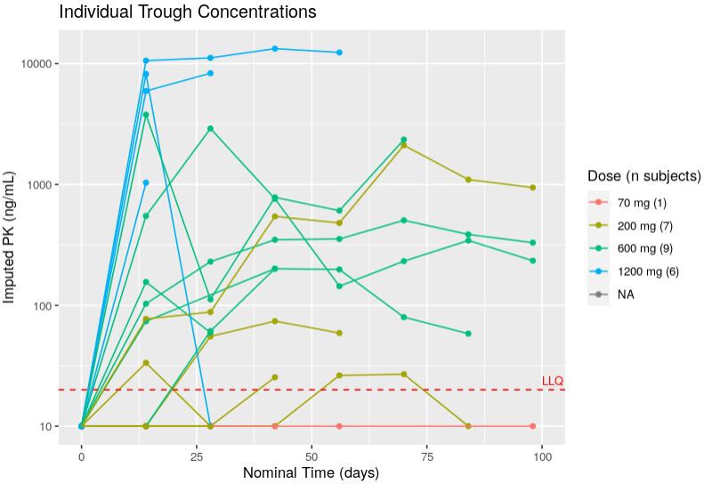
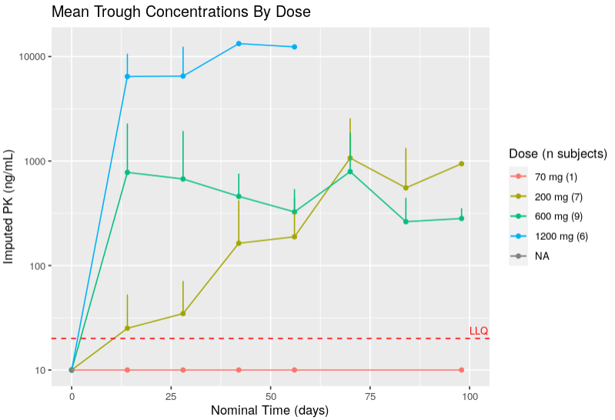
Trough Concentrations

Slide 10
Base PK Model

Slide 11
Run | Description | #Subject | #Obs | Minimization Successful? | Covariance Successful? | OFV
1 | 1CMT - Linear Elimination - Proportional error | no IIV | 25 | 282 | Yes | Yes | 6104.004
2 | 1CMT - Linear Elimination - Proportional error | IIV on CL and VC | 25 | 282 | Yes | Yes | 5558.172
3 | 1CMT - Linear + MM Elimination - Proportional error | IIV on CL and VC | 25 | 282 | Yes | No | 5558.172
4 | 2CMT - Linear Elimination - Proportional error | no IIV | 25 | 282 | Yes | Yes | 5794.449
5 | 2CMT - Linear Elimination - Proportional error | IIV on CL and VC | 25 | 282 | Yes | Yes | 5557.232
6 | 2CMT - Linear + MM Elimination - Proportional error | no IIV | 25 | 282 | Yes | No | 5761.03
7 | 2CMT - Linear + MM Elimination - Proportional error | IIV on CL and VC | 25 | 282 | Yes | No | 5767.743
Notes:
1 cmt vs 2 cmt, including etas vs not, MM exploration no etas for 1 and 2 CMT

Slide 12
Model Comparisons – Parameter values
 | 1CMT - Linear Elimination - Proportional error no IIV |  | 1CMT - Linear Elimination - Proportional error IIV on CL and VC |  | 2CMT - Linear Elimination - Proportional error no IIV |  | 2CMT - Linear Elimination - Proportional error IIV on CL and VC
 | Est. | stderr | Est. | stderr | Est. | stderr | Est. | stderr
Prop. | 0.700 | 0.035 | 0.370 | 0.049 | 0.562 | 0.038 | 0.369 | 0.048
CL | 0.856 | 0.065 | 1.612 | 0.153 | 0.933 | 0.073 | 1.644 | 0.150
V1 | 5.259 | 0.230 | 3.734 | 0.183 | 4.162 | 0.256 | 3.55 | 0.170
Q | - | - | - | - | 0.315 | 0.032 | 3.529 | 4.211
V2 | - | - | - | - | 1289.29 | 247.303 | 0.285 | 0.305
CL eta | - | - | 0.209 | 0.068 | - | - | 0.208 | 6.71E-02
V1 eta | - | - | 0.026 | 0.012 | - | - | 0.030 | 1.48E-02
OFV | 6104.004 |  | 5558.172 |  | 5794.449 |  | 5557.232

Slide 13
Model Comparisons – Parameter values
 | 1CMT - Linear Elimination - Proportional error no IIV |  | 1CMT - Linear Elimination - Proportional error IIV on CL and VC |  | 2CMT - Linear Elimination - Proportional error no IIV |  | 2CMT - Linear Elimination - Proportional error IIV on CL and VC
 | Est. | stderr | Est. | stderr | Est. | stderr | Est. | stderr
Prop. | 0.700 | 0.035 | 0.370 | 0.049 | 0.562 | 0.038 | 0.369 | 0.048
CL | 0.856 | 0.065 | 1.612 | 0.153 | 0.933 | 0.073 | 1.644 | 0.150
V1 | 5.259 | 0.230 | 3.734 | 0.183 | 4.162 | 0.256 | 3.55 | 0.170
Q | - | - | - | - | 0.315 | 0.032 | 3.529 | 4.211
V2 | - | - | - | - | 1289.3 | 247.30 | 0.285 | 0.305
CL eta | - | - | 0.209 | 0.068 | - | - | 0.208 | 6.71E-02
V1 eta | - | - | 0.026 | 0.012 | - | - | 0.030 | 1.48E-02
OFV | 6104.004 |  | 5558.172 |  | 5794.449 |  | 5557.232
Tested several iterations of 1 and 2CMT, with or without IIV, Linear or Linear+MM clearance
Models with Michaelis-Menten dynamics had heuristic problems (not shown here)
Linear dynamics fit data well, no significant improvement in OFV moving to 2CMTs
2CMT models have unrealistic fit values for V2, high error on Q with IIV
Move forward with 1CMT model + IIV

Slide 14
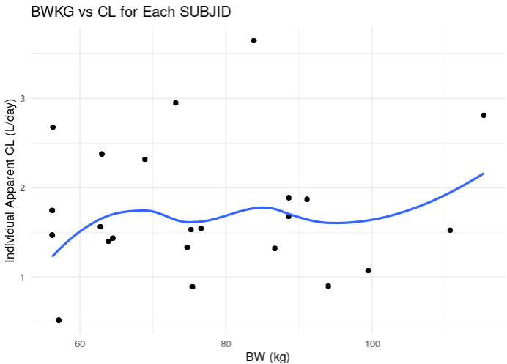
Eta plot for Bodyweight on CL
Not seeing a strong correlation due to low number of subjects, but will add in anticipation of more trend with more data
Centering at 70kg
Variable | N | MEAN_SD | MEDIAN_IQR | MIN_MAX | MISSING
Baseline Weight (kg) | 24 | 77.00 | 75.4 (63,88.6) | 51.7; 115.3 | 0

Slide 15
Model Comparisons – Adding Bodyweight Covariate
 | 1CMT - Linear Elimination - IIV on CL and VC |  | 1CMT - Linear Elimination - IIV on CL and VC Bodyweight covariate on CL, V1 standard 0.75 and 1 exponents, respectively |  | 1CMT - Linear Elimination - no IIV Bodyweight covariate on CL, V1 Fit exponents
 | Est. | stderr | Est. | stderr | Est. | stderr
Prop. | 0.370 | 0.049 | 0.370 | 0.048 | 0.369 | 0.048
CL | 1.612 | 0.153 | 1.514 | 0.151 | 1.571 | 0.161
V1 | 3.734 | 0.183 | 3.442 | 0.197 | 3.581 | 0.186
CL exponent | - | - | 0.75 | FIX | 0.355 | 0.513
V1 exponent | - | - | 1 | FIX | 0.534 | 0.159
CL eta | 0.209 | 0.068 | 0.209 | 0.057 | 0.205 | 0.063
V1 eta | 0.026 | 0.012 | 0.022 | 0.007 | 0.015 | 0.008
OFV | 5558.172 |  | 5557.32 |  | 5550.659

Slide 16
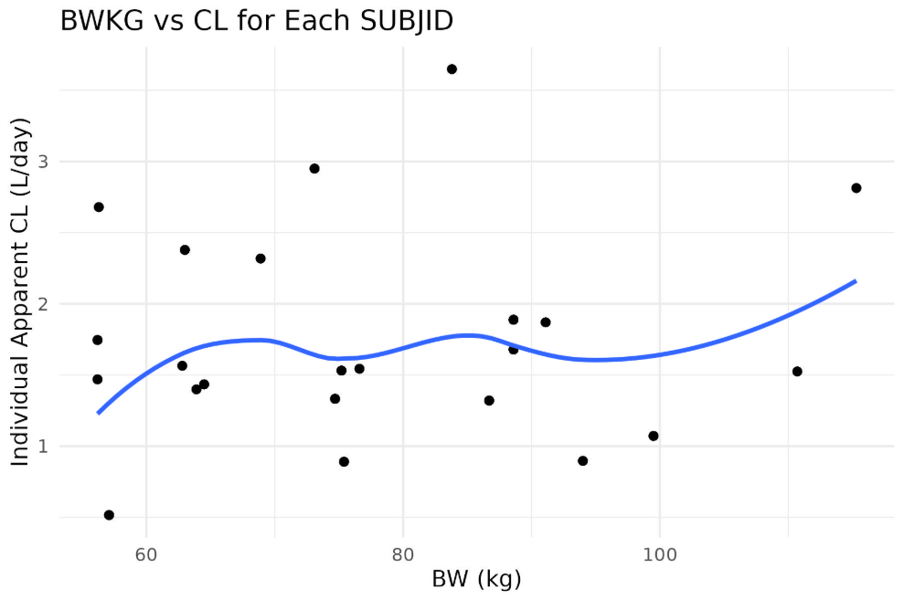
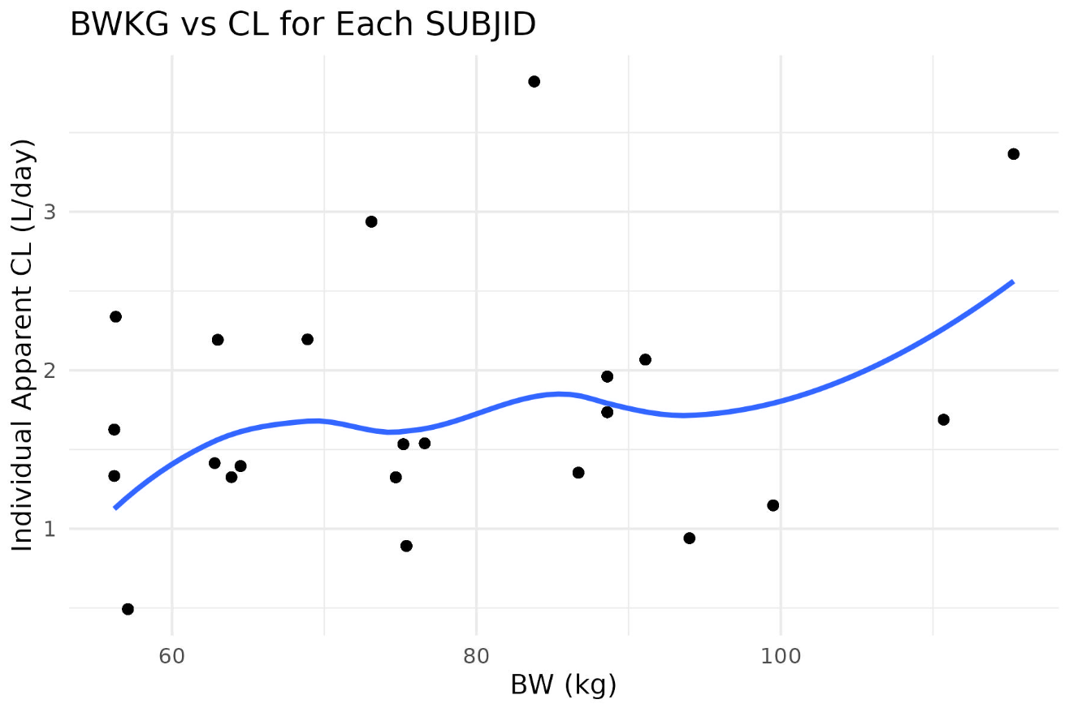
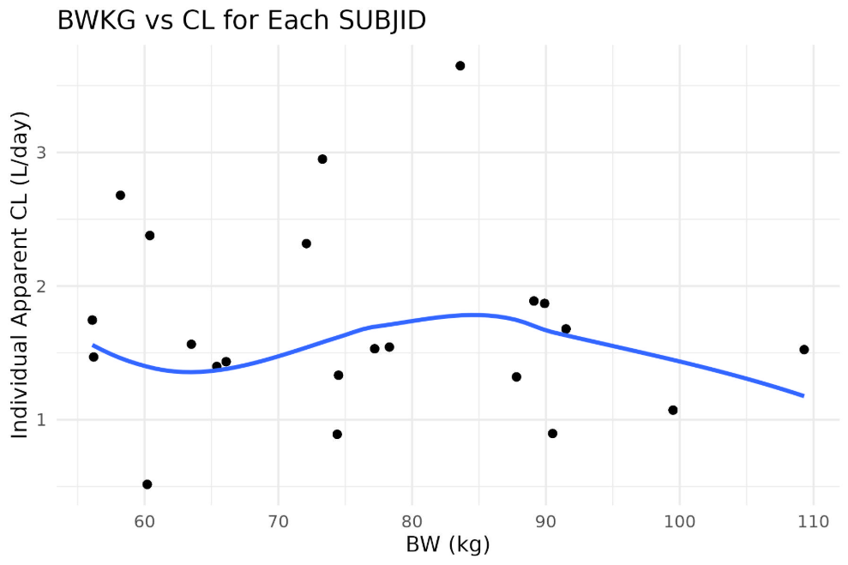
Eta Plot Comparison
1CMT - Linear Elimination - IIV on CL and VC | 1CMT - Linear Elimination - IIV on CL and VC Bodyweight covariate on CL, V1 standard 0.75 and 1 exponents, respectively | 1CMT - Linear Elimination - no IIV Bodyweight covariate on CL, V1 Fit exponents

Slide 17
Final Structure
 | 1CMT - Linear Elimination - IIV on CL and VC |  | 1CMT - Linear Elimination - IIV on CL and VC Bodyweight covariate on CL, V1 standard 0.75 and 1 exponents, respectively |  | 1CMT - Linear Elimination - no IIV Bodyweight covariate on CL, V1 Fit exponents
 | Est. | stderr | Est. | stderr | Est. | stderr
Prop. | 0.370 | 0.049 | 0.370 | 0.048 | 0.369 | 0.048
CL | 1.612 | 0.153 | 1.514 | 0.151 | 1.571 | 0.161
V1 | 3.734 | 0.183 | 3.442 | 0.197 | 3.581 | 0.186
CL exponent | - | - | 0.75 | FIX | 0.355 | 0.513
V1 exponent | - | - | 1 | FIX | 0.534 | 0.159
CL eta | 0.209 | 0.068 | 0.209 | 0.057 | 0.205 | 0.063
V1 eta | 0.026 | 0.012 | 0.022 | 0.007 | 0.015 | 0.008
OFV | 5558.172 |  | 5557.32 |  | 5550.659
Central (V1)
Linear CL
One compartment model with Linear Clearance and IIV on V1 and CL
Proportional Residual Error
Bodyweight covariate on Clearance with standard exponents
Fit exponent <0.5 and non-significant improvement in Fit exponents rules them out for now

Slide 18
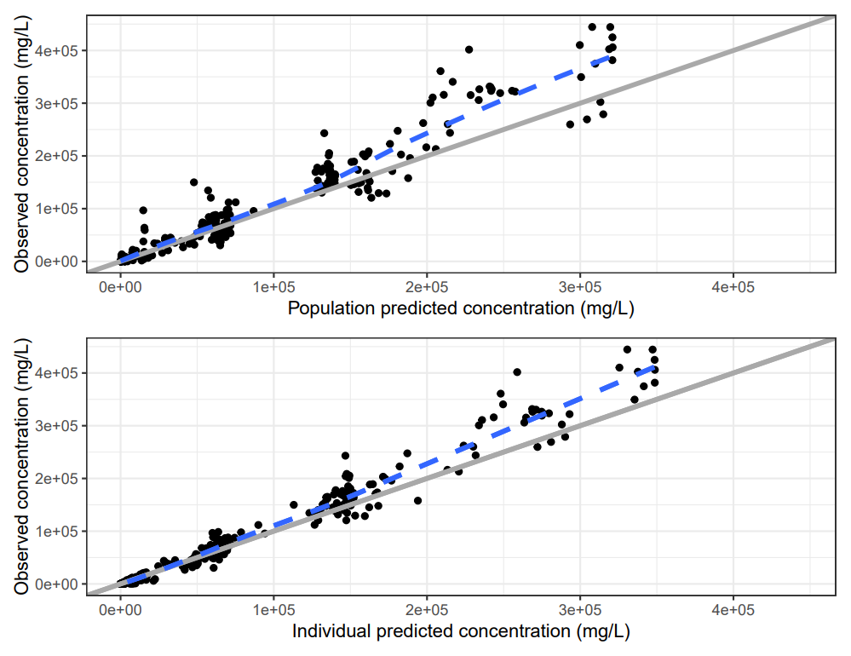
Observed vs. Predicted
(ng/mL)
(ng/mL)
BNT317 concentration vs PRED (population prediction)
BNT317 concentration vs IPRED (individual prediction)

Slide 19
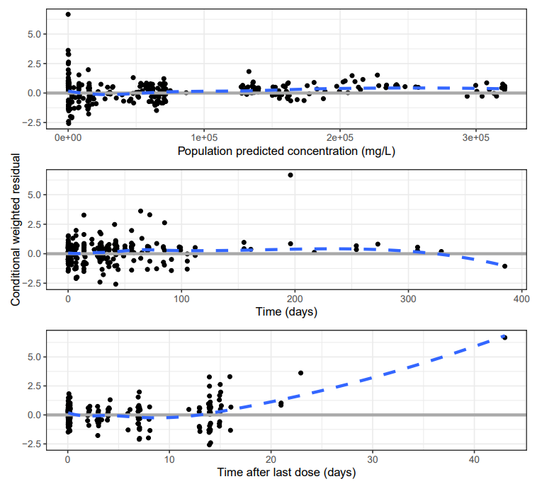
CWRES/IWRES

Slide 20
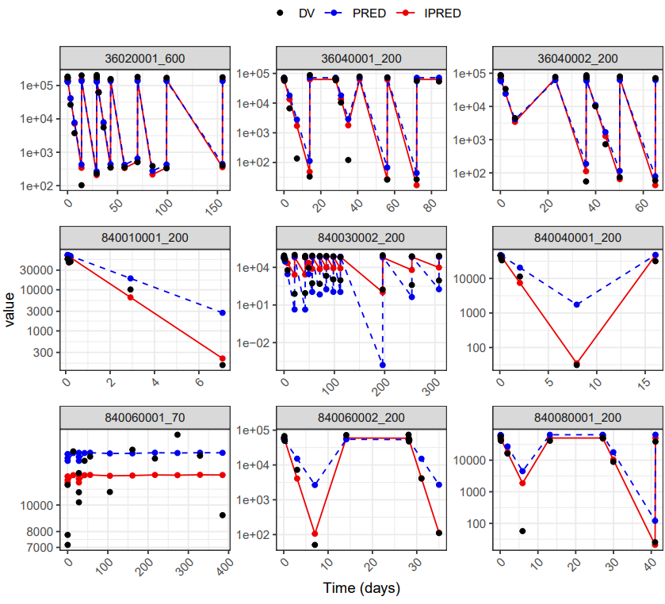
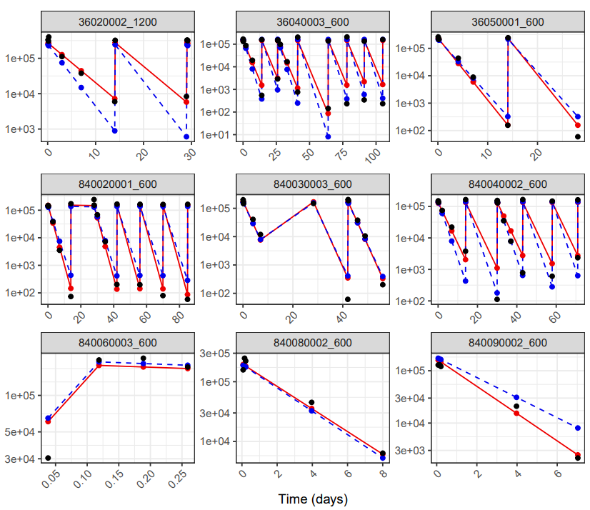
Individual Plots, Title: Subject ID_Dose
Concentration (ng/mL)

Slide 21
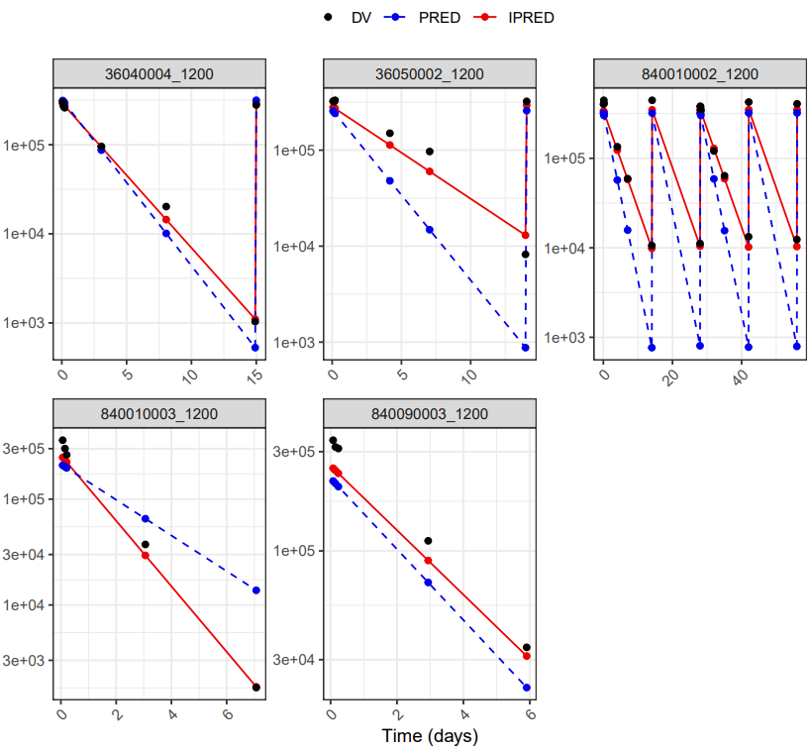
Individual Plots, Title: Subject ID_Dose (con’t)
Concentration (ng/mL)

Slide 22
70 mg Patient Note
70 mg patient not captured well by any iteration of model
Hesitant to exclude them because most lower RO data is in this dose, but may need to in the future
Concentration (ng/mL)
Time (days)

Slide 24
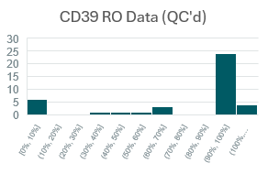
Next Steps
Direct Effects model with RO
Received some QC’d CD39 RO data and all PD1 RO data
CD39 QC’d data includes 40 datapoints across 7 patients (3 pts at 200mg, 2 at each 600mg, and 1200mg)
Safety ER
Not enough events?
ADA considerations?
RO %

Slide 25
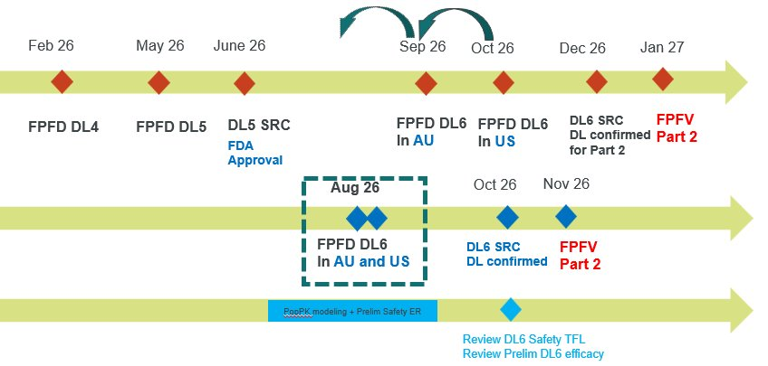
Timeline
August – DL5 data expected
Update model
Add safety ER (if sufficient events)
Deliver model (mid?) September

Slide 26
Stage​ | Analysis Step​ | Data needed​ | Estimated Time ​ | Outputs​ | Status​
Stage 1a​ 600mg data​ | 1. Data assembly + EDA​ | bioanalytical PK​ actual measurement times​ Bodyweight​ dosing information​ through 600 mg dose​ | 1 week​ | Data through 22Jan26​ 70mg – 1 patient​ 200 – 7 patients​ 600 – 3 patients​ 11 total patients, 136 obs.​ ​ EDA here: 317 PK Summary Slides.pptx​ ​ | Complete​ ​ ​
Stage 2​ 1200mg data (DL4)​ | 1-3. PopPK + MM/TMDD​ Develop PopPK+MM and evaluate if PopPK+TMDD needed​ | bioanalytical PK​ actual measurement times​ Bodyweight​ dosing information​ Through 1200 mg dose​ | 2 weeks​ | Initial popPK model with fits​ ​ | Shown here ​ ​
​ | 4. Direct Effects Model​ | Plasma TO of PD-1 and CD39​ ** We have some QC’ed but not all | 1 week​ | RO predictions across concentrations | In progress
Stage 2b​ | PopPK, Direct Effects through DL5 and Safety ER​ | All above and DL5 data​ 5-7 safety endpoints​ Minimum 20-25 total subjects, safety signal from 10​ | 1 week – June/July 2026 for XX deadline​ | ​ | DL 5 data through C2D1 expected XX​
Stage 3​ | Semi-mechanistic Tumor RO ​ | All above and PK/TO in all doses through saturation of TO​ GC vs RCC distribution?​ | 2 weeks​ | Predict dose necessary to maintain Target Occupancy in Tumor​ | ​

