Slide 1

Clinical Pharmacology Considerations
for Cell Therapy Development:
A Case Study with CARVYKTI
Tairan Yang
Aug 27, 2026

Slide 2
Introduction
Recent Work Experience:
Associate Director, Clin Pharm & Pharmacometrics, Praxis Precision Medicines (Sept 2024–Present)
Principal Scientist, Quantitative Clinical Pharmacology, Legend Biotech (Jan 2022–Sept 2024)
Principal Scientific Researcher, Genentech (May 2020–Dec 2021)
Therapeutic Area and Modality Experience:
Immunology, oncology, hematology, neurology
Small molecules, antibodies, cell and gene therapies (CAR-T, ASO)
Education:
Georgia Tech; MS Computer Science, 2022
University of Toronto; MS Chemistry and PharmD, 2020
University of British Columbia; BS Chemistry, 2013

Slide 3
Outlines
Chimeric Antigen Receptor (CAR) T-cell Therapies
CAR-T background: mechanism of action and approved products
Clinical pharmacology framework for CAR-T therapies
PK, exposure-response, and modeling approaches based on approved products in the clinic
Case study: CARVYKTI® (CARTITUDE-1 phase 1b/2, CARTITUDE-4 phase 3)
PK, exposure-response (efficacy and safety), and population PK modeling
Immunogenicity (ADA) and a candidate PD biomarker (soluble BCMA)
Challenges and opportunities in CAR T-cell therapy development
Summary / Conclusion / Q & A
4

Slide 4
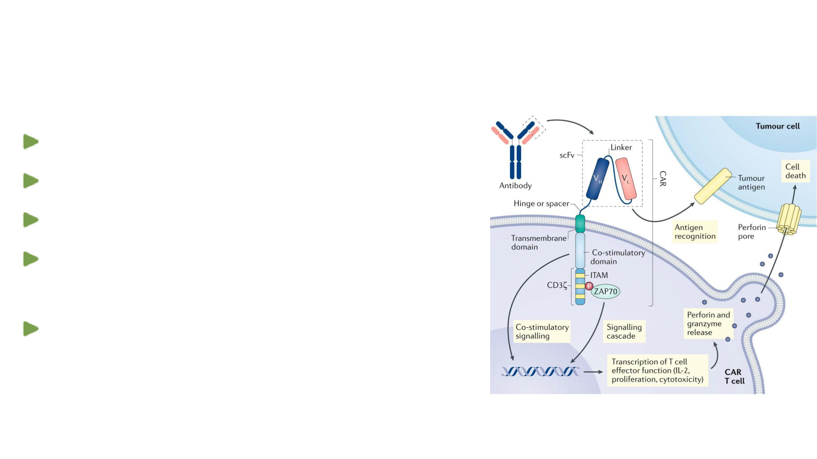
Background – Mechanism of Action (MoA)
Mechanism of action for a 2nd-generation CAR-T therapy1
Antigen recognition and engagement
Induction of signaling cascade in T-cells
T-cell activation and proliferation
Perforin and granzyme release from activated T-cell;
and cytokine production
Tumor cell killing through perforin and granzyme
activity
1 Larson, RC et al. Nat Rev Cancer. 2021
7

Slide 5
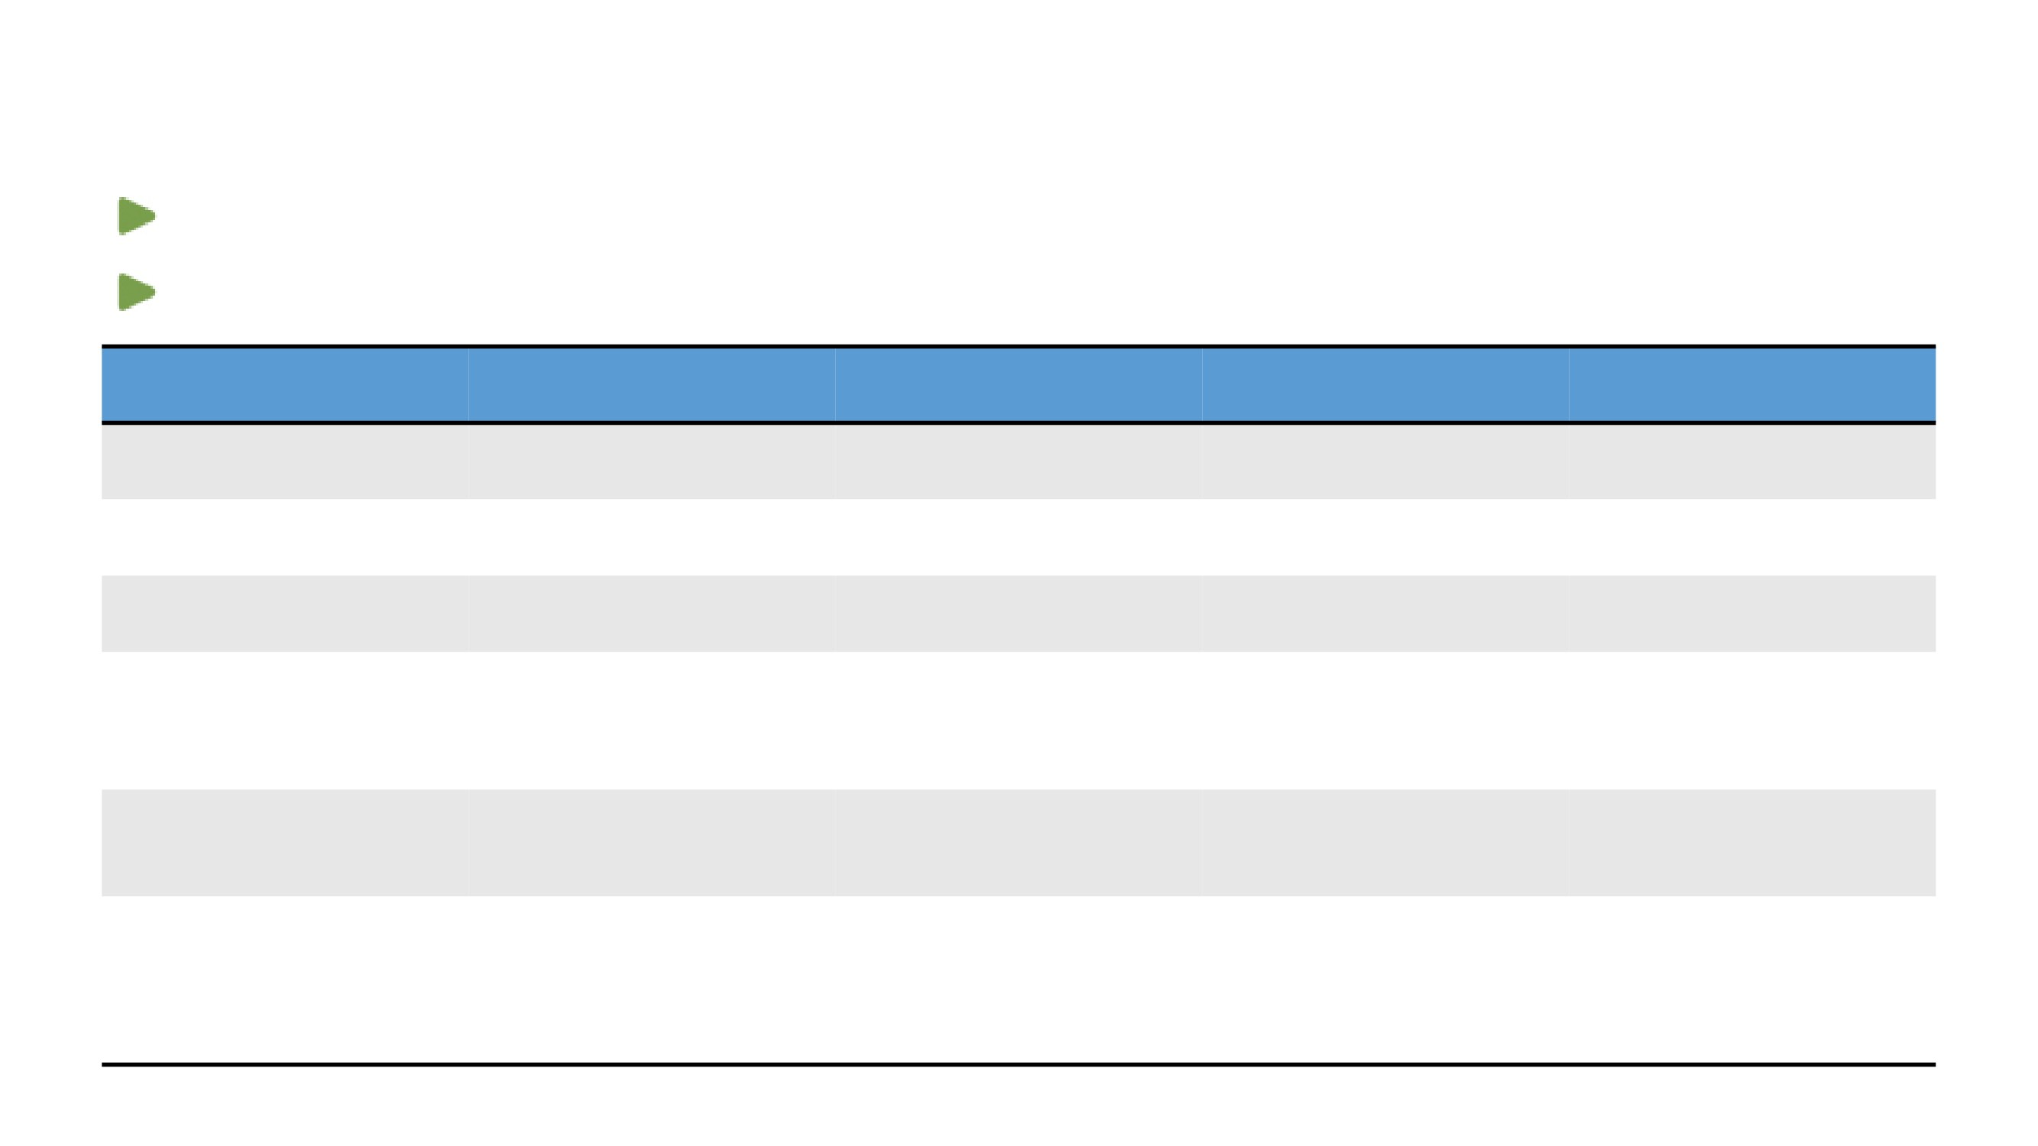
US Approved Products
Seven CAR-T oncology products (autologous) have been approved in the US
Accelerated approval for cell and gene therapies is incoming
Brand name
Approved indications
Target
Year of first approval
Approved dose (US)
(generic name)
in the US
CARVYKTI
Adult R/R multiple myeloma
BCMA
2022
0.5–1 × 106/kg, maximal of
(ciltacabtagene autoleucel)
100 × 106 cells
ABECMA
Adult R/R multiple myeloma
BCMA
2021
300–460 × 106 cells
(idecabtagene vicleucel)
BREYANZI
Adult R/R large B-cell
CD19
2021
3L+: 50–110 × 106 cells;
(lisocabtagene maraleucel)
lymphoma
2L: 90–110 × 106 cells
Adult R/R mantle cell
r/r MCL: 2 × 106/kg,
TECARTUS
lymphoma; adult R/R B-cell
CD19
2020
maximum of 200 × 106 cells;
(brexucabtagene autoleucel)
precursor acute
r/r B-cell ALL:1 × 106/kg,
lymphoblastic leukemia
maximum of 100 × 106 cells
YESCARTA
Adult R/R large B-cell
2 × 106/kg, maximum of
(axicabtagene ciloleucel)
lymphoma; adult R/R
CD19
2017
200 × 106 cells
follicular lymphoma
Adult R/R large B-cell
Pediatric and young adult:
KYMRIAH
lymphoma and follicular
0.2–5.0 × 106/kg (≤ 50 kg);
(tisagenlecleucel)
lymphoma; pediatric
CD19
2017
10–250 × 106 cells (> 50 kg);
refractory acute
Adult: 60–600 × 106 cells
lymphoblastic leukemia
Abbreviations: BCMA, B-cell maturation antigen; CD19, cluster of differentiation 19; R/R, relapsed or refractory.
8

Slide 6
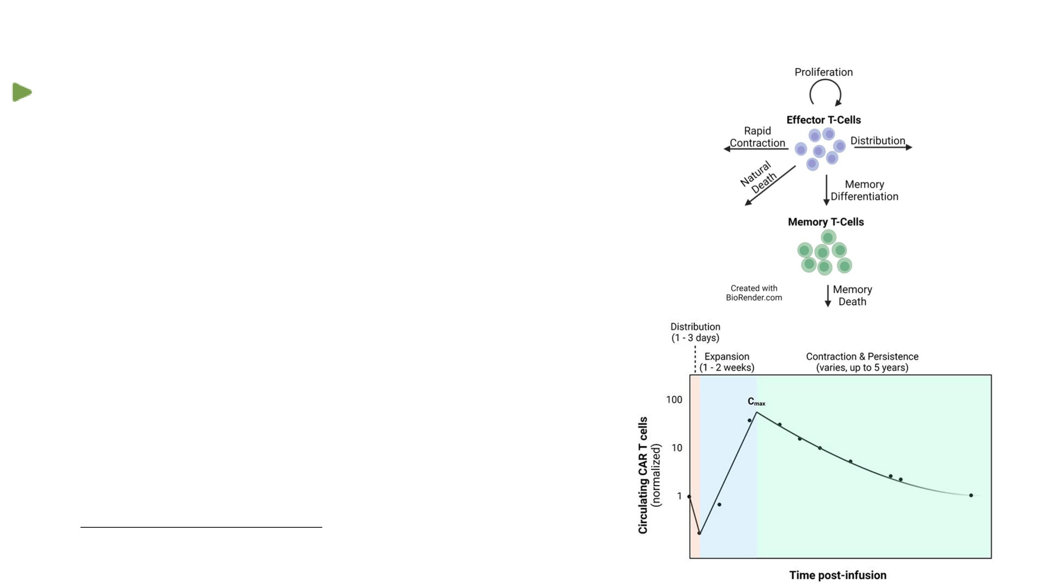
Pharmacokinetics (PK) of CAR-T Therapies
Defined as “Cellular Kinetics (CK)”
→ Different mechanism but similar C-t curve (multiphasic)
•
Margination/distribution: T-cell clones/phenotypes in
circulation
•
Expansion: in response to target and homeostatic cytokines
•
Maybe driven by clonotypes
•
Unlike TMDD for mABs, target engagement generally increases
circulating cell levels
•
Contraction/Redistribution
•
Some effector T-cells become exhausted and die
•
Persistence
•
Other T- cells differentiate to memory T cells and persist
•
May provide longer-term disease control
Qi et al, Adv Drug Deliv Rev (2022) 188:114421
TMDD: Target mediated drug disposition
11

Slide 7
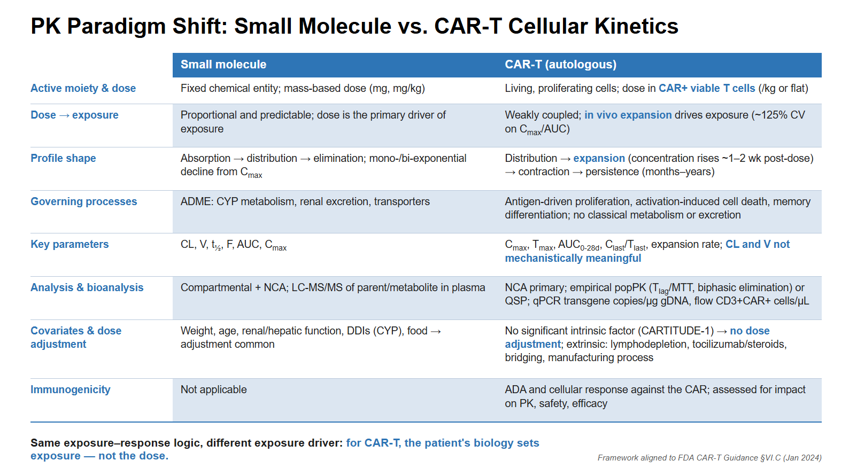

Slide 8
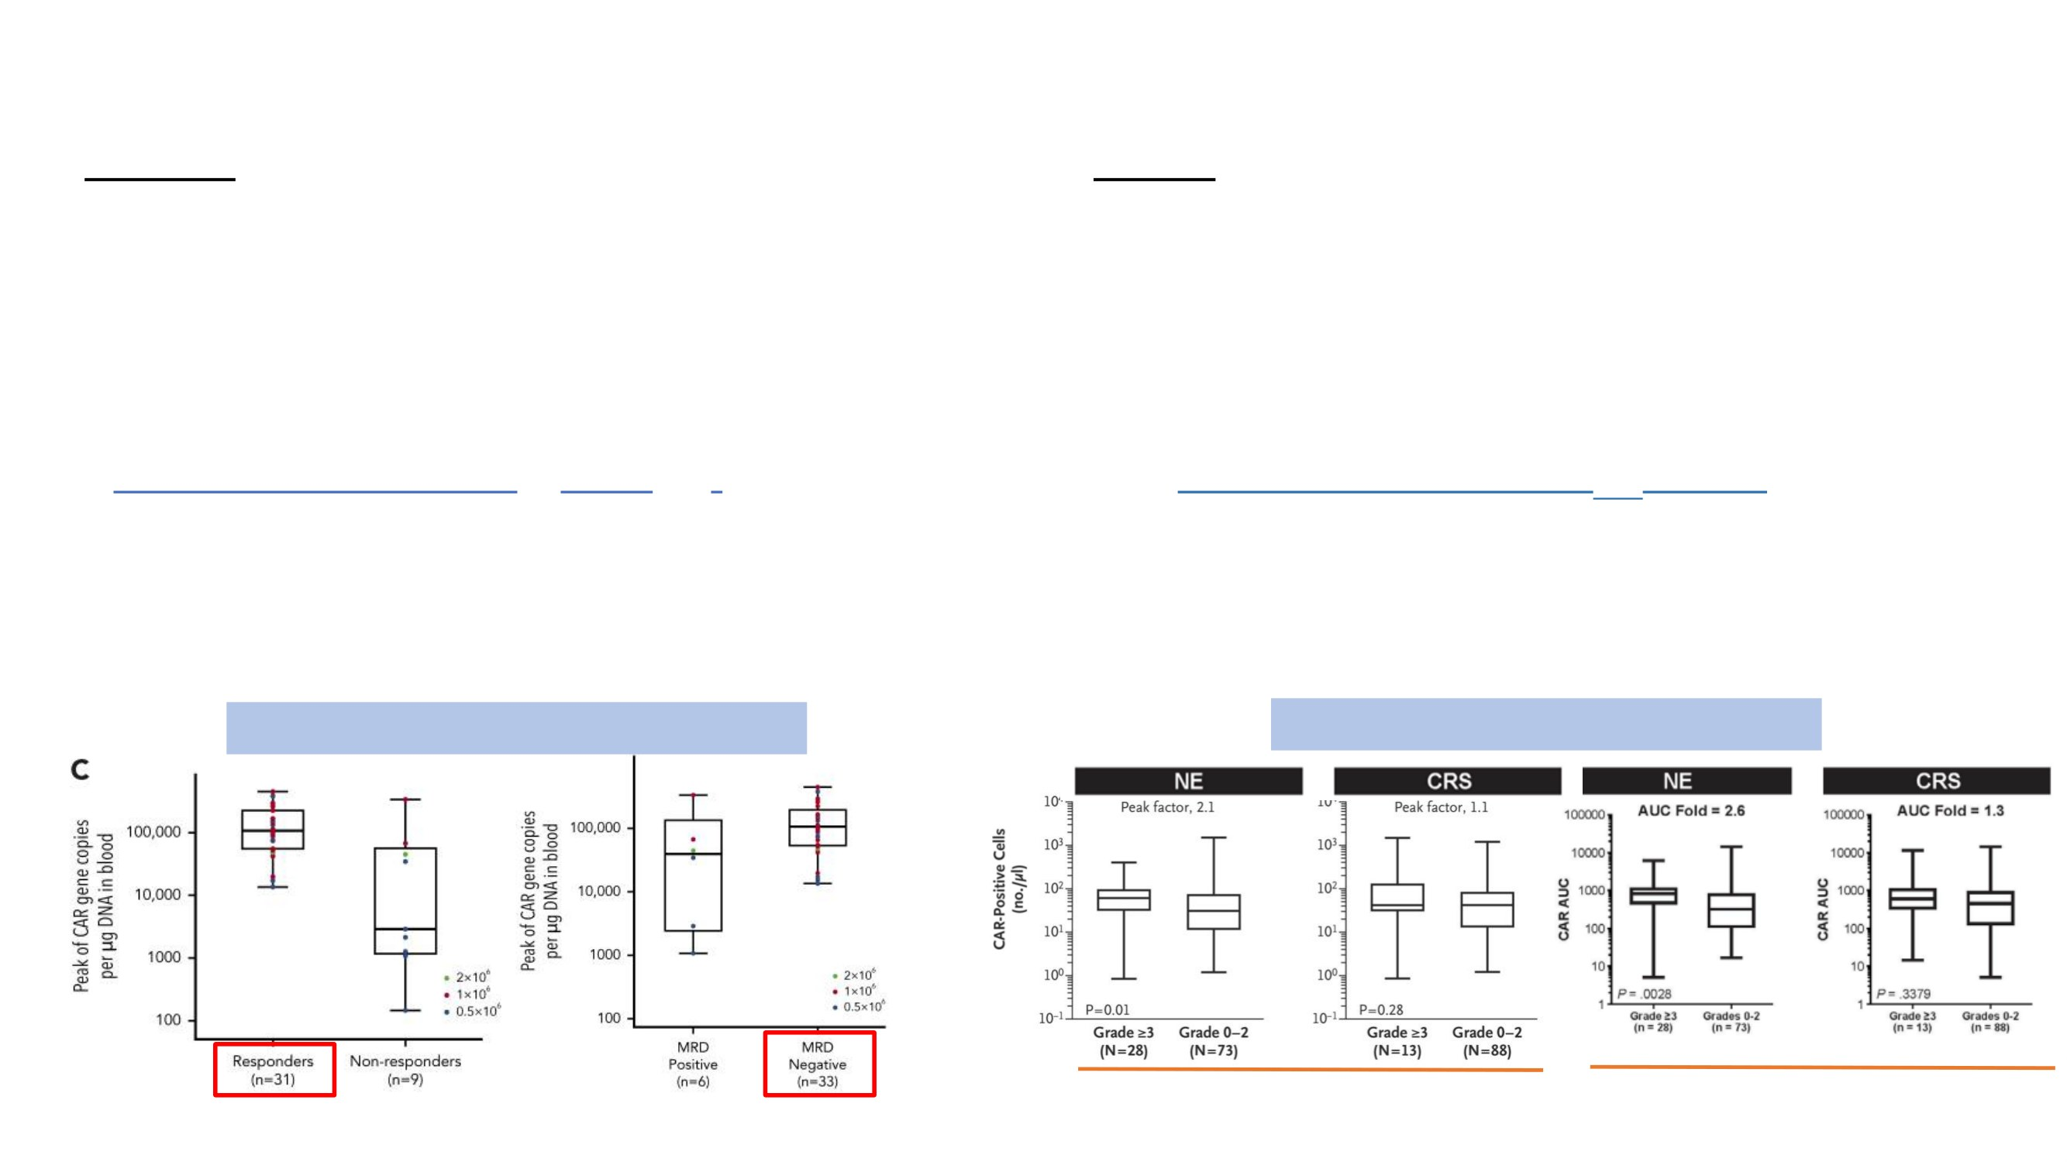
Dose-Response Relationship of CAR-T Therapies
Efficacy
Safety
→ Outcome: ORR, DOR, PFS, OS, and minimal residual
→ TEAE: cytokine release syndrome (CRS), neurologic
disease (MRD, for multiple myeloma)
events (NE) and hematologic toxic effects (e.g., neutropenia,
→ Generally, consistent exposure-efficacy relationship seen
anemia, thrombocytopenia, leukopenia, and lymphopenia)
responders vs. non-responders
→ A trend that patients with more serious AE (CRS or NE)
I. Higher exposure (higher Cmax, AUC0-28d)/short expansion
have higher exposure (median Cmax or AUC)
time (lower Tmax)/longer persistence time (higher t1/2 and Tlast)
ICANS: immune effector cell-associated neurotoxicity
II. PFS, as well as depth (MRD negative) and durability of
MNT: movement and neurocognitive TEAE
responses also shown to be associated with exposure
(Parkinsonism and Guillain-Barré syndrome)
TECARTUS in lymphoblastic leukemia1
YESCARTA in lymphoma2
Cmax
Cmax
AUC0-28d
1 Shah, BD et al. Blood. 2021
2 Neelapu, SS et al. N Engl J Med. 2017
14

Slide 9
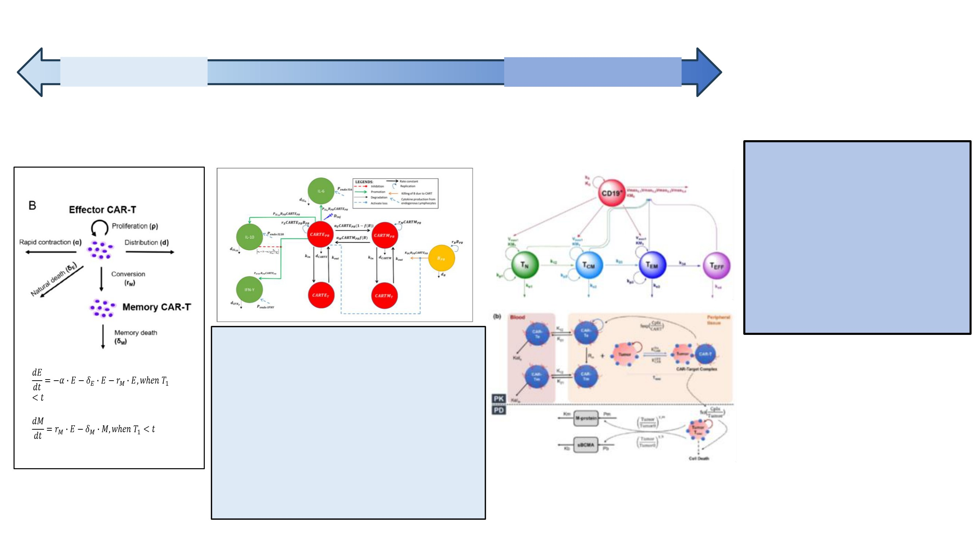
Modeling Approaches for CAR-T
More empirical
Fit-for-purpose
More mechanistic
Empirical
Semi-mech
QSP/PBPK:
E vs. M
E vs. M and cytokine included
More cell subsets (TN)
No tissue
Lumped tissue
Tissue of interest
Biomarker (target related: BCMA)
Why Mechanistic Models?
Modified model1
• Integrates rich data.
• Test hypotheses in silico to
reduce clinical studies.
• Reverse translation.
• Prioritize candidates in early
development.
• Inform dose/schedule for
combinations.
The model(s) could
→
Capture clinical multi-phasic PK (CK)
profile
→
Potentially test the impact of extrinsic
and intrinsic factors and the impact of
1 Liu, C et al. Clin Pharmacol Ther. 2021
CRS-treating therapies
→
Explore dose-exposure-response
relationships
3 Mueller-Schoell, A et al. Cancers. 2021
4 Singh, AP. CPT Pharmacometrics Syst Pharmacol. 2021
2 Hardiansyah, D et al. Clin Transl Sci. 2019
16

Slide 10

Summary of CAR T-cell (Autologous Platform)
Characteristics
Different mechanisms and profile of PK (CK) from small or large-molecule drugs
(in vivo cell proliferation and differentiation)
Lack of consistent Dose-Exposure (Dose-Response) relationships partially due to high
variability
Clinical response (efficacy and safety) generally associated with exposure
(expansion: Cmax and AUC0-28d)
Potential future directions of clinical pharmacology and pharmacometrics for CAR-T
therapies
→ Mechanism-based modeling of PK (CK) and PD of CAR-T therapies (e.g., QSP model)
→ Deeply quantitative dose-exposure-response characterization and factors impacting
→ Further preclinical to clinical translation
17

Slide 11
FDA Guidance: FIH Dose Selection & Preclinical PK/PD Translation
Role of Nonclinical/Preclinical Data (Guidance Section V):
Because CAR T-cells expand in vivo to a variable, patient-specific degree, FDA notes starting dose is often not determined from animal studies alone
In vitro/in vivo effector:target ratio, expansion kinetics, and PK/PD anti-tumor response data are informative but supportive — prior clinical experience with similar constructs typically carries more weight for starting-dose justification
Dose Selection & Escalation (Guidance Section VI.B.1):
Dose based on viable transduced CAR+ T-cells, not total cell number (transduction efficiency varies lot-to-lot); flat or weight/BSA-based dosing acceptable with justification
Escalation historically in half-log (~3-fold) increments; single-patient cohorts and intra-patient dose escalation not considered suitable for FIH CAR-T given tumor-burden-dependent CRS risk; staggered enrollment required within and between cohorts
Clinical Pharmacology Considerations (Guidance Section VI.C):
PK (“cellular kinetics”): no classical ADME framework applies; recommended metrics are Cmax, Tmax, partial AUC, and Clast
PD biomarkers selected per mechanism of action; immunogenicity assessed via humoral/cellular assays against the CAR construct, weighing patient- and product-related risk factors
Source: FDA/CBER, Considerations for the Development of Chimeric Antigen Receptor (CAR) T Cell Products — Guidance for Industry (final, January 2024)

Slide 12
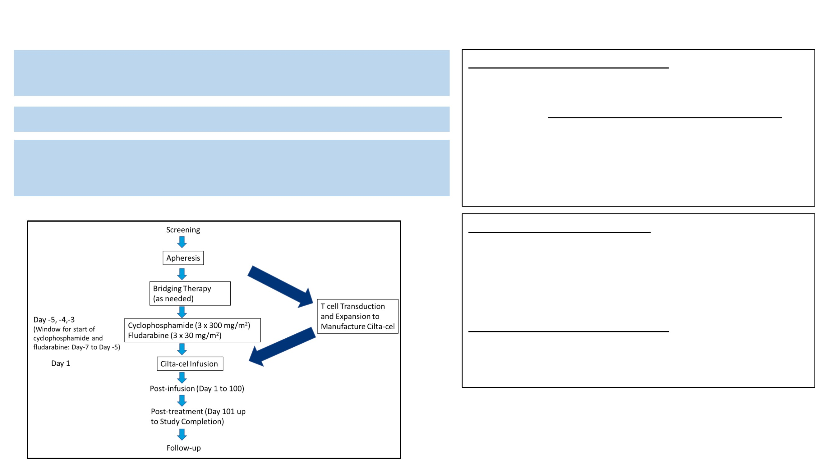
CARTITUDE Studies: CART-1 and CART-4
CARVYKTI®: CAR-T therapy directed against B-cell
CART-1 (BLA) Proof of Concept:
maturation antigen (BCMA)
Phase1b-2, Open-Label Study (BLA)
Indication: Relapsed or Refractory Multiple Myeloma
Populations: R/R MM at least 3 PL of **PI and IMiD,
N=97
Dose: single dose
•
ORR = 93.8% (87.0%, 97.7%)
Total targeted dose of 0.75 x 106 CAR-positive viable T cells/kg
•
CR or better (sCR + CR) = 76% (68.8%, 86.1%)
(range: 0.5-1.0 x 106 CAR-positive viable T cells/kg)
•
The 30-month OS survival rate was 68.0% (95% CI:
57.7-76.3)
Schematic Overview of GRATITUDE -1/CARTITUDE-4
CART-4 (sBLA) Confirmatory:
Phase 3 Randomized Study (sBLA):
•
Arm A: *PVd or DPd, N=211
•
Arm B: Cilta-cel, N=208 (N=176 for study treatment)
Populations: Relapsed and lenalidomide-refractory MM
Received 1-3 PL of **PI and IMiD
•
ORR = 99.4% (96.9%, 100.0%)
•
CR or better (sCR + CR) = 86.4% (80.4%, 91.1%)
*Pomalidomide, Bortezomib and Dexamethasone (PVd) or
Daratumumab, Pomalidomide and Dexamethasone (DPd) ,
**proteasome inhibitor (PI)
immunomodulatory drug (IMiD)
21

Slide 13
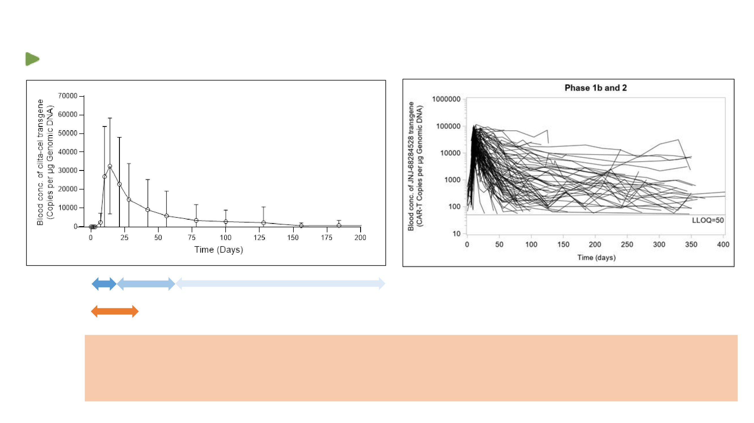
CAR Transgene Concentration Profile in CART-1
Blood transgene conc showed high intersubjective variability (%CV= 125.2% for AUC)
Phase 1b and 2 (n=97)
1
2
3
1.
Expansion
2.
Contraction
3.
Persistence
0
28
The median time to onset of CRS was 7 days (range: 1 to 12 days).
Safety
The median time to onset of ICANS was 8 days (range: 1 to 28 days).
management
NE: The median onset of parkinsonism in the 5 patients in CARTITUDE-1 was 43 days (range: 15 to 108
(CRS and NE)
days)/Median time to onset of cranial nerve palsies was 26 days (range: 21 to 101 days)
23

Slide 14
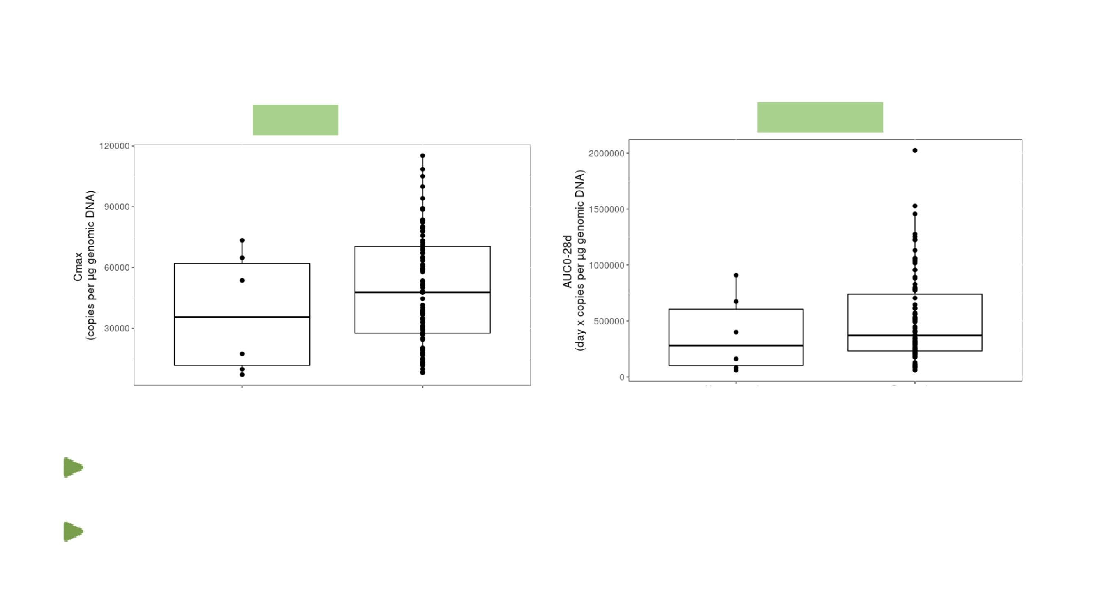
ER for Efficacy in CART-1
Scatter-Boxplot of Blood PK transgene (Cmax and AUC0-28d) by Non-responders vs. Responders
Cmax
AUC0-28d
Non-responders
Responders
Non-responders
Responders
(n=6)
(n=91)
(n=6)
(n=91)
Higher median PK parameters in responders (sCR+CR+VGPR+PR) compared to non-
responders but the ranges were overlapping
Limited sample size in non-responders (n=6); data was skewed
26

Slide 15
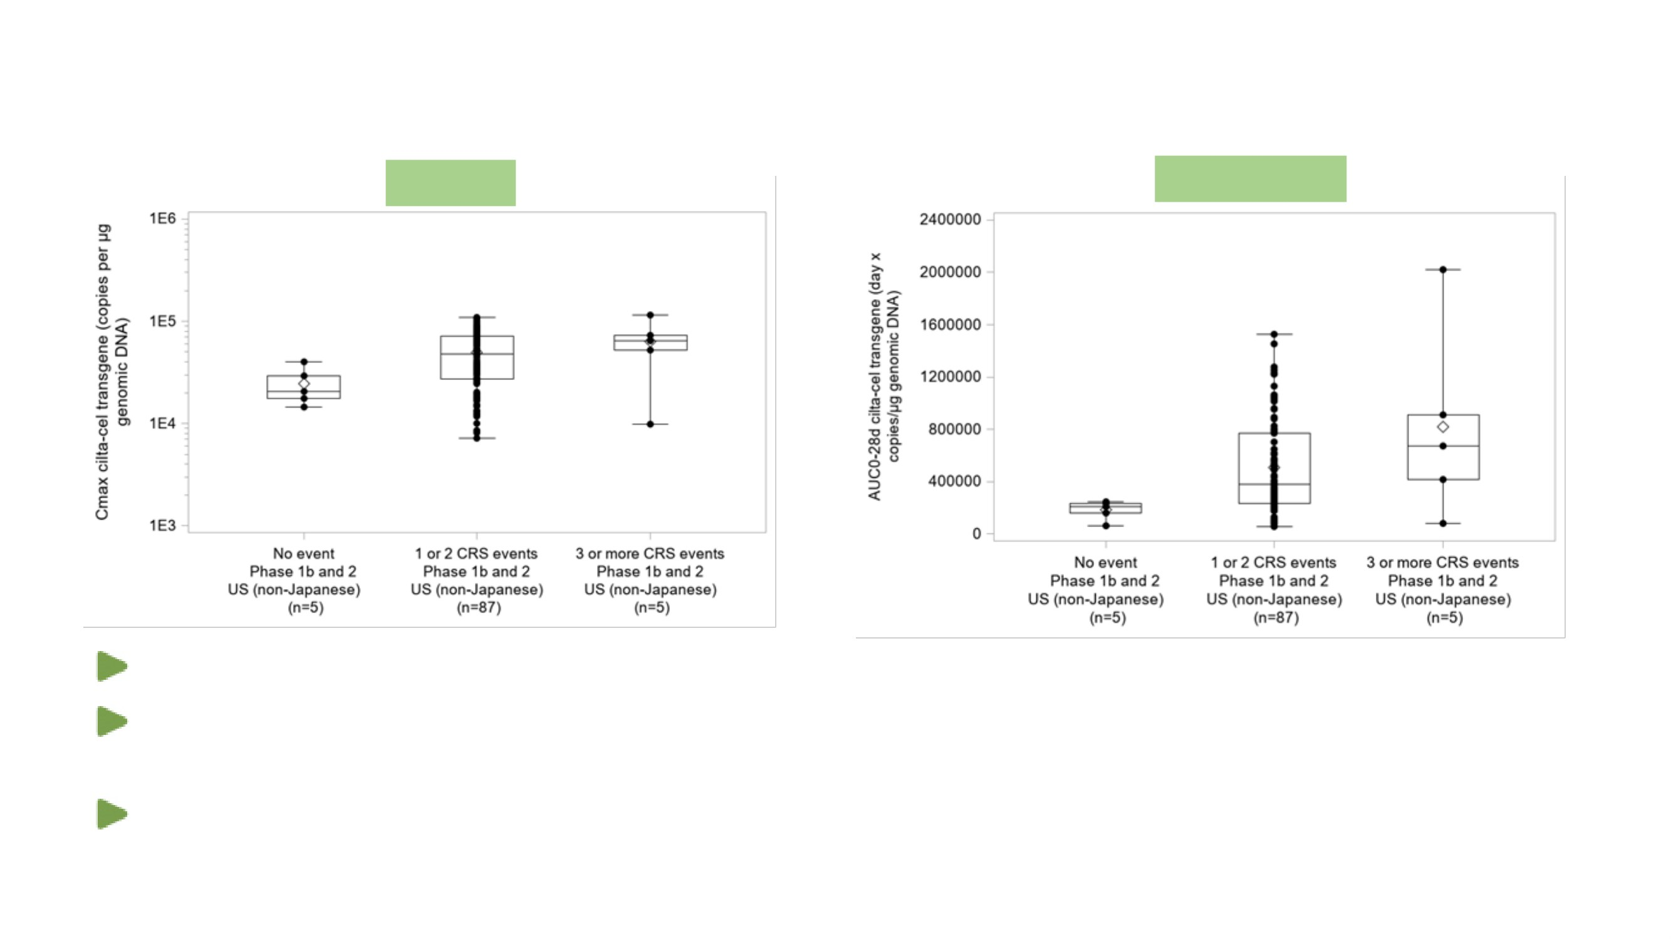
ER for Safety in CART-1
CRS: cytokine release syndrome
Cmax
AUC0-28d
All-grade CRS was observed for 92 subjects (94.8%)
Apparent trend of higher exposure during the expansion phase: higher medium PK during
expansion but the ranges were overlapping
Higher median Cmax and AUC0-28d among subjects who were treated with
tocilizumab/corticosteroids-confounding concurrence of CRS and overlapping exposure range.
27

Slide 16
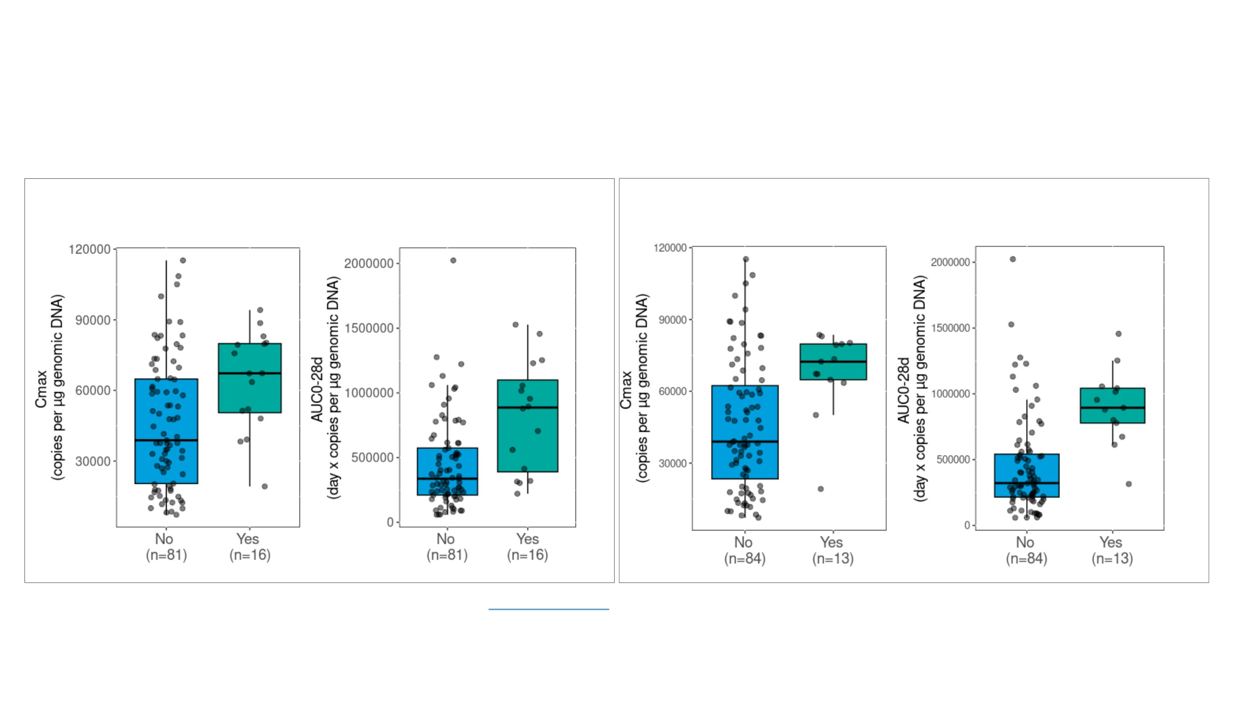
ER for Safety in CAR-T1
*: Immune effector cell-associated neurotoxicity syndrome:
Nes: neurologic events
**: Other neurotoxicity
ICANS (n=16, including 2 subjects with Grade 3 or 4 )
Other neurotoxicity: ONTX (n=13, including movement and neurocognitive treatment-emergent adverse events: MNTs (n=6): 3 subjects with Grade 2,
9 subjects with Grade 3 or 4, and 1 subject with Grade 5)
Scatter-Boxplot of Blood PK transgene (Cmax and AUC0-28d) by
Scatter-Boxplot of Blood PK transgene (Cmax and AUC0-28d) by
ICANS
ONTX
A
B
B
• Subjects with CAR-T cell neurotoxicity had apparent higher median CAR transgene PK metrics (Cmax and AUC0-28d) compared to subjects
without neurotoxicity AEs
• The association between exposure and neurotoxicity AEs was not clear due to wide overlapping ranges of PK transgene levels and high
interindividual variability
Chang., et al., ACCP poster 2023
29

Slide 17
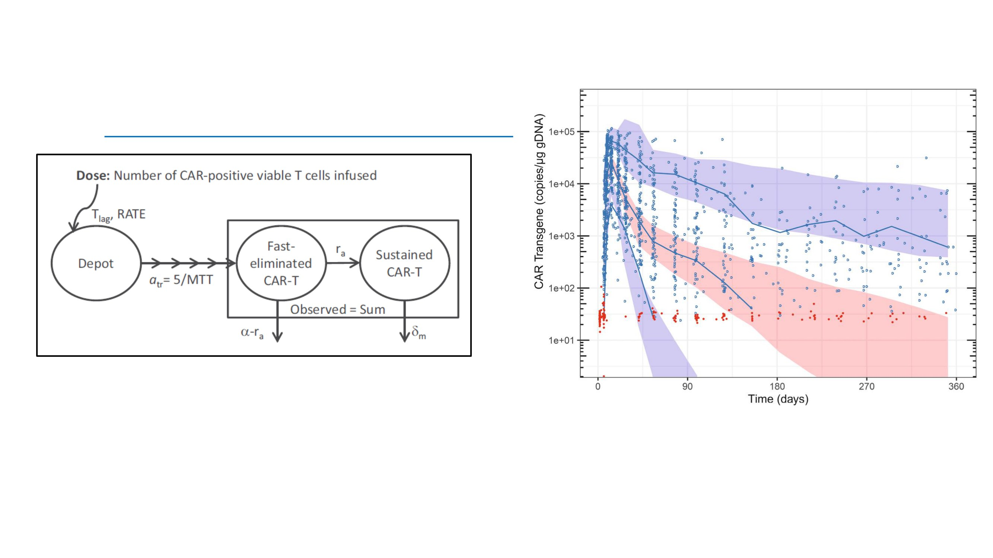
PopPK Model Based on Transgene Results
Empirical 2-compartment model (not mass-balance):
Dose: number of CAR-positive viable T cells infused
Fitted in: Observed CAR transgene level (copies/µg gDNA)
90th percentiles of the simulation
median
10th percentiles of the simulation
Parameters: lag time (Tlag)
mean transit time (MTT),
apparent rapid decline rate (α, apparent transition rate from fast eliminated to sustained CAR-T (ra)
apparent gradual decline rate ((dm).
initial margination (distribution), expansion, differentiation, contraction, and persistence.
Wu LS et al., Clin Transl Sci. 2022 Dec;15(12):3000-3011
31

Slide 18
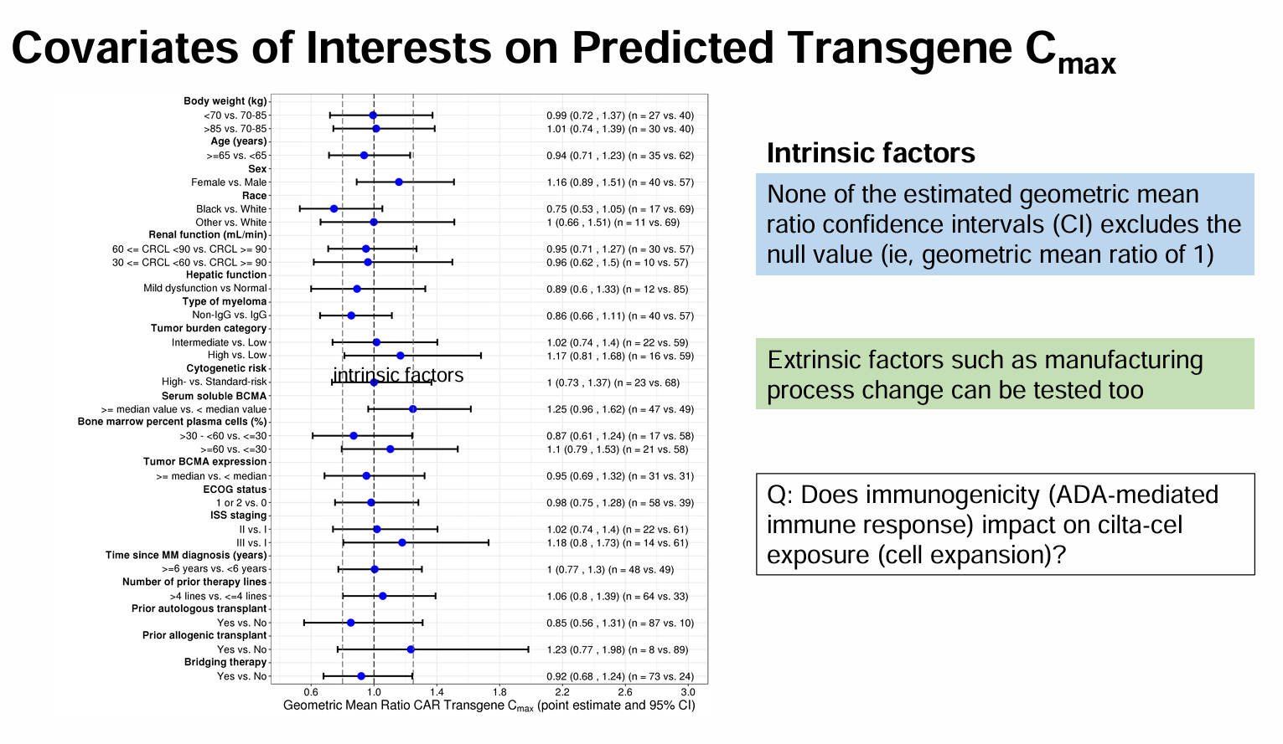

Slide 19
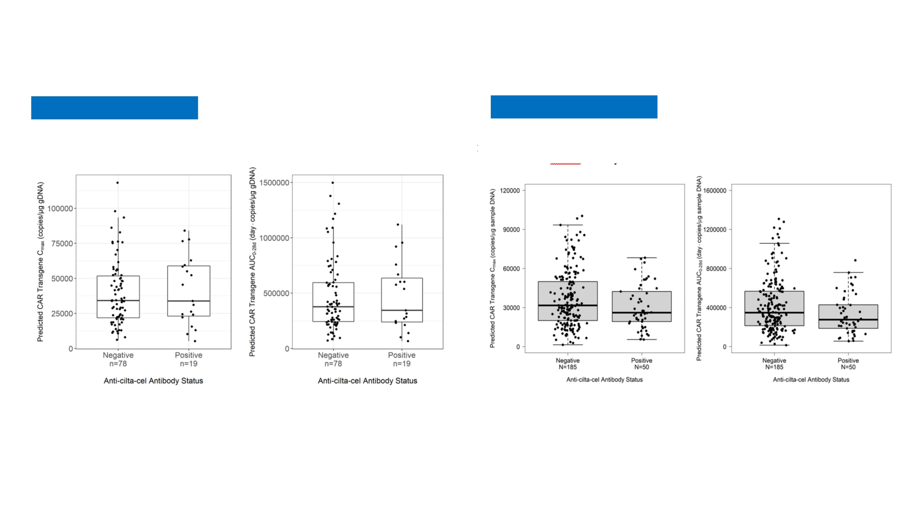
Immunogenicity (ADA) and PK
CART-1 (MMY2001)
CART-4 (MMY3002)
Scatter-Boxplot of Blood PK transgene (Cmax and AUC0-28d) by ADA
Scatter-Boxplot of Blood PK transgene (Cmax and AUC0-28d) by ADA
No apparent difference of CAR transgene exposure (i.e., predicted Cmax and AUC0-28d) was observed
between ADA+ and ADA- subjects in CART-1 and CART-4
33

Slide 20
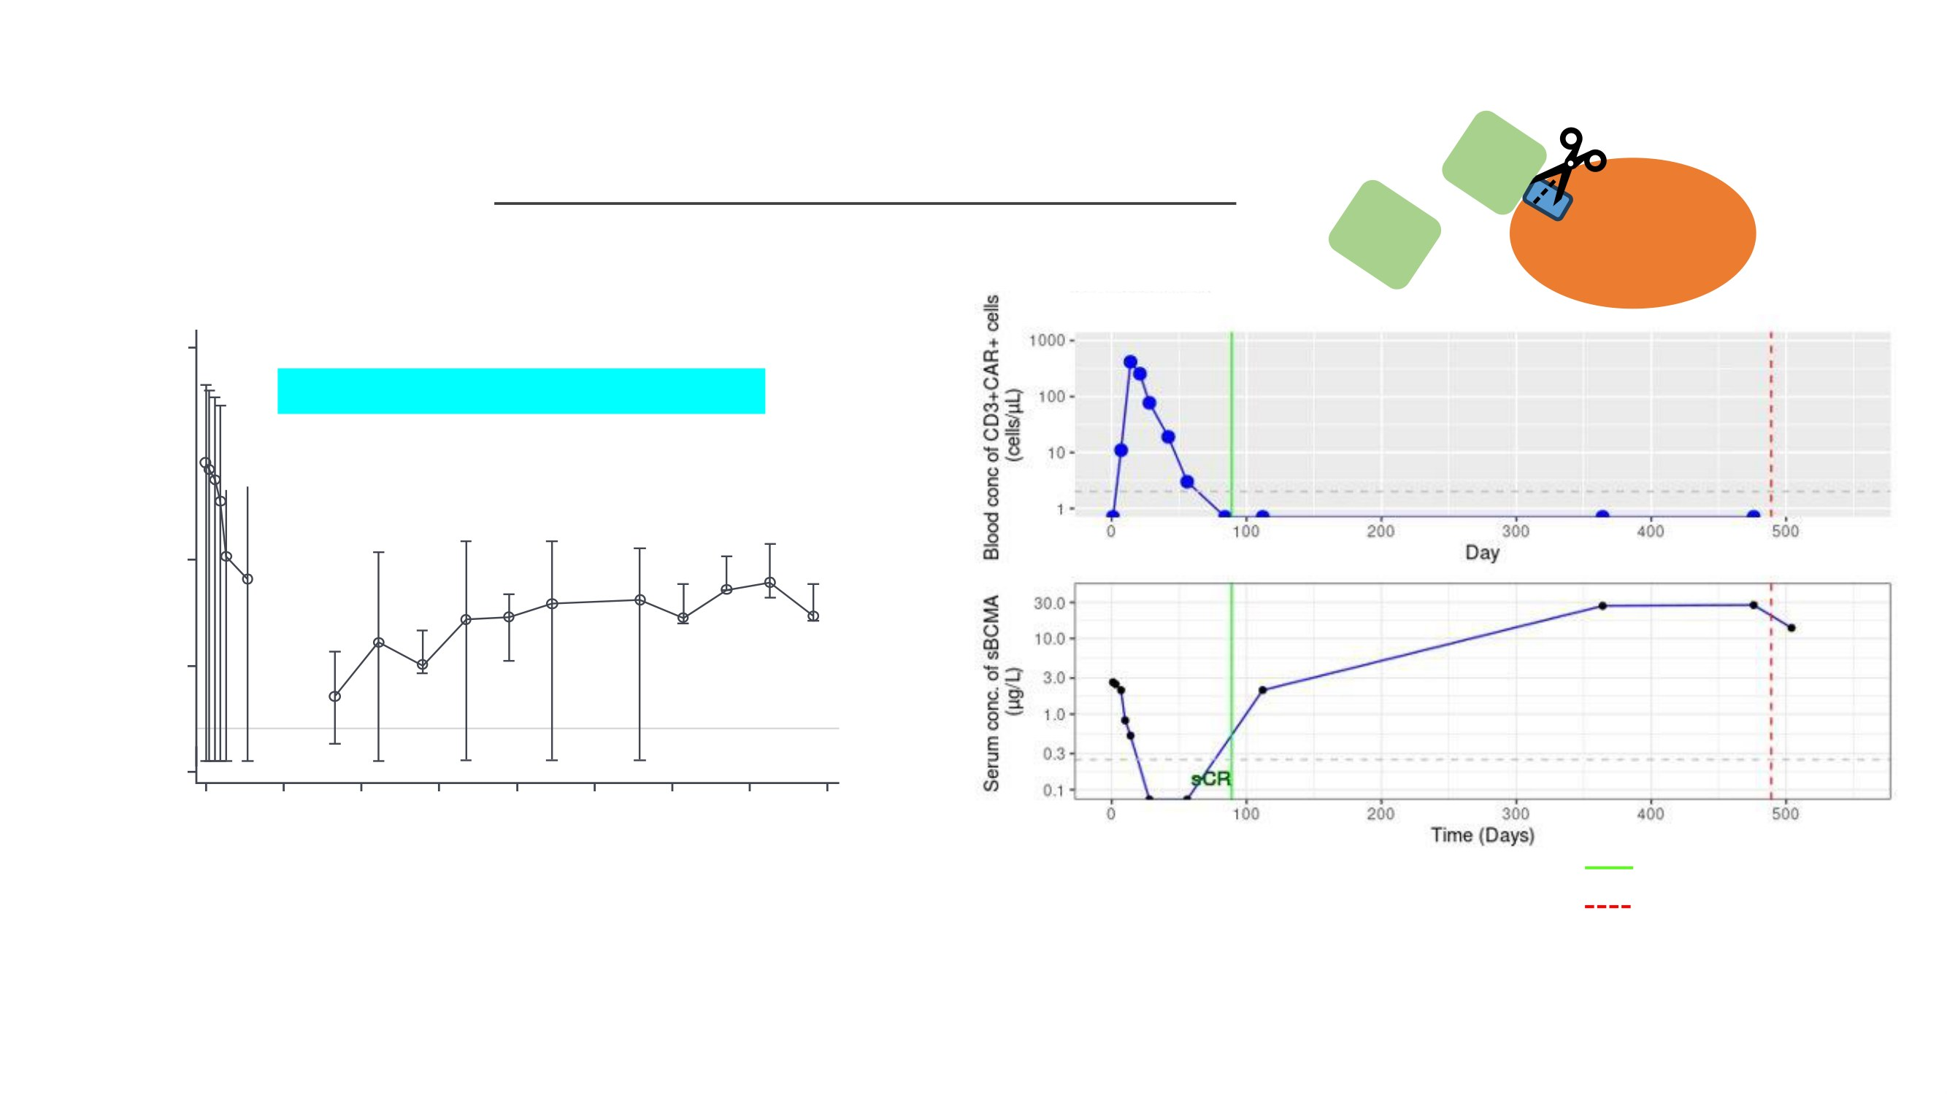
Pharmacodynamic Marker: Soluble BCMA (sBCMA)
gamma secretase
•
The value of sBCMA as biomarker for disease progression in the clinic
BCMA
sBCMA
Myeloma
Mean sBCMA levels over time in CART-4 (MMY3002)
1000
Mean sBCMA level, µg/L
Median time to undetectability was D56
Best Response
100
Disease Progression
10
1
LLOQ
0.1
0
50
100
150
200
250
300
350
400
Time from infusion, days
Best Response
Disease Progression
Mean conc was below LLOQ (bql = 0) on Day 56, suggesting sBCMA reached to nadir
After Day 56, some subjects had higher sBCMA conc during disease progression (sBCMA reversal vs. disease
progression)
CF de Larrea., et al., IMS 2023
36

Slide 21
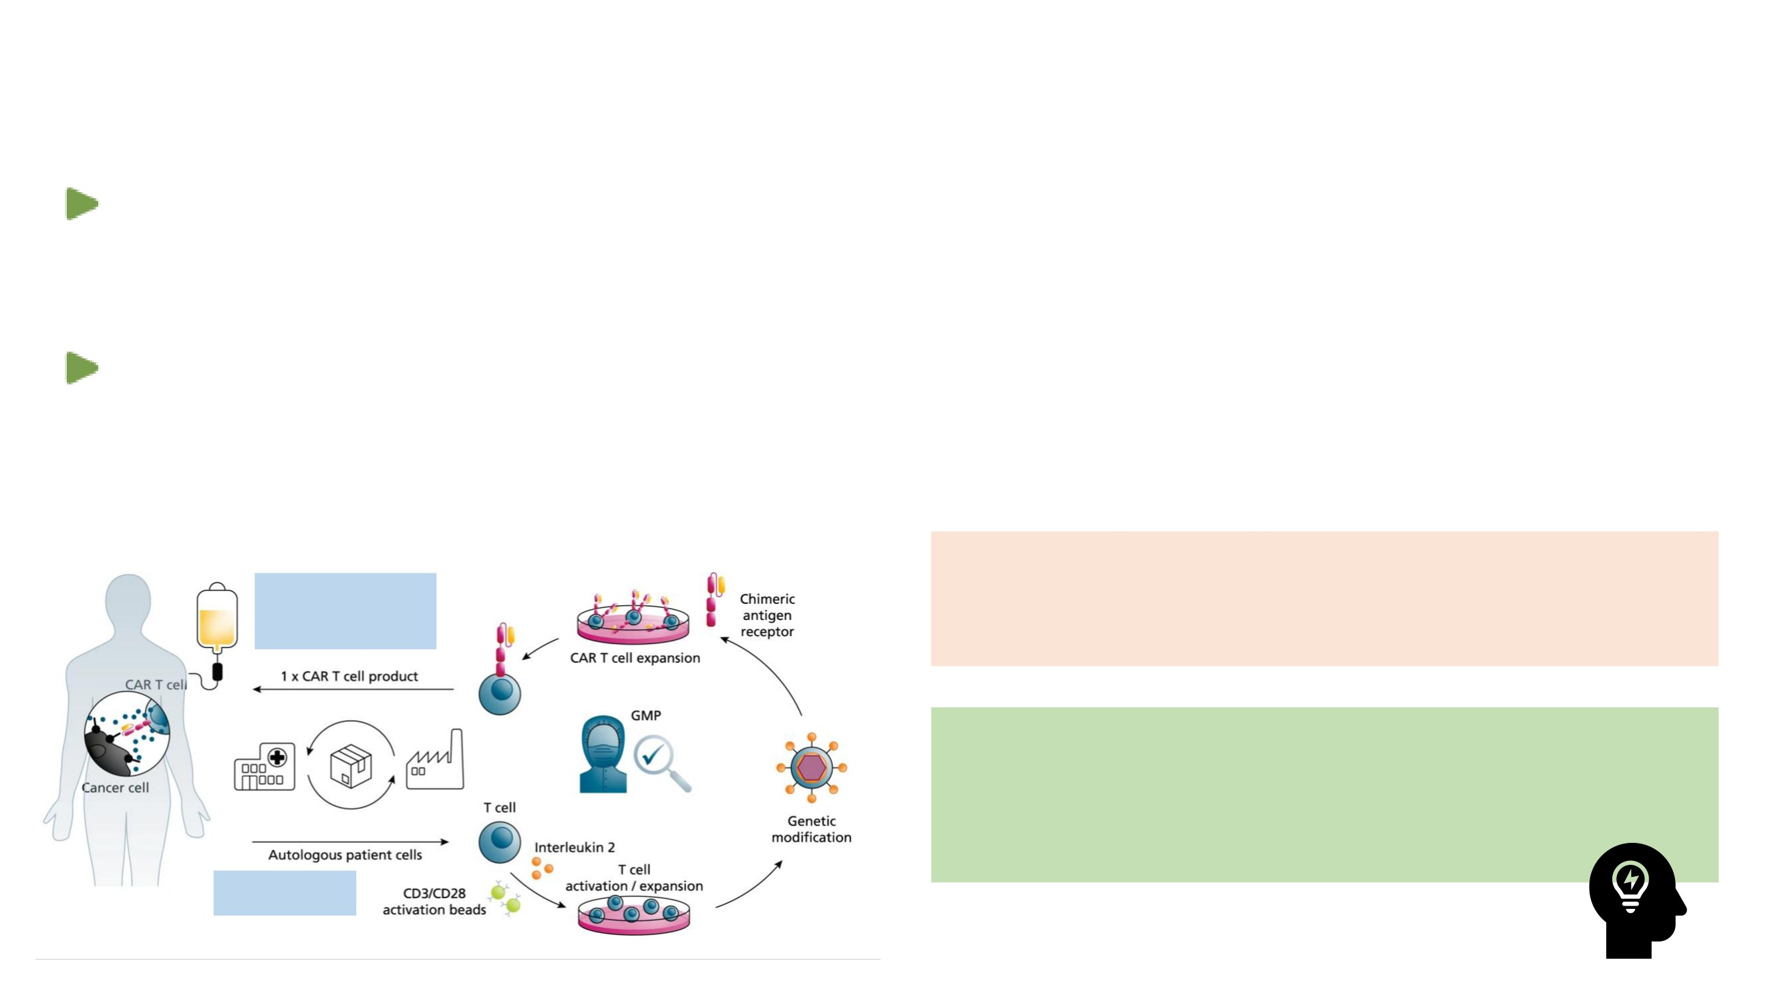
Challenges and Opportunities in CAR T Products
(Personalized Medicine)
CMC issue (QC issue, limited manufacturing capacity, lentivirus manufacturing process,
OOS comparability studies)
The mechanism of NE is unclear (biodistribution)
• Radiolabel (half-life is too short) or reporter gene transfected- CAR+ cells to figure out bio-distribution
Q: How to optimize the manufacturing process and
Quality
accelerate the development of cell therapy?
assessment
A: Translational research (T-cell population and
phenotyping over time), cross-functional
collaboration, and industry and health authority
collaboration
Apheresis
Blache, U. et al., Nat Commun 13, 5225 (2022).
38

Slide 22

Case Study: CARVYKTI®
(ciltacabtagene Autoleucel;Cilta-cel)
CARTITUDE-1 (MMY2001: phase1b/2) and CARTITUDE-4 (MMY3002: Phase3) for BLA
The PK profiles of cilta-cel, characterized by significant interindividual variability,
displayed distinct phases of expansion, contraction, and persistence.
Exposure-response analysis (efficacy/safety): a trend of higher Cmax/AUC0-28d was
observed but wide overlapping ranges. The dose-exposure relationship was not clear
Immunogenicity (ADA) doesn’t have an apparent impact on exposure, safety, and
efficacy (provides a rationale for not performing neutralizing antibody assessments)
sBCMA appears to be a promising pharmacodynamic (PD) biomarker, particularly
when combined with M-protein, for potential clinical applications in the future.
• Further exploratory PD modeling is warranted to investigate its full potential.
39

