Slide 1
CD39 competitor PK & RO: what can we leverage for BNT317?
Discussion starter for PMx • Clin Pharm

Slide 2
EXECUTIVE SUMMARY
Anti-CD39 competitors: PK/RO Data Summary
Asset
Dose / PK
Peripheral RO
Tumor RO / PD and read-through
SRF617
IV Q2W; monotherapy RP2D 1400 mg Q2W.
Linear PK; sustained full target occupancy through interval.
PK correlated strongly with PD target occupancy.
Quantitative peripheral RO threshold not disclosed in abstract.
Biopsies were collected to assess CD39 ATPase, but public abstract does not provide a robust tumor RO/PD threshold.
IPH5201
100-3000 mg Q3W +/- durvalumab.
Nonlinear at 100-300 mg; linear at >=1000 mg; t1/2 8-9 d.
Soluble CD39 saturated at >=300 mg; monocyte/B-cell membrane-bound CD39 saturated at 3000 mg.
Tumor CD39 ATPase decreased in 5/7 patients; all evaluable 3000 mg patients had reduction.
AB598
900-3000 mg Q3W approximately dose-proportional; t1/2 6-8 d.
2000 mg Q2W selected for expansion.
Tumor-paired PK/PD model estimated 90% tumor CD39 RO at 107 ug/mL.
90% tumor enzymatic inhibition at 176 ug/mL; 2000 mg Q2W achieved both targets.
Sources: Patnaik et al., Ann Oncol 2021; Powderly et al., Cancer Res Commun 2025; Adeojo et al., ENA 2025 poster.
1

Slide 3
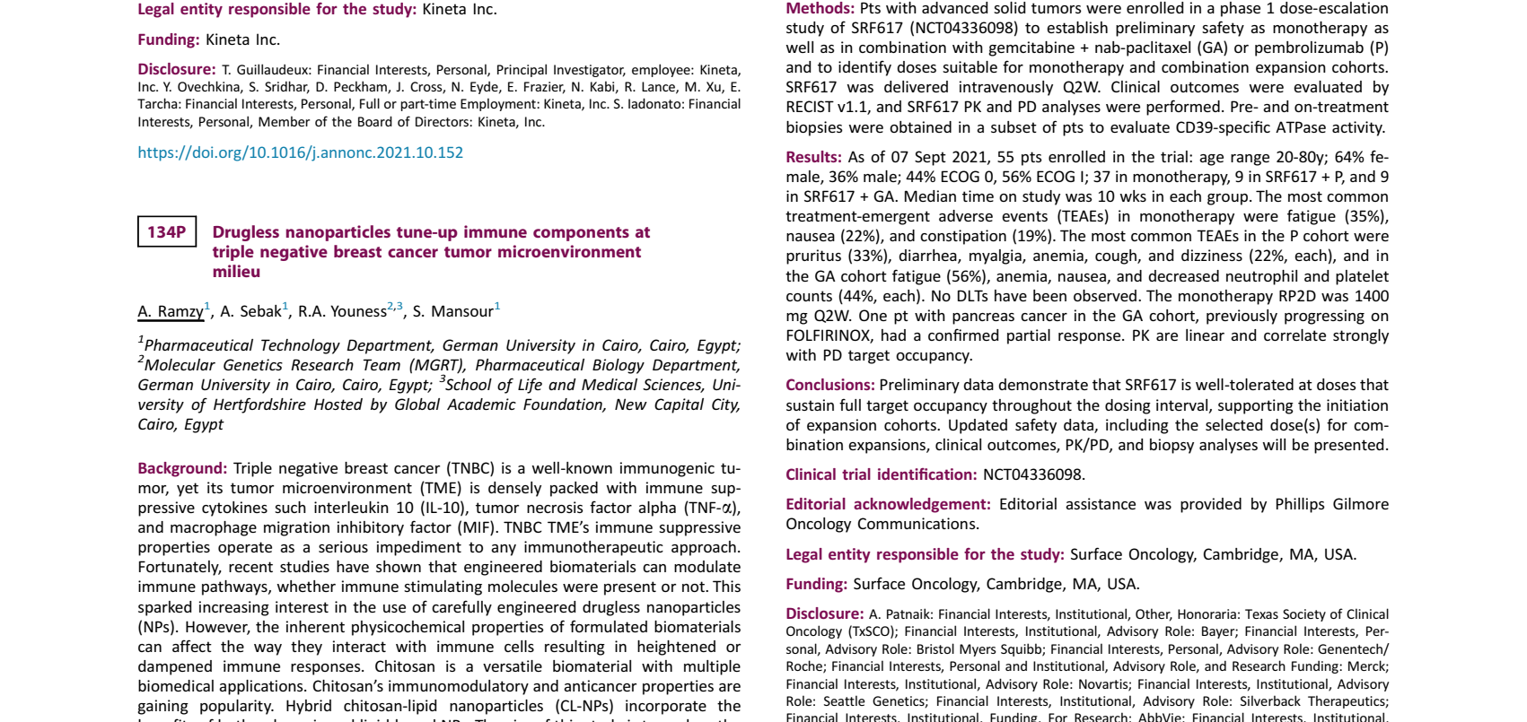
SRF617: full target occupancy was achieved, but tumor RO bridge remains thin
Useful benchmark for peripheral saturation; less useful for dose selection without quantitative tumor RO/enzymatic inhibition targets.
Study and dose
FIH phase 1 in advanced solid tumors; IV Q2W as monotherapy or in combination with pembrolizumab or gemcitabine + nab-paclitaxel.
As of Sept 2021: 55 patients; monotherapy RP2D 1400 mg Q2W; no DLTs reported.
PK/RO signal
PK described as linear and strongly correlated with PD target occupancy. Doses sustained full target occupancy throughout the dosing interval.
No numerical concentration-RO target or t1/2 was disclosed in the abstract.
Source excerpt: SRF617 phase 1 abstract
Source: Patnaik et al. 135P, Annals of Oncology 2021; comparison comment also discussed in Powderly et al. 2025.
2

Slide 4
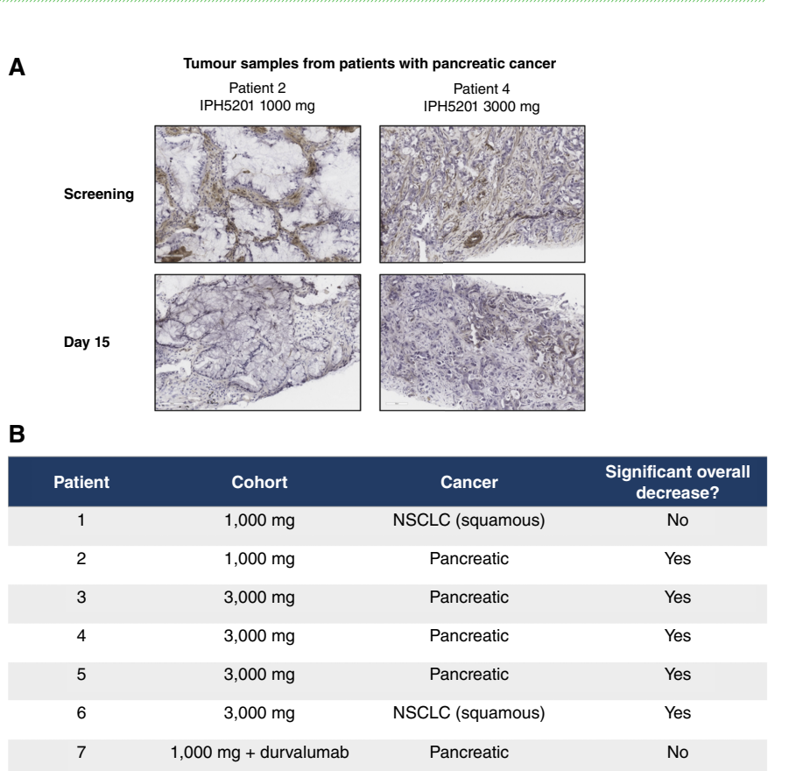
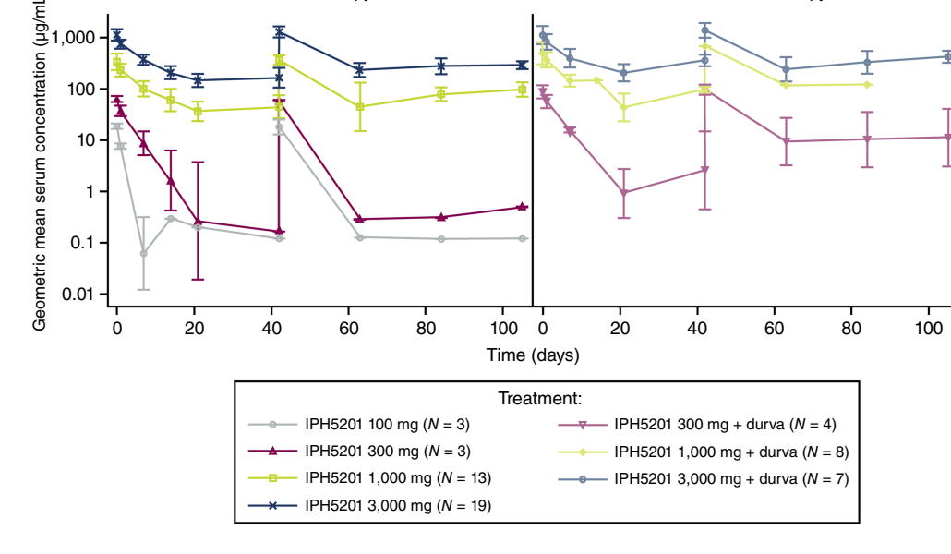
IPH5201: peripheral saturation at lower doses did not fully predict tumor enzymatic blockade
The most informative read-through is the dose transition from peripheral RO to on-treatment tumor ATPase activity.
Mean serum concentration by dose and treatment
PK and peripheral RO
Tumor CD39 enzymatic activity before vs on-treatment
Tumor PD
Nonlinear PK at 100-300 mg, linear at >=1000 mg; terminal t1/2 approximately 8-9 days at higher doses.
Soluble CD39 saturated at >=300 mg, but membrane-bound CD39 on monocytes/B cells saturated at 3000 mg.
Tumor CD39 ATPase activity decreased in 5/7 evaluable paired biopsies, including all evaluable 3000 mg Q3W patients.
Interpretation: the highest tested dose was needed to ensure tumor enzymatic blockade.
Source: Powderly et al., IPH5201 anti-CD39 mAb phase 1 study, Cancer Research Communications 2025.
3

Slide 5
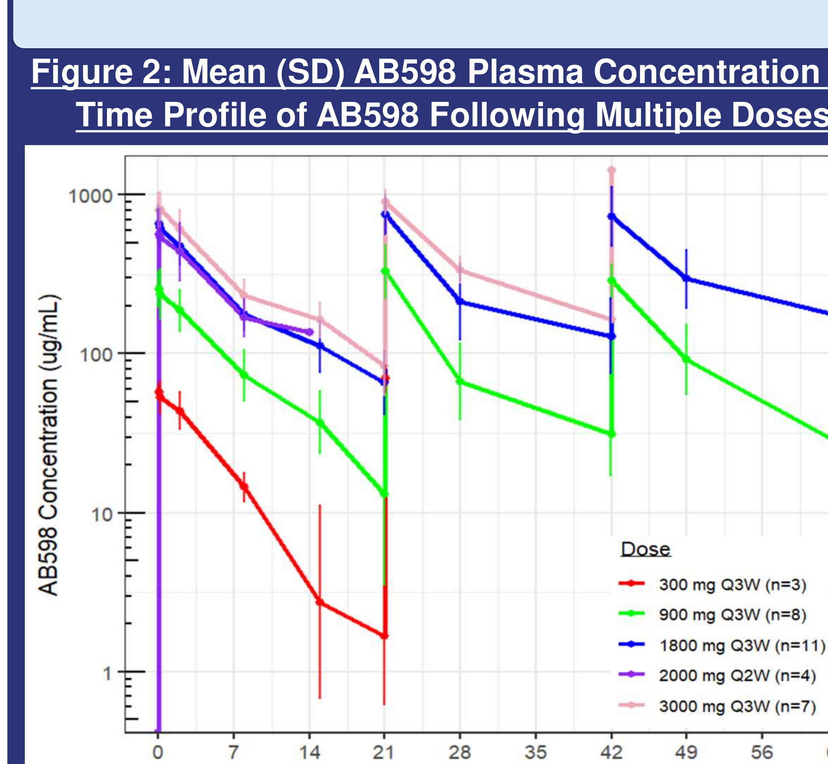
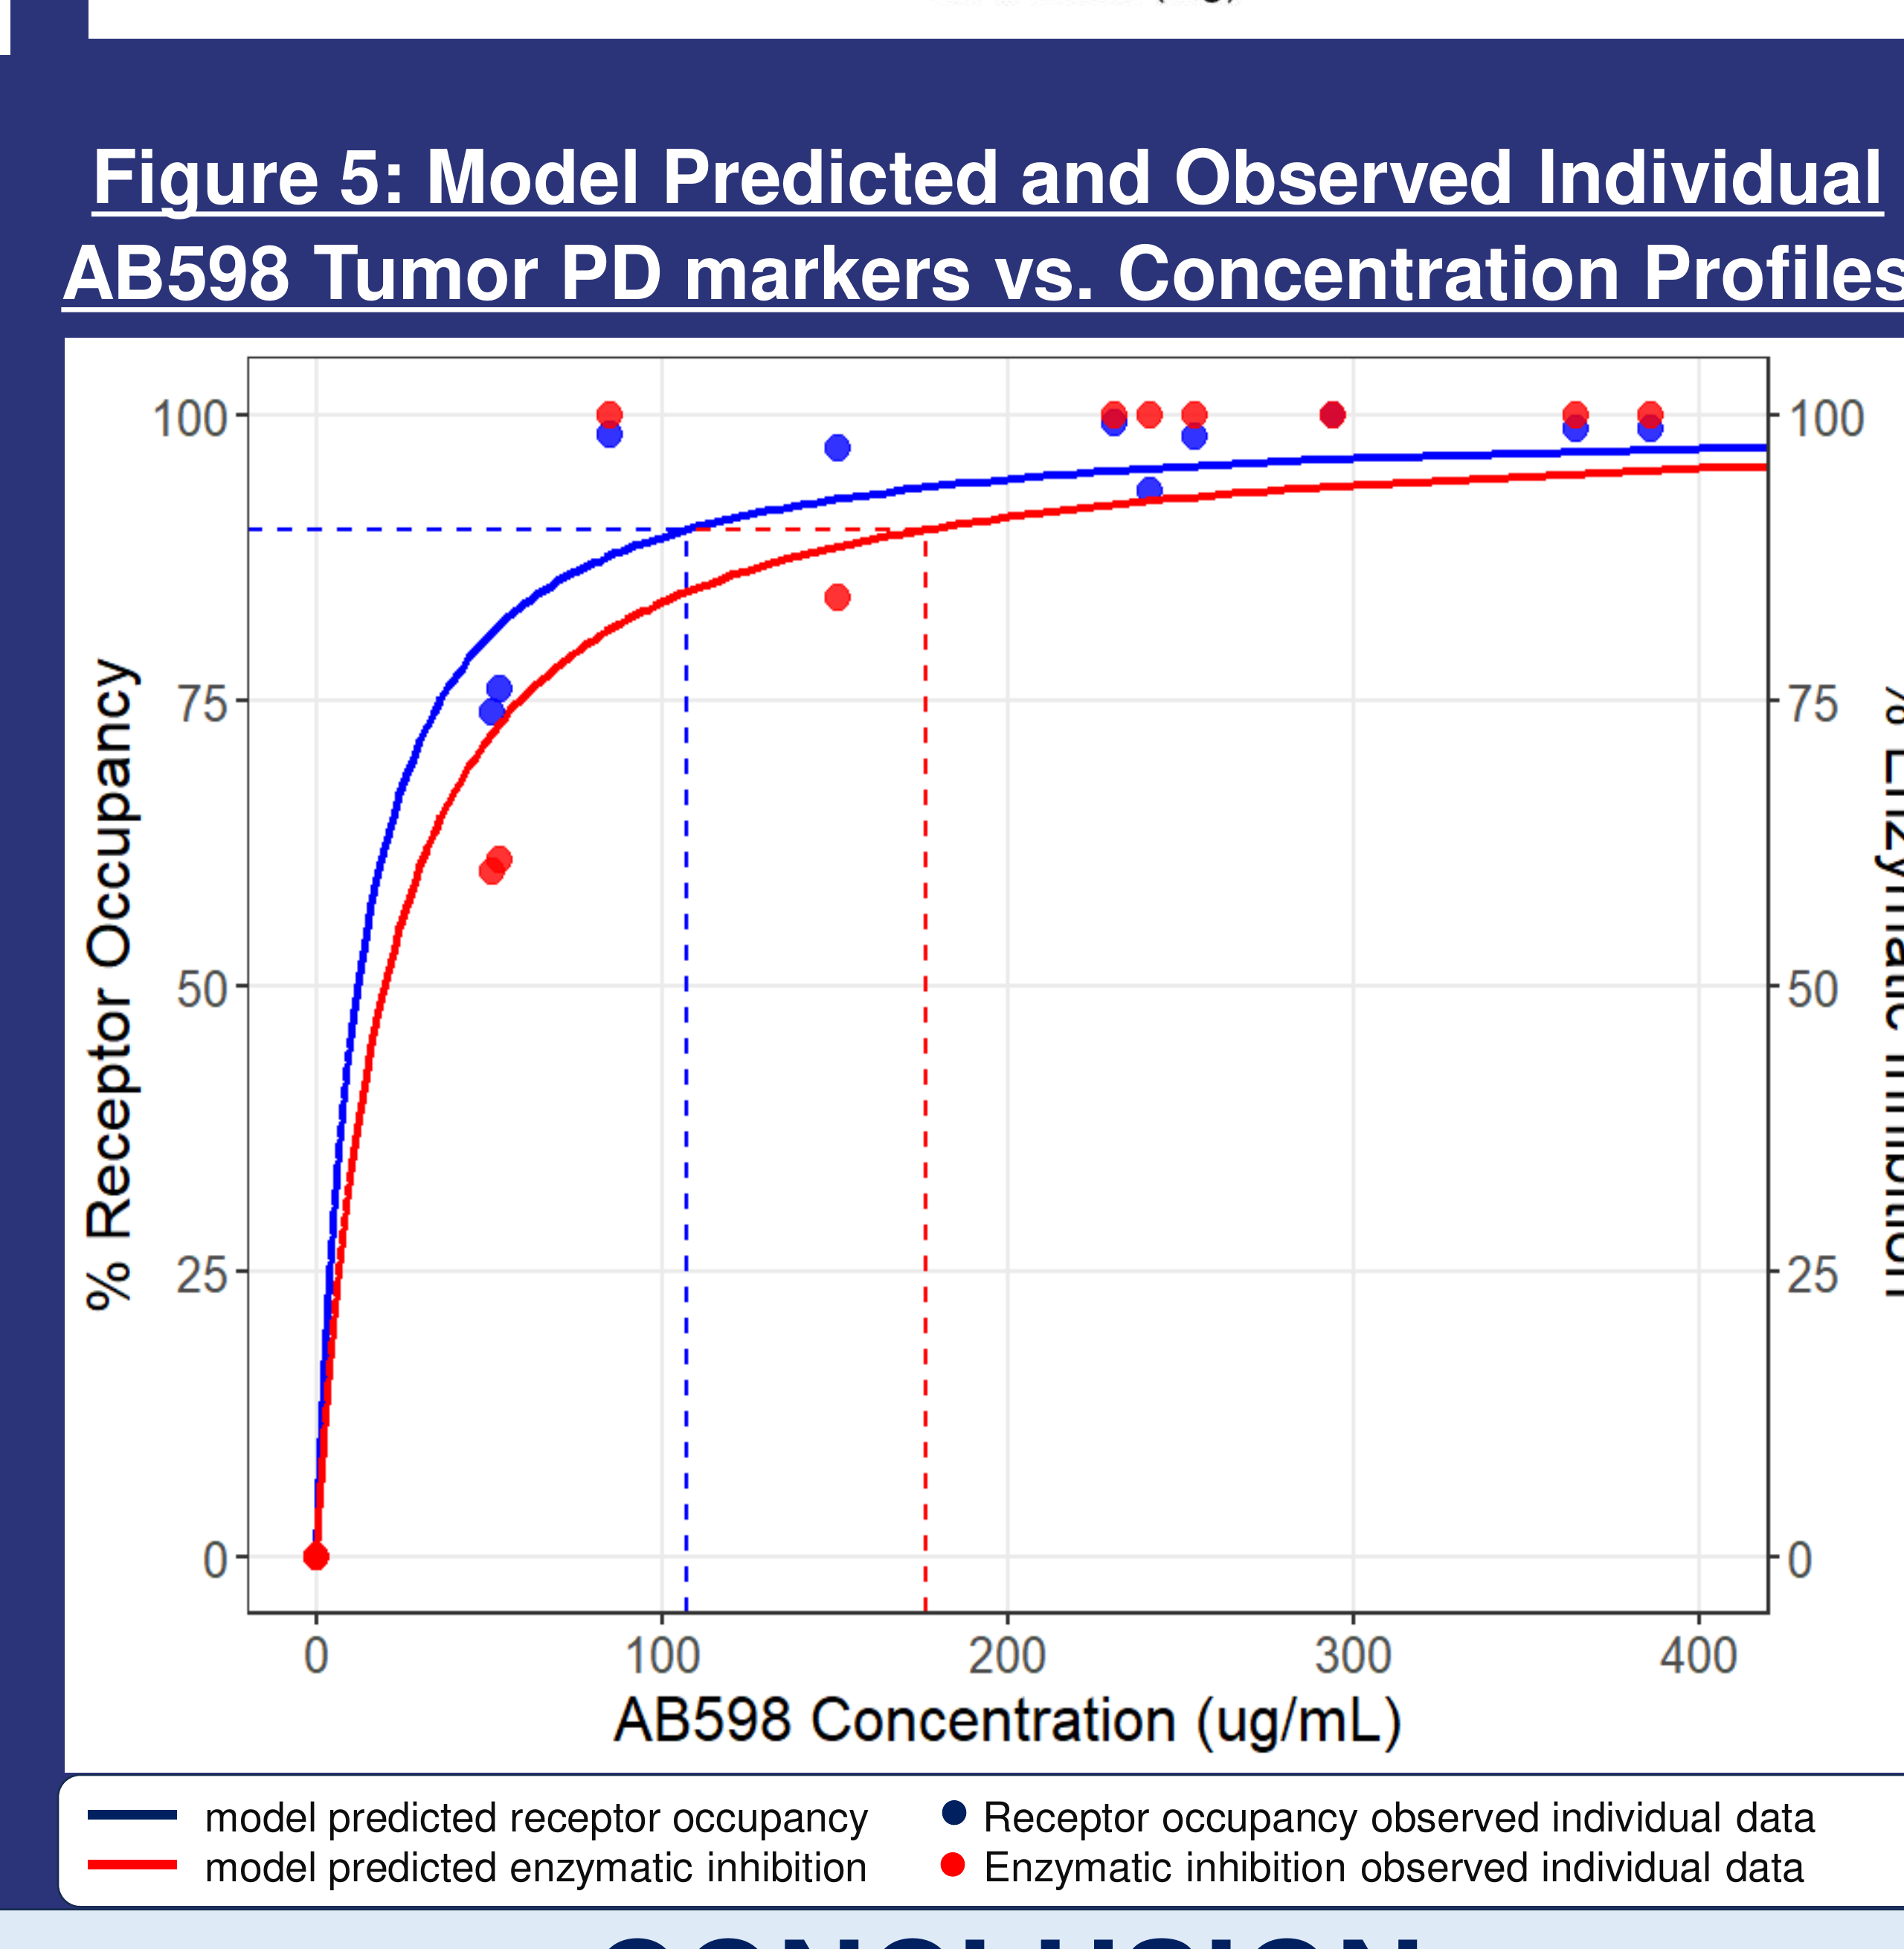
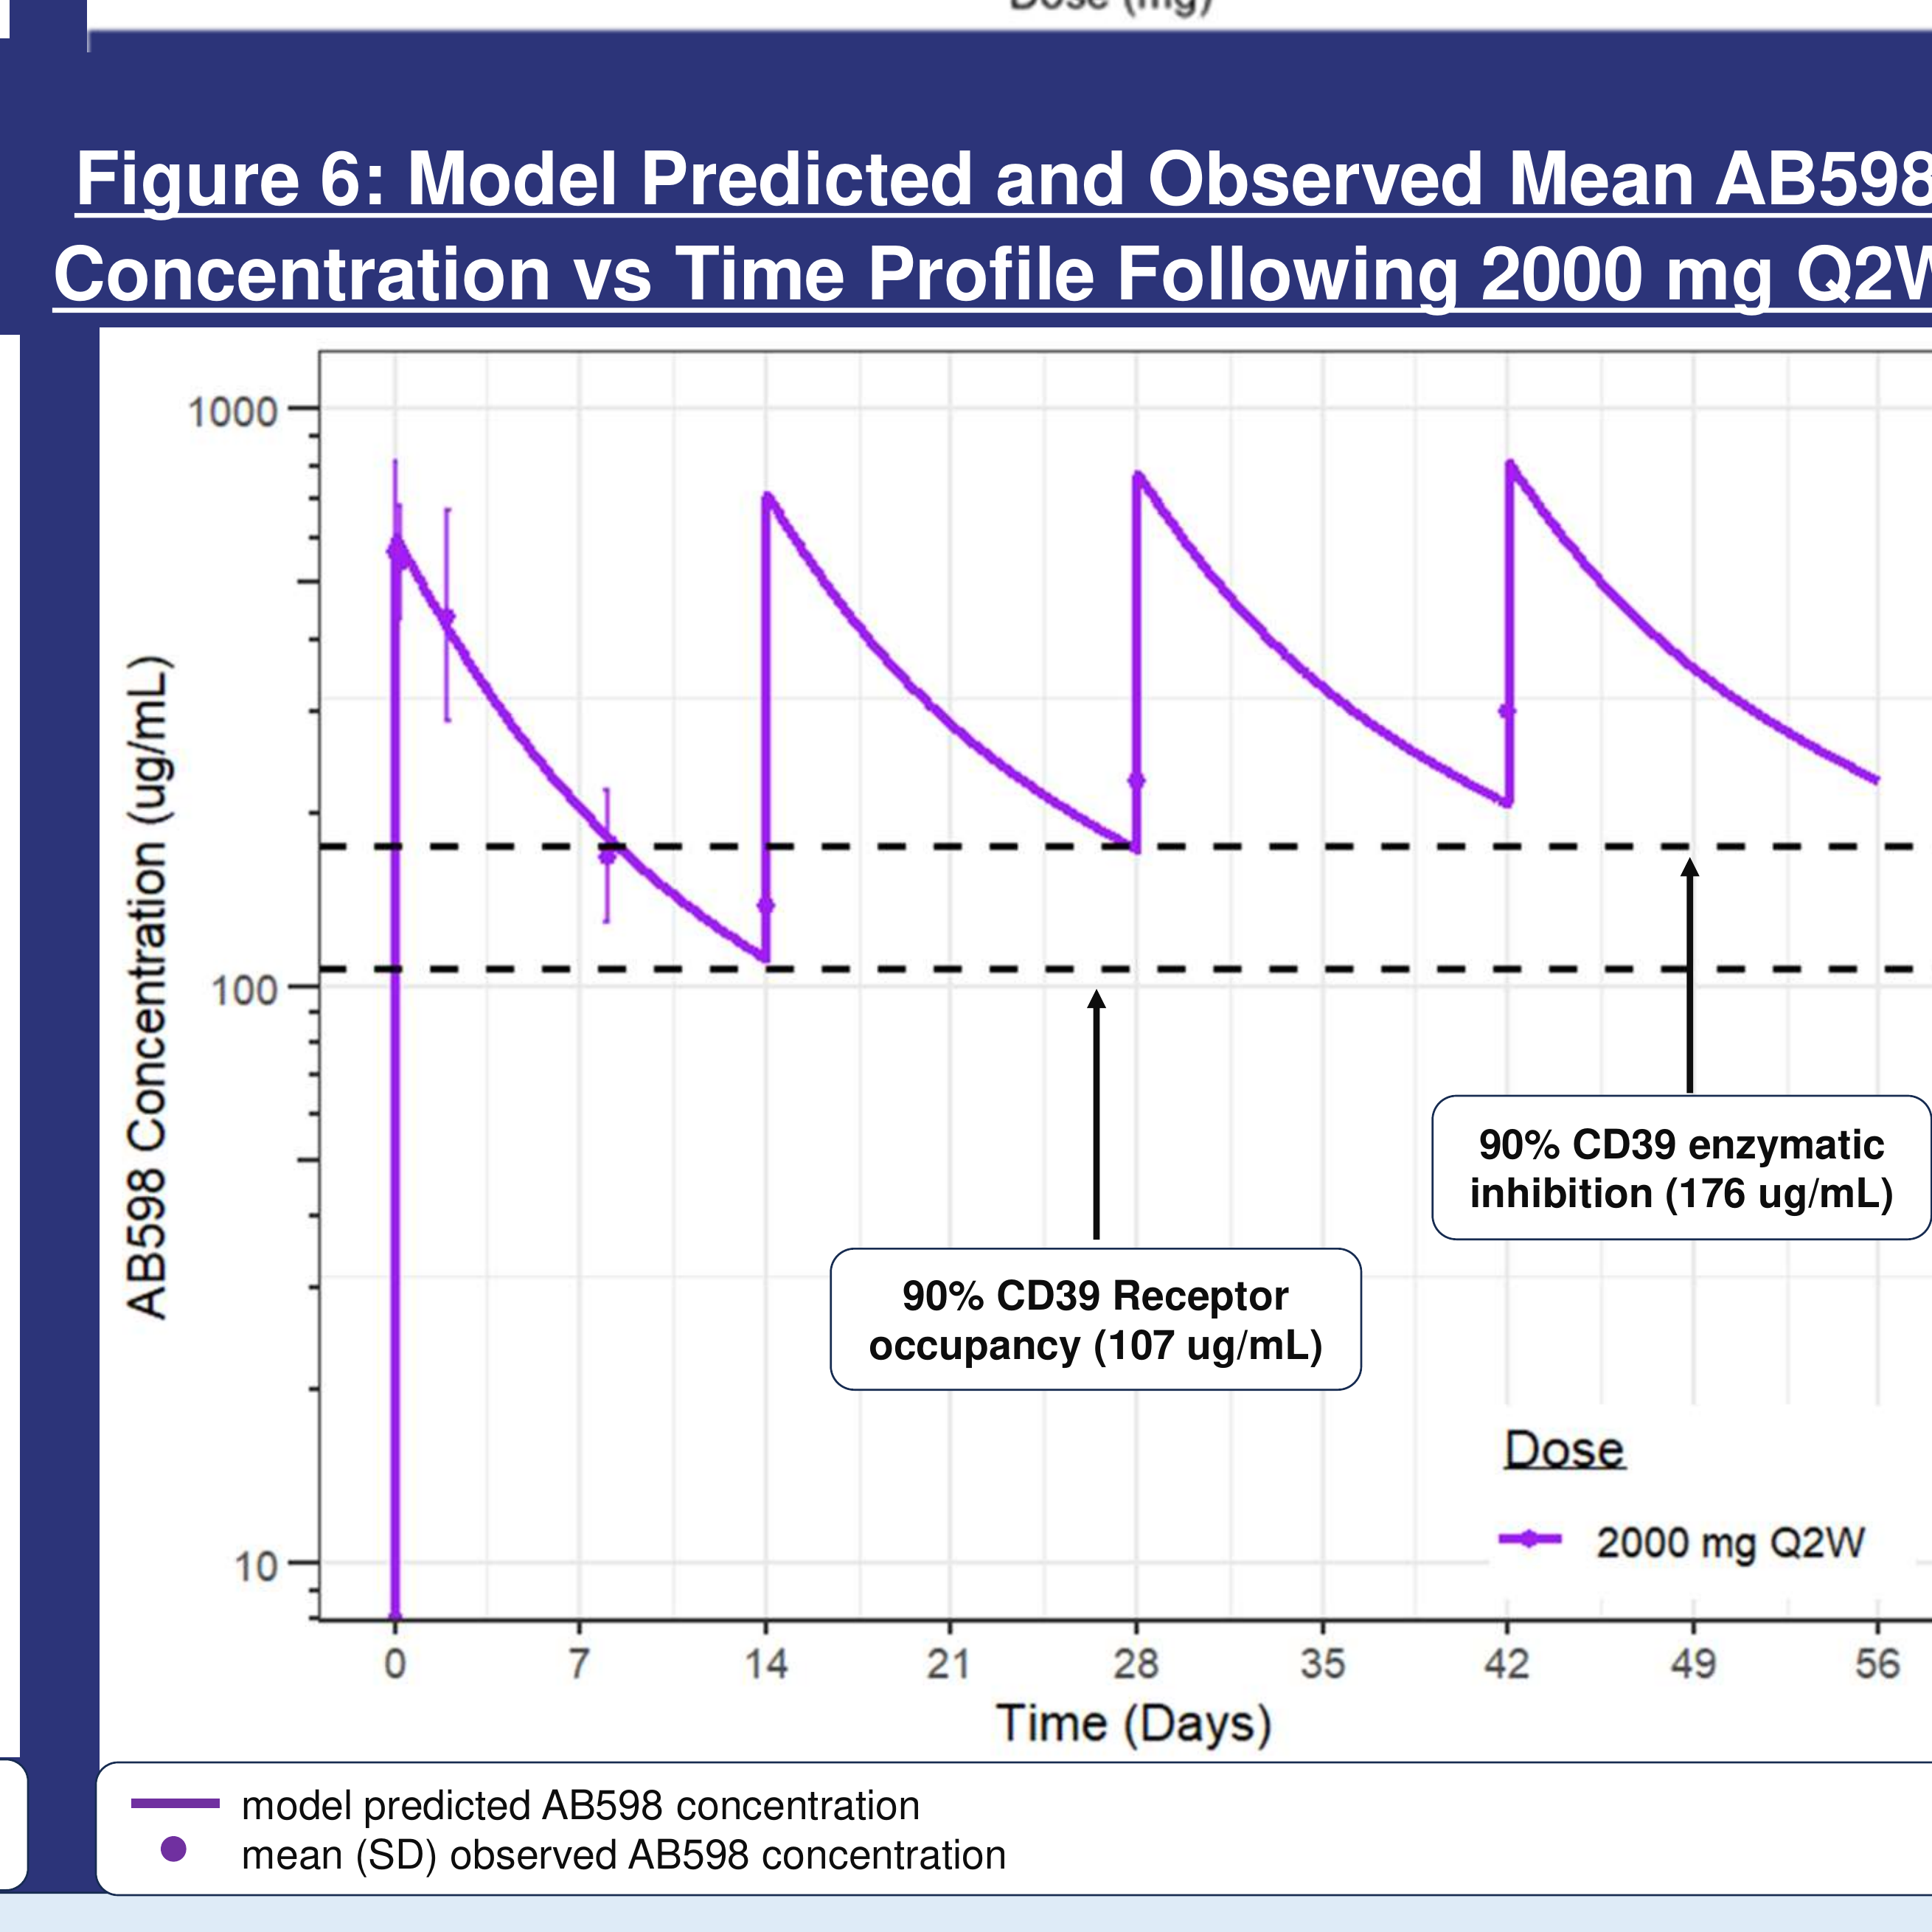
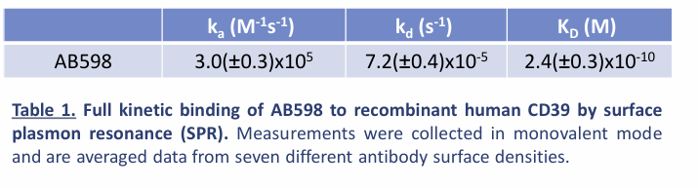
AB598: paired PK-tumor PD modeling provides the clearest Cmin-driven dose bridge
PK: multiple-dose concentrations
PK/PD: tumor RO and enzymatic inhibition
Simulation: 2000 mg Q2W
6-8 d
107 ug/mL
176 ug/mL
2000 mg Q2W
terminal t1/2 in linear 900-3000 mg Q3W range
model-estimated 90% tumor CD39 RO
model-estimated 90% tumor enzymatic inhibition
selected expansion dose; achieves both tumor PD targets
3000 mg Q3W and 2000 mg Q2W yield similar steady state exposure, therefore 2000 mg Q2W was selected as the expansion dose.
Expansion dose of 2000 mg Q2W achieves both 90% receptor occupancy and 90% enzymatic inhibition
Source: Adeojo et al., Clinical PK/PD Relationship for AB598 anti-CD39 mAb, ENA 2025 poster.
4

Slide 6
LEARNINGS FROM COMPETITORS
Key Take-aways
IPH5201:
Peripheral RO saturated at different doses depending on analyte: soluble CD39 at >=300 mg, but membrane-bound CD39 on monocytes/B cells at 3000 mg. Tumor ATPase reduction was most consistent at 3000 mg Q3W.
Implication: peripheral saturation underestimates the dose needed for tumor enzymatic blockade.
AB598:
Paired serum PK + tumor biopsy PD enabled quantitative thresholds: 90% tumor RO at 107 ug/mL and 90% enzymatic inhibition at 176 ug/mL.
Implication: the dose can be justified by simulated Cmin,ss coverage of the higher tumor PD threshold.
Key translational principle: do not equate peripheral RO with tumor pharmacology. Use peripheral RO to screen doses, then build a tumor PK/PD model to select the expansion dose.
Sources: Powderly et al. 2025; Adeojo et al. 2025; Patnaik et al. 2021.
5

