Slide 1
BNT211 CLDN6 CAR-T — PopPK Update
Exploratory data analysis of cellular kinetics
Tairan Yang
06/12/2026

Slide 2
Dataset & analysis set
Source data: SDTM dm, ex and ADaM adsl, adpc. Primary endpoint: CLDN6 CAR-T transgene (WPRE copies per µg genomic DNA, qPCR).
DV = transgene WPRE copies/µg DNA (qPCR), the canonical CAR-T cellular-kinetics readout. The paired flow-based readout (% WPRE copies per total cells) is carried alongside each record (PCELL) for reference.
Continuous TIME (days) is reconstructed from actual datetimes (sample collection PCDTC; dose EXSTDTC) relative to each subject’s first CAR-T infusion, so re-dosing cycles sit on one continuous timeline.
CAR-T infusions are EVID=1 / CMT=1 events with AMT = number of transduced CAR+ cells
RNA-LPX vaccine doses are EVID=1 / CMT=2 events with AMT in µg;
BLQ samples (observed 0 or < LLOQ) are retained with CENS=1 and DV set to the LLOQ (M3-ready), rather than dropped

Slide 3
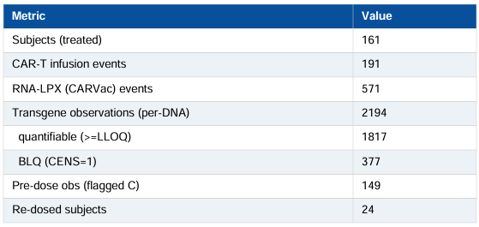
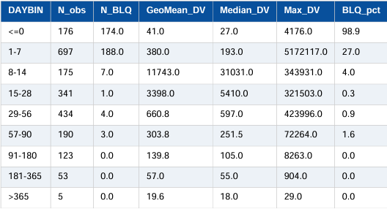
Data Summary
2194 transgene observations were available; 17% were BLQ, concentrated at the earliest (pre/peri-infusion) and latest (persistence-phase) timepoints, with the lowest BLQ fraction during peak expansion (week 1-4)

Slide 4
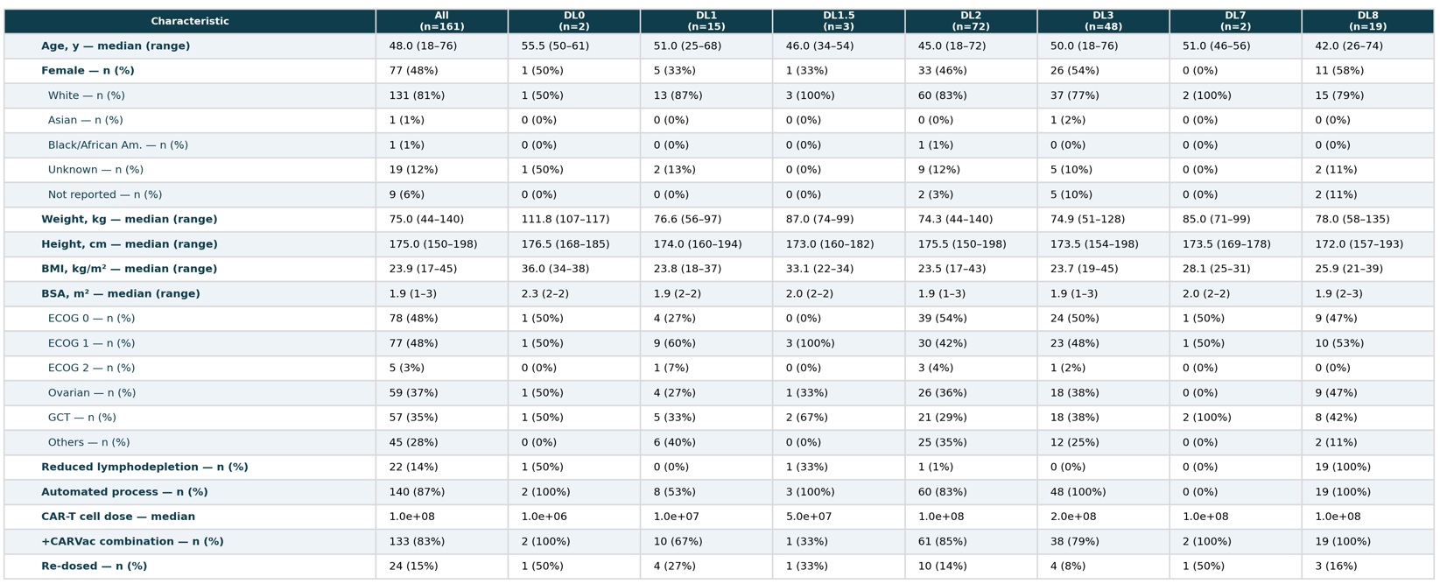
Demographics and Baseline Covariates

Slide 5
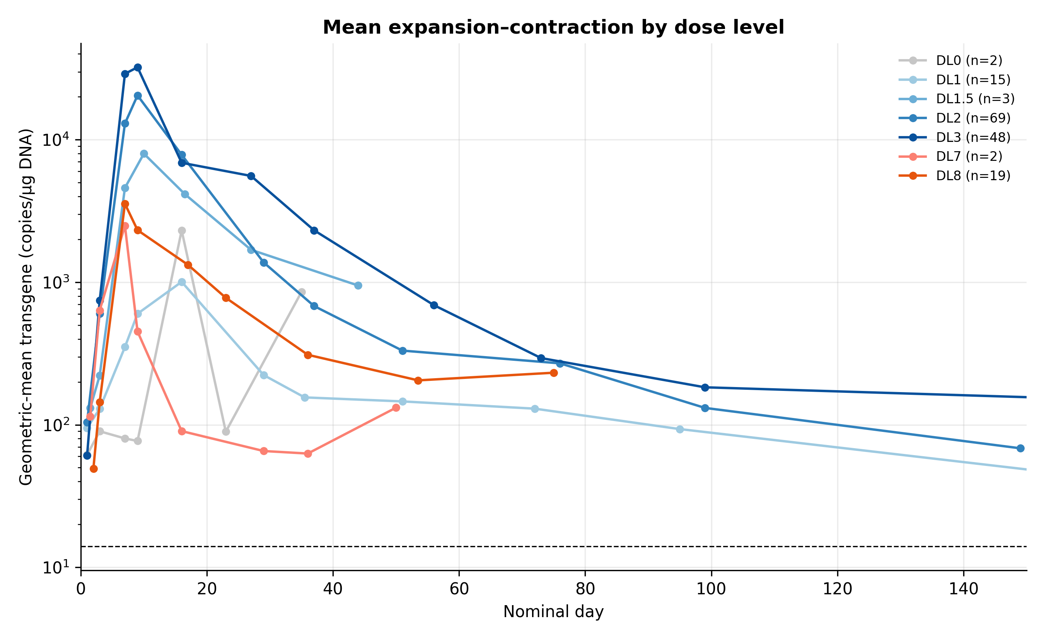
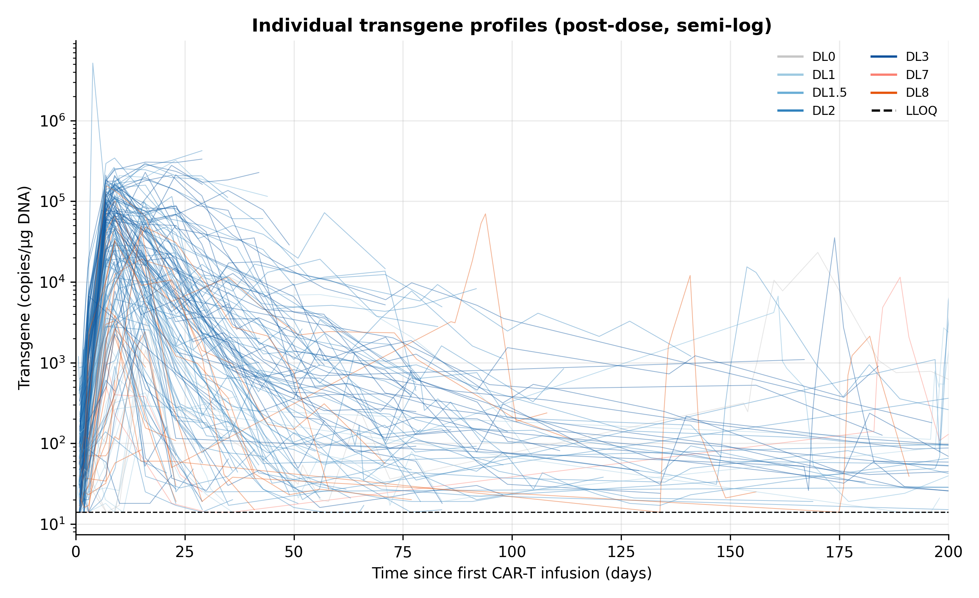
EDA

Slide 6
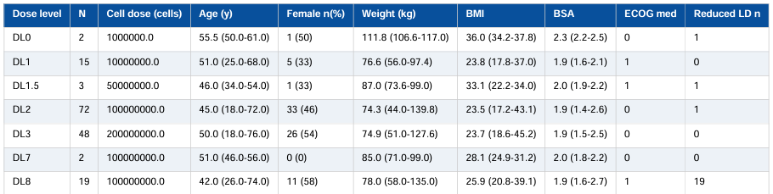
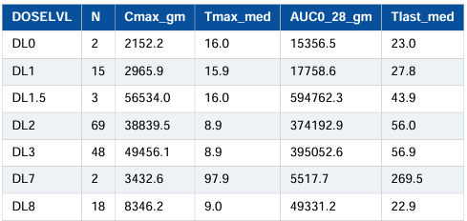
Peak expansion (Cmax ) and early exposure (AUC0-28 ) increase with dose across DL0–DL3; median Tmax falls in the ~9–16 day window typical of CAR-T expansion. DL7/DL8 (reduced-lymphodepletion / process-variant cohorts) show distinct profiles.

Slide 7
Backup

Slide 8
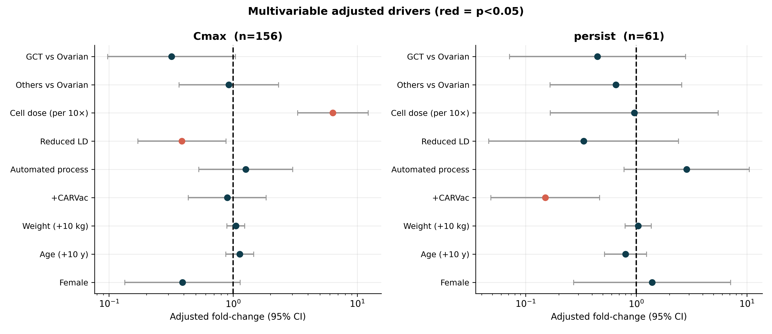
Forest Plots

