Slide 1




For more than 20 years, Duarte has developed visual stories for the world’s leading corporate brands, thought leadership forums, and an Academy Award-winning documentary.
Now they bring you…
FIVE RULES FOR CREATING GREAT PRESENTATIONS
Notes:
To view this presentation, first, turn up your volume and second, launch the self-running slide show.

Slide 2


To View This Presentation
FIRST
Turn Up Your Volume
SECOND
Launch Self-Running Slide Show
Notes:
To view this presentation, first, turn up your volume and second, launch the self-running slide show.

Slide 3









Notes:
Presentations are a powerful communication medium.

Slide 4


Notes:
For more than 20 years, Duarte has developed presentations…

Slide 5



D
Notes:
…to launch products,

Slide 6



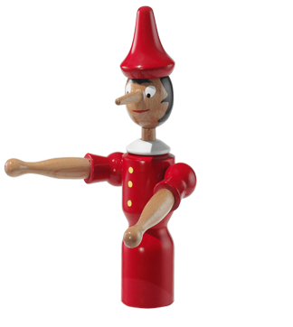


Notes:
…align employees,

Slide 7
Notes:
…increase company value,

Slide 8
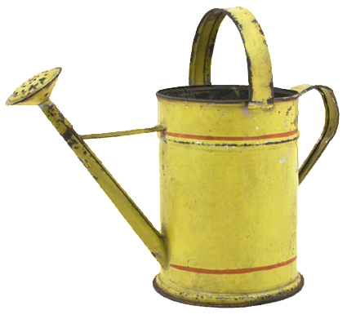

Notes:
…and propel

Slide 9














Notes:
…global causes.

Slide 10




5
RULES
Notes:
Along the way we’ve discovered…

