Slide 1
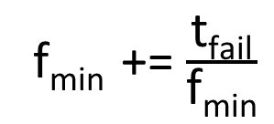
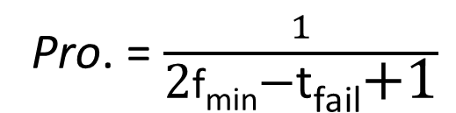
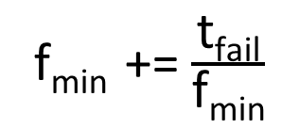
Min-heap
e_{min} 2
a 5
d 9
c 6
q 7
…
8
7
6
5
4
3
2
1
Stream 1
g
v
g
g
e
g
e
q
Probability
1/4
1/5
1/6
1/7
1/3
1/4
1/5
Pro. = $\frac{1}{\text{2}\text{f}\text{min}\text{−}\text{t}\text{fail}\text{+1}}$
Successful?
√ × × × √ × × 7+1
f_{min}
4 3 3 3 3 2 2 2
f_{min} += $\frac{\text{t}\text{fail}}{\text{f}\text{min}}$
t_{fail}
0 3 2 1 0 2 1 0
Root node
g e e e e e_{min} e_{min} e_{min}
8
7
6
5
4
3
2
1
Stream 2
e
e
e
e
e
v
r
g
Probability
1
1/2
1/3
1/4
1/5
1/5
1/5
1/5
Successful?
√ × × × × √ √ √
f_{min}
4 2 2 2 2 2 2 2
f_{min} += $\frac{\text{t}\text{fail}}{\text{f}\text{min}}$
t_{fail}
5 4 3 2 1 0 0 0
Root node
e v v v v v r g

Slide 2
…
4 3 2 1
Stream S
S₃,d₇
S₁,d₅
S₂,d₃
S₁,d₁
S₁,d₁
S₂,d₃
h₁(.)
h₃(.)
h₁(.)
h₃(.)
h₂(.)
h₂(.)
Bloom filter
1
1
1
0
1
1
Min-heap
S₅ 2
e_{min} 2
S₃ 5
S₆ 9
S₈ 6
S₁ 7

Slide 3
1 period
1 period
12 11 10 9 8 7 6 5 4 3 2 1
Stream S
c
a
b
b
b
b
d
c
a
g
a
a
a
g
h₁(.)
h₃(.)
h₁(.)
h₃(.)
h₂(.)
h₂(.)
Bloom filter for each period
1
0
1
0
1
1
a
g
e 2
Min-heap
e_{min} 2
a 5
d 9
c 6
q 7

Slide 4
w buckets
g, f₃
…
h₁(e)
…
h₂(e)
v, f₇
d arrays
e
…
…
h_{d}(e)
…
b, f_{d}

Slide 5



e
h(e)
$$\text{b}\text{, }\text{f}\text{7}$$
$$\text{g}\text{, }\text{f}\text{3}$$
d cells
$$\text{v}\text{, }\text{f}\text{9}$$
w buckets

Slide 6
min-heap
incoming item
filter
keep hot items

