Slide 1

Difference Bloom Filter
ICC 2017 CNN-IS01
Dongsheng Yang, Deyu Tian, Junzhi Gong, Siang Gao
Tong Yang*, Xiaoming Li
Notes:
Good afternoon, everyone. My name is Dongsheng Yang from Peking university, China. Today, my topic is “Difference Bloom filter”

Slide 2
ICC 2017 CNN-IS01
Difference Bloom Filter
Background
Structure
Operation
Conflicts
Evaluation
Conclusion
Multi-set Membership Query
element e set S1 set S2
Query. e in S1 and S2 ?
e in S1 or S2 ?
In data centers, switches need to know which port a packet should be forwarded to. This is actually a multi-set membership query.
Notes:
First, let me introduce what is multi-set membership query.
Here is an example. Given an element e, and two disjoint sets: S1, and S2.
We want to know whether e is in these two sets,
and if yes, which set it belongs to?
Multi-set membership query is a fundamental operation in computer systems and applications.
For instance, In data centers, switches need to know which port a packet should be forwarded to.
So each switch keeps a MAC address table, which associates a destination MAC address with an outgoing port.
This is actually a multi-set membership query, where destination MAC addresses are element and outgoing ports are multi-sets.
Now the problem is how to construct the MAC address table.

Slide 3
ICC 2017 CNN-IS01
Difference Bloom Filter
Background
Structure
Operation
Conflicts
Evaluation
Conclusion
Speed vs. Memory
The memory of a switch is composed of SRAM and DRAM.
The SRAM is fast but small. The DRAM is big but slow.
The space of SRAM is very tight for huge data centers.
Therefore, a small data structure is demanded for fast multi-set query.
Fast Speed
SRAM
Small Memory
Notes:
The lookup of the MAC address table needs to be fast enough to catch up with the line speed.
So a straight forward solution is to build a hash table as a MAC address table.
The hash table can achieve O(1) query speed in theory.
However, it is not fast enough in practice. The reason is that it cannot fit into the SRAM.
The memory of a switch is composed of SRAM and DRAM.
The SRAM is fast but very small. The DRAM is big but slow.
As there are more and more computers in the data center nowadays, the size of the hash table is becoming larger and larger.
So that the hash table cannot fit into the SRAM in some cases.
When we look up the hash table, we need to access the slow DRAM memory.
Therefore, the hash table is not fast in practice.
To achieve a fast speed, a data structure using little memory is in great demand.

Slide 4
ICC 2017 CNN-IS01
Difference Bloom Filter
Background
Structure
Operation
Conflicts
Evaluation
Conclusion
Standard Bloom filters: Membership Query
e
Insertion:
Calculating k hash functions for e
Set k hashed bits to 1 to symbol the existence of e
k = 3 hash functions
h₁(e)
h₃(e)
h₂(e)
0
1
0
1
0
0
1
1
1
0
0
0
0
1
0
1
bitmap
Query:
Calculating k hash functions for e
Check if all the k hashed bits are 1
If yes, reports e in the set
Otherwise, e is not in the set
e
h₁(e)
h₃(e)
h₂(e)
0
0
1
0
0
1
0
1
0
1
1
0
0
0
1
1
Notes:
Bloom filters has long been used for single set membership query.
Its advantage is small and fast.
Now let me introduce the Bloom filter in detail.
Bloom filter is a Bitmap with k hash functions.
When inserting an element e into the data set, we compute the k hash functions for e,
and set the k corresponding bits in the Bitmap to 1.
When querying an element e, we compute the k hash functions for e,
if all the corresponding k bits are 1, BF reports true, which means that e is in the data set,
otherwise BF reports false, which means that e is not in the data set.
If Bloom filter reports false for an element e, then e is definitely not in this set.
However, when BF reports true, it only means that e is very likely to be in this set.
Due to conflicts, e may not in this set with a small probability. And this leads to inaccuracy.
The Bloom filter trades off accuracy with memory.
When we use 14 bits per element to represent a data set using a Bloom filter, the false rate is 0.1 percent.
This is a very small memory usage, and the false rate is tolerable.
We can build a small white list along with the Bloom filter to guarantee the correctness.

Slide 5
ICC 2017 CNN-IS01
Difference Bloom Filter
Background
Structure
Operation
Conflicts
Evaluation
Conclusion
Standard Bloom filters: Metrics
e
False positive: An element not in the set is reported to be in the set.
False negative: An element in the set is reported to be not in the set.
The Bloom filter suffers only from the false positive error.
When the space is larger than 14 bits per element, the Bloom filter has a 0.1% false positive rate.
k = 3 hash functions
h₁(e)
h₃(e)
h₂(e)
0
1
0
1
0
0
1
1
1
0
0
0
0
1
0
1
bitmap
e
h₁(e)
h₃(e)
h₂(e)
0
0
1
0
0
1
0
1
0
1
1
0
0
0
1
1
Notes:
Bloom filters has long been used for single set membership query.
Its advantage is small and fast.
Now let me introduce the Bloom filter in detail.
Bloom filter is a Bitmap with k hash functions.
When inserting an element e into the data set, we compute the k hash functions for e,
and set the k corresponding bits in the Bitmap to 1.
When querying an element e, we compute the k hash functions for e,
if all the corresponding k bits are 1, BF reports true, which means that e is in the data set,
otherwise BF reports false, which means that e is not in the data set.
If Bloom filter reports false for an element e, then e is definitely not in this set.
However, when BF reports true, it only means that e is very likely to be in this set.
Due to conflicts, e may not in this set with a small probability. And this leads to inaccuracy.
The Bloom filter trades off accuracy with memory.
When we use 14 bits per element to represent a data set using a Bloom filter, the false rate is 0.1 percent.
This is a very small memory usage, and the false rate is tolerable.
We can build a small white list along with the Bloom filter to guarantee the correctness.

Slide 6
ICC 2017 CNN-IS01
Difference Bloom Filter
Background
Structure
Operation
Conflicts
Evaluation
Conclusion
Standard Bloom filters: Multi-set Membership Query
BF₁
Building s Bloom filters for s sets.
If the i^{th} Bloom filter reports true, e is thought to be in set i
If no Bloom filter reports true, e is not in these s sets
If more than one Bloom filter reports true, only one of these sets really holds e.
0
0
1
0
0
1
0
1
0
1
1
0
0
0
1
1
…
0
0
1
1
0
0
0
1
0
1
1
0
0
1
1
0
BF_{s}
Summary of Bloom filter:
Trade off memory with accuracy
Advantage: very compact, very fast
Disadvantage: when it is applied to multi-sets,
the false positive rate increases rapidly
when the number of sets increase.
Notes:
Bloom filters can also be used for multi-set membership query.
If there are s disjoint sets, s Bloom filters should be built.
To insert an element e into set i, find the i^th bloom filter and insert e into it.
To query an element e, we check all the s bloom filters.
If the i^th Bloom filter reports true, it is thought that e is in set i.
If no Bloom filter reports true, it is certain that e is not in these s sets.
An element cannot belong to more than one set, since these sets are disjoint.
So if there are more than one Bloom filters report true, we randomly report a set among these true sets.
Now we summarize the idea of the Bloom filter.
The Bloom filter can achieve fast speed, because it uses very little memory, and thus it can fit into the SRAM.
The Bloom filter can use little memory because it loses information and is not accurate.
Although in many applications error is acceptable, high accuracy is always demanded.

Slide 7
bit
ICC 2017 CNN-IS01
Difference Bloom Filter
Background
Structure
Operation
Conflicts
Evaluation
Conclusion
Difference Bloom filter: data structure
Table: assisting insertions and deletions.
Filter: answering queries.
Key idea: recording all sets into one filter.
using the number of 0s to tell which set an element is in.
SRAM
1 | 0 | 1 | 0 | 0 | 1 | 0 | 1 | 1
filter
DRAM
2 0 1 1 0 1 0 2 1
counters
table
e₁
e₁ e₂
e₁
e₁ e₂
cell
linked lists
e₂
e₂
Notes:
In this paper, we propose the Difference Bloom filter to significantly improve the accuracy of the Bloom filter.
The DBF is composed of a filter and a table.
The filter is a bitmap to answer multiset membership queries, it is small enough to fit into the SRAM.
The table is placed on the DRAM.
It consists of counters and linked lists, to record which elements are hashed to the corresponding bits of the filter.
The table is only used to assist insertions and deletions and is not used when for queries.
So the DBF only access the fast SRAM memory when dealing with queries, which makes it as fast as the Bloom filter.
The key idea of the DBF is to record all sets into one filter, and use the number of 1s to discriminate elements of different sets.
The Bloom filters are not accurate because there may be many Bloom filters report true when querying an element,
so that we do not know which set the element is in.
On the contrary, by settling conflicts during the insertions, our Difference Bloom filter does not report more than one set,
so the accuracy is improved significantly.

Slide 8
ICC 2017 CNN-IS01
Difference Bloom Filter
Background
Structure
Operation
Conflicts
Evaluation
Conclusion
Difference Bloom filter: Insertions
Hash e to k bits of the filter.
Objective: If e is in set i, then we set k – i bits to 1 and i bits to 0.
Technical challenge: Avoid conflicts between old elements and new elements.
Example: Suppose there are s = 2 disjoint sets, id in {0,1}. There are k = 3 hash functions.
 | [h₁(e)] | [h₂(e)] | [h₃(e)]
Set 0 | 1 | 1 | 1
Set 1 | 0 | 1 | 1
Set 1 | 1 | 0 | 1
Set 1 | 1 | 1 | 0
e is in set id = 1
e
h₁(e)
h₃(e)
h₂(e)
0
0
0
1
0
0
1
0
0
0
0
1
0
1
1
1
Notes:
Here we introduce the insertion operation of Difference Bloom filter.
First, we present the objective of the insertion.
When inserting an element e, we compute $k$ hash functions for e, and locate $k$ bits.
Instead of setting the k bits of all elements to 1 like the Bloom filter does, we treat elements in different sets differently.
To insert e into set i, we set k-i bits to 1, and i bits to 0.
Now let’s see an example.
Suppose there are s = 2 disjoint sets. Sets’ id is 0 and 1, respectively. And there are k = 3 hash functions.
Then, to insert an element e in set 0, the objective is to set all the 3 hashed bits to 1.
To insert e in set 1, the objective is to set arbitrary 1 hashed bit to 0 and 2 hashed bits to 1.
Next, we will present the process of insertion,
and discuss how to use DRAM table to detect and settle conflicts between old elements and new elements.

Slide 9
ICC 2017 CNN-IS01
Difference Bloom Filter
Background
Structure
Operation
Conflicts
Evaluation
Conclusion
Difference Bloom filter: Insertions
Process: Compute k hash functions for element e
Insert e into the k buckets of the table
Detect and settle conflicts using the table
Set the k bits of the filter
0 0 0 0 0
1 0 1 1 1
1 0 1 1 0
filter
e₀
e₁
2 1 1 1 1
0 0 0 0 0
1 0 1 1 0
Example: 1) Inserting e₀ of set 0:
set the 1st, 3rd and 4th bits to 1.
table
e₀
e₁
e₀
e₀
e₁
Inserting e₁ of set 1:
leave the 1st bit to 1
leave the 2nd bit to 0
set the 5th bit to 1
e₁
Notes:
Here we present the process of the insertion.
First, we compute $k$ hash functions for e, and locate $k$ bits on the table and the filter.
Then we insert e into the table. That is to say, we increase the counter of the corresponding buckets, and hang e on the linked list.
Next, we check the corresponding linked lists to see if there are already elements in these positions.
If yes, we will see whether there are conflicts or not.
Conflicts mean that we have to write a 1 on a 0 written by existing elements, or we have to write a 0 on a 1 written by existing elements.
After settle the conflicts, we will set the filter to the right state.
Now let’s see two examples.
First we insert an element e$_0$, which is in set 0, into an empty Difference Bloom filter.
We compute k = 3 hash functions, and insert e$_0$ into the table.
Since the table is empty, so there are no conflicts.
So we just set the corresponding bits of the filter to 1.
Next we insert an element e$_1$, which is in set 1, into this Difference Bloom filter.
We also compute 3 hash functions, and insert e$_1$ into the table.
Notice that e$_1$ is sharing the first bucket with e$_0$.
Recall that the objective of inserting $e_1$ is to set arbitrary 1 bit to 0 and 2 bits to 1.
As long as we do not try to set the first bit to zero, which is written to 1 by e$_0$, there will be no conflicts.
Therefore, we do not change the first bit and the second bit of the filter, and we just set the fifth bit of the filter to 1.
Now the insertions of both e$_0$ and e$_1$ have been done successfully.
However, sometimes conflicts are inevitable, so we need to settle conflicts.
There are two kinds of conflicts, one is writing a 0 on a 1, and the other is writing a 1 on a 0.

Slide 10

ICC 2017 CNN-IS01
Difference Bloom Filter
Background
Structure
Operation
Conflicts
Evaluation
Conclusion
Settling Conflicts: change 1 to 0
1 1 1 1 0
1 0 1 1 1
1 1 1 1 0
set 0: 3 bits to 1
e₀
e₂
e₂
2 1 1 1 1
2 2 2 2 1
2 2 2 2 1
Settle e₂
set 1: 2 bits to 1
e₀
e₁
e₀
e₀
e₁
e₀
e₁
e₀
e₀
e₁
e₁
e₂
e₁
e₂
e₂
e₂
e₁
e₂
e₂
e₂
Notes:
If we want to write a 0 on a 1, we should first change 1 to 0 to avoid conflicts.
To change one of the k hashed bits from 1 to 0, we need to find one of the k buckets with only elements in set 1.
And then we move the 0 bits of these elements from other bits to this bit.
Here is an example. Suppose e$_2$ is in set 1, and we insert e$_2$ into Difference Bloom filter.
We compute 3 hash functions, and find that all the 3 buckets are appropriated by other elements.
What’s more, all the 3 corresponding bits of the filter are written to 1.
So there are no place for e$_2$ to write a 0 on.
To settle this conflict, we need to change a 1 among these 3 bits to 0.
First, we check if there is a bucket among these 3 buckets that are only occupied by elements in set 1.
If there is no such a bucket, then the attempt of settling conflicts fail, and the e$_2$ is not inserted into the Difference Bloom filter.
In this example, we can find such a bucket.
It is the second bucket, and it only holds e$_1$.
Next we find the 0 written by e$_1$, which is the fifth bit.
Since e$_1$ is the only element in the fifth bit, so we can change it without influencing other elements.
Now we change the fifth bit from 0 to 1 and change the second bit from 1 to 0 at the same time.
After that, the representation of e$_2$ is correct.
Also, the representation of e$_1$ is still correct.

Slide 11
ICC 2017 CNN-IS01
Difference Bloom Filter
Background
Structure
Operation
Conflicts
Evaluation
Conclusion
Settling Conflicts: change 0 to 1
1 1 1 1 0
1 0 1 1 1
set 0: 3 bits to 1
e₀
e₂
e₂
e₂
3 1 2 1 2
3 1 2 1 2
2 1 1 1 1
Settle e₂
set 1: 2 bits to 1
e₀
e₁
e₀
e₀
e₁
e₀
e₁
e₀
e₀
e₁
e₁
e₁
e₂
e₂
e₁
e₂
e₂
e₂
e₂
Notes:
If we want to write a 1 on a 0, we should first change this 0 to 1 to avoid conflicts.
To change one of the k hashed bits from 0 to 1, we need to find one of the k buckets with only elements in set 1.
And then we move the 0 bit of these elements from this bit to other bits.
Here is an example. Suppose e$_2$ is in set 0, and we insert e$_2$ into Difference Bloom filter.
We compute 3 hash functions, and check the 3 buckets in the table.
Recall that element in set 0 should write all its bits to 1.
However, we find out that the fifth bit is appropriated by e$_1$, (which is an element in set 1,) and the fifth bit is written to 0.
So e$_2$ cannot write a 1 on the fifth bit.
To settle this conflict, we need to change the fifth bit from 0 to 1.
First, we find a bucket among the other two buckets of e$_1$, which is only occupied by e$_1$, .
If there is no such a bucket, then the attempt of settling conflicts fails.
If it fails, for element in set 0, we still insert it into the Difference Bloom filter, but at the same time, at least an element in set 1 goes wrong.
In this example, fortunately, we find the second bucket is a bucket only occupied by e$_1$.
Now we change the fifth bit from 0 to 1 and change the second bit from 1 to 0 at the same time.
After that, the representation of e$_2$ is correct.
Also, the representation of e$_1$ is still correct.

Slide 12
ICC 2017 CNN-IS01
Difference Bloom Filter
Background
Structure
Operation
Conflicts
Evaluation
Conclusion
Difference Bloom filter: query and deletion
Query: Get the k hashed bits of e from the filter
If i (0 ≤ i ≤ s-1) of them are 0, then we think e is in set i.
If i (i ≥ s) of them are 0, then e is not in these s sets.
Suppose there are s = 2 disjoint sets, id in {0,1}.
Deletion: Delete e from the table.
Reset the k hashed bits of e to 0 if they are not shared by others
k = 3 hash functions
e
h₁(e)
h₃(e)
h₂(e)
0
0
0
1
0
0
1
1
1
0
0
0
1
e is in set id = 1
Notes:
Here we introduce how query and deletion work.
To query an element e, we compute the k hash functions for e,
and check how many 0s there are among the k corresponding bits of the filter.
If there are i zeros, where i is smaller than s, the DBF reports that e is in set i.
If there are more than or equal to s 0s, e is not in these s sets.
To delete an element e, we first delete e from the table.
Then, for each bucket of e, if this bucket only holds e, we reset the corresponding bit of the filter to 0.

Slide 13
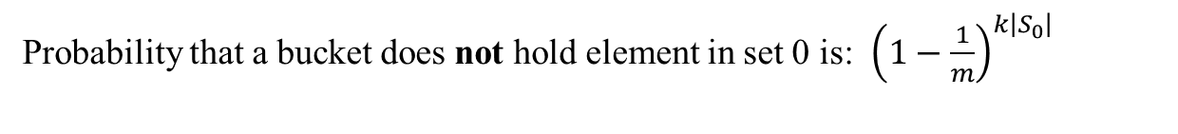
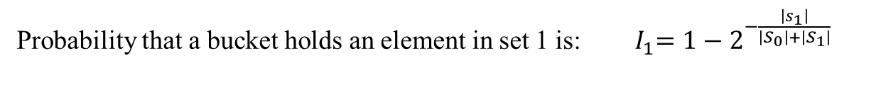


ICC 2017 CNN-IS01
Difference Bloom Filter
Background
Structure
Operation
Conflicts
Evaluation
Conclusion
Difference Bloom filter: analysis
$m:$number of bits/buckets $k$: number of hash functions $\left|S\right|$ : size of the set
Probability that a bucket does not hold element in set 0 is: ${\left(1−\frac{1}{m}\right)}^{k\left|S_{0}\right|}$
When $k=\ln{2}×\frac{m}{\left|S_{0}\right|+\left|S_{1}\right|}$, the performance is the best. (proved by early works)
Probability that a bucket holds an element in set 0 is: ${ I}_{0}=1−2^{−\frac{\left|s_{0}\right|}{\left|S_{0}\right|+\left|S_{1}\right|}}$
Probability that a bucket holds an element in set 1 is: ${ I}_{1}=1−2^{−\frac{\left|s_{1}\right|}{\left|S_{0}\right|+\left|S_{1}\right|}}$
Probability that an element of set 0 fails the insertion is: 0
Probability that an element of set 1 fails the insertion is: ${\left(I_{0}+I_{1}^{4}\right)}^{k}$
If the insertion is successful, the query result must be correct.
For 2-sets membership query, when using 14 bits per element:
The false rate of 2 Bloom filters is 10⁻³
The false rate of a Difference Bloom filter is 6 $×$10⁻⁶
Notes:
Here we analyze the false rate of the Difference Bloom filter for two sets membership query.

Slide 14
ICC 2017 CNN-IS01
Difference Bloom Filter
Background
Structure
Operation
Conflicts
Evaluation
Conclusion
Experimental setups
Comparison algorithms
DBF: Difference Bloom filter (our algorithm)
Double-BF or 10-BF: 2 or 10 Bloom filters (a famous algorithm)
ShBF: Shifting Bloom filter (state-of-the-art, VLDB 16)
Default settings
Memory size: 289M bits
Total number of elements: 20M
Number of sets: 2 or 10
Number of hash functions: 10
Distribution: the sizes of all sets are equal

Slide 15
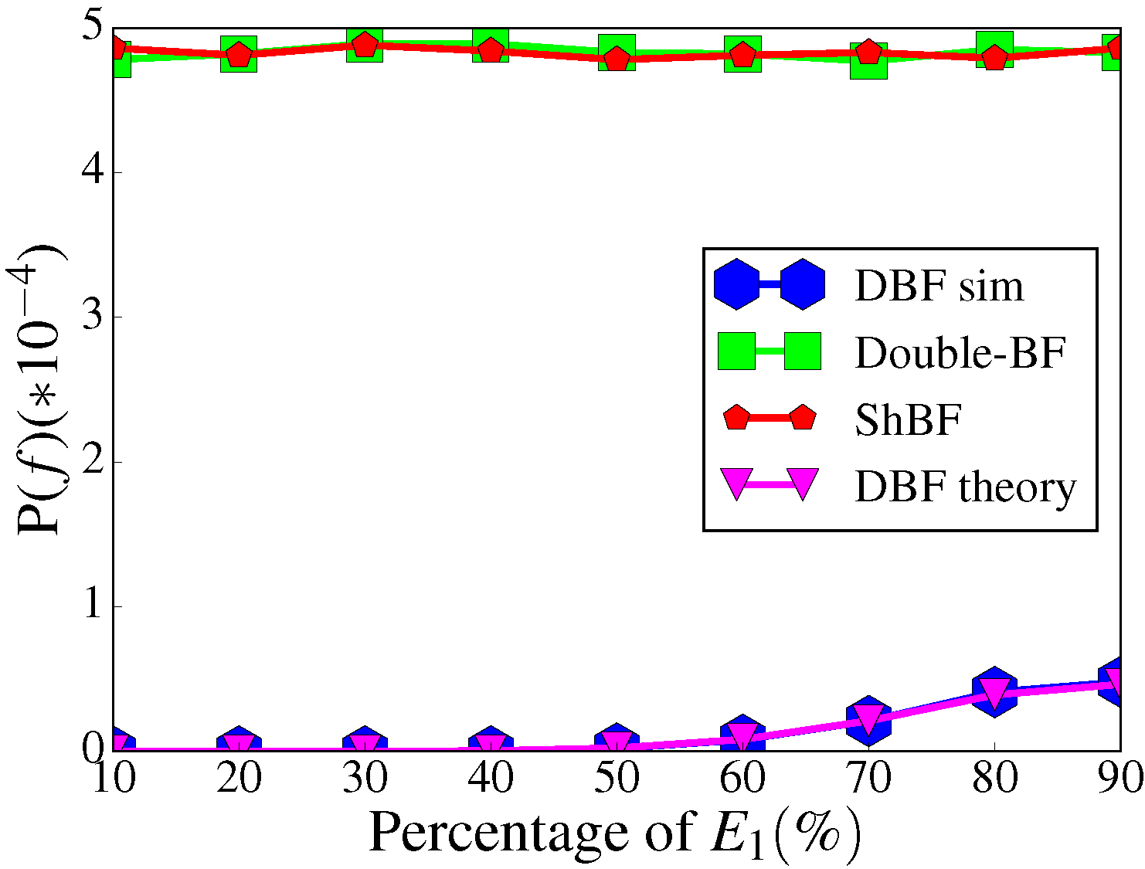
ICC 2017 CNN-IS01
Difference Bloom Filter
Background
Structure
Operation
Conflicts
Evaluation
Conclusion
For 2-sets membership query, when increasing the percentage of set 0:
The false rate of DBF is increasing, but is less than 10% of the Double Bloom filters solution.
The theory of DBF is perfectly matched with the experimental results.
False rate for querying an element
S₀
Notes:
We have written C codes to carry out experiments. The code has been released on Github.
Now we show some of the experimental results.
First we show the impact of the distribution of elements on accuracy.
When the percentage of element in set 0 is small, the false rate of DBF is nearly 0.
When the percentage of element in set 0 is increasing, the false rate is increasing slowly.
The DBF performs better than 2 BFs in all conditions.

Slide 16
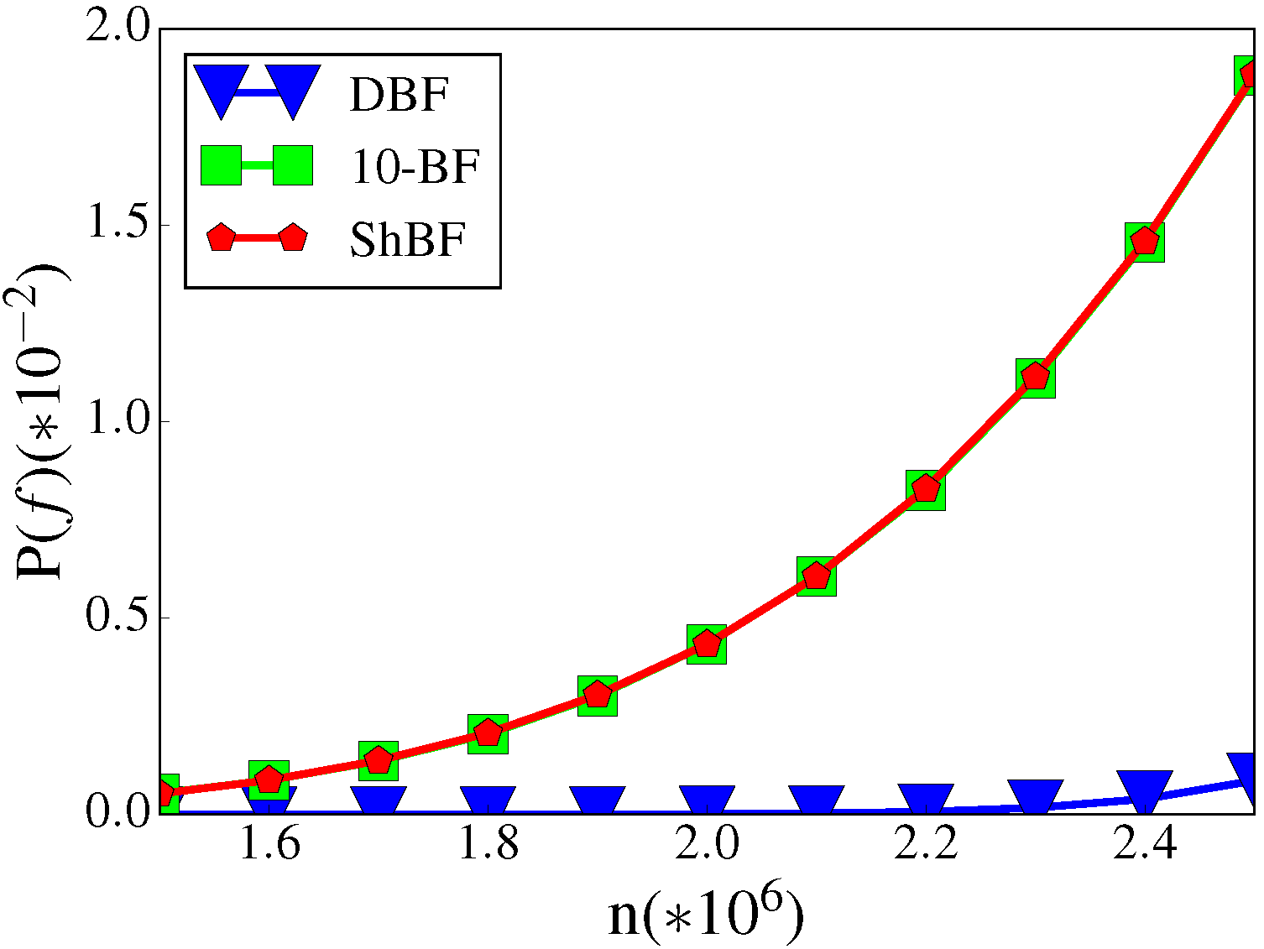
ICC 2017 CNN-IS01
Difference Bloom Filter
Background
Structure
Operation
Conflicts
Evaluation
Conclusion
For 10-sets membership query, when increasing the number of elements:
The false rates of all three algorithms are increasing.
DBF is tens of times more accurate than the other two algorithms.
False rate for querying an element
Number of elements
Notes:
Now we do experiments on 10 sets.
First we fix the memory size and increase the number of elements.
The BF is the higher line and the DBF is the lower line, which demonstrates that the error rate of the DBF is much more smaller than BF.

Slide 17
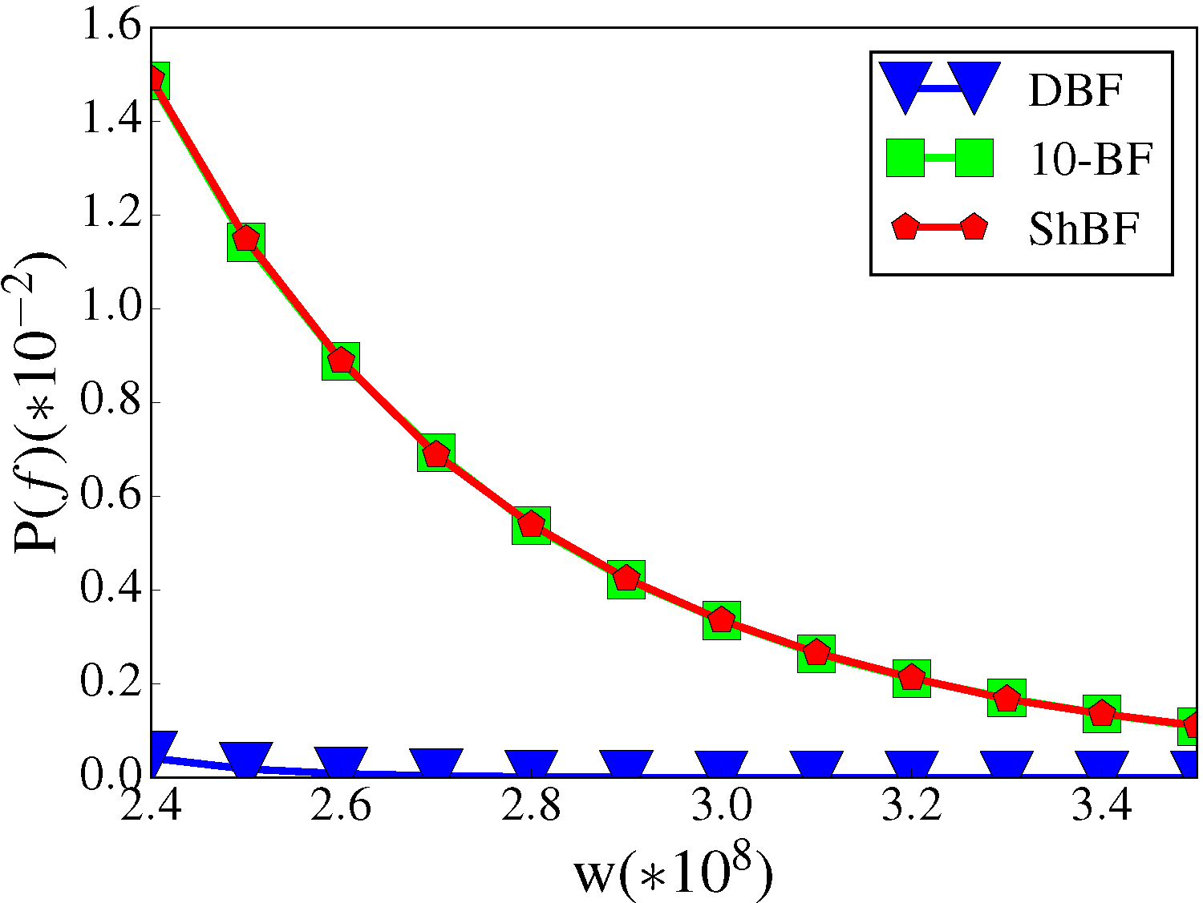
ICC 2017 CNN-IS01
Difference Bloom Filter
Background
Structure
Operation
Conflicts
Evaluation
Conclusion
For 10-sets membership query, when increasing the memory:
The false rates of all three algorithms are decreasing.
DBF is tens of times more accurate than the other two algorithms.
False rate for querying an element
Size of memory
Notes:
This figure shows when fixing number of element and increase memory size, the DBF is also always better than BF.

Slide 18
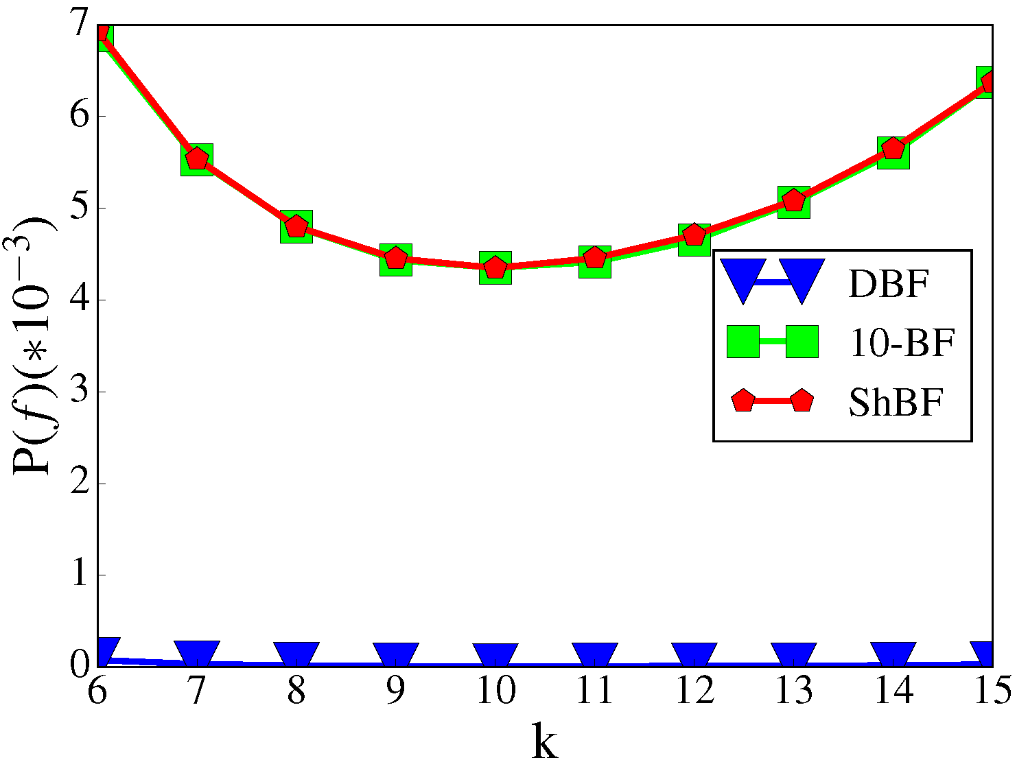
ICC 2017 CNN-IS01
Difference Bloom Filter
Background
Structure
Operation
Conflicts
Evaluation
Conclusion
For 10-sets membership query, when increasing the number of hash functions:
The false rates of all three algorithms first decrease then increase.
When k is around 10, the performance is the best.
False rate for querying an element
Number of hash functions
Notes:
This figure shows the impact of number of hash functions on error rate.
When the number of hash functions is around 10, the performance of the BF and the DBF is the best.
The performance of DBF is always significantly better than BF.

Slide 19
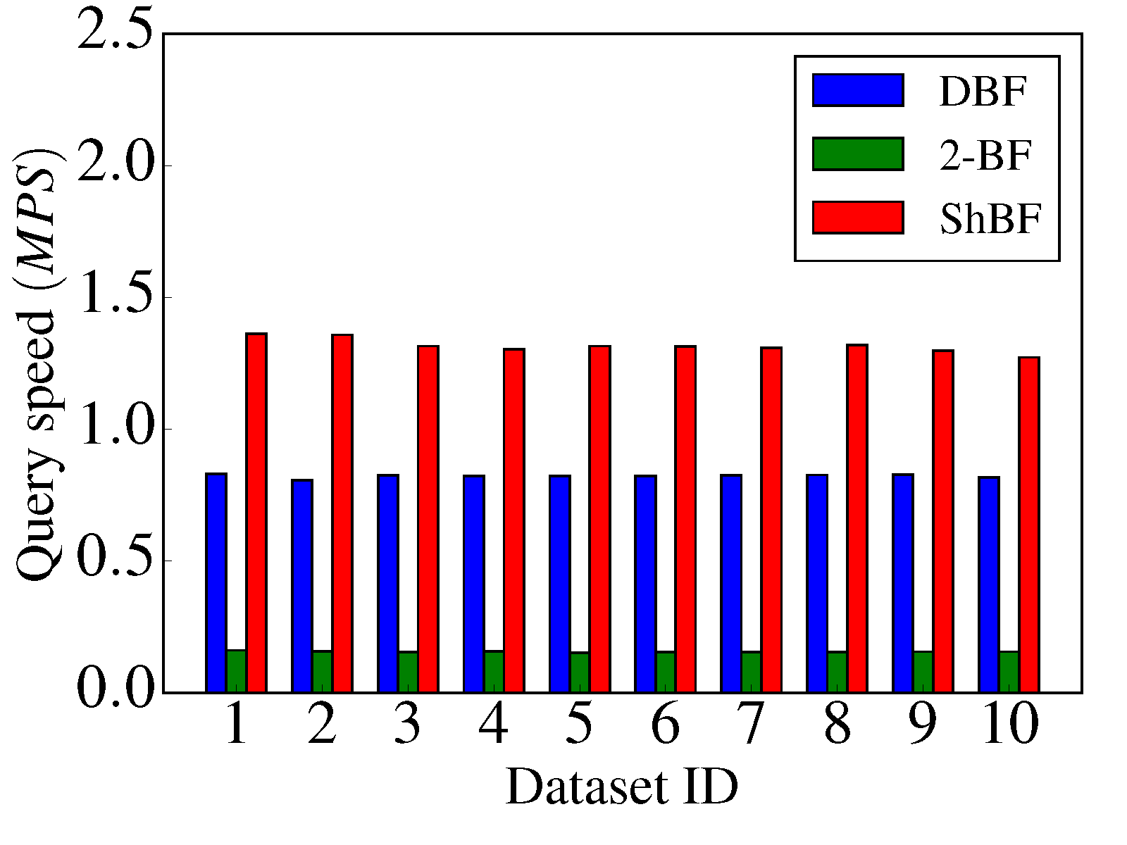
ICC 2017 CNN-IS01
Difference Bloom Filter
Background
Structure
Operation
Conflicts
Evaluation
Conclusion
For 2-sets membership query, when using different data sets:
The query speed of ShBF is the fastest, followed by DBF, and 2-BF is the slowest.
The query speed of DBF is nearly one million elements per second.
Notes:
This figure shows the impact of number of hash functions on error rate.
When the number of hash functions is around 10, the performance of the BF and the DBF is the best.
The performance of DBF is always significantly better than BF.

Slide 20
ICC 2017 CNN-IS01
Difference Bloom Filter
Background
Structure
Operation
Conflicts
Evaluation
Conclusion
Conclusion
In this paper, we proposed a new data structure: Difference Bloom filter, which is used to handle multi-set membership query.
The key idea of DBF is to use different number of 1s to record elements of different sets. In this way, all sets can be recorded into one filter.
When querying an element, DBF will not report more than one set, so the accuracy of multi-set membership query is increased significantly.
DBF can be applied to all multi-set membership query problems where a few errors are tolerable.
Future work can be done on designing a system of DBF. Also, the accuracy of DBF may be improved further.

Slide 21
Thanks!
Dongsheng Yang
yangds@pku.edu.cn
Code: github.com/yangdsh/DBF

