Slide 1
Thread Workers
Tristan Lorach (& Demo-Team ☺)

Slide 2
Overall View
ThreadWorkerPool
Main Thread
RenderLoop(…) {
…
…}
pollTask()
ThreadWorker #3
Round-robin
Least-queued
pushTask()
ThreadWorker #2
threadFunc() {
pollTask()
}
ThreadWorker #1
threadFunc() {
pollTask()
}
TaskQueue
for Main Thread
threadFunc() {
pollTask()
}
…
Task list
Task list
TaskQueue
Task2
Task1(args…) {…}
}
Task1
Task1(args…) {…}
// Specific Work
}
Invoke() {
Invoke() {
pushTask() / Call()
…
TaskBase
TaskBase
Invoke()
Invoke()

Slide 3
Shared Queue Mode
TaskN
Task1(args…) {…}
// Specific Work
}
Task2
Task1(args…) {…}
// Specific Work
}
Task1
Task1(args…) {…}
// Specific Work
}
Invoke() {
Invoke() {
Invoke() {
Task Base
Task Base
Task Base
Invoke()
Invoke()
Invoke()
Thread-worker Pool
Thread Worker #1
Queued Work Processor
Task
Invoke() {
While(1) {
readRingBuffer()
Invoke()
}
Main Thread
RenderLoop(…) {
…
…}
Thread Worker #2
pollTask()
pushTask()
…
Ring Buffer
Task list for Main Thread
Thread Worker #N
…
Task Base

Slide 4
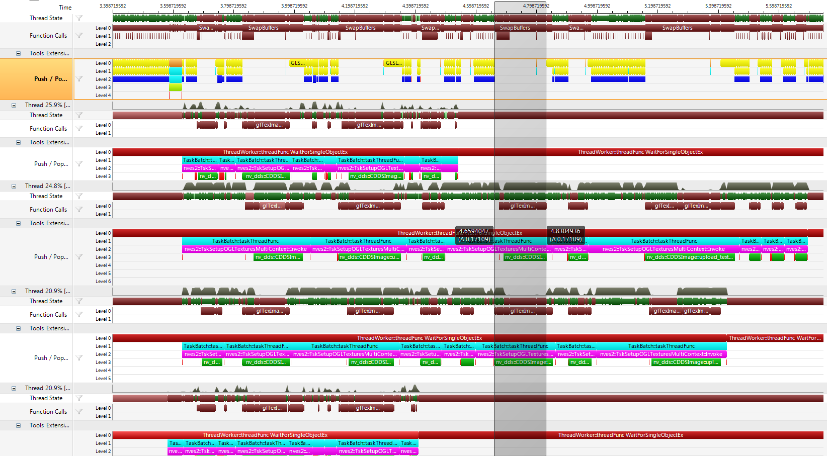

Slide 5
