Slide 1
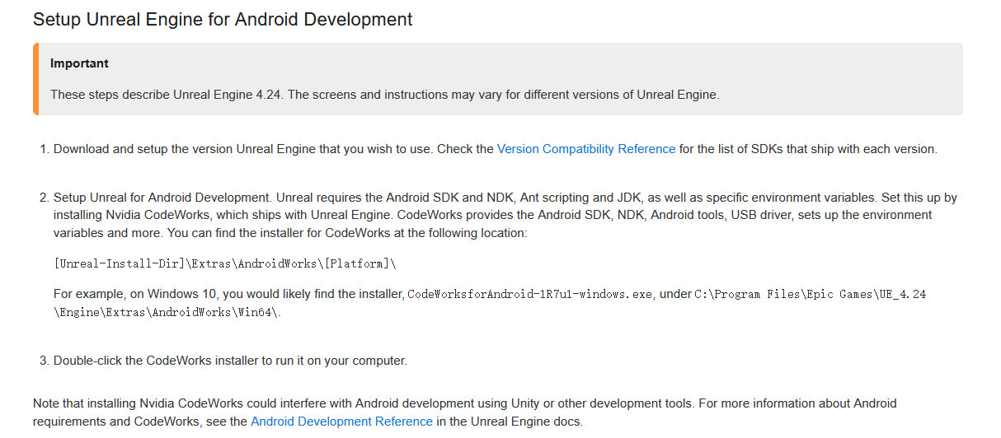

Slide 2
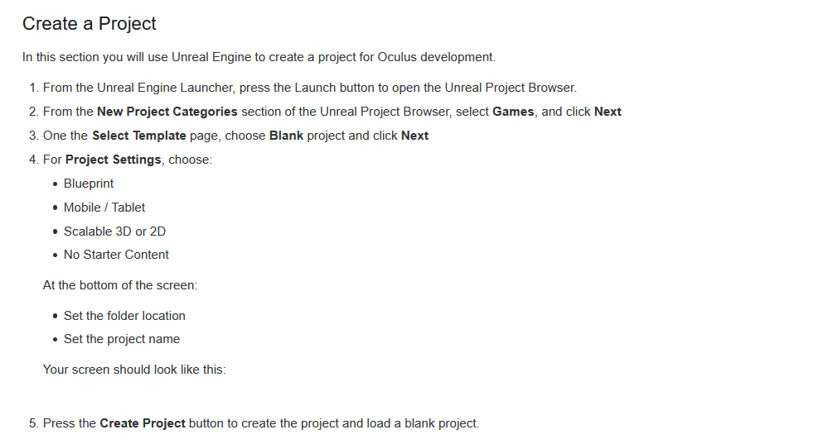

Slide 3
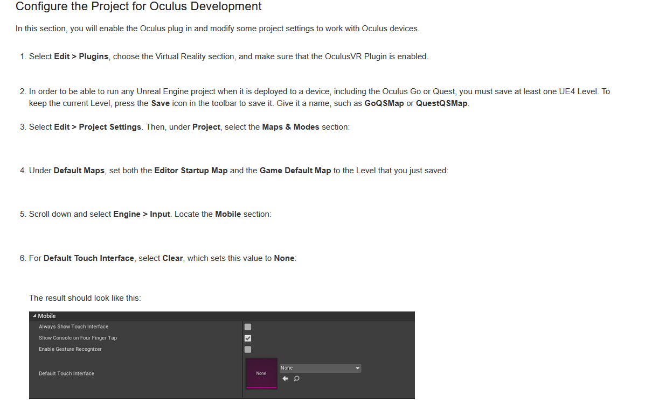

Slide 4
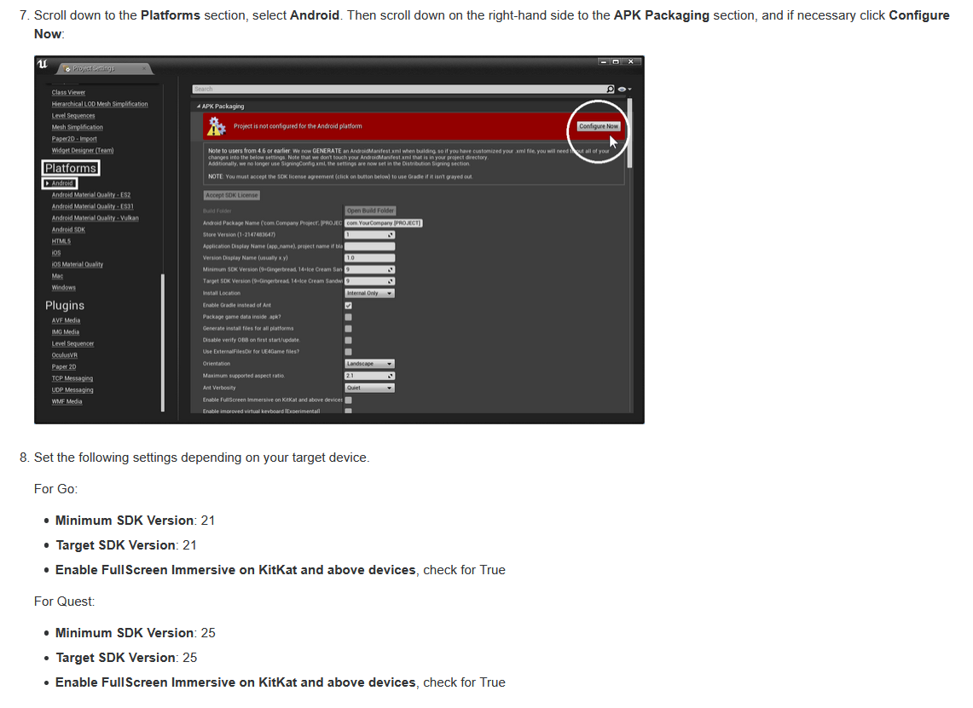

Slide 5
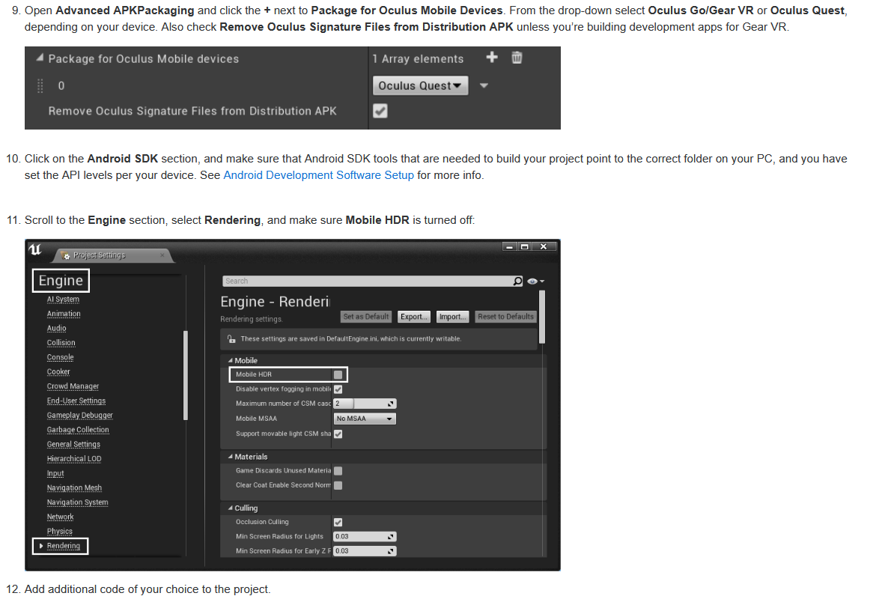

Slide 6
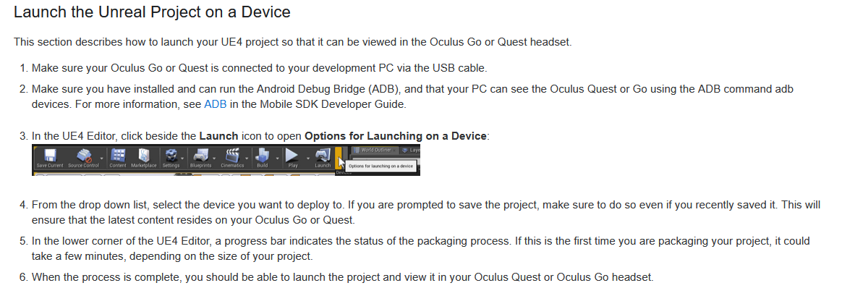

Slide 7
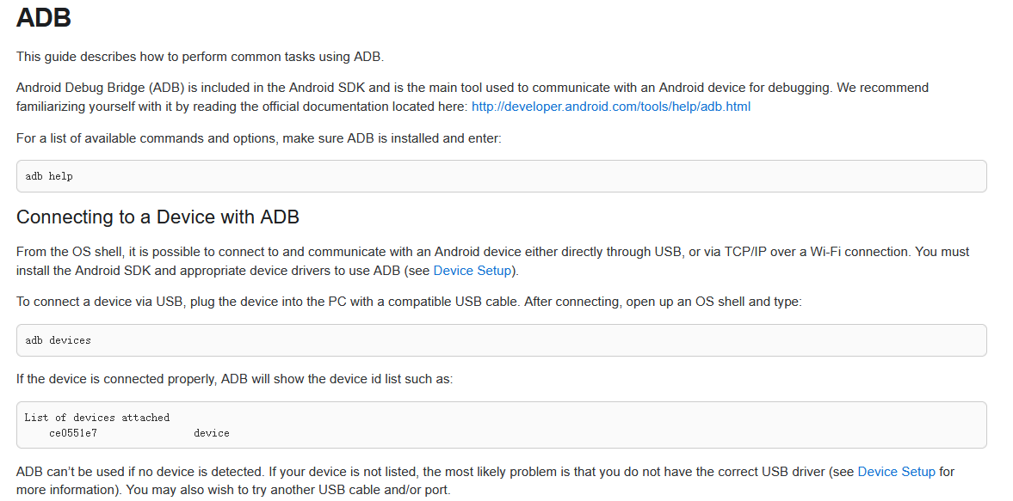
Notes:
http://developer.android.com/tools/help/adb.html
https://developer.android.com/studio/command-line/adb

Slide 9
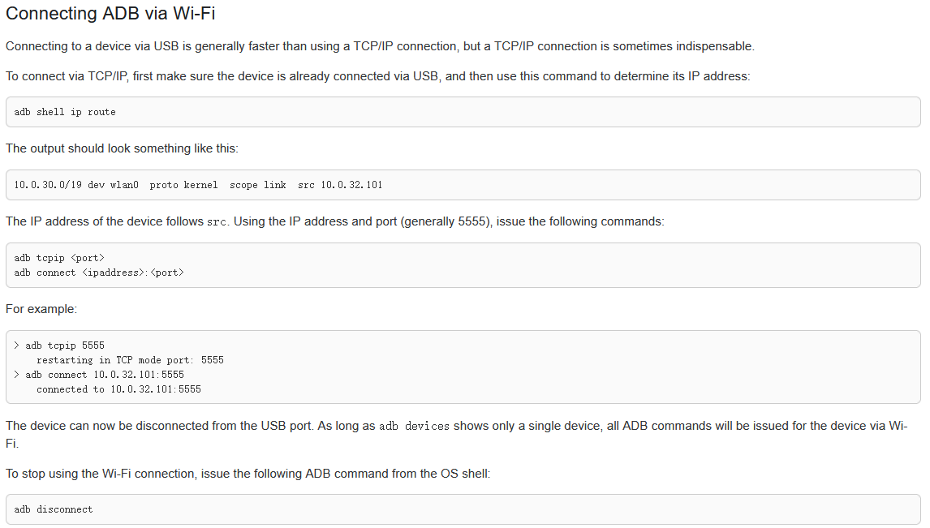

Slide 10
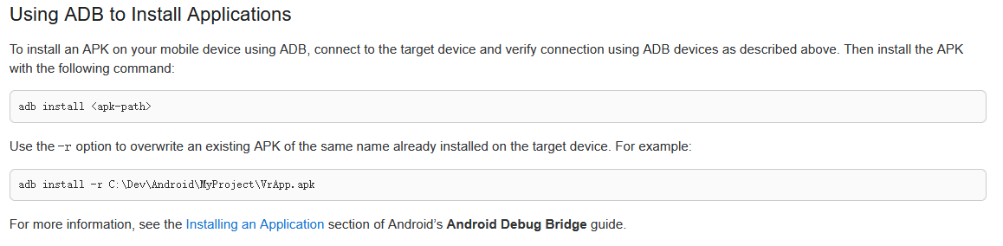

Slide 11
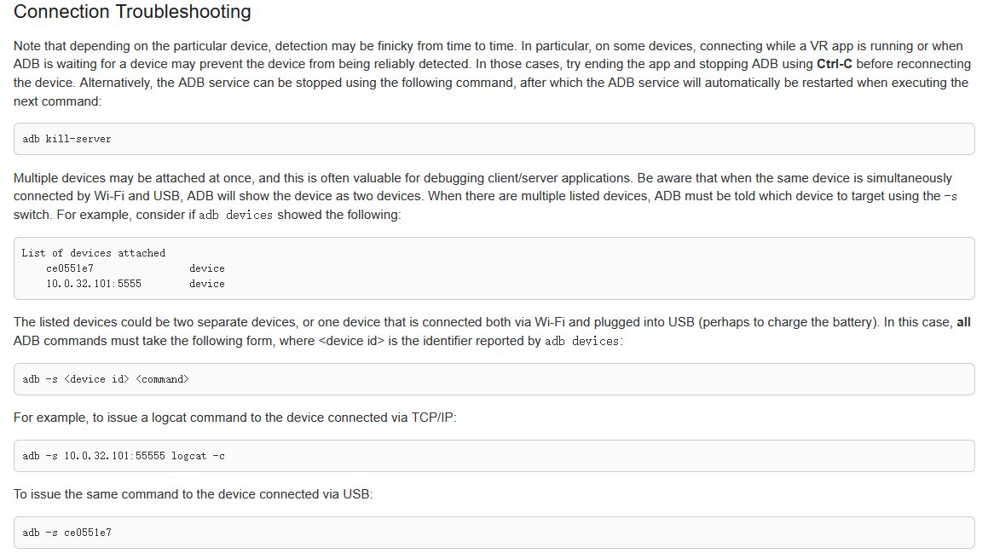

Slide 12
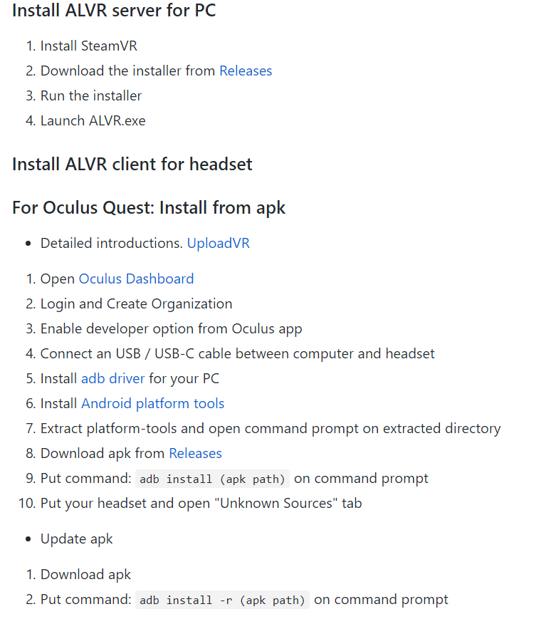
ALVR
串流

Slide 13
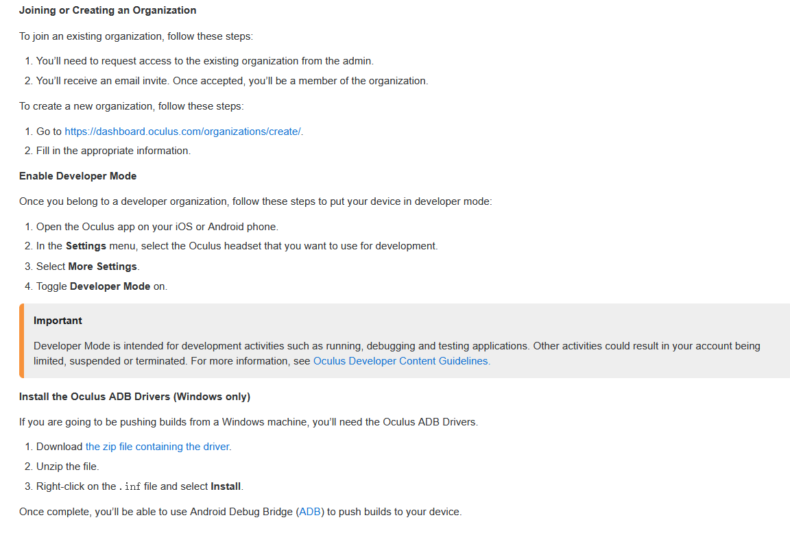

Slide 14
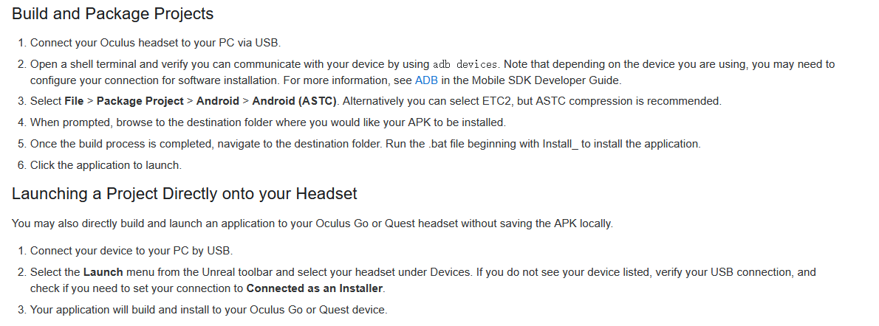

Slide 15
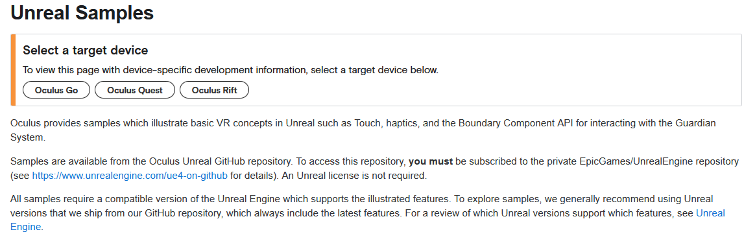

Slide 16
TODO
开发者账号
开启开发者模式
未知来源安装（早期的library）
安装ALVR

Slide 17
DOWN
开发者账号注册一次就ok了
借助梯子，登录oculus app,登录设备关联账号
实验性功能：不启用新版通用菜单
安装ALVR ,PC端启用sever
sidequest 投屏

Slide 18
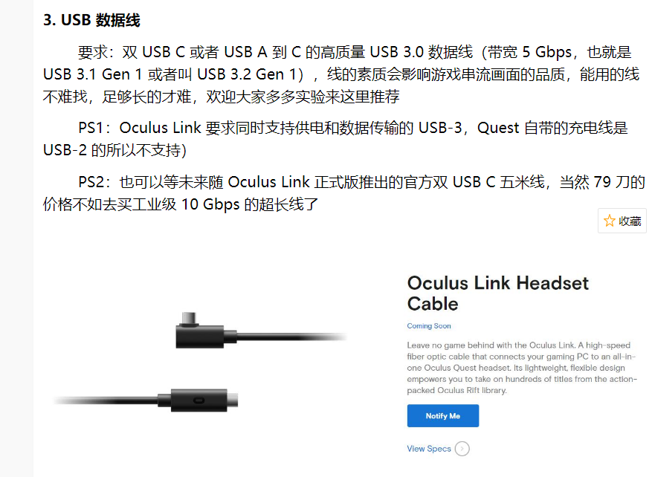

Slide 19
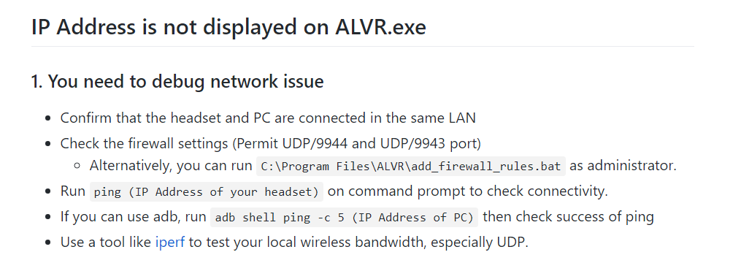

Slide 20
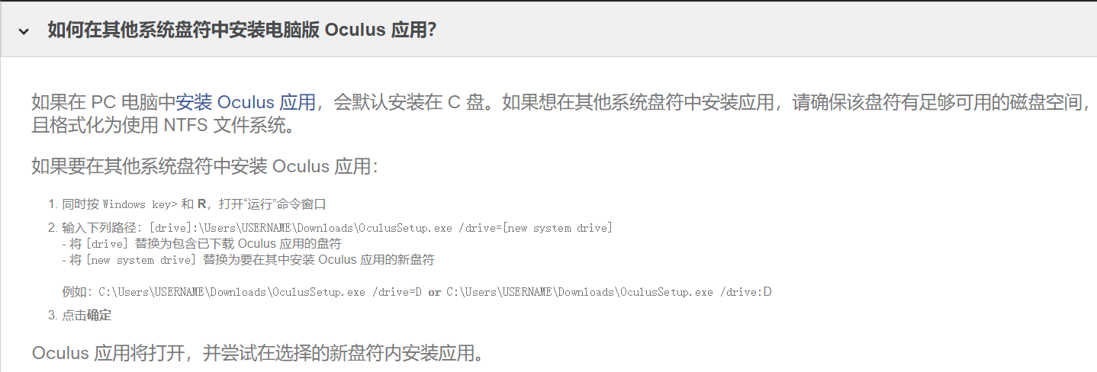

Slide 21
alvr常见故障与解决方法
https://github.com/polygraphene/ALVR/wiki/Troubleshooting#2-try-to-terminate-vrserverexe-vrcompositorexe-vrmonitorexe-from-task-manager-and-retry

Slide 22
VR 电脑性能测试
https://store.steampowered.com/app/323910/SteamVR_Performance_Test/
Oculus 开发者模式
https://dashboard.oculus.com/
SteamVR 高级设置插件
https://github.com/OpenVR-Advanced-Settings/OpenVR-AdvancedSettings/releases
下载 RiftCat
https://riftcat.com/vridge
下载 VRidge APK 和 ADB
https://support.riftcat.com/hc/en-us/articles/360005631080-How-to-install-VRidge-on-Oculus-Quest-preview
下载 WinRAR 压缩工具
https://download.cnet.com/s/winrar/
正版 RiftCat（九折）
https://go.riftcat.com/VROasis

Slide 23
oculus link
https://www.bilibili.com/video/BV1XJ411m7AS?from=search&seid=11287340644124408129

