Slide 1
cesiumjs讲解

Slide 2
地理信息系统（GIS，Geographic Information System）
地球表面位置（即地理空间位置） 经纬度
倾斜摄影模型（航拍模型）

Slide 3
cesium获取与启动
https://cesium.com/docs/
var tileset = scene.primitives.add(new Cesium.Cesium3DTileset({
url : 'http://localhost:8002/tilesets/Seattle/tileset.json'
}));

Slide 4
场景
entity
var viewer = new Cesium.Viewer('cesiumContainer');
var wyoming = viewer.entities.add({
})
viewer.zoomTo(wyoming);

Slide 5
相机
viewer.flyTo(wyoming)
var heading = Cesium.Math.toRadians(90);
var pitch = Cesium.Math.toRadians(-30);
viewer.zoomTo(wyoming, new Cesium.HeadingPitchRange(heading, pitch));

Slide 6
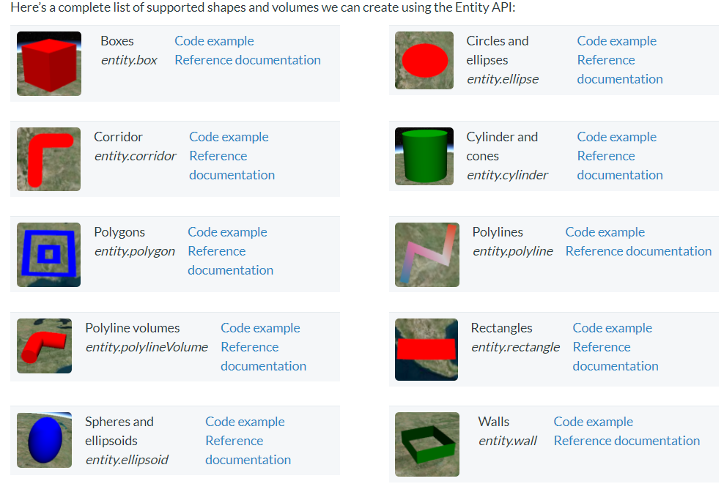
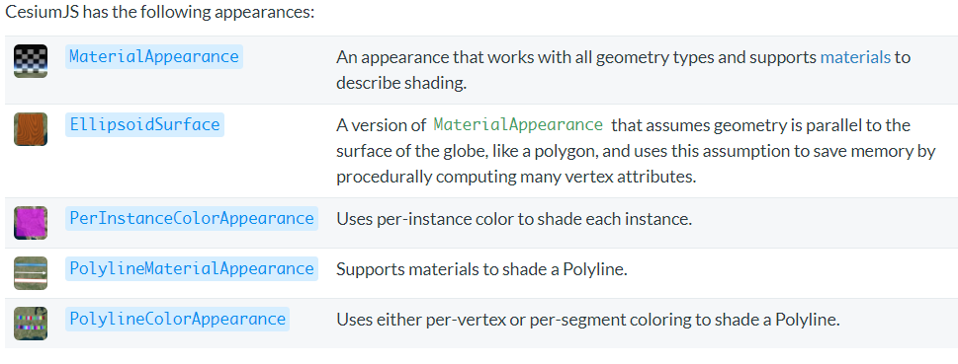
五花八门的实体
var entity = viewer.entities.getById('uniqueId');

Slide 7
点 广告牌 文字
point : {
pixelSize : 5,
color : Cesium.Color.RED,
outlineColor : Cesium.Color.WHITE,
outlineWidth : 2
},
label : {
text : 'Citizens Bank Park',
font : '14pt monospace',
style: Cesium.LabelStyle.FILL_AND_OUTLINE,
outlineWidth : 2,
verticalOrigin : Cesium.VerticalOrigin.BOTTOM,
pixelOffset : new Cesium.Cartesian2(0, -9)
}
billboard : {
image : '//cesium.com/images/docs/tutorials/creating-entities/Philadelphia_Phillies.png',
width : 64,
height : 64
},

Slide 8
外部模型加载
var entity = viewer.entities.add({
position : Cesium.Cartesian3.fromDegrees(-123.0744619, 44.0503706),
model : {
uri : '../../../../Apps/SampleData/models/GroundVehicle/GroundVehicle.glb'
}
});

Slide 9
坐标
经纬度坐标
new Cesium.Cartographic(longitude, latitude, height)
笛卡尔坐标
new Cesium.Cartesian3(x, y, z)
Cesium.Cartesian3.fromDegrees(longitude, latitude, height, ellipsoid, result) → Cartesian3
var position=Cesium.Cartesian3.fromDegrees(-103.0, 40.0)

