Slide 1

用Cocos2d做游戏
By Wuhao

Slide 2
What can Cocos2d do
Display
show what is going on in the game world
Interaction
let player take part in the game world

Slide 3
Game Concepts
Scene
Layer
Object

Slide 4

Cocos2d::Sprite
Transform?
AnchorPoint?
local? world?
IgnoreAnchorPoint?

Slide 5
Collision
Distance Check
Circle to Circle
Rectangle to Rectangle (not rotated)
  AABB (Axis Aligned Bounding Box)
Rectangle to Rectangle (rotated)

Slide 6
Distance Check
If (a.pos - b.pos < x)
{
// collision!
}

Slide 7
Circle to Circle
if (distanceBetween(a,b) - (a.radius + b.radius) <= 0)
{
// Collision!
}

Slide 8
AABB Check
b.height
a.height
b.y
a.y
a.x
b.x
a.width
b.width

Slide 9
AABB Check
if((abs(a.x-b.x)*2 <= (a.width+b.width)) &&
(abs(a.y-b.y)*2 <= (a.height+b.height)))
{
// Collision!
}

Slide 10

Rectangle to Rectangle
Rotated!
intersect
AABB collides
intersect

Slide 11
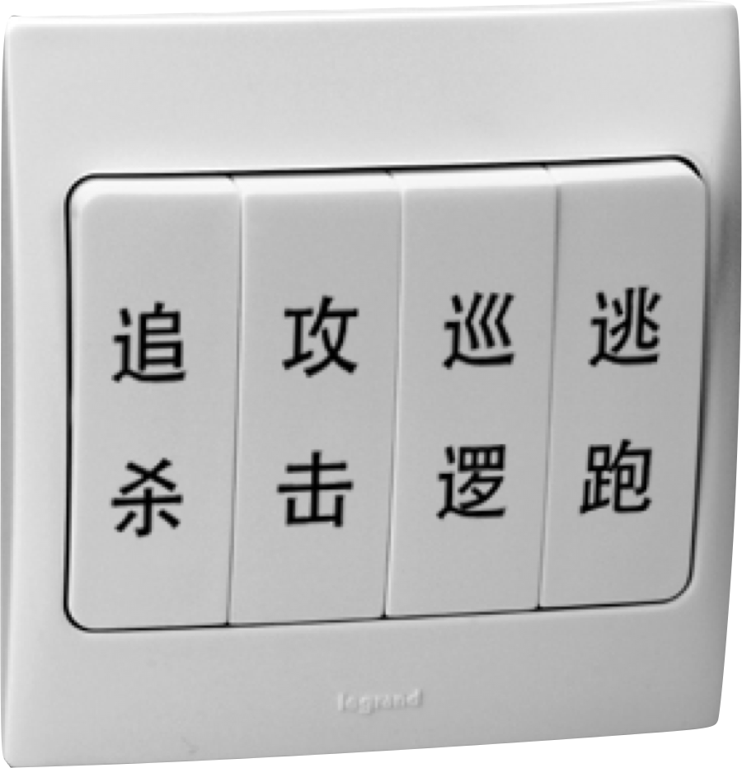
State Machine AI

Slide 12
Neural Network AI

