Slide 1
Computer Performance Microscopy with SHIM
Xi Yang
Australian National University
Steve Blackburn
Australian National University
Kathryn McKinley
Microsoft Research
Notes:
today I am going to show you how to turn every computer into a high freq oscilloscope to observe and correlate and hardware and software signals.

Slide 2
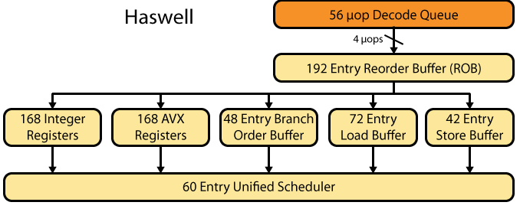
4 μops
Intel i7-4770, 3.4 GHz
Notes:
many of you have this micro-architecture CPU in your laptop

Slide 3
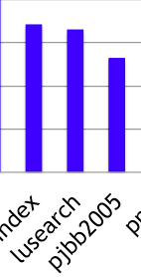

Benchmark IPC
Plenty of room here!
Lusearch is a DaCapo benchmark based on the widely used open source search engine framework Lucene.
Notes:
need strong reasons for lusearch
similar to Bing and Google.

Slide 4

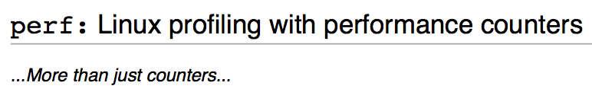
Interrupt Driven Profilers
Sampling at default 1 KHz, maximum 100 KHz.
Notes:
intrinsic limitations of interrupt driven profilers.

Slide 5

Method IPC Lusearch
IPC
top 10 methods (74% total execution time)
Notes:
if we increase the frequency 100x more, then we see very interesting pictures.
20 for legends, keys, 28 font size for words, title 36

Slide 6
Sampling IPC
Two counters: C – cycles, R - retired instructions
IPC = (R_{t} – R_{t-1}) / (C_{t} – C_{t-1})
IPC₁
IPC₂
IPC₃
time
R₀ C₀
R₁ C₁
R₂ C₂
R₃ C₃
IPC is a high frequency signal.

Slide 7
Sampling Lusearch IPC
default 1 KHz
IPC
maximum 100 KHz
IPC
SHIM 10 MHz
IPC

Slide 8
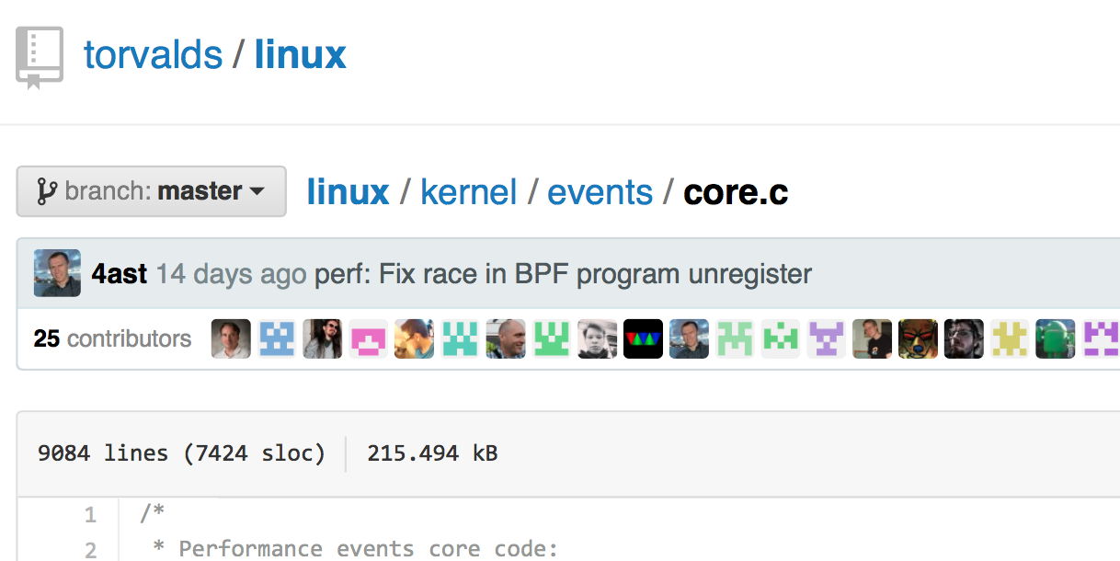
/*
* perf samples are done in some very critical code paths (NMIs).
* If they take too much CPU time, the system can lock up and not
* get any real work done. This will drop the sample rate when
#define DEFAULT_MAX_SAMPLE_RATE 100000
 | profilers | SHIM | simulators
HiFi
handy
online
✗
✓
✓
✓
✓
✗
✓
✓
✗
Notes:
TTTTTTTTTTTTTTTTTTTTTTTTTTTTTTTTTTTTTTTT
Transaction, let’s see how we build this tool,

Slide 9
insight
Notes:
let’s start with the insights of SHIM

Slide 10
Hardware and Software Generate Signals
hardware signals
software signals
memory locations
A (x){
x.y = B();
x.z = C();
}
hardware
performance counters
C()
B()
A()
time
Notes:
software signal: explicit signal and implicit signal

Slide 11
Signals
hardware signals
software signals
 | hardware | software
counters
tags
✓
✓
✓
✓
Notes:
speak examples for the matrix

Slide 12

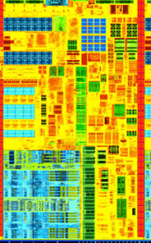
Observe Signals From Another Hardware Context
Notes:
transition: HC could be a core or a Hyper Thread

Slide 13
SHIM design

Slide 14
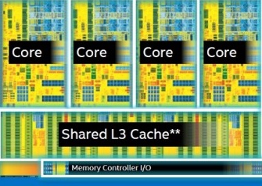
Observe Global Counters
LLC misses per cycle
while (true):
for counter in LLC misses, cycles:
buf[i++] = readCounter(counter)

Slide 15

Observe Local Counters
HT1 IPC
HT1
Core IPC
HT2
HT2 SHIM IPC
HT1 IPC = Core IPC – HT2 SHIM IPC
while (true):
for counter in HT2 SHIM, Core, Cycles:
buf[i++] = readCounter(counter);
Notes:
have to explain it why HT2 IPC is stable
talk about the size of profiling loop

Slide 16
Correlate Hardware and Software Signals
HT1 IPC
HT1
Core IPC
HT2
HT2 SHIM IPC
HT1 stack
C()
B()
A()
while (true):
for counter in HT2 SHIM, Core, cycles:
buf[i++] = readCounter(counter);
tid = thread on HT1
buf[i++] = tid.method;
Notes:
software signa

Slide 17
Fidelity
Notes:
Now we have shown the design of SHIM, we need one more thing, how can we trust those numbers.

Slide 18

Raw Samples
% of samples
(log scale)
IPC (log scale)
Notes:
Existing profilers share a same problem, low sampling rate.
Low sampling rate -> 1) can’t observe fine granularity events, 2) can’t

Slide 19
Problem: Samples Are Not Atomic
Counters: C – cycles, R - retired instructions
IPC = (R_{t} – R_{t-1}) / (C_{t} – C_{t-1})
✓
✓
✗
IPC₁
IPC₂
IPC₃
time
R₀ C₀
R₁ C₁
R₂ C₂
R₃ C₃

Slide 20
Solution: Use Clock As Ground Truth
CPC = (Ce_{t} – Ce_{t-1}) / (C^{s}_{t} – C^{s}_{t-1}) this should be 1!
CPC₁ = 1.0 +/- 1%
CPC₂ = 1.0 +/- 1%
CPC₃ != 1.0 +/- 1%
✓
✓
✗
IPC₁
IPC₂
IPC₃
time
while (true):
buf[i++] = readCycle();// read C^{s}
for counter in HT2 SHIM, Core, cycles:
buf[i++] = readCounter(counter);
buf[i++] = readCycle();// read Ce
tid = thread on HT1
buf[i++] = tid.method;
C^{s}₀R₀C₀Ce₀
C^{s}₁R₁C₁Ce₁
C^{s}₂R₂C₂Ce₂
C^{s}₃R₃C₃Ce₃

Slide 21

Filter Lusearch Samples
% of samples (log scale)
---- raw IPC
---- filtered IPC
---- raw CPC
---- filtered CPC in [0.99,1.01]
Notes:
after filitering with CPC metric, we can trust those samples, and they are in the valid range
Thant is the completed design of our tool, we can check it out from github

Slide 22
overheads
Notes:
We are going to show a few simple examples and overheads

Slide 23
Software Signal Other Core
113MHz: more than three orders of magnitude better than ‘maximum’
3MHz: more than an order of magnitude better than ‘maximum’
Normalized to without SHIM
observe method and loop IDs.
Overheads are from write invalidate transactions.
Notes:
change fonts
method and loop IDs are very high frequency signals

Slide 24
Software Signal Same Core
Normalized to without SHIM
observe method and loop IDs.
Overheads are from sharing the core resources.

Slide 25
Hardware and Software Signals Same Core
Normalized to without SHIM
Correlate IPC with method and loop IDs.

Slide 26
Reducing Overheads
Bursty sampling
SMT priorities
Heterogeneous multicore
Globally visible per-thread performance counters
Notes:
SMT priority isn’t har

Slide 27
Conclusion
High frequency sampling is important
SHIM observes signals directly, low overhead
Cycles per cycle filters samples
Opportunities for hardware analysis
Opportunities for hardware design
https://github.com/ShimProfiler/SHIM
Questions?
Notes:
put url here

Slide 28
Backup Slides

Slide 30
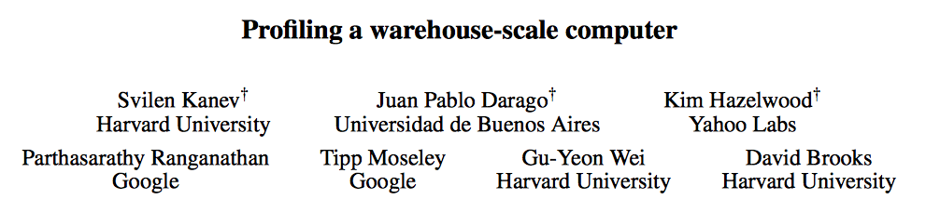
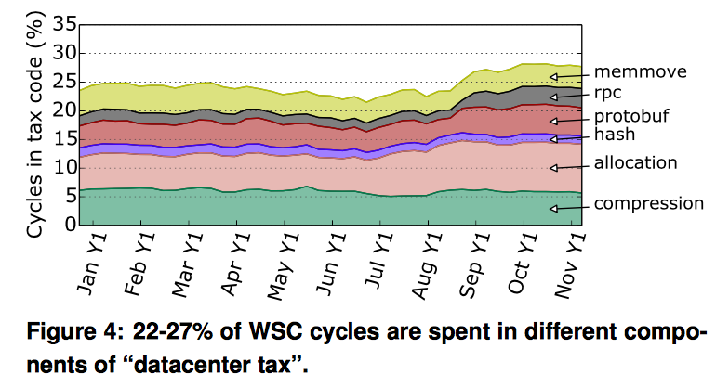
Notes:
Existing profilers share a same problem, low sampling rate.
Low sampling rate -> 1) can’t observe fine granularity events, 2) can’t

Slide 31
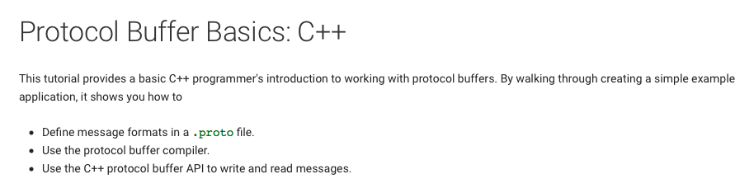
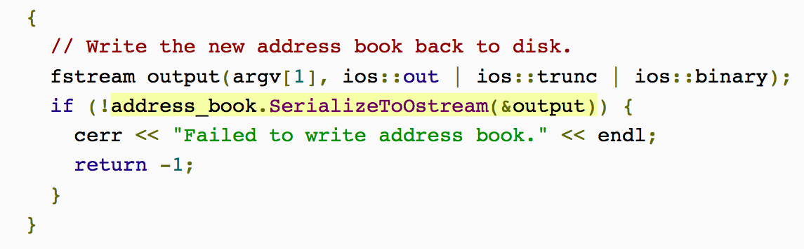
25 μs!
Notes:
Existing profilers share a same problem, low sampling rate.
Low sampling rate -> 1) can’t observe fine granularity events, 2) can’t

Slide 32
100 KHz (10 μs) won’t see this
The 25 μs life of the address_book.SerializeToOstream(&output).
Sampling at 5 MHz, 608 cycles
Notes:
Existing profilers share a same problem, low sampling rate.
Low sampling rate -> 1) can’t observe fine granularity events, 2) can’t

