Slide 1

Case Competition: Electronic Arts
Yang Xiao | Yabing Hu
Mian Wang | Tien Pham
Notes:
Anthony Farias – Engagement Lead, MBA
Matthew Li – Data Engineer, BA
Robin Tan – Data Engineer, BA

Slide 2
Our Mission:
Enable EA to understand user behaviors and opinions to make more informed product and marketing decisions
Data Obtained:
Internal Sources: Entitlements Game Launch Games Sessions Subscription | 2. External Sources: Amazon Product Reviews for Top 9 Games
Notes:
Anthony / Peter

Slide 3


Project Workstreams
Goal: Enable EA to convert free-trial to paid subscribers and explore public datasets to support the data analytics process to optimize business decision making
WORKSTREAM 1: EXPLORATION ANALYTICS
WORKSTREAM 2: CUSTOMER ANALYTICS
Data exploration and recommendation system:
Define the demographics of our subscribers and franchises
Strategize recommendation system
External resources for opinion mining
Web scrape data from Amazon
Gain insights from customers’ opinions and reviews

Slide 4
Demographics of our subscribers
US & CANADA
GREAT BRITAIN
RUSSIA
GERMANY
FRANCE
CHINA
JAPAN
AUS
Notes:
⅓ are from north america, ⅓ are from Europe, ⅓ are from Asia

Slide 5
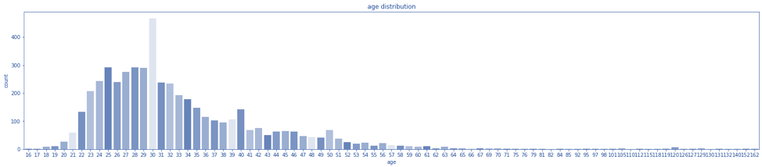
Demographics of our subscribers
Age distribution follows normal distribution with mean around age 28
Notes:
Tien / Peter

Slide 6
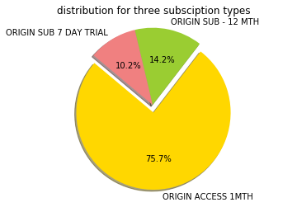
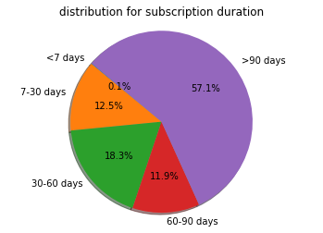
Conversion rates from free trial to paid subscription
85.3% subscribed to Origin Access without a free trial. Out of the rest 1405 users who did free trials, 894 of them continued into paid subscription
Notes:
Tien / Peter

Slide 7
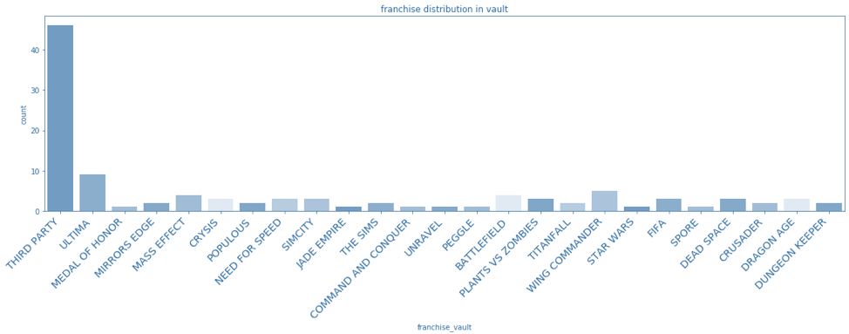
Our franchise vault
The majority of our franchise distribution relies on the third party games
Notes:
Tien / Peter

Slide 8

Assessing user loyalty
Signature franchises manage to have great conversion rate
Game Names | % Successful Conversion | % Churn
Battlefield 1 | 9.37 | 7.4
FIFA 18 | 9.37 | 3.6
Battlefield 4 | 6.25 | 0.89
Sim 4 | 3.91 | 0.78
Waterfront | 2.56 | 1.78
TitanFall 3 | 2.45 | N/A
Sim 2 | 2.45 | 0.33
Notes:
6.25% continued subscribers have played Battlefield 4
0.89% users stop subscription after free trial have played Battlefield 4

Slide 9
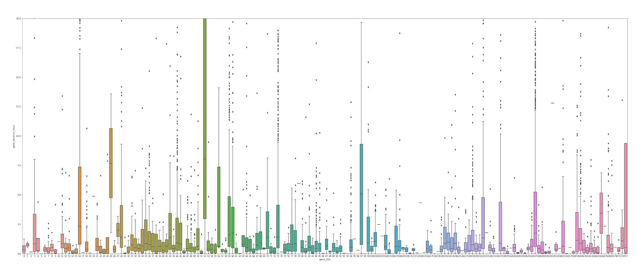
Assessing users’ behaviors
Candlestick plot demonstrates the play duration in hours between games - implies the popularity of games
Duration (hours)
Games
Notes:
Mian
Here I plot the game duration distribution versus game, x-axis represent the index of all games, and y-axis represent the hours users have spent on playing those games, from which we can have a glimpse of the popularity of the games.
E.g., the top popular games based on game duration hours are FIFA 18, PILLARS OF ETERNITY II DEADFIRE, FIFA 14, FIFA MANAGER 14, SIMS 4, etc.

Slide 10


Building Recommendation System: Content-based approach
Focus on items’ own features, instead of players’ interactions and feedbacks with video games
Game title: encodes character sequences as numerical features
Description/Short Introduction/Plot: encodes character sequences as numerical features
Genres: Strategy, Role Playing , Shooter, etc.
Franchise: FIFA, FIFA MANAGER ,MySims , Need for Speed
Publishers: EA/third party
Developer: development studios
currently
playing
similar
likely to
buy

Slide 11
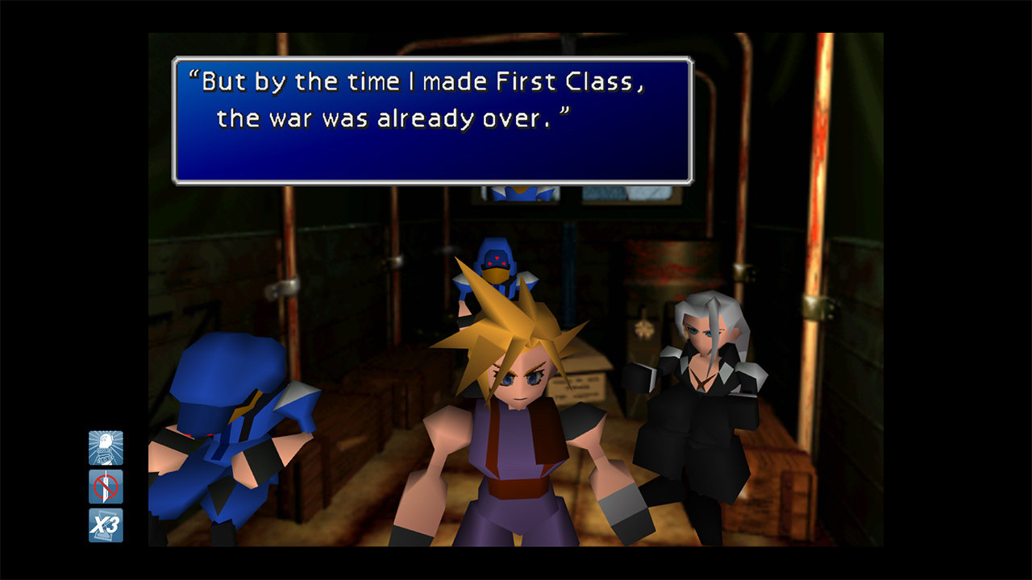

Building Recommendation System: Content-based approach
To encourage subscriptions, we might want to give higher priorities for candidate video games that are already in the game vault.
Release Date: Even video games from same franchise releasing at different times could have significant variations on art styles, game play, etc.
Review Scores:
Game Review Sites,e.g, IGN,metacritic - gamewise
Retailer website: Target, amazon - product wise
Final Fantasy VII Original
(1997)
Final Fantasy Remake
(2020)
Notes:
We want to use these features to calculate the similarity between different games and get list of candidate video games for recommendation.

Slide 12
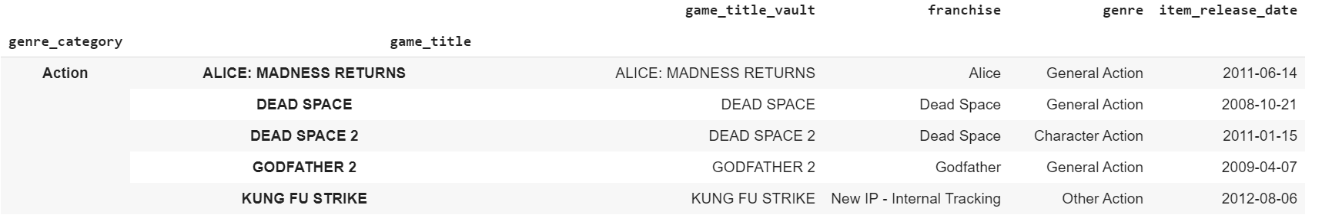
Example of two similar games: Content-based approach
To encourage subscriptions, we might want to give higher priorities for candidate video games that are already in the game vault.

Slide 13
Building Recommendation System: User-based approach
To encourage subscriptions, we might want to give higher priorities for candidate video games that are already in the game vault.
Method:
Nearest Neighborhood:
Uses franchises to compute Jaccard similarity
Find union of similar users’ games which has not been played by players
Problem:
Does not handle sparsity well when no one in the neighborhood rated an item, that is when users just focus on one type of game
Solution: content-based approach
buy
similar
buy
likely to buy
Notes:
Mian
Basically, the idea is to find the most similar users to our target user (aka, nearest neighbors) and weight their ratings of an item as the prediction for our target user. In our case we have used franchise instead of rating, to compute Jaccard similarity, based on which we can find similar users.
Then, what we do is to find union of similar users’ games, and recommend what hasn’t been played by target user.

Slide 14
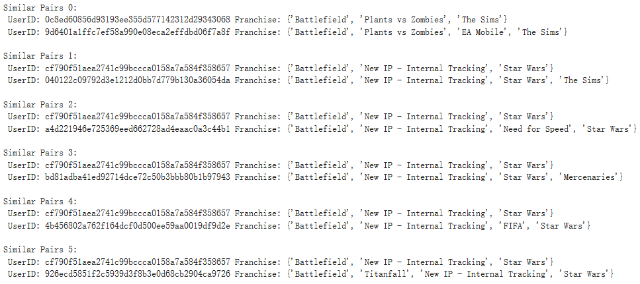
Building Recommendation System: User-based approach
Top 6 similar users based on franchise
Notes:
Mian
Here are the top 6 similar users based on franchise, e.g., similar pair 0. User A prefers franchise of ‘battlefield, plants vs zombies, the sims’, and User B prefers franchise ‘battlefield, plants vs zombies, EA mobile, the sims’. Their preferences overlap a lot, which makes them similar users, so we can try to recommend User B’s preference of ‘EA mobile’ to User A.

Slide 15
Workstream 2: External Resources
Goal: Obtaining insights into customers’ opinions and experience with EA
Web scraping
Scraped with BeautifulSoup:
2000 Amazon reviews and ratings on 9 most popular games
Cleaned and processed reviews with Python’s nltk/spacy
Implemented pyLDAvis to visualize topic modeling through an interactive map
Notes:
We also incorporated external sources to further help us gain insights into customers’ experience with EA games.
We scraped Amazon for the most popular 9 games on EA platform, and got 2000 reviews and ratings.
we plotted the ratings with regard to time. to visualize how customers’ opinions changed over time
We then processed the reviews, using keywords extraction, clustering and topic modelling
We also visualized the topics for better interpretability

Slide 16
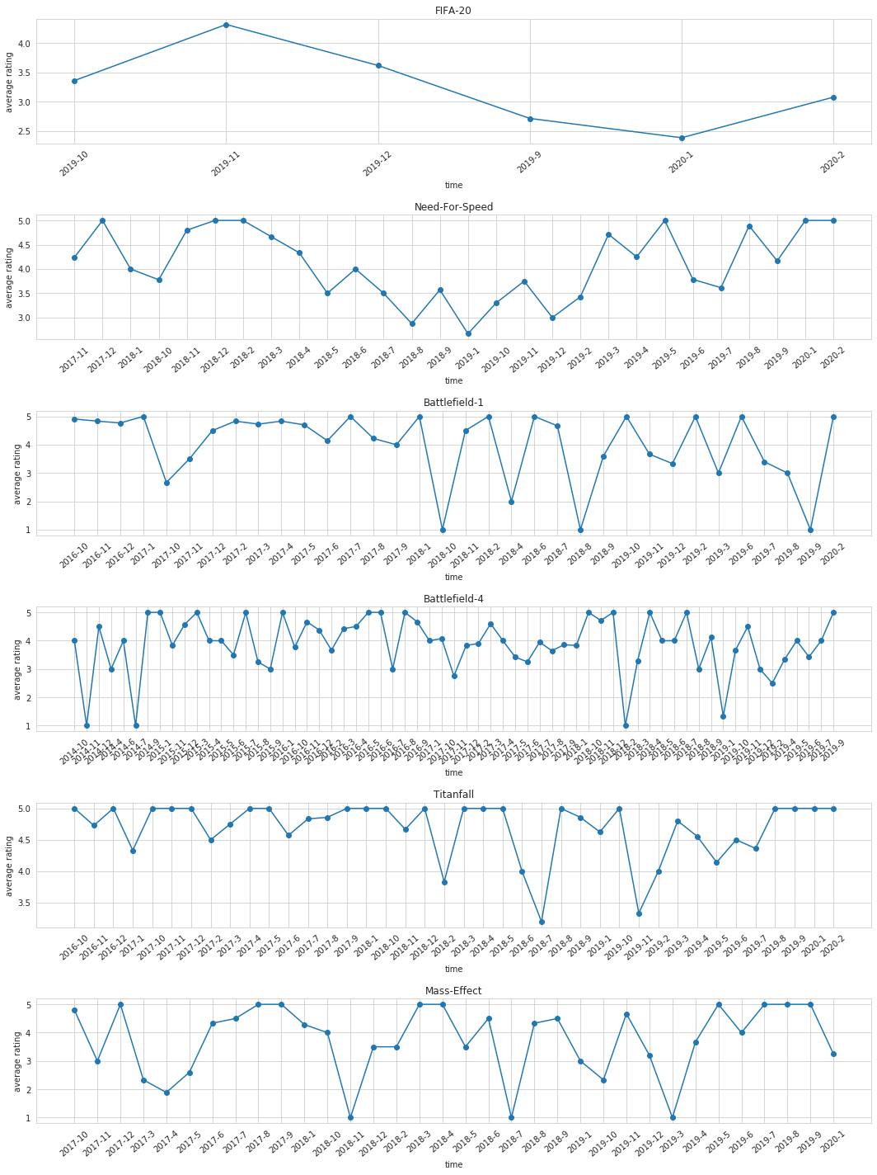
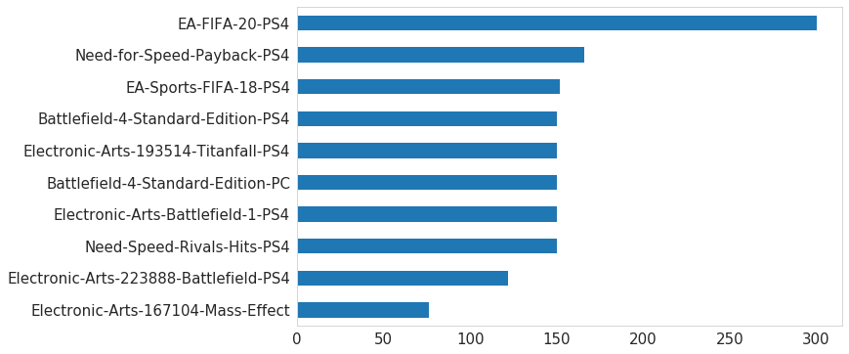
Perception on games over time
Number of Amazon reviews for each game
Notes:
We plotted ratings of 6 games with the most ratings on Amazon
they are reflective of users’ perception on games. but we want to point out that
Due to the limited data we have, e.g we only have 50 ratings for Mass Effect over 3 years
these are not truly representative of user views to those games. This is an approach we propose to EA to take into their consideration

Slide 17
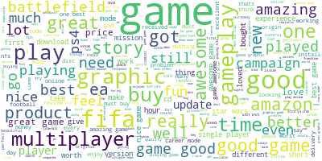
Users’ opinions of EA Games
Many praise the content and graphic quality. Franchise games play a great role in success of EA
Preprocessing with tokenization, lemmatization, and stopwords removal
Notes:
In text preprocessing, we removed all the stop words and performed lemmatization. Lemmatization reduces multiple forms of a word to a single word
On the top level, we summarized users’ opinions on EA games from the reviews we have from Amazon.
some of the most frequent words are: game, multiplayer, good, amazing, graphic, fifa, and battlefield
Many praise the content and graphic quality. Franchise games play a great role in success of EA

Slide 18
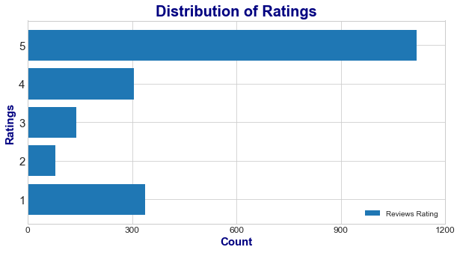
Positive and Negative Reviews
We split the reviews into positive and negative based on ratings - if below 4, it’s negative. Else, it’s positive
Key words in positive reviews:
'experience', 'awesome', 'game', 'fifa20', 'finance', 'fill', 'file', 'fight', 'thank', 'better'
Key words in negative reviews:
'first', 'order', 'experience', 'bad', 'youtube', 'feel', 'fast2','fault', 'faulty', 'favor'
Notes:
Over 80% of the rewiews are positive.
We segmented reviews into positive and negative groups to get a big picture of why users leave those comments.
we extracted keywords using countvectorizer, which is basically word frequency, and Tf-idf vectorizer
they gave similar results, probably due to the fact we only have a moderate size of texts
Positive reviews comment that they had awesome experience and they love fifa20
Negative reviews comment that they has bad experience and perhaps the games are faulty and there is bugs
They also commented on order, but that may relate to Amazon itself not EA

Slide 19
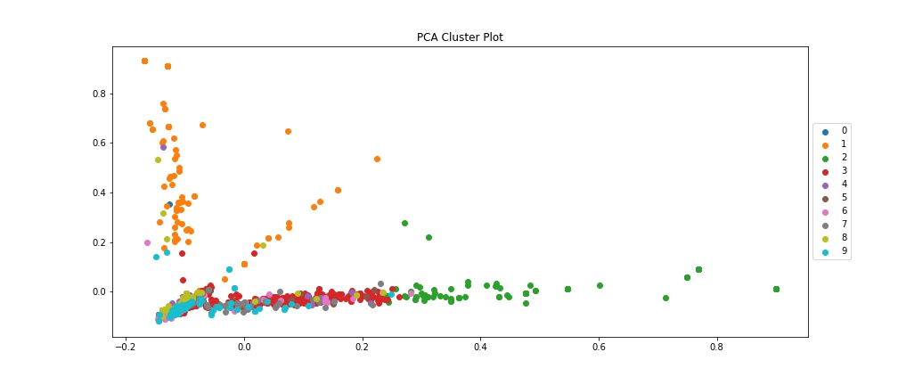
Clustering analysis
Performing minibatch K-means and obtain 10 categories in the reviews. Must look specifically into the comments to obtain further underlying analysis
Notes:
Why minibatch kmeans?
similar to kmeans
the most computationally costly step is conducted on only a random sample of observations as opposed to all observations.

Slide 20
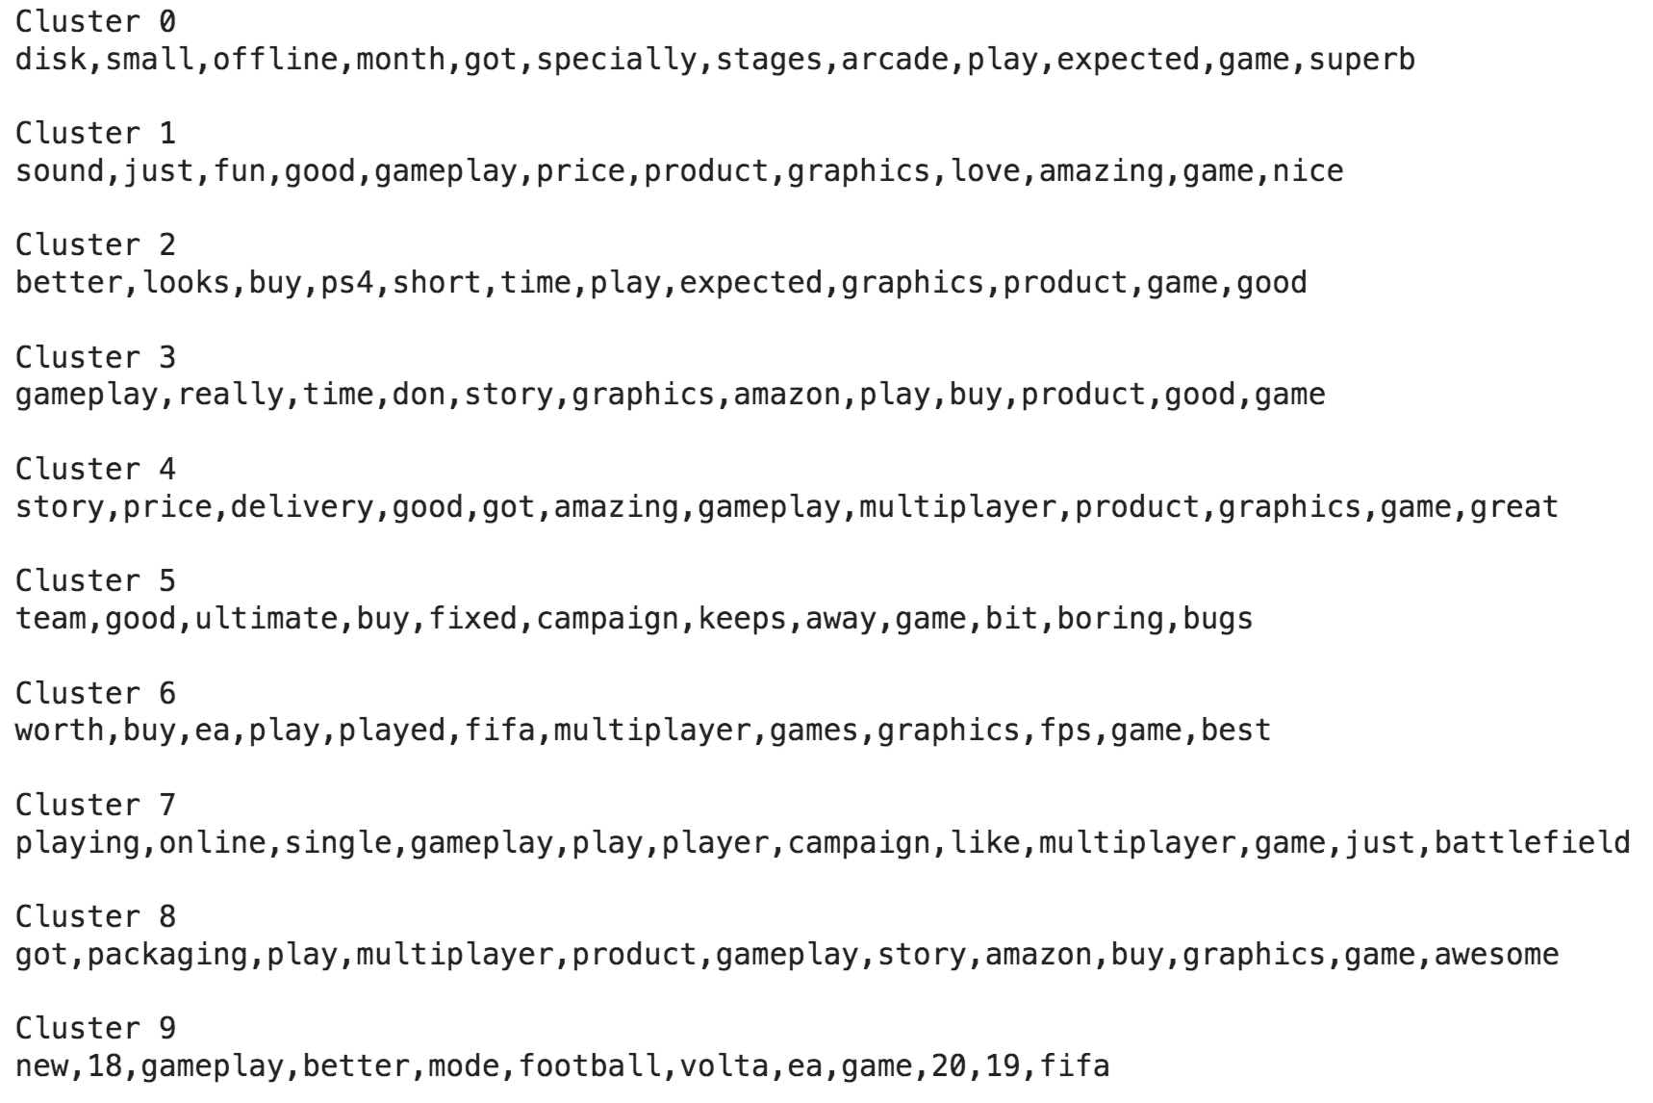
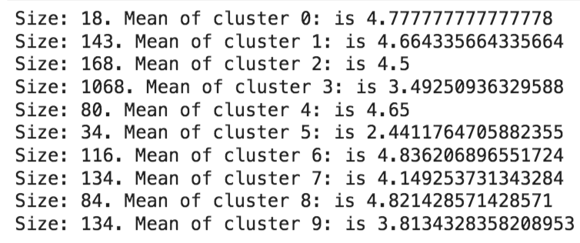
Clustering analysis
The top 10 words in all clusters correspond to each of the mean rating levels. We derive that product reviews can be a mixture of comments about EA and Amazon’s services
Notes:
Tien

Slide 21
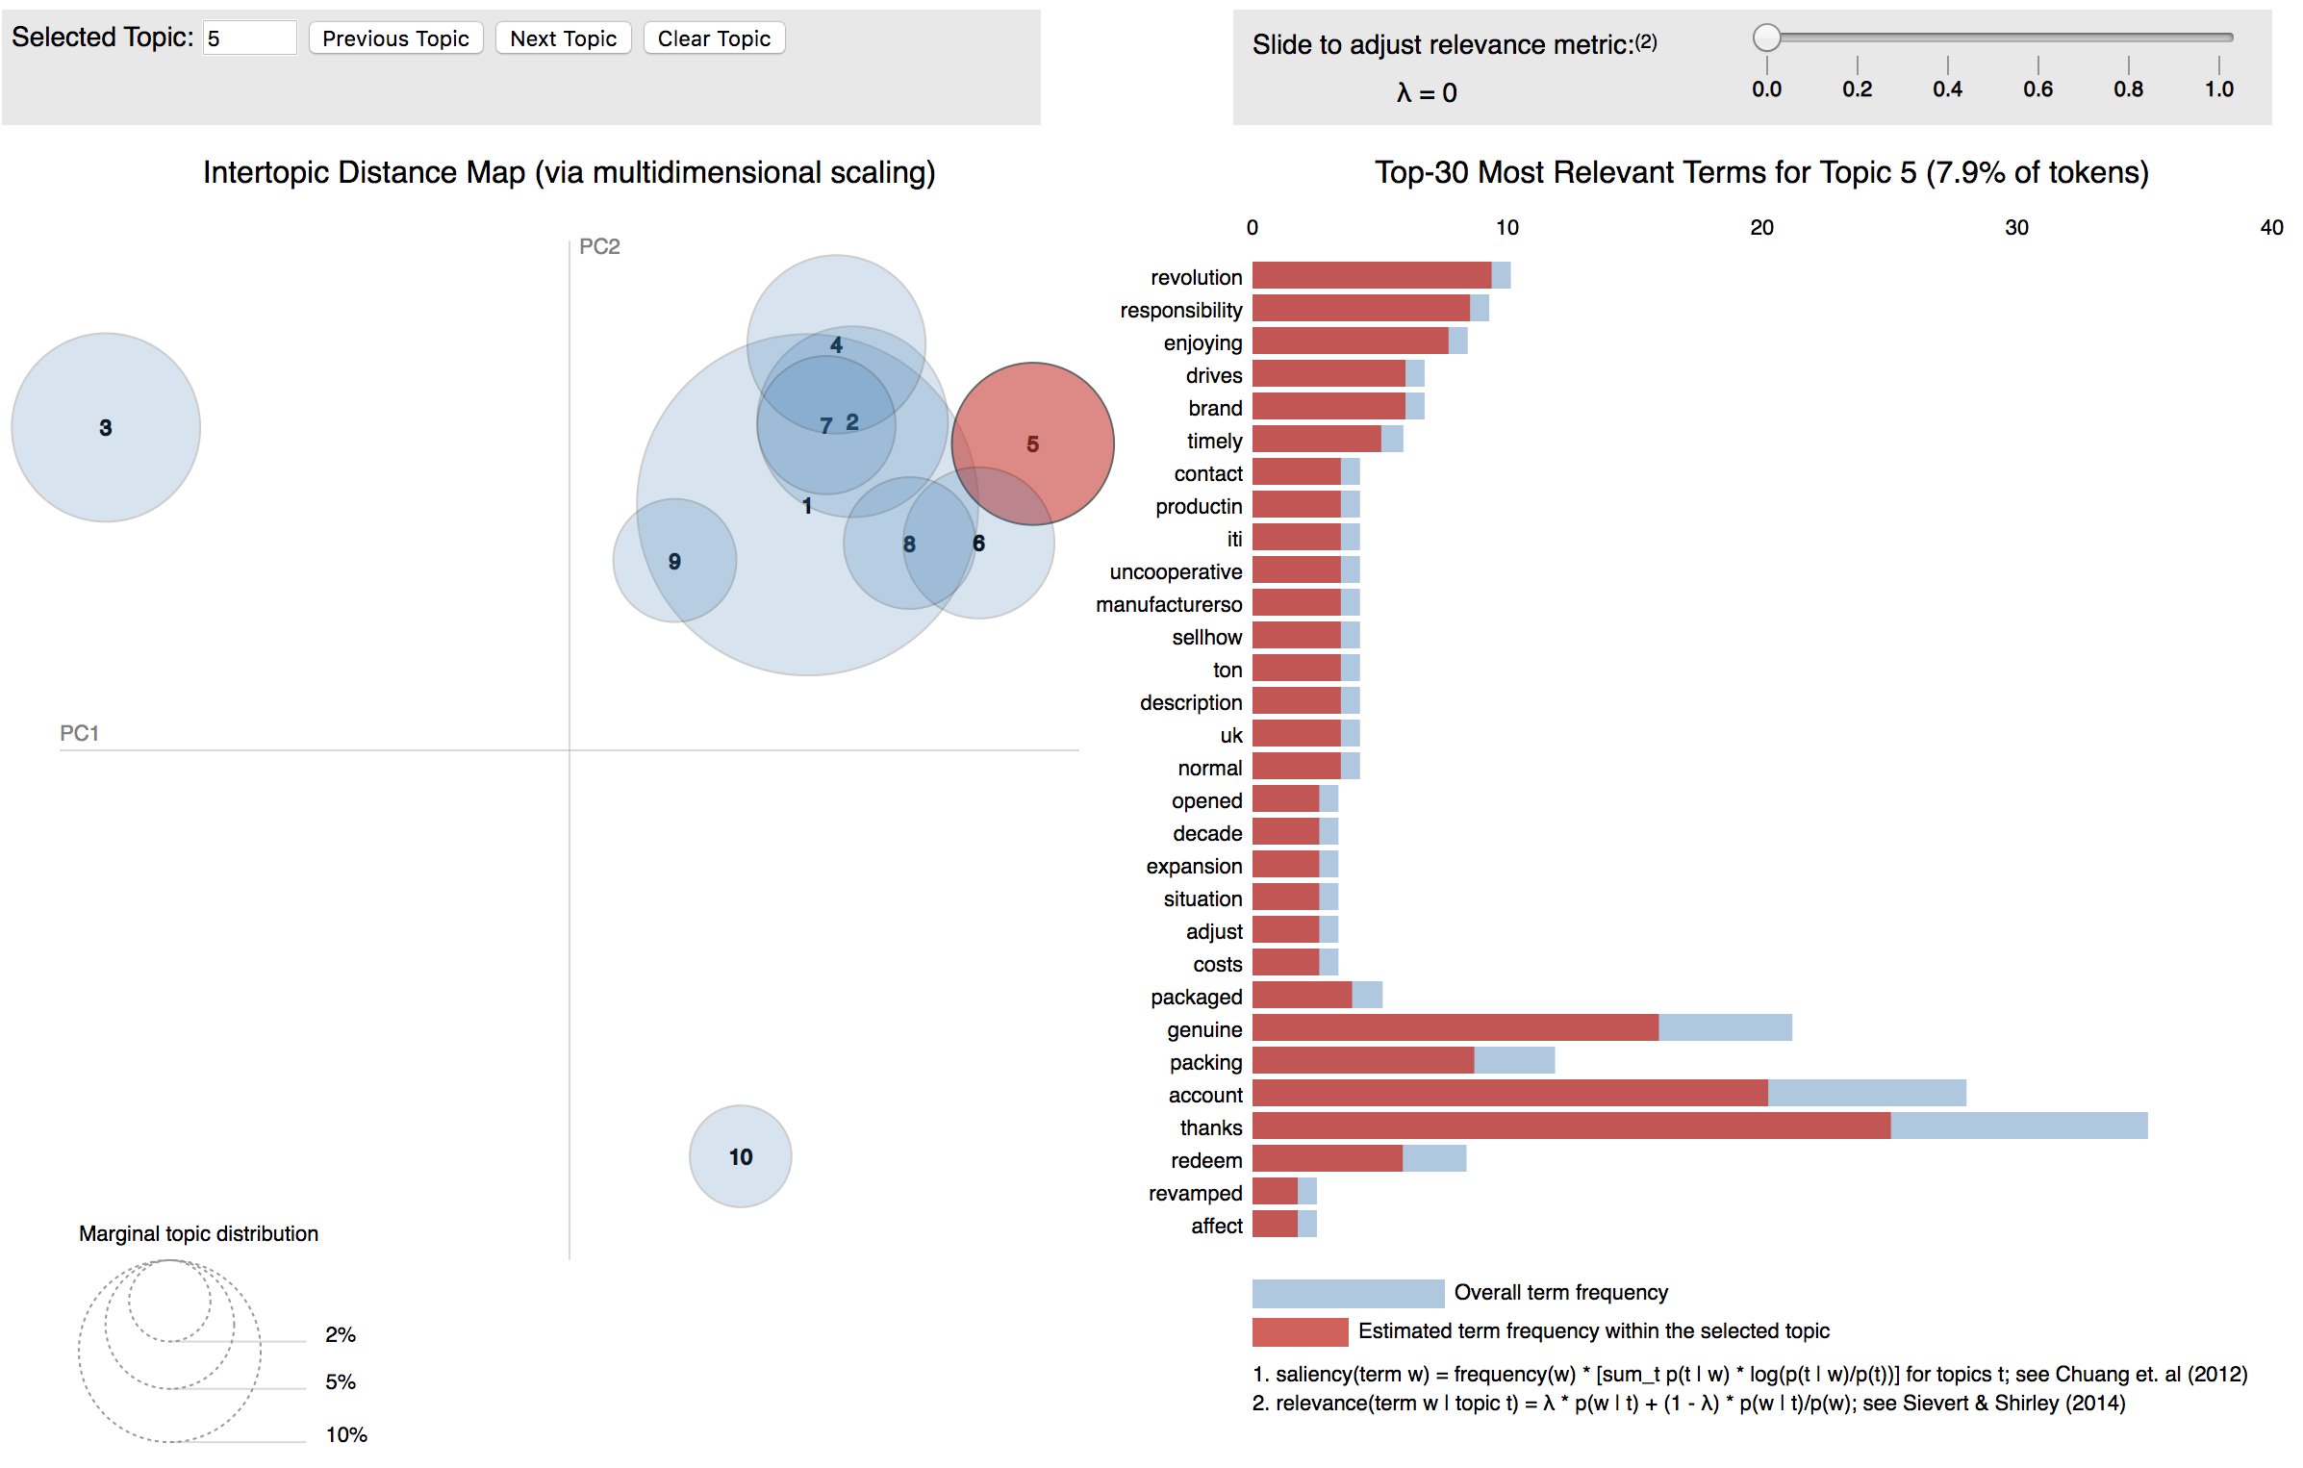
pyLDAvis: A more interactive way to summarize
Apply topic modelling to derive more insights into the EA’s content and quality
Notes:
LDA is an algorithm that estimates:
the probability of a mixture of words that is associated with each topic
and a mixture of topics that describes each review

Slide 22
Closing notes
The two work streams aim to provide insights and suggestion on the recommendation systems and external sources that can support EA in data and customer analytics
Content-based approach
User-based approach
Webscraping tool - Topic modeling
Other suggestions/ What we wish to have done more:
Speech analysis to improve on call center
Comparison with competitors to analyze the current and future trends
Extract more reviews from Amazon

