Slide 1
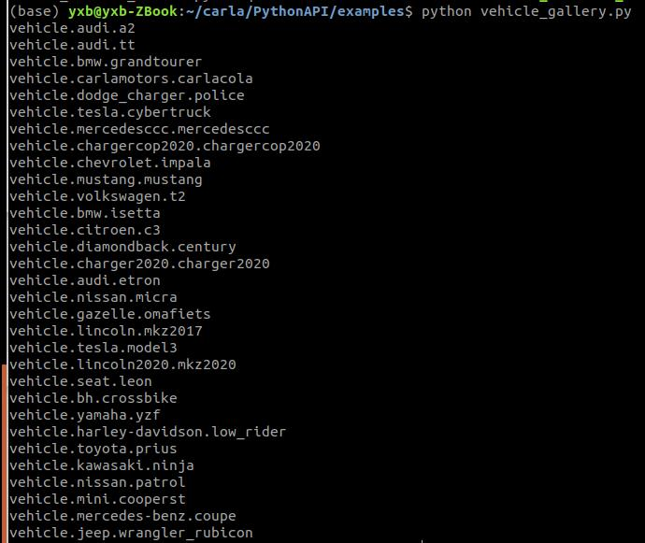
内置的车型

Slide 2

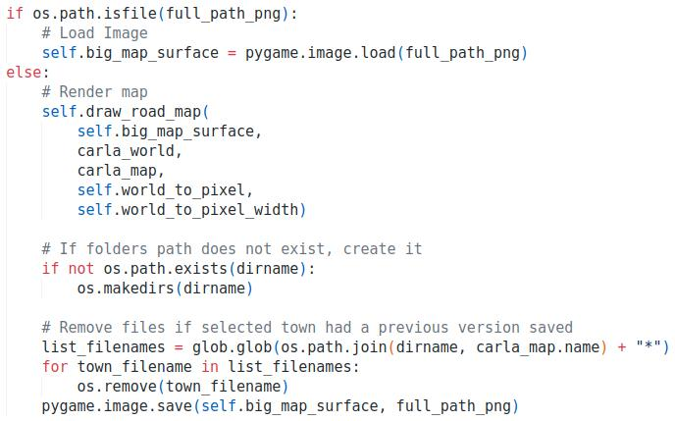
高精地图
carla中提供的Town02地图是最小的；
0.9.11及以后的地图分两类：Town02和Town02_Opt;
Town02是不分层的，Town02_Opt是分层的；
分为以下这些层：
carla.MapLayer.NONE,
carla.MapLayer.Buildings,
carla.MapLayer.Decals, 贴花
carla.MapLayer.Foliage, 树脂
carla.MapLayer.Ground,
carla.MapLayer.ParkedVehicles,
carla.MapLayer.Particles,
carla.MapLayer.Props,
carla.MapLayer.StreetLights,
carla.MapLayer.Walls,
carla.MapLayer.All
None是最小布局，由道路、人行道、交通灯和交通标志组成。
在非渲染模式源码中将Town02输出：

Slide 3
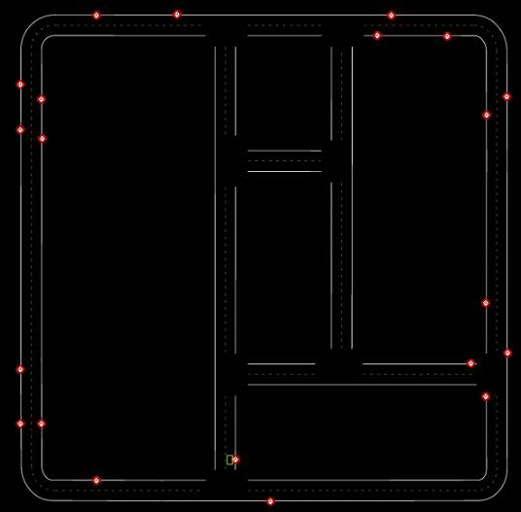
193.717 135.181 15 30
193.694 260.128 13 30
限速标志
地图限速标志
x y road_id speedlimit
7.981 191.556 4 30
160.672 109.434 12 30
23.216 105.483 12 30
45.859 293.540 7 30
34.402 302.540 18 30
193.694 260.128 13 30
189.677 283.900 13 30
161.437 306.527 19 30
-7.449 208.758 0 30
193.717 135.181 15 30
-3.400 135.221 1 30
74.209 302.539 19 30
147.550 105.443 12 90
22.957 109.484 12 90
143.752 109.446 12 60
46.226 105.400 12 60
53.270 306.532 19 60
153.811 302.537 19 60
193.682 169.238 15 60
189.698 254.090 13 60
166.660 105.430 12 60
160.672 109.434 12 30
30
60
30
60
30
166.660 105.430 12 60
60
30
193.682 169.238 15 60
30
161.437 306.527 19 30
60
147.550 105.443 12 90
189.677 283.900 13 30
90
60
189.698 254.090 13 60
153.811 302.537 19 60
143.752 109.446 12 60
x
y
74.209 302.539 19 30
30
45.859 293.540 7 30
60
53.270 306.532 19 60
46.226 105.400 12 60
60
30
30
34.402 302.540 18 30
23.216 105.483 12 30
30
90
22.957 109.484 12 90
30
7.981 191.556 4 30
30
30
-3.400 135.221 1 30
-7.449 208.758 0 30

Slide 4
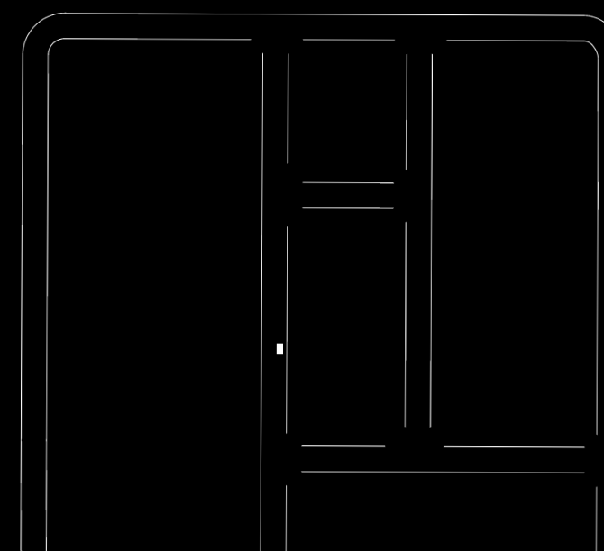
全局路径规划
global:
[(<carla.libcarla.Waypoint object at 0x7f222fa625f0>, <RoadOption.LANEFOLLOW: 4>), (<carla.libcarla.Waypoint object at 0x7f222fb282e0>, <RoadOption.RIGHT: 2>), (<carla.libcarla.Waypoint object at 0x7f222fa7be40>, <RoadOption.RIGHT: 2>), (<carla.libcarla.Waypoint object at 0x7f222fa782e0>, <RoadOption.RIGHT: 2>), (<carla.libcarla.Waypoint object at 0x7f222fa780b0>, <RoadOption.RIGHT: 2>), (<carla.libcarla.Waypoint object at 0x7f222fa78430>, <RoadOption.RIGHT: 2>), (<carla.libcarla.Waypoint object at 0x7f222fa784a0>, <RoadOption.RIGHT: 2>), (<carla.libcarla.Waypoint object at 0x7f222fa78510>, <RoadOption.RIGHT: 2>), (<carla.libcarla.Waypoint object at 0x7f222fb28350>, <RoadOption.RIGHT: 2>), (<carla.libcarla.Waypoint object at 0x7f222fa62040>, <RoadOption.LANEFOLLOW: 4>), (<carla.libcarla.Waypoint object at 0x7f222fae4510>, <RoadOption.LANEFOLLOW: 4>), (<carla.libcarla.Waypoint object at 0x7f222faec970>, <RoadOption.LANEFOLLOW: 4>), (<carla.libcarla.Waypoint object at 0x7f222faec3c0>, <RoadOption.LANEFOLLOW: 4>), (<carla.libcarla.Waypoint object at 0x7f222faecac0>, <RoadOption.LANEFOLLOW: 4>), (<carla.libcarla.Waypoint object at 0x7f222faecb30>, <RoadOption.LANEFOLLOW: 4>), (<carla.libcarla.Waypoint object at 0x7f222faecba0>, <RoadOption.LANEFOLLOW: 4>), (<carla.libcarla.Waypoint object at 0x7f222faecc10>, <RoadOption.LANEFOLLOW: 4>), (<carla.libcarla.Waypoint object at 0x7f222faecc80>, <RoadOption.LANEFOLLOW: 4>), (<carla.libcarla.Waypoint object at 0x7f222faeccf0>, <RoadOption.LANEFOLLOW: 4>), (<carla.libcarla.Waypoint object at 0x7f222faecd60>, <RoadOption.LANEFOLLOW: 4>), (<carla.libcarla.Waypoint object at 0x7f222faecdd0>, <RoadOption.LANEFOLLOW: 4>), (<carla.libcarla.Waypoint object at 0x7f222faece40>, <RoadOption.LANEFOLLOW: 4>), (<carla.libcarla.Waypoint object at 0x7f222faeceb0>, <RoadOption.LANEFOLLOW: 4>), (<carla.libcarla.Waypoint object at 0x7f222faecf20>, <RoadOption.LANEFOLLOW: 4>), (<carla.libcarla.Waypoint object at 0x7f222fa620b0>, <RoadOption.LANEFOLLOW: 4>), (<carla.libcarla.Waypoint object at 0x7f222fa62c80>, <RoadOption.STRAIGHT: 3>), (<carla.libcarla.Waypoint object at 0x7f222faee200>, <RoadOption.STRAIGHT: 3>), (<carla.libcarla.Waypoint object at 0x7f222faee900>, <RoadOption.STRAIGHT: 3>), (<carla.libcarla.Waypoint object at 0x7f222faee970>, <RoadOption.STRAIGHT: 3>), (<carla.libcarla.Waypoint object at 0x7f222fad4430>, <RoadOption.STRAIGHT: 3>), (<carla.libcarla.Waypoint object at 0x7f222fad4270>, <RoadOption.STRAIGHT: 3>), (<carla.libcarla.Waypoint object at 0x7f222fad49e0>, <RoadOption.STRAIGHT: 3>), (<carla.libcarla.Waypoint object at 0x7f222fad4a50>, <RoadOption.STRAIGHT: 3>), (<carla.libcarla.Waypoint object at 0x7f222fad4190>, <RoadOption.STRAIGHT: 3>), (<carla.libcarla.Waypoint object at 0x7f222fa62cf0>, <RoadOption.STRAIGHT: 3>), (<carla.libcarla.Waypoint object at 0x7f222fa62e40>, <RoadOption.LANEFOLLOW: 4>), (<carla.libcarla.Waypoint object at 0x7f222fad4cf0>, <RoadOption.LANEFOLLOW: 4>), (<carla.libcarla.Waypoint object at 0x7f222fad4350>, <RoadOption.LANEFOLLOW: 4>), (<carla.libcarla.Waypoint object at 0x7f222faebba0>, <RoadOption.LANEFOLLOW: 4>), (<carla.libcarla.Waypoint object at 0x7f222faeb660>, <RoadOption.LANEFOLLOW: 4>), (<carla.libcarla.Waypoint object at 0x7f222faeb4a0>, <RoadOption.LANEFOLLOW: 4>), (<carla.libcarla.Waypoint object at 0x7f222faebc10>, <RoadOption.LANEFOLLOW: 4>), (<carla.libcarla.Waypoint object at 0x7f222faeb900>, <RoadOption.LANEFOLLOW: 4>), (<carla.libcarla.Waypoint object at 0x7f222faeb740>, <RoadOption.LANEFOLLOW: 4>), (<carla.libcarla.Waypoint object at 0x7f222faebeb0>, <RoadOption.LANEFOLLOW: 4>), (<carla.libcarla.Waypoint object at 0x7f222faebac0>, <RoadOption.LANEFOLLOW: 4>), (<carla.libcarla.Waypoint object at 0x7f222faeb200>, <RoadOption.LANEFOLLOW: 4>), (<carla.libcarla.Waypoint object at 0x7f222faeb040>, <RoadOption.LANEFOLLOW: 4>), (<carla.libcarla.Waypoint object at 0x7f222faeb7b0>, <RoadOption.LANEFOLLOW: 4>), (<carla.libcarla.Waypoint object at 0x7f222faeb820>, <RoadOption.LANEFOLLOW: 4>), (<carla.libcarla.Waypoint object at 0x7f222faebf90>, <RoadOption.LANEFOLLOW: 4>), (<carla.libcarla.Waypoint object at 0x7f222faebdd0>, <RoadOption.LANEFOLLOW: 4>), (<carla.libcarla.Waypoint object at 0x7f222faeb510>, <RoadOption.LANEFOLLOW: 4>), (<carla.libcarla.Waypoint object at 0x7f222faeb120>, <RoadOption.LANEFOLLOW: 4>), (<carla.libcarla.Waypoint object at 0x7f222faeb890>, <RoadOption.LANEFOLLOW: 4>), (<carla.libcarla.Waypoint object at 0x7f222faeb6d0>, <RoadOption.LANEFOLLOW: 4>), (<carla.libcarla.Waypoint object at 0x7f222faeb3c0>, <RoadOption.LANEFOLLOW: 4>), (<carla.libcarla.Waypoint object at 0x7f222faebb30>, <RoadOption.LANEFOLLOW: 4>), (<carla.libcarla.Waypoint object at 0x7f222faeb970>, <RoadOption.LANEFOLLOW: 4>), (<carla.libcarla.Waypoint object at 0x7f222faeb0b0>, <RoadOption.LANEFOLLOW: 4>), (<carla.libcarla.Waypoint object at 0x7f222faebcf0>, <RoadOption.LANEFOLLOW: 4>), (<carla.libcarla.Waypoint object at 0x7f222faeb430>, <RoadOption.LANEFOLLOW: 4>), (<carla.libcarla.Waypoint object at 0x7f222faeb270>, <RoadOption.LANEFOLLOW: 4>)]
全局路径规划一次性规划了所有关键路点（有可能因给出目的地点太近的缘故，需核查），路点信息包括车道保持和交叉路口的直行右转左转。

